Slide 1



13TH ANNUAL CONFERENCE
Infection Prevention
Network – Kenya
Advancing Safe Care Through Infection Prevention & Control
CONFERENCE THEME
“Advancing IPC, AMR, and One Health:
Science, Policy, and Practice”
13TH IPNET KENYA CONFERENCE • 19–21 AUGUST 2026 • PRIDE INN PLAZA, NAIROBI
01

Slide 2

ABSTRACT INFORMATION
02
Abstract Details
TITLE OF ABSTRACT: Operationalizing WHO Core Elements to Strengthen Antimicrobial Stewardship: A Quality Improvement Experience at Valley Hospital
PRESENTER NAME: Dr. Wendy Nyamusana
INSTITUTION / AFFILIATION: Valley Hospital LTD
COUNTY: Nakuru
COUNTRY: Kenya
13TH IPNET KENYA CONFERENCE • 19–21 AUGUST 2026 • PRIDE INN PLAZA, NAIROBI
02

Slide 3
SECTION 01
03
Background
AMR is among the top 10 global health threats in the 21st century, with major impact in Sub-Saharan Africa.
1.27 million deaths directly attributable to AMR in 2019 with 4.95 million associated deaths.
The World Health Organization (WHO) recommends implementation of Antimicrobial Stewardship (AMS) Core Elements to optimize antimicrobial use and strengthen institutional accountability.
A baseline assessment conducted in January 2025 at Valley Hospital demonstrated overall AMS compliance of 30% across the six WHO Core Elements.
13TH IPNET KENYA CONFERENCE • 19–21 AUGUST 2026 • PRIDE INN PLAZA, NAIROBI
03

Slide 4
SECTION 02
04
Objective
To improve overall AMS compliance from 30% to 60% by December 2025 through structured implementation of the WHO AMS Core Elements using a quality improvement framework.
13TH IPNET KENYA CONFERENCE • 19–21 AUGUST 2026 • PRIDE INN PLAZA, NAIROBI
04

Slide 5
SECTION 03
05
Methodology
A prospective quality improvement project from January–December 2025.
Interventions included;
strengthening the AMS committee
Developing governance documents
Enforcing antimicrobial restrictions
Structured prescriber education
Initiating monitoring and reporting systems.
Progress was reassessed after ten months using the WHO AMS assessment tool.
13TH IPNET KENYA CONFERENCE • 19–21 AUGUST 2026 • PRIDE INN PLAZA, NAIROBI
05

Slide 6
SECTION 03
05
Methodology
13TH IPNET KENYA CONFERENCE • 19–21 AUGUST 2026 • PRIDE INN PLAZA, NAIROBI
05

Slide 7
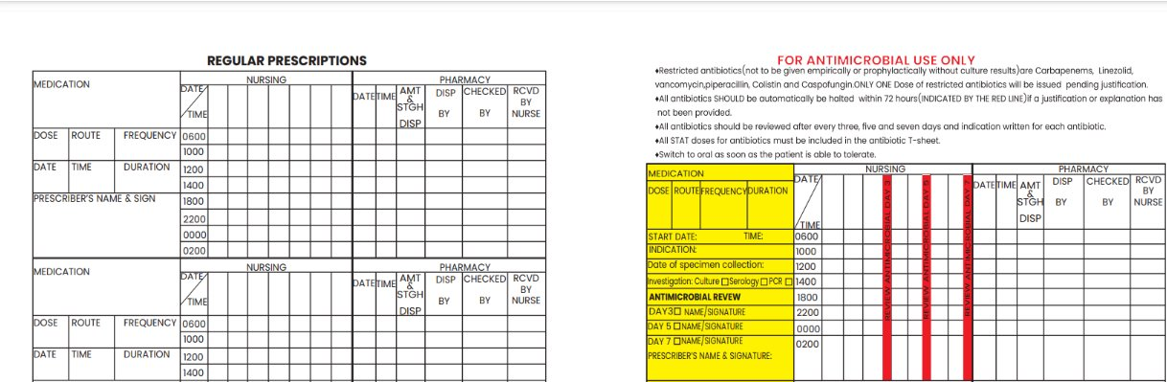
SECTION 03
05
Methodology
AMS Actions- Antibiotic prescribing Initiatives
13TH IPNET KENYA CONFERENCE • 19–21 AUGUST 2026 • PRIDE INN PLAZA, NAIROBI
05

Slide 8
SECTION 03
05
Methodology
Education
Webinars
AMS case reviews
Unit based CMES
AMS Ward rounds
13TH IPNET KENYA CONFERENCE • 19–21 AUGUST 2026 • PRIDE INN PLAZA, NAIROBI
05

Slide 9
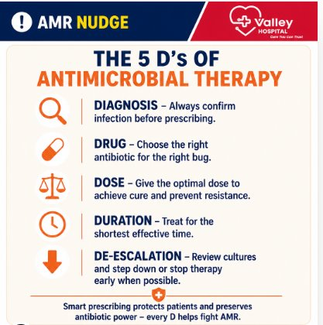
SECTION 03
05
Methodology
Education
Weekly AMR Nudges
Structured Short quizzes
13TH IPNET KENYA CONFERENCE • 19–21 AUGUST 2026 • PRIDE INN PLAZA, NAIROBI
05

Slide 10
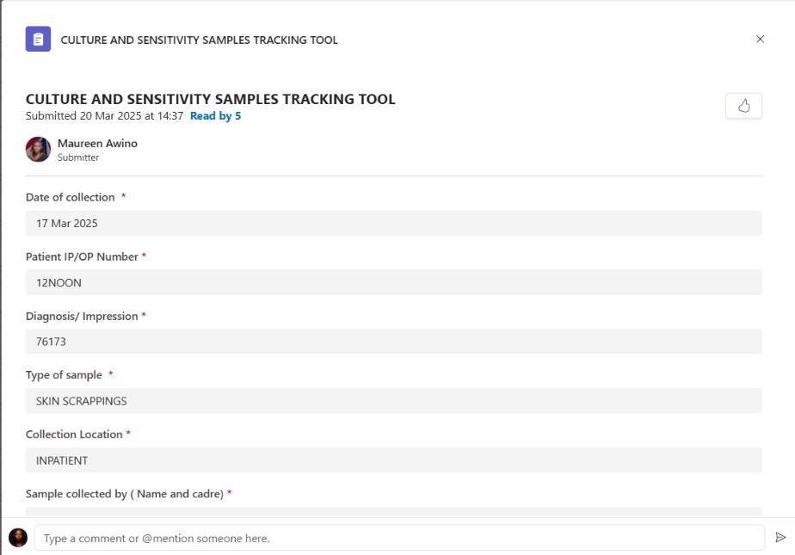
SECTION 03
05
Methodology
Monitoring
Developed tools for monitoring culture and sensitivity at each stage from sample collection to reporting
13TH IPNET KENYA CONFERENCE • 19–21 AUGUST 2026 • PRIDE INN PLAZA, NAIROBI
05

Slide 11
SECTION 04
06
Results
13TH IPNET KENYA CONFERENCE • 19–21 AUGUST 2026 • PRIDE INN PLAZA, NAIROBI
06

Slide 12
SECTION 04
06
Results
13TH IPNET KENYA CONFERENCE • 19–21 AUGUST 2026 • PRIDE INN PLAZA, NAIROBI
06

Slide 13
SECTION 04
06
Results
13TH IPNET KENYA CONFERENCE • 19–21 AUGUST 2026 • PRIDE INN PLAZA, NAIROBI
06

Slide 14
SECTION 04
06
Results
Cefazolin’s share of parenteral prophylaxis DDDs rose from 2.6% to 44.1% — cefazolin use climbed 16-fold (3.8 → 59 vials/month) while cefuroxime fell 47% (190 → 100 vials/month).
13TH IPNET KENYA CONFERENCE • 19–21 AUGUST 2026 • PRIDE INN PLAZA, NAIROBI
06

Slide 15
SECTION 04
06
Results
Weekly AMS nudges and quizzes demonstrated increasing multidisciplinary engagement, with average participation rising from 21 to 65 respondents per week over the implementation period.
Engagement extended beyond clinical teams to include administration, finance, IT, HR, sustainability and client services, reflecting growing institution-wide stewardship awareness.
13TH IPNET KENYA CONFERENCE • 19–21 AUGUST 2026 • PRIDE INN PLAZA, NAIROBI
06

Slide 16
SECTION 05
07
Conclusion & Recommendations
Applying the WHO AMS Core Elements through a structured quality improvement approach significantly strengthened stewardship capacity at Valley Hospital.
Embedding behavioural education strategies within the Education Core Element fostered multidisciplinary ownership and organizational culture change.
13TH IPNET KENYA CONFERENCE • 19–21 AUGUST 2026 • PRIDE INN PLAZA, NAIROBI
07

Slide 17
SECTION 05
07
Acknowledgement
Valley Hospital Board and Management
Nakuru County Antimicrobial Stewardship Interagency Committee (CASIC)
Valley Hospital AMS Committee Members
AMS Unit Champions
Valley Hospital Staff
13TH IPNET KENYA CONFERENCE • 19–21 AUGUST 2026 • PRIDE INN PLAZA, NAIROBI
07

Slide 18
THANK YOU
13th IPNET-Kenya Conference • 19–21 August 2026 • Pride Inn Plaza, Nairobi
www.ipnetkenya.org | info@ipnetkenya.org
08

