Slide 1



13TH ANNUAL CONFERENCE
Infection Prevention
Network – Kenya
Advancing Safe Care Through Infection Prevention & Control
CONFERENCE THEME
“Advancing IPC, AMR, and One Health:
Science, Policy, and Practice”
13TH IPNET KENYA CONFERENCE • 19–21 AUGUST 2026 • PRIDE INN PLAZA, NAIROBI
01

Slide 2

ABSTRACT INFORMATION
02
ASSESSMENT OF KNOWLEDGE, ATTITUDES, PRACTICES, AND CAPACITY OF COMMUNITY HEALTH PROMOTERS ON AMR AND IPC IN MAKUENI COUNTY, KENYA
PRESENTER : DOMINIC MUTETI MUASYA - IPC CO-ORDINATOR
DEPARTMENT OF HEALTH SERVICES
MAKUENI
KENYA
13TH IPNET KENYA CONFERENCE • 19–21 AUGUST 2026 • PRIDE INN PLAZA, NAIROBI
02

Slide 3
SECTION 01
03
Introduction
Antimicrobial resistance (AMR) poses a global threat-Micro-organisms can no longer respond to antimicrobials
Emergence and spread of AMR can occur at the community, household level driven by;
  the inappropriate use of antibiotics (Misuse and overuse)
  poor access to clean water, sanitation and hygiene (WASH)
  inadequate infection prevention and control in households, health-care facilities and farms
  limited access to vaccines, diagnostics and medicines
  lack of awareness and enforcement of relevant legislation
At the community level- CHPs strategically positioned to promote awareness and behaviour change on AMR/IPC
Kenya has deployed over 100,000 Community Health Promoters (CHPs) across 47 counties to provide preventive and promotive healthcare at the community level (AfyaNyumbani)
13TH IPNET KENYA CONFERENCE • 19–21 AUGUST 2026 • PRIDE INN PLAZA, NAIROBI
03

Slide 4
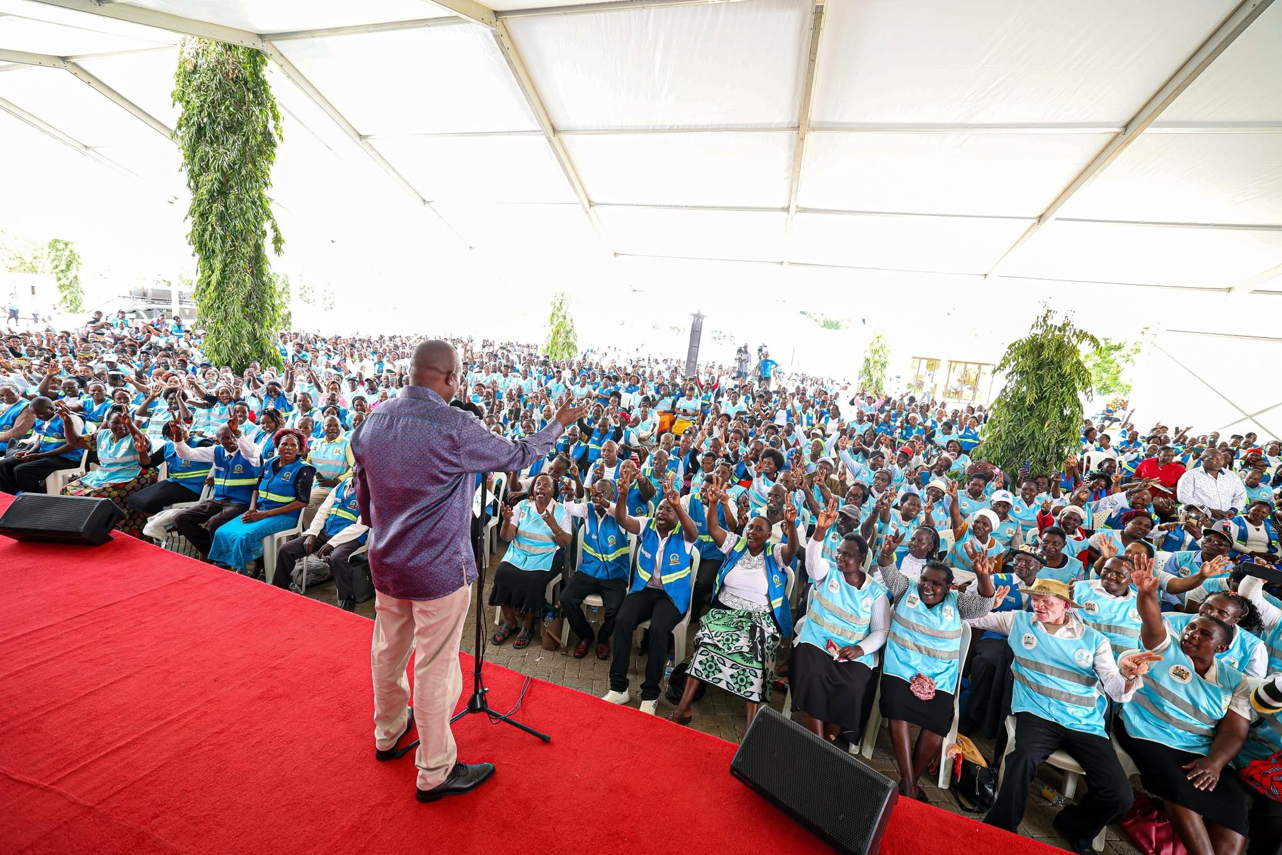

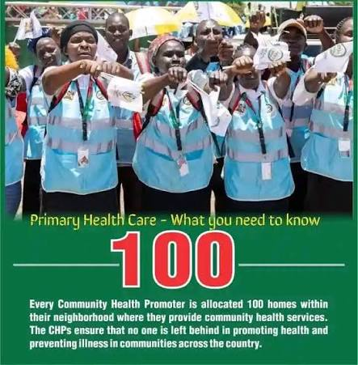
SECTION 01
03
Introduction
13TH IPNET KENYA CONFERENCE • 19–21 AUGUST 2026 • PRIDE INN PLAZA, NAIROBI
03

Slide 5
SECTION 02
04
Objectives
Broad Objective
To assess the knowledge, attitudes, practices (KAP), and capacity of CHPs to promote AMR awareness and IPC practices.
Specific Objectives
Assess CHPs’ knowledge on AMR and IPC
Evaluate attitudes towards AMR and IPC
Determine practices in community education
Assess capacity (training, materials, supervision)
Identify barriers to effective AMR/IPC awareness delivery
13TH IPNET KENYA CONFERENCE • 19–21 AUGUST 2026 • PRIDE INN PLAZA, NAIROBI
04

Slide 6
SECTION 03
05
Methodology
Study Design and Period
Cross-sectional survey done from January to April 2026
Study Population
Community Health Promoters in Makueni County
Data Collection
Structured self administered KAP questionnaire
Data Analysis
Data analyzed using SPSS:
    Descriptive statistics
    Inferential statistics
Ethical Considerations
    Informed consent
    Confidentiality maintained
13TH IPNET KENYA CONFERENCE • 19–21 AUGUST 2026 • PRIDE INN PLAZA, NAIROBI
05

Slide 7
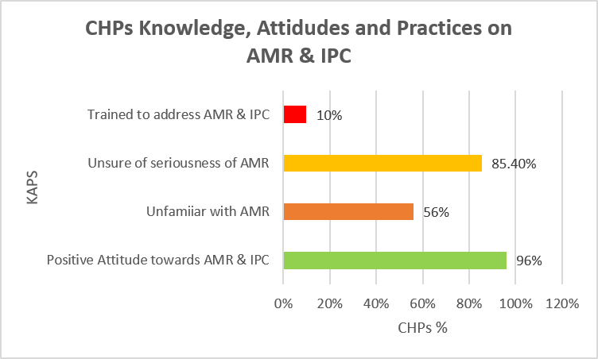
SECTION 04
06
Key Findings
96% demonstrated a positive attitude towards AMR and IPC
56% (n=103) were unfamiliar with AMR.
85.4% were unsure whether AMR is a serious public health issue (p <0.001)
90 % felt inadequately trained and empowered to address AMR and IPC
Gaps were identified in knowledge and access to educational resources
13TH IPNET KENYA CONFERENCE • 19–21 AUGUST 2026 • PRIDE INN PLAZA, NAIROBI
06

Slide 8
SECTION 04
06
Key Findings
CHPs routinely promote hand hygiene and WASH (89%)
AMR-specific education and antimicrobial stewardship activities remain limited
Only 25% provide AMR education
14% provide antibiotic-use advice
10% actively discourage self-medication
Results demonstrate and provide an important opportunity to integrate AMR and antimicrobial stewardship messages into routine CHP home-visit tools
13TH IPNET KENYA CONFERENCE • 19–21 AUGUST 2026 • PRIDE INN PLAZA, NAIROBI
06

Slide 9
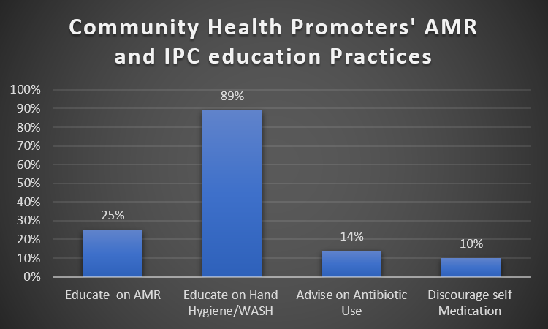
SECTION 04
06
Key Findings- Gaps in CHP Delivery of AMR and IPC Education
13TH IPNET KENYA CONFERENCE • 19–21 AUGUST 2026 • PRIDE INN PLAZA, NAIROBI
06

Slide 10
SECTION 05
07
Conclusion & Recommendations
Findings suggest that CHPs’ KAP and capacity are heavily influenced and limited by the content included in the official tools they use in their routine work
CHPs are critical but under-supported to create awareness and promote behavioral change on AMR and IPC
Need to integrate AMR for rational antibiotic use and expand IPC education in their curriculum
Strengthen capacity through targeted training, resource provision for AMS and IPC
Integrate their agenda into the national IPC and AMR strategies and policy
  Provide standardized IEC materials on AMR and IPC
  Enhance supervision and support systems e.g an AMR/IPC indicator for reporting in the routine monthly reports
13TH IPNET KENYA CONFERENCE • 19–21 AUGUST 2026 • PRIDE INN PLAZA, NAIROBI
07

Slide 11
THANK YOU
13th IPNET-Kenya Conference • 19–21 August 2026 • Pride Inn Plaza, Nairobi
www.ipnetkenya.org | info@ipnetkenya.org
08

