Slide 1



13TH ANNUAL CONFERENCE
Infection Prevention
Network – Kenya
Advancing Safe Care Through Infection Prevention & Control
CONFERENCE THEME
“Advancing IPC, AMR, and One Health:
Science, Policy, and Practice”
13TH IPNET KENYA CONFERENCE • 19–21 AUGUST 2026 • PRIDE INN PLAZA, NAIROBI
01

Slide 2

ABSTRACT INFORMATION
02
Abstract Details
UTILIZATION OF THE NEST-IT DASHBOARD TO ENHANCE ANTIMICROBIAL STEWARDSHIP IN THE NEWBORN UNIT AT THIKA LEVEL 5 HOSPITAL
PRESENTER NAME: LUCY BEATRICE MWAI
INSTITUTION : THIKA LEVEL 5 HOSPITAL
COUNTY: KIAMBU
COUNTRY: KENYA
13TH IPNET KENYA CONFERENCE • 19–21 AUGUST 2026 • PRIDE INN PLAZA, NAIROBI
02

Slide 3
SECTION 01
03
Background / Introduction
NEST-IT 360 dashboard is a data platform created by NEST360 to improve small and sick newborn care .
This helps teams to:
  Track clinical outcomes by monitoring clinical processes and outcomes.
  Manage equipment by checking medical device availability, performance, and maintenance.
  Guide decisions by Providing real-time data.
13TH IPNET KENYA CONFERENCE • 19–21 AUGUST 2026 • PRIDE INN PLAZA, NAIROBI
03

Slide 4
SECTION 02
04
Objectives / Research Question
To examine the role of the NEST-IT dashboard in promoting antimicrobial stewardship (AMS) among neonates at the Thika Level 5 Hospital NBU between September 2025 and February 2026.
13TH IPNET KENYA CONFERENCE • 19–21 AUGUST 2026 • PRIDE INN PLAZA, NAIROBI
04

Slide 5
SECTION 03
05
Methodology
This was a retrospective study
Analysis of monthly aggregated data extracted from the NEST-IT dashboard was done during monthly Continuous Quality Improvement (CQI) meetings
Gaps in AMS were identified,
Implemented targeted staff sensitizations, and tracking of the performance of a newly introduced culture-tracking register.
13TH IPNET KENYA CONFERENCE • 19–21 AUGUST 2026 • PRIDE INN PLAZA, NAIROBI
05

Slide 6
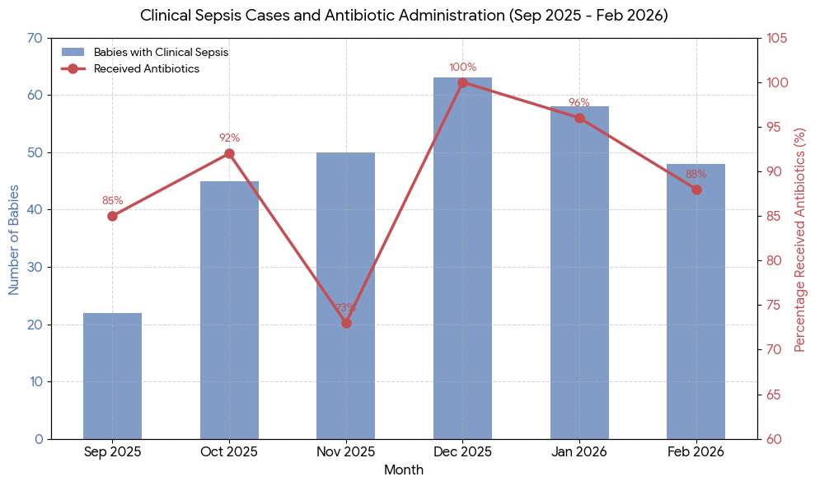
SECTION 04
06
Results / Key Findings
13TH IPNET KENYA CONFERENCE • 19–21 AUGUST 2026 • PRIDE INN PLAZA, NAIROBI
06

Slide 7
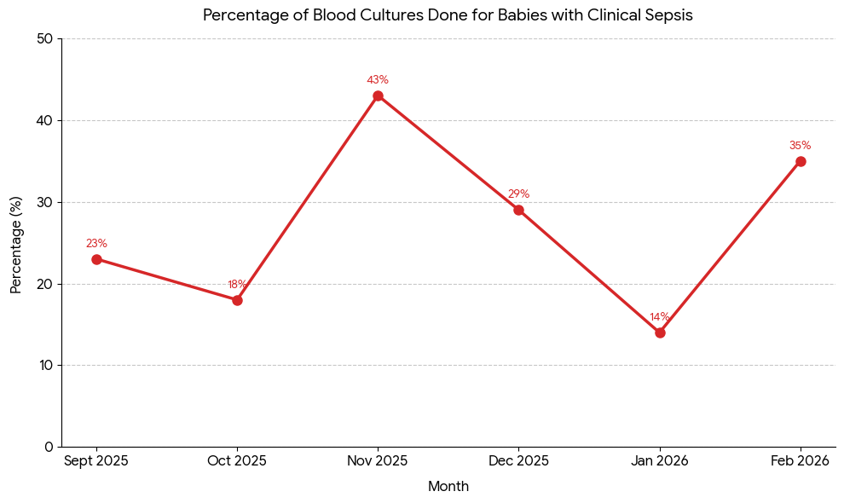
SECTION 04
06
Results / Key Findings
13TH IPNET KENYA CONFERENCE • 19–21 AUGUST 2026 • PRIDE INN PLAZA, NAIROBI
06

Slide 8
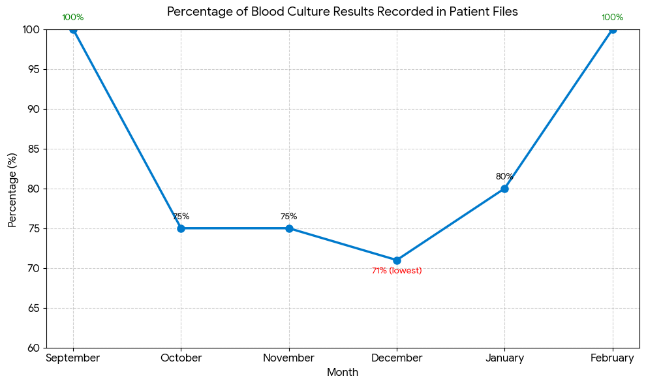
SECTION 04
06
Results / Key Findings
13TH IPNET KENYA CONFERENCE • 19–21 AUGUST 2026 • PRIDE INN PLAZA, NAIROBI
06

Slide 9
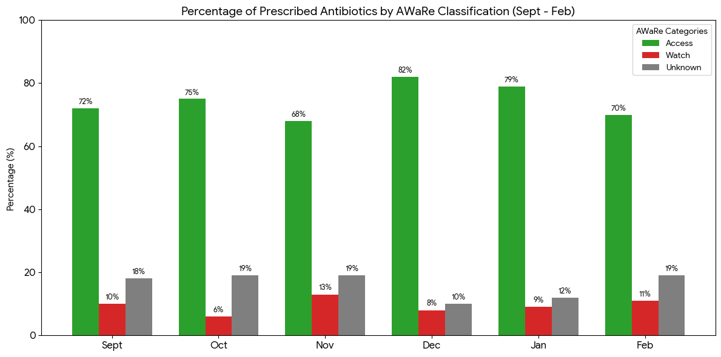
SECTION 04
06
Results / Key Findings
13TH IPNET KENYA CONFERENCE • 19–21 AUGUST 2026 • PRIDE INN PLAZA, NAIROBI
06

Slide 10
SECTION 04
06
Results / Key Findings
Month % Positivity Rate Isolated Microorganisms
September 7.7 Staphylococcus aureus
October 0.0 None Isolated
November 4.5 Klebsiella species
December 22.2 Other Gram-positives
January 5.0 Other Gram-positives, Klebsiella
February 20.0 Staph. aureus, Other Gram-positives
13TH IPNET KENYA CONFERENCE • 19–21 AUGUST 2026 • PRIDE INN PLAZA, NAIROBI
06

Slide 11
SECTION 05
07
Conclusion
High Treatment but Low Diagnostics: 85.9% of infants received immediate antibiotics, but only 23.0% had a blood culture done
Good Stewardship: First-line "Access" drugs averaged 74.7% (exceeding WHO's 60% target),
Data Gaps: 17.8% of prescriptions remain unclassified "Unknowns".
Culture positivity above 20% in December and February and Staphylococcus aureus volumes suggest sample contamination.
The NEST-IT dashboard serves as an effective platform for enhancing antimicrobial stewardship by providing visible data on antibiotic deployment and diagnostic gaps
13TH IPNET KENYA CONFERENCE • 19–21 AUGUST 2026 • PRIDE INN PLAZA, NAIROBI
07

Slide 12
SECTION 05
07
Recommendations
Blood cultures to be drawn before the first antibiotic dose is released by pharmacy
Re train staff on strict sterile techniques and skin preparation to fix the 20%+ positivity spikes.
Include all the drugs according to AWaRe classsification on the Nest-IT dashboard to close the data gap
13TH IPNET KENYA CONFERENCE • 19–21 AUGUST 2026 • PRIDE INN PLAZA, NAIROBI
07

Slide 13
SECTION 05
07
References
World Health Organization. (2022). The WHO AWaRe (Access, Watch, Reserve) antibiotic book
American Academy of Pediatrics (AAP) Committee on Fetus and Newborn. (2012 / Reaffirmed). Management of Neonates With Suspected or Proven Early-Onset Sepsis
13TH IPNET KENYA CONFERENCE • 19–21 AUGUST 2026 • PRIDE INN PLAZA, NAIROBI
07

Slide 14


Acknowledgement
07
SECTION 05
Thika Level 5 Hospital administration
NBU CQI team
13TH IPNET KENYA CONFERENCE • 19–21 AUGUST 2026 • PRIDE INN PLAZA, NAIROBI
07

Slide 15
THANK YOU
13th IPNET-Kenya Conference • 19–21 August 2026 • Pride Inn Plaza, Nairobi
www.ipnetkenya.org | info@ipnetkenya.org
08

