Slide 1



13TH ANNUAL CONFERENCE
Infection Prevention
Network – Kenya
Advancing Safe Care Through Infection Prevention & Control
CONFERENCE THEME
“Advancing IPC, AMR, and One Health:
Science, Policy, and Practice”
13TH IPNET KENYA CONFERENCE • 19–21 AUGUST 2026 • PRIDE INN PLAZA, NAIROBI
01

Slide 2

ABSTRACT INFORMATION
02
Abstract Details
TITLE OF ABSTRACT: Cost- Benefit Analysis of On- Site STREAM Chlorine Generator Utilization for Environmental Disinfection at Macalder Sub- County Hospital, Migori County, Kenya
PRESENTER NAME: Kenneth Okumu
INSTITUTION / AFFILIATION: Migori County Department of Health Services, Washington State University, Global Health- Kenya
COUNTY: Migori County
COUNTRY: Kenya
13TH IPNET KENYA CONFERENCE • 19–21 AUGUST 2026 • PRIDE INN PLAZA, NAIROBI
02

Slide 3
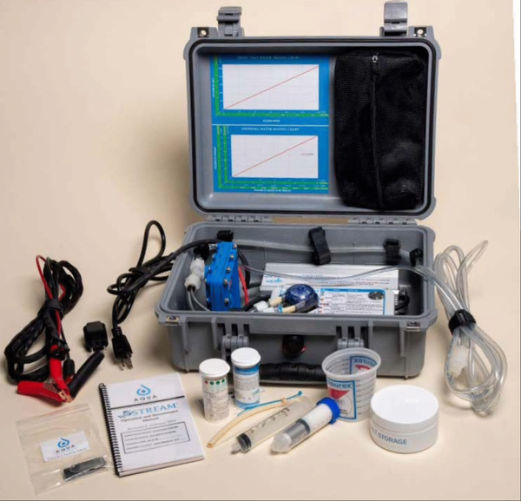
SECTION 01
03
Background / Introduction
THE SOLUTION: THE STREAM CHLORINE GENERATOR
THE PROBLEM: CHLORINE STOCK- OUTS UNDERMINE IPC
Recurrent chlorine stock- outs compromise infection prevention and control (IPC) in health facilities across low- and middle- income countries, raising procurement costs and increasing the risk of healthcare- associated infection.
Commercial supply chains are costly and inconsistent, especially for rural and sub- county hospitals- creating a need for a reliable, low- cost, on- site alternative.
13TH IPNET KENYA CONFERENCE • 19–21 AUGUST 2026 • PRIDE INN PLAZA, NAIROBI
03

Slide 4
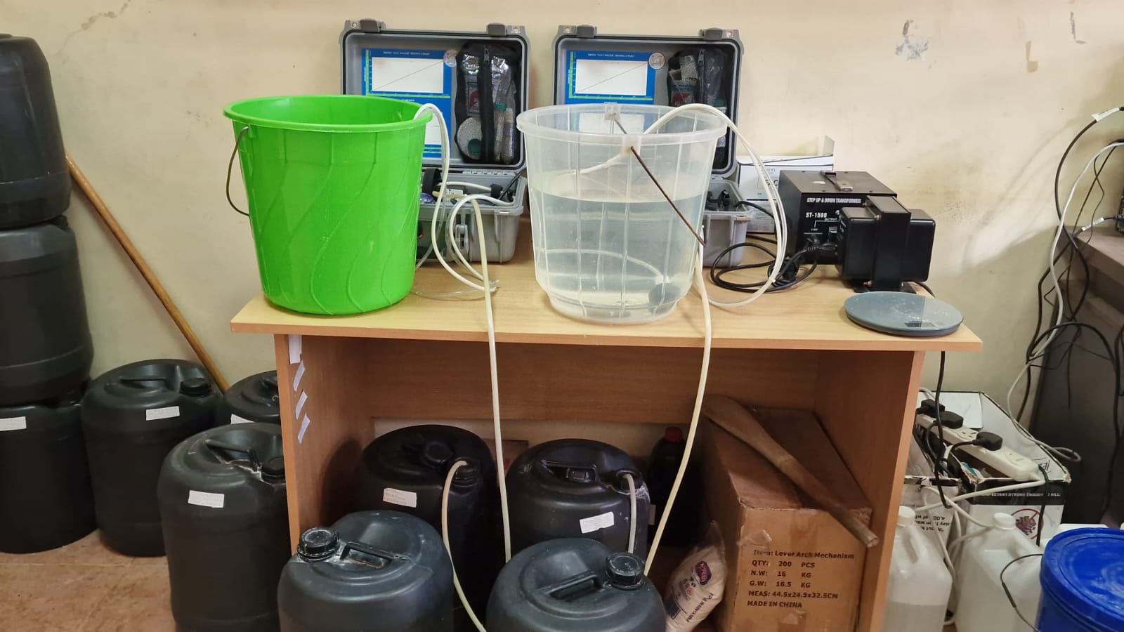
SECTION 01
03
Background / Introduction
THE SOLUTION: THE STREAM CHLORINE GENERATOR
An electrolytic, on- site device that converts salt, water, and electricity into ready-to-use 0.5% (5,000 mg/L) available chlorine at low cost.
Piloted by the Migori County Department of Health Services across five hospitals- with Macalder Sub- County Hospital selected as the focal pilot site- and supported by Washington State University Global Health Kenya and the U.S. CDC.
13TH IPNET KENYA CONFERENCE • 19–21 AUGUST 2026 • PRIDE INN PLAZA, NAIROBI
03

Slide 5
SECTION 02
04
Objectives / Research Question
OBJECTIVE
To evaluate the cost- effectiveness and operational impact of on- site STREAM chlorine generation as a sustainable alternative to commercial chlorine supply for environmental disinfection at Macalder Sub- County Hospital, Migori County.
KEY QUESTIONS
What is the cost differential between commercial chlorine procurement and on- site STREAM generation?
Does on- site generation improve chlorine reliability and IPC compliance compared with commercial supply?
Is the intervention feasible and scalable across similar resource- constrained health facilities?
13TH IPNET KENYA CONFERENCE • 19–21 AUGUST 2026 • PRIDE INN PLAZA, NAIROBI
04

Slide 6
SECTION 03
05
Methodology
RETROSPECTIVE COST- BENEFIT ANALYSIS
Chlorine expenditure, volume, and reliability were compared before and after STREAM installation at Macalder Sub- County Hospital, drawing on four data sources:
Procurement records – monthly commercial chlorine expenditure before installation
IPC monitoring registers – compliance and chlorine availability tracked over time
Operational logs – STREAM device output, maintenance, and utilization data
Key informant feedback – interviews with IPC focal persons and facility administrators
13TH IPNET KENYA CONFERENCE • 19–21 AUGUST 2026 • PRIDE INN PLAZA, NAIROBI
05

Slide 7
SECTION 04
06
Results: Before vs. After STREAM
Chlorine cost, volume, and supply reliability at Macalder Sub- County Hospital, before and after STREAM installation.
BEFORE STREAM
KSh 35,000
spent monthly on commercial chlorine
35 L / month
chlorine procured – insufficient for facility- wide disinfection
✗ Frequent stock- outs
AFTER STREAM
KSh 5,000
monthly operating cost (salt & vinegar)
~1,200 L / month
produced on- site (~40 L/day), incl. surplus shared with neighbouring facilities
✓ Uninterrupted supply
13TH IPNET KENYA CONFERENCE • 19–21 AUGUST 2026 • PRIDE INN PLAZA, NAIROBI
06

Slide 8
SECTION 04
07
Results: Savings & System Benefits
AN 86% REDUCTION IN CHLORINE EXPENDITURE
KSh 30,000
saved every month
KSh 360,000
saved annually
86%
reduction in monthly cost
BEYOND COST: OPERATIONAL & SYSTEM BENEFITS
✓ Uninterrupted Supply
No chlorine stock- outs reported since installation
✓ Improved IPC Compliance
Consistent availability strengthened adherence to IPC protocols
✓ Emergency Preparedness
On- site production enhances readiness for outbreak response
✓ Reallocated Savings
Freed funds redirected toward essential medicines and supplies
13TH IPNET KENYA CONFERENCE • 19–21 AUGUST 2026 • PRIDE INN PLAZA, NAIROBI
07

Slide 9
SECTION 05
08
Conclusion & Recommendations
On- site STREAM chlorine production addresses the root cause of IPC disruption in resource- constrained facilities: dependence on external, costly supply chains.
The five- hospital pilot suggests feasibility for broader county- wide and national adoption.
Cost- Effectiveness
Sustained savings free up budget for other essential health commodities
Reliability
Local production removes exposure to procurement delays and supply- chain disruption
Regional Spillover
Surplus chlorine redistribution extends benefits to neighbouring facilities
RECOMMENDATION
On- site STREAM chlorine generation is a highly cost- effective IPC intervention. Wider adoption is recommended across resource- constrained health facilities.
86% cost reduction · KSh 360,000 saved annually · US$2,810 device cost
13TH IPNET KENYA CONFERENCE • 19–21 AUGUST 2026 • PRIDE INN PLAZA, NAIROBI
08

Slide 10
THANK YOU
13th IPNET- Kenya Conference • 19–21 August 2026 • Pride Inn Plaza, Nairobi
www.ipnetkenya.org | info@ipnetkenya.org
09

