Slide 1



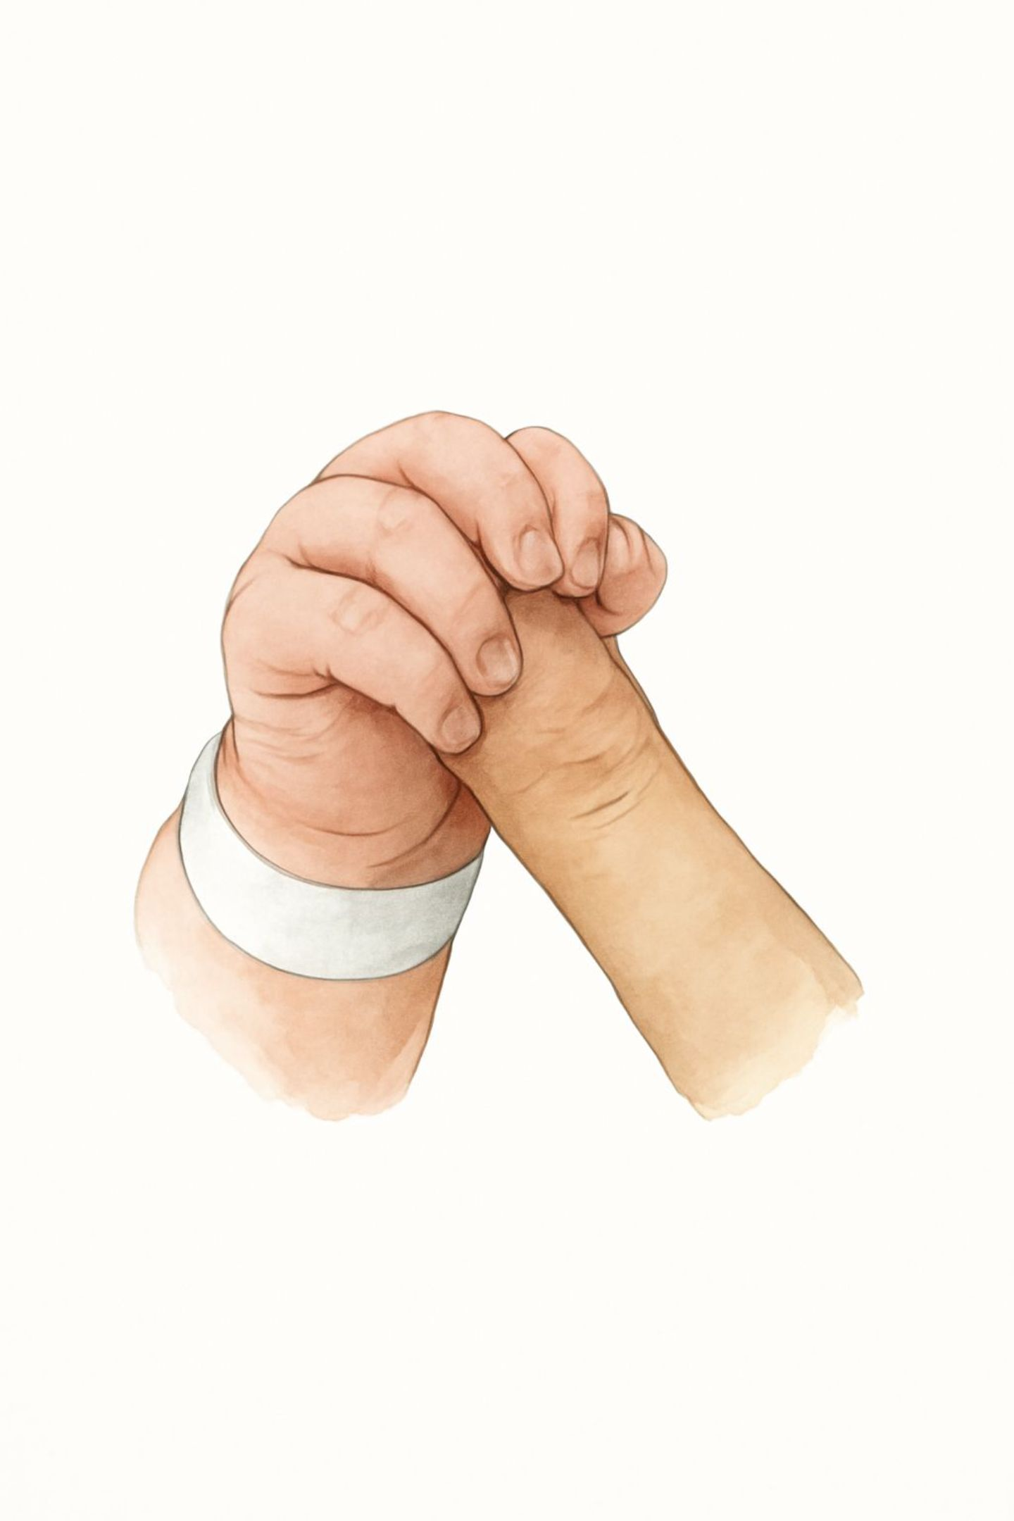

A Comparative Study on Umbilical Cord Care Practices and Outcomes Among Newborns Delivered in Selected Health Facilities in Nyandarua County, Kenya
Michael Ruitururi
IPC Focal Person
Nyandarua county-Health Services
13TH ANNUAL CONFERENCE
Infection Prevention
Network – Kenya
Advancing Safe Care Through Infection Prevention & Control
CONFERENCE THEME
“Advancing IPC, AMR, and One Health:
Science, Policy, and Practice”
13TH IPNET KENYA CONFERENCE • 19–21 AUGUST 2026 • PRIDE INN PLAZA, NAIROBI
01

Slide 2

The Burden of Neonatal Sepsis
2.3M
Neonatal Deaths Annually
15–20% attributable to sepsis (WHO, 2020)
21
Deaths per 1,000 Live Births
Kenya's neonatal mortality rate (MoH, 2022)
18%
Neonatal Deaths from Sepsis
Cord infections: 8–12% of neonatal admissions in Kenya
40%
Global Neonatal Deaths
In Sub-Saharan Africa, driven by gaps in infection prevention

Slide 3

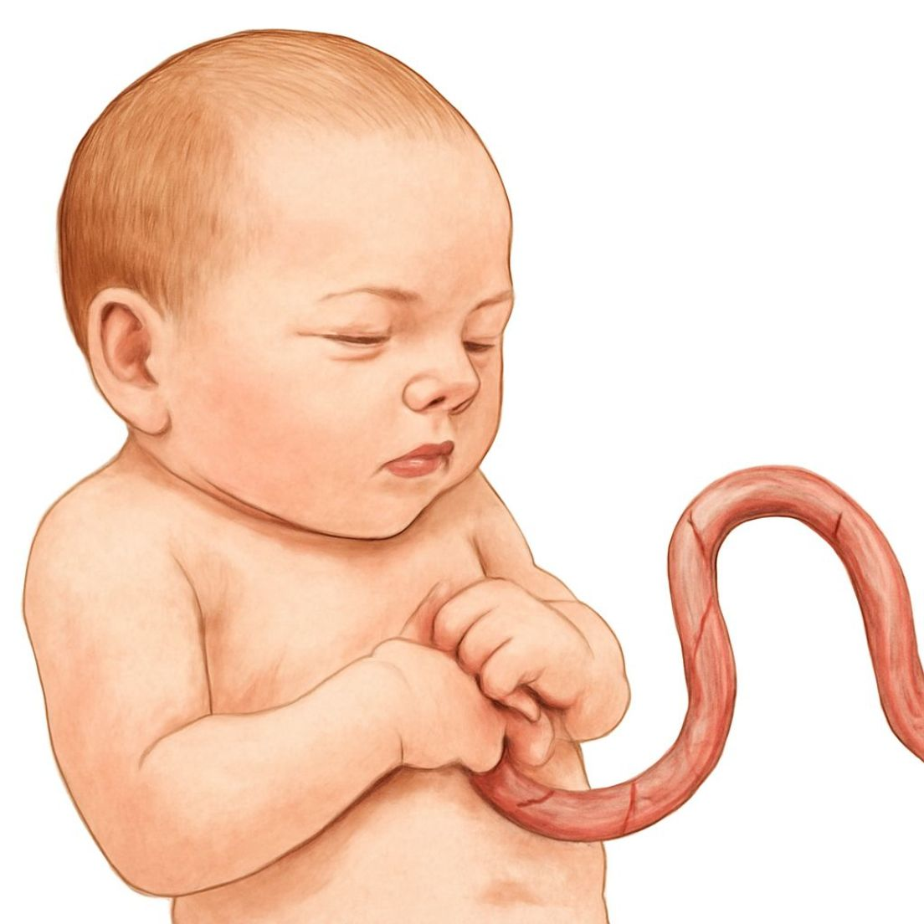
Why Umbilical Cord Care Matters
The Cord as a Portal of Entry
WHO & Kenya MoH Recommendation
Local Context
Nyandarua County's cold climate may affect cord drying and separation, but no local evidence exists to guide practice.
The umbilical stump is a direct pathway for pathogens. Inadequate cord care can rapidly progress from omphalitis to systemic sepsis and death.
Chlorhexidine digluconate 7.1% is recommended for cord care in high-mortality settings — yet adherence remains inconsistent across Kenya.

Slide 4



Study Objectives
Compare Healing Time
Measure Infection Rates
Assess Maternal Compliance
Time to complete umbilical cord healing: chlorhexidine vs. surgical spirit 70% v/v
Incidence of cord-related infections and omphalitis under each method
Adherence to cord care protocols and caregiver perceptions in both groups

Slide 5

Study Design & Methodology
Study Snapshot
Design: Prospective comparative cohort study
Setting: Selected public health facilities, Nyandarua County, Kenya
Participants: 48 mother–newborn pairs consecutively allocated
Group A: Chlorhexidine 7.1% (n=22)
Group B: Surgical Spirit 70% (n=26)
Follow-up: Until cord separation and complete healing
Outcome data: Available for 16 newborns
Enrollment
Analysis
48 mother‑newborn pairs prospective cohort
Allocation
Descriptive stats, p<0.05; 16 newborns complete data
Group A Chlorhexidine 7.1% n=22; Group B Surgical Spirit 70% n=26

Slide 6
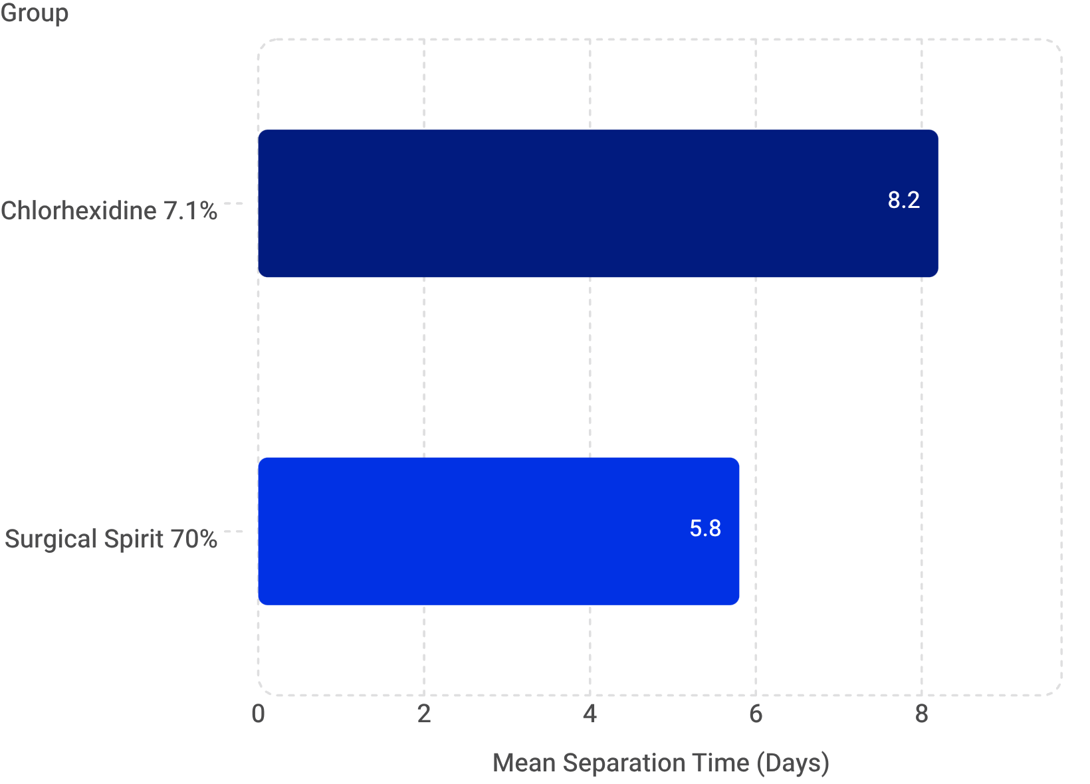

Key Results: Cord Separation Time
What the Data Shows
Chlorhexidine group: 8.2 days mean separation time (SD ±2.2)
Surgical Spirit group: 5.8 days mean separation time (SD ±1.3)
A 41% increase in separation time was observed with chlorhexidine — well-documented in the literature and not inherently harmful.
Delayed cord separation requires caregiver education to manage expectations and reduce anxiety, but does not indicate adverse outcomes.

Slide 7
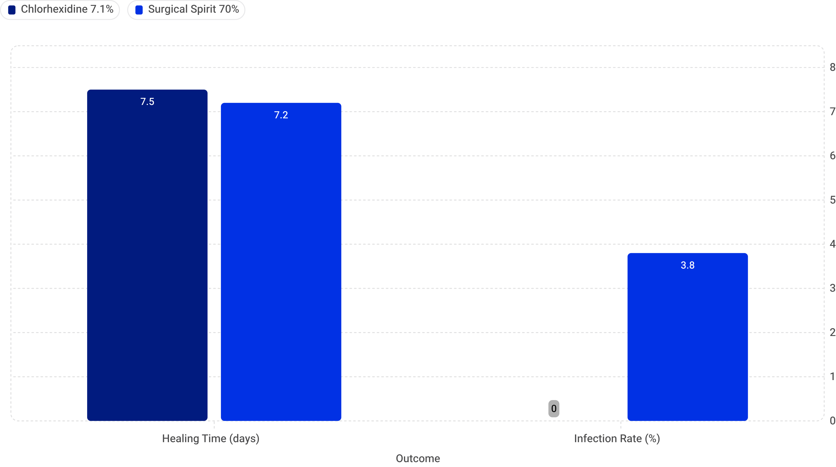
Key Results: Healing & Infection Outcomes
Healing Time: Comparable
Infection Rates: A Critical Difference
Complete healing was nearly identical between groups:
7.5 days (Chlorhexidine) vs. 7.2 days (Surgical Spirit)
Delayed separation does not translate to delayed healing.
0% cord infections in the chlorhexidine group
3.8% (1 case) in the surgical spirit group
No infections occurred under chlorhexidine care — a clinically significant finding even at small sample size.

Slide 8

What the Evidence Tells Us
Superior Infection Protection
Zero infections in the chlorhexidine group reinforce WHO and Kenya MoH recommendations for high-mortality settings.
Manageable Trade-Off
Delayed separation (8.2 vs. 5.8 days) is offset by comparable healing times and superior infection outcomes.
Context Matters
Nyandarua's cold highland climate may influence cord drying. Local evidence is essential to guide context-appropriate practice.

Slide 9


Ethical Considerations
Approvals & Clearances
1
2
3
Hospital Administration
Murang'a University Ethics Review Committee
NACOSTI Clearance
Permission sought through the Head of Research and Policies in Nyandarua County
National Commission for Science, Technology and Innovation clearance obtained
Formal ethical review approval granted prior to study commencement

Slide 10
Conclusion
Chlorhexidine cord care was associated with delayed cord separation but provided superior protection against cord infection — without compromising healing outcomes.
Separation Time
Healing Outcomes
Infection Protection
8.2 vs. 5.8 days — 41% longer with chlorhexidine, but clinically manageable with proper counseling
7.5 vs. 7.2 days — virtually identical, confirming delayed separation ≠ delayed healing
0% vs. 3.8% — zero infections under chlorhexidine, validating evidence-based guidelines

Slide 11





Implications for Practice & Policy
For Healthcare Workers
Continue promoting chlorhexidine 7.1% as first-line cord care. Counsel caregivers on expected delayed separation. Standardize IPC protocols to address facility-acquired infections.
For Policy Makers
Nyandarua County DoH and Kenya MoH can use these findings to inform contextual adaptation of national cord care guidelines for cold highland regions.
For Researchers
Larger, multi-county studies are needed to validate findings and strengthen the evidence base for neonatal infection prevention policy in similar settings.
For Program Managers
Integrate cord care education into antenatal and postnatal counseling. Monitor adherence and infection rates at facility level.

Slide 12






Acknowledgements
This research would not have been possible without the generous support of the following institutions and their dedicated staff.
Department of Health
For their invaluable support and guidance throughout this research.
JM Hospital Maternity
Nursing staff whose dedication made data collection possible.
Manunga Health Centre
Nursing staff for their collaboration and invaluable assistance.
Engineer Hospital Maternity
Nursing staff for their commitment and dedication to this research.

Slide 13

Thank You 🙏
We appreciate your time and attention.
Questions? 💬

