Slide 1



13TH ANNUAL CONFERENCE
Infection Prevention
Network – Kenya
Advancing Safe Care Through Infection Prevention & Control
CONFERENCE THEME
“Advancing IPC, AMR, and One Health:
Science, Policy, and Practice”
13TH IPNET KENYA CONFERENCE • 19–21 AUGUST 2026 • PRIDE INN PLAZA, NAIROBI
01

Slide 2

ABSTRACT INFORMATION
02
Abstract Details
TITLE OF ABSTRACT: Detected Prevalence of Healthcare-Associated Infections and Diagnostic Practices: Results from a Point Prevalence Survey in Nine Ethiopian Hospitals
PRESENTER NAME: Selamawit Gebreegziabher, MPH, MSc
INSTITUTION / AFFILIATION: U.S. Centers for Disease Control and Prevention
ON BEHALF OF: Hailegebriel Abomsa, MPH, MSc (Ethiopia Ministry of Health)
COUNTRY: Ethiopia
13TH IPNET KENYA CONFERENCE • 19–21 AUGUST 2026 • PRIDE INN PLAZA, NAIROBI
02

Slide 3
SECTION 01
03
Background / Introduction
Healthcare-associated infections (HAIs) threaten patient safety, outcomes, and increase costs.
In Ethiopia, HAI burden is underreported due to fragmented surveillance and limited diagnostic capacity.
Need for standardized methods to estimate HAI prevalence and to assess diagnostic practices in public hospitals
13TH IPNET KENYA CONFERENCE • 19–21 AUGUST 2026 • PRIDE INN PLAZA, NAIROBI
03

Slide 4
SECTION 02
04
Objectives / Research Question
To estimate the detected prevalence of selected HAIs (SSI, UTI, BSI, pneumonia) in nine public hospitals within the pilot national surveillance network (PNSN).
To assess diagnostic testing practices among patients receiving antimicrobials
13TH IPNET KENYA CONFERENCE • 19–21 AUGUST 2026 • PRIDE INN PLAZA, NAIROBI
04

Slide 5
SECTION 03
05
Methodology
Study design: Point prevalence survey (PPS) based on Global Action in Healthcare Network-HAI (GAIHN-HAI) methodology and WHO HAI case definitions
Conducted in nine public hospitals during November 2025–March 2026
Study population: Adult (≥18 years) patients admitted in select wards before/on 8 am
Data collection and analysis tools: REDCap, Rstudio, Rshiny
Analysis: Facility-level medians and IQR
13TH IPNET KENYA CONFERENCE • 19–21 AUGUST 2026 • PRIDE INN PLAZA, NAIROBI
05

Slide 6
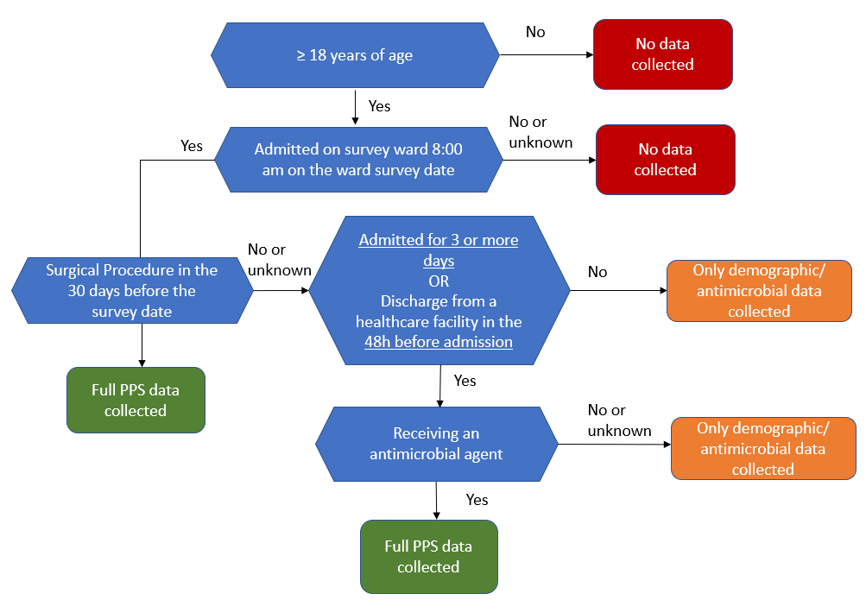
SECTION 03
05
Methodology
13TH IPNET KENYA CONFERENCE • 19–21 AUGUST 2026 • PRIDE INN PLAZA, NAIROBI
05

Slide 7
SECTION 04
06
Results / Key Findings: PPS Summary
Facility | Facility Level | # of wards included in PPS | # of patients admitted on survey date | Patients with surgery in the last 30d
Adama CSH | Tertiary | 6 | 183 | 65
Adare GH | Secondary | 11 | 40 | 11
Bishoftu GH | Secondary | 4 | 59 | 23
Dessie CSH | Tertiary | 4 | 144 | 38
Felege Hiwot CSH | Tertiary | 4 | 99 | 22
Gambella GH | Secondary | 4 | 30 | 6
St. Peter Hospital | Tertiary | 4 | 115 | 31
Yekatit 12 Hospital Medical College | Tertiary | 4 | 145 | 51
Zewditu Memorial Hospital | Secondary | 7 | 144 | 54
13TH IPNET KENYA CONFERENCE • 19–21 AUGUST 2026 • PRIDE INN PLAZA, NAIROBI
06

Slide 8
Results / Key Findings: Healthcare-Associated Infections:
06
SECTION 04
73
0% to 23.5%
0%–10.4%
Total HAIs identified
SSI prevalence range
Median HAI 5.6% (IQR 3.4-9.6%)
Median SSI 9.2%, (IQR 2.6-13.3%)
Non-SSI (UTI/BSI/pneumonia) HAI Median 4.3% (IQR 1.2%-5.3%)
Facility | # of HAIs | SSI prevalence | Non-SSI prevalence
Adama CSH | 8 | 9.2% | 1.1%
Adare GH | 1 | 0.0% | 5.0%
Bishoftu GH | 2 | 8.7% | 0.0%
Dessie CSH | 16 | 5.3% | 10.4%
Felege Hiwot CSH | 8 | 13.6% | 5.1%
Gambella GH | 1 | 0.0% | 3.3%
St. Peter Hospital | 9 | 12.9% | 4.3%
Yekatit 12 Hospital Medical College | 20 | 23.5% | 5.5%
Zewditu Memorial Hospital | 8 | 11.1% | 1.4%
13TH IPNET KENYA CONFERENCE • 19–21 AUGUST 2026 • PRIDE INN PLAZA, NAIROBI
06

Slide 9
SECTION 04
06
Results / Key Findings: Diagnostic testing
Facility | Patients receiving at least 1 antimicrobial and no diagnostic test | Patients with full chart review | % patients with no diagnostic test
Adama CSH | 61 | 81 | 75%
Adare GH | 5 | 20 | 25%
Bishoftu GH | 11 | 23 | 48%
Dessie CSH | 12 | 28 | 43%
Felege Hiwot CSH | 31 | 63 | 49%
Gambella GH | 10 | 15 | 67%
St. Peter Hospital | 6 | 50 | 12%
Yekatit 12 Hospital Medical College | 25 | 60 | 42%
Zewditu Memorial Hospital | 28 | 98 | 29%
13TH IPNET KENYA CONFERENCE • 19–21 AUGUST 2026 • PRIDE INN PLAZA, NAIROBI
06

Slide 10
SECTION 05
07
Conclusion & Recommendations
A measurable HAI burden is present in these Ethiopian hospitals, driven primarily by SSIs.
Low detected UTI and BSI prevalence likely reflect diagnostic and documentation limitations rather than absence of infections.
SSI prevention strategies, diagnostic stewardship interventions, and clinical documentation improvement activities should be prioritized.
13TH IPNET KENYA CONFERENCE • 19–21 AUGUST 2026 • PRIDE INN PLAZA, NAIROBI
07

Slide 11
THANK YOU
13th IPNET-Kenya Conference • 19–21 August 2026 • Pride Inn Plaza, Nairobi
www.ipnetkenya.org | info@ipnetkenya.org
08

