Slide 1
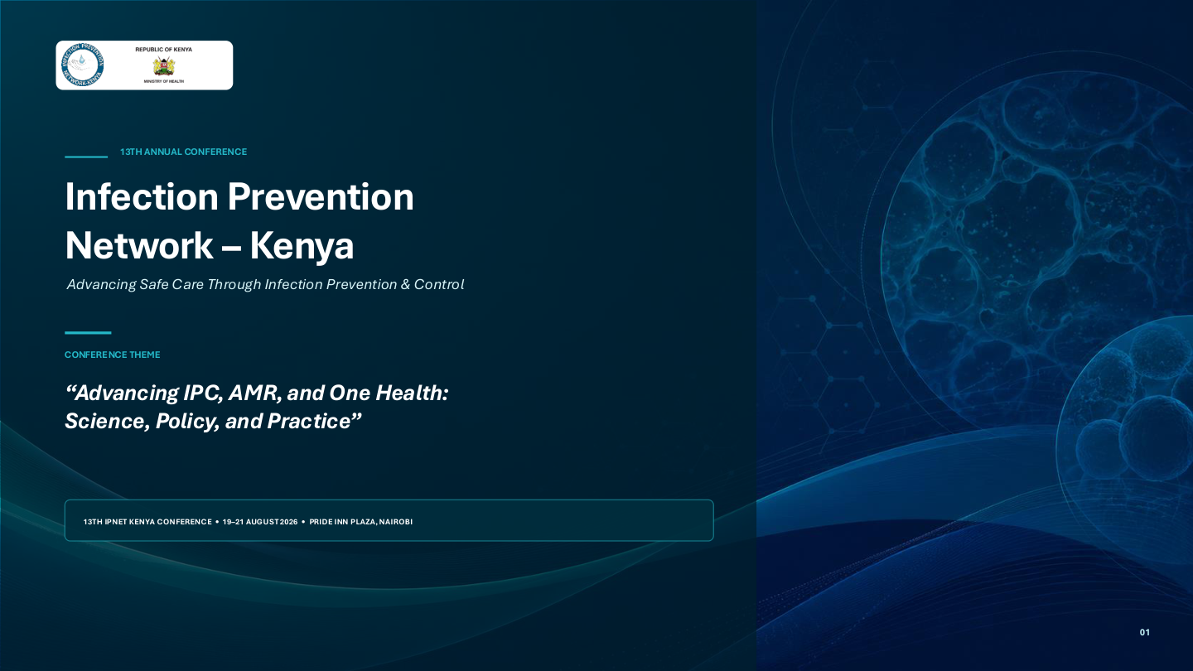

Slide 2
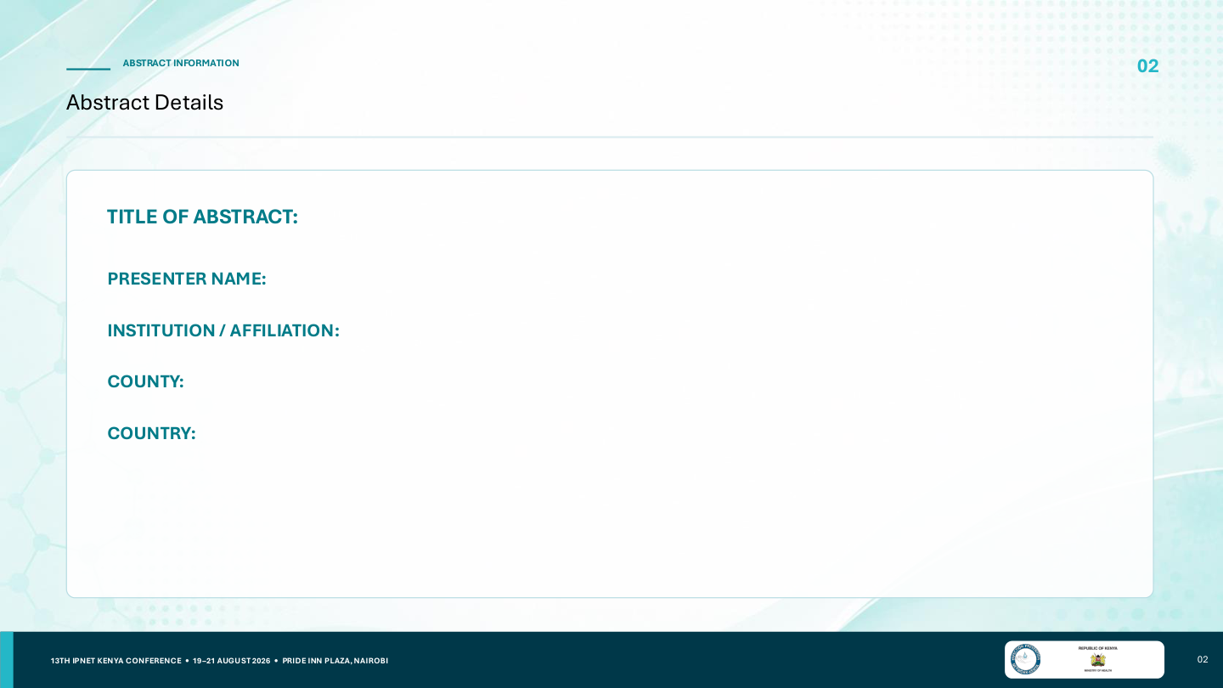
Improving Infection Prevention and Control Compliance Through Continuous Training and Supportive Supervision
Lucy Walegwa
:
Renal Dialysis Unit • Level 6 Referral Hospital
Nairobi
Kenya

Slide 3
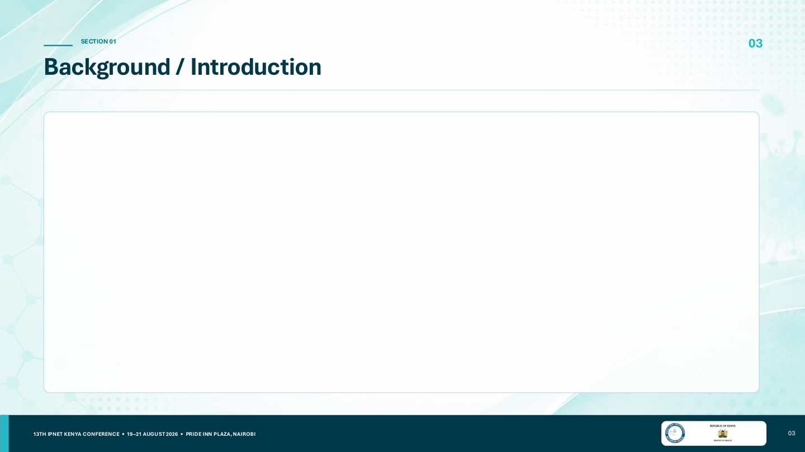
• Dialysis care involves repeated exposure to blood, body fluids, invasive procedures, contaminated equipment and sharps.
• Variation in adherence to standard IPC precautions can increase healthcare-associated infection and occupational exposure risk.
• Routine observation, feedback, training and supportive supervision are needed to identify and address practice gaps.
• The audit used the WHO Five Moments framework for hand hygiene and facility IPC tools for PPE, sharps and waste management.

Slide 4
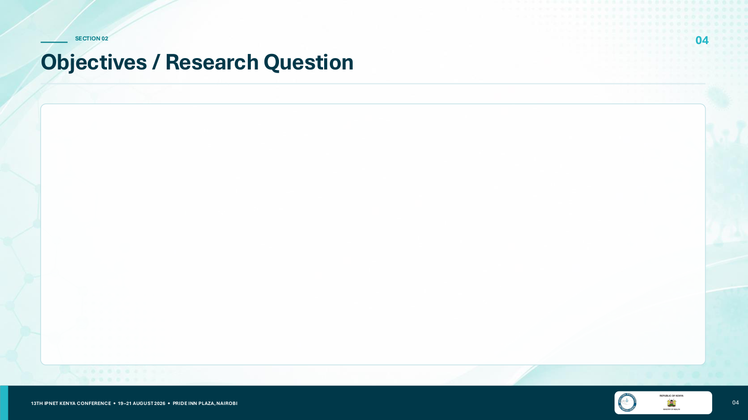
Audit focus
50
371
• Routine observation of IPC practices to identify compliance gaps.
• Focus on hand hygiene, PPE, sharps safety and waste management.
• Use findings to guide targeted training, feedback and supportive supervision.
Unique healthcare workers
Hand-hygiene observations
20
17
PPE assessments
Sharps assessments
Audit design
Descriptive observational quality improvement audit • Renal dialysis unit • January–December 2025

Slide 5
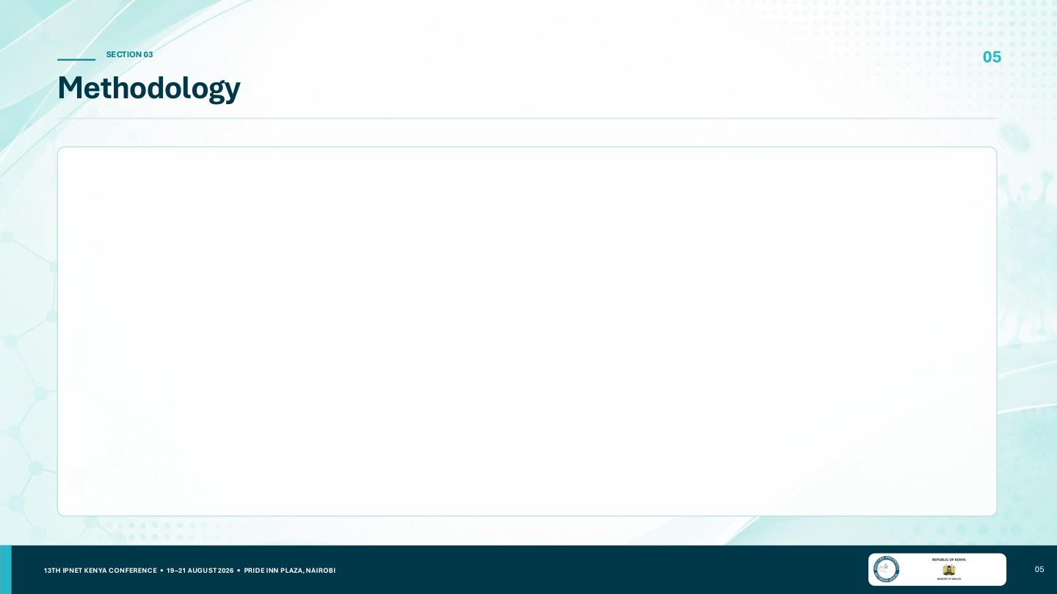
Participants & observations
Quality assurance
• 11 medical doctors, 36 nurses and 3 housekeepers were among the 50 unique staff observed.
• Hand hygiene was observed daily.
• PPE, sharps and other focused IPC practices were observed weekly.
• IPC champions received 30-minute on-site training on observation tools and standardized criteria.
• Formal inter-observer reliability testing was not conducted.
• Percentages were calculated as compliant ÷ assessed × 100.
Period
Jan–Dec 2025
Setting
Renal dialysis unit
Framework
WHO Five Moments + facility IPC tools

Slide 6
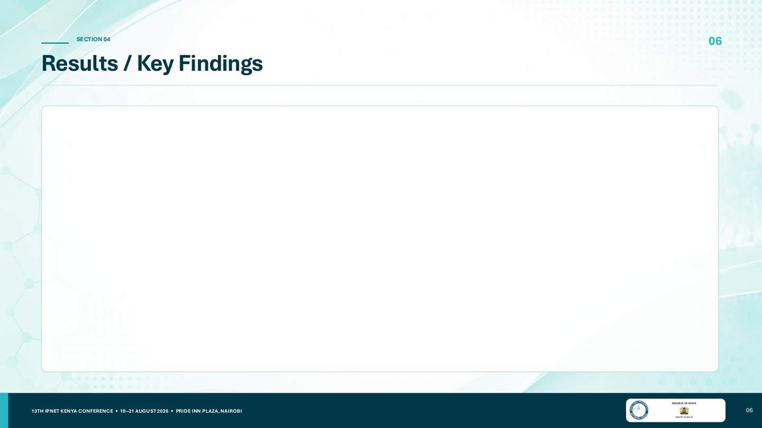
PPE donning compliance
Sharps-safety compliance — 10 indicators
75.0%
15/20 compliant
Q1 Closable
82.4%
Q2 Puncture resistant
76.5%
Q3 Leakproof
76.5%
25.0% non-compliant (5/20)
Q4 Fill indicator
76.5%
Q5 Accepts sharps
82.4%
Q6 Safe transport/label
82.4%
Q7 Secure assembly
82.4%
Q8 Point-of-origin disposal
5.9%
Q9 No resheathing
76.5%
Q10 Below fill level
64.7%
)

Slide 7
Results: Key IPC Gaps & Safety Event
1/17 (5.9%)
point-of-origin sharps disposal
11/17 (64.7%)
containers below fill level
1
reported prick/sharps incident
100%
routine waste collection & segregation
Renal Dialysis Unit | 2025 IPC Quality Improvement Audit | 7

Slide 8

What the audit shows
Priority quality-improvement actions
• IPC performance varied by practice rather than showing a uniform pattern across the unit.
• Hand-hygiene observation was sustained daily across doctors, nurses and housekeepers.
• PPE donning had a measurable compliance gap: 5/20 (25.0%) non-compliant.
• Sharps safety showed the most substantial gaps, especially point-of-origin disposal and needle resheathing.
• Strengthen point-of-origin sharps disposal.
• Reinforce no-resheathing practice.
• Provide PPE refresher training and return demonstration.
• Continue daily hand-hygiene observation and feedback.
• Continue weekly focused IPC observations using standardized tools.
• Review every reported prick/sharps incident through the established reporting process.
• Maintain routine waste collection and segregation at the point of collection.
Take-home: Continuous observation + targeted training + feedback + supportive supervision

Slide 9
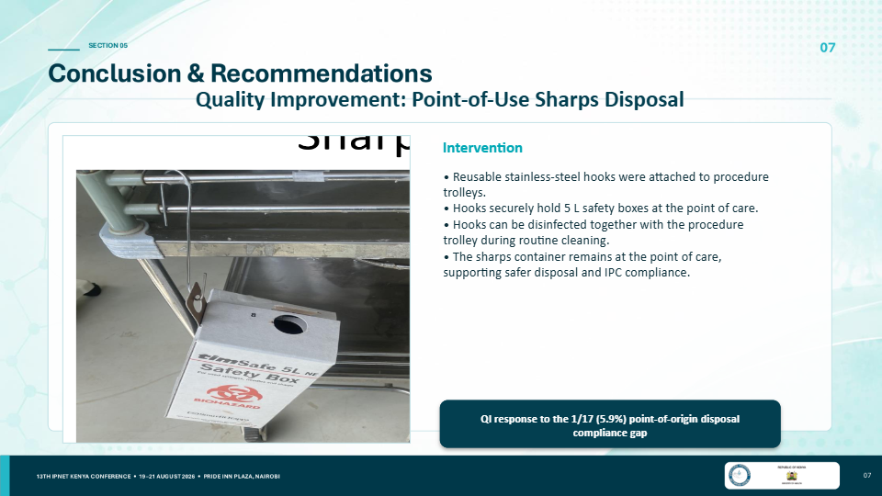

Slide 10
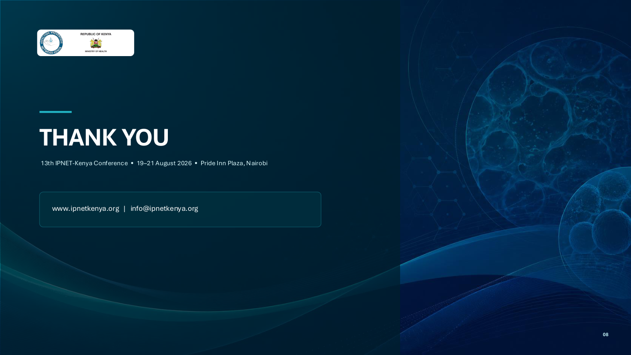
Thank You
Improving Infection Prevention and Control Compliance
Discussion & Questions

