Slide 1




13TH ANNUAL CONFERENCE
Infection Prevention
Network – Kenya
Advancing Safe Care Through Infection Prevention & Control
CONFERENCE THEME
“Advancing IPC, AMR, and One Health:
Science, Policy, and Practice”
Presenter: Racheal Kimani, MNUC
Other investigators
Dr Sam Mungai and team
Simon Irungu
Antony Kipkoech
Allan Muya
13TH IPNET KENYA CONFERENCE • 19–21 AUGUST 2026 • PRIDE INN PLAZA, NAIROBI
01

Slide 2

ABSTRACT INFORMATION
02
Abstract Details
TITLE OF ABSTRACT: Detecting Healthcare associated infections without records: Evidence from Microbiological Sampling in Kenya
PRESENTER NAME: Dr Racheal Kimani
INSTITUTION / AFFILIATION: Mama Ngina University College and CRID, MKU
COUNTY: KIAMBU
COUNTRY: KENYA
13TH IPNET KENYA CONFERENCE • 19–21 AUGUST 2026 • PRIDE INN PLAZA, NAIROBI
02

Slide 3
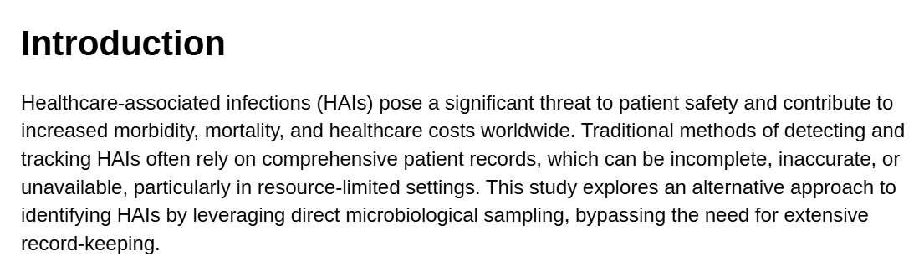
SECTION 01
03
Background / Introduction
13TH IPNET KENYA CONFERENCE • 19–21 AUGUST 2026 • PRIDE INN PLAZA, NAIROBI
03

Slide 4
SECTION 02
04
Objectives / Research Question
To determine the prevalence and distribution of healthcare associated infections (HAIs) among patients admitted to Thika Level V Hospital using standardized HAI surveillance criteria
To describe the epidemiological and clinical characteristics of healthcare associated infections at Thika Level V Hospital.
To characterize the microorganisms causing healthcare associated infections and their antimicrobial susceptibility
13TH IPNET KENYA CONFERENCE • 19–21 AUGUST 2026 • PRIDE INN PLAZA, NAIROBI
04

Slide 5
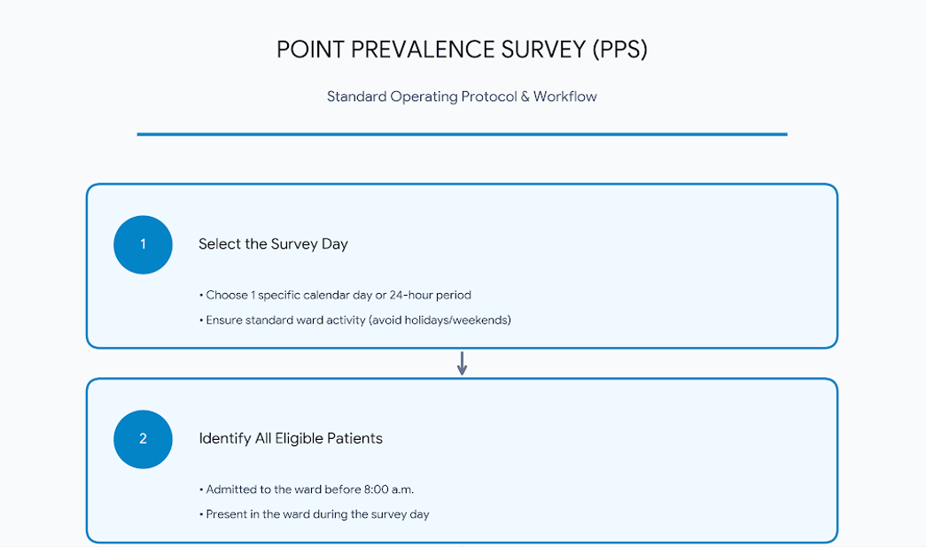

Slide 6
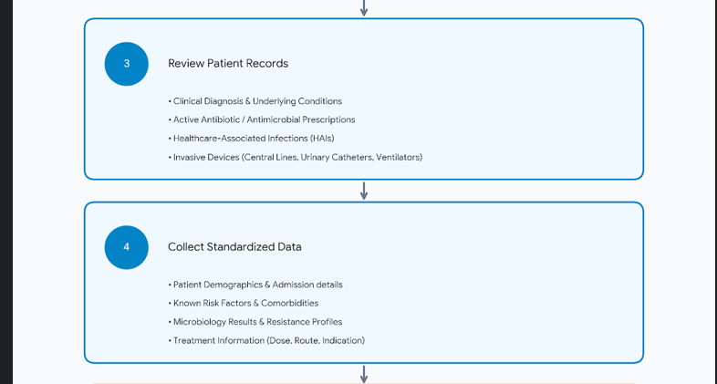

Slide 7
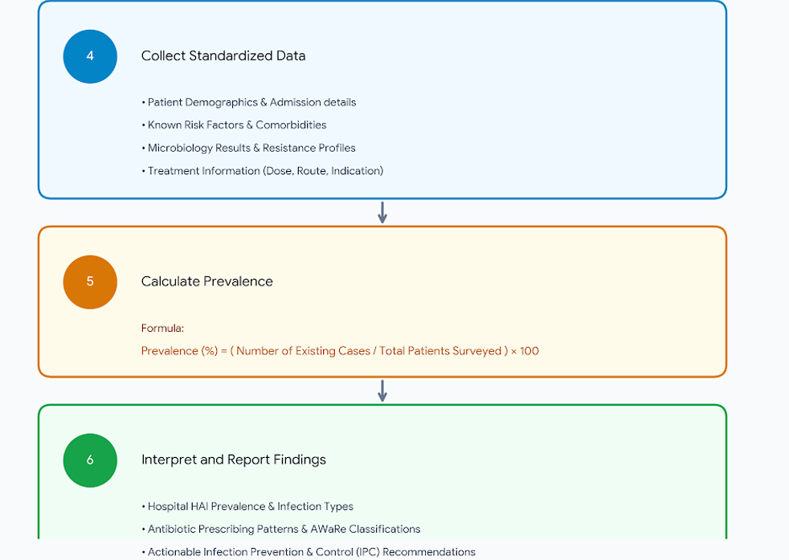

Slide 8
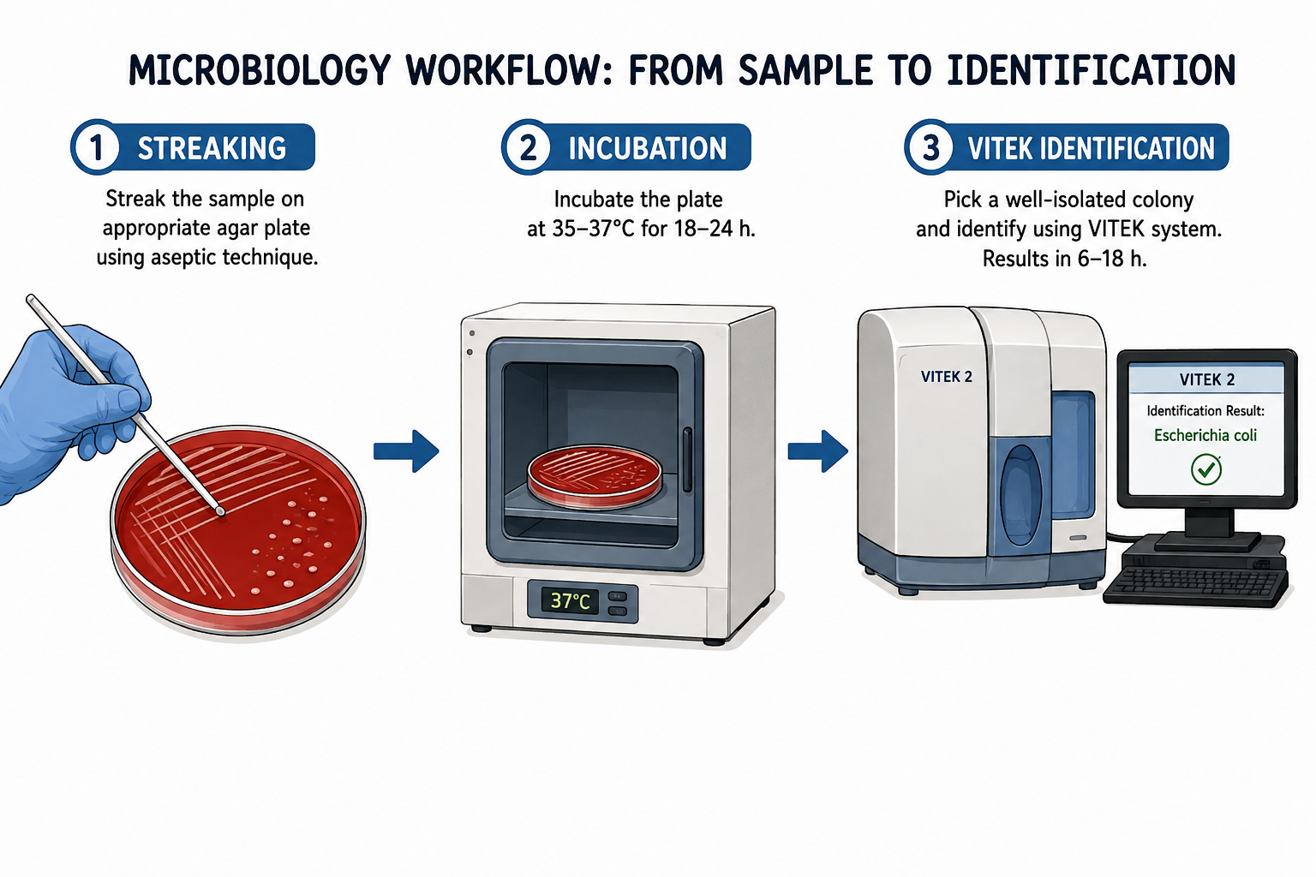
SECTION 03
05
Methodology
Consenting patients demographic data were collected using a carefully designed form
Sampling was done on basis of suspicion of a patient having condition of interest-judgemental sampling
Male surgical ward patients were sampled from Thika Level V
Samples were analysed at MKU CME lab, and referral lab (VITEK)
13TH IPNET KENYA CONFERENCE • 19–21 AUGUST 2026 • PRIDE INN PLAZA, NAIROBI
05

Slide 9
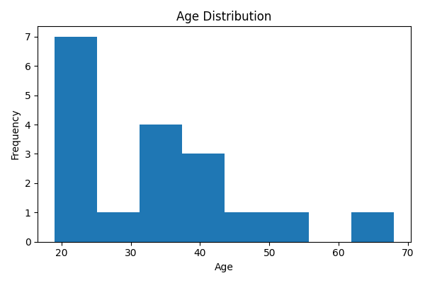
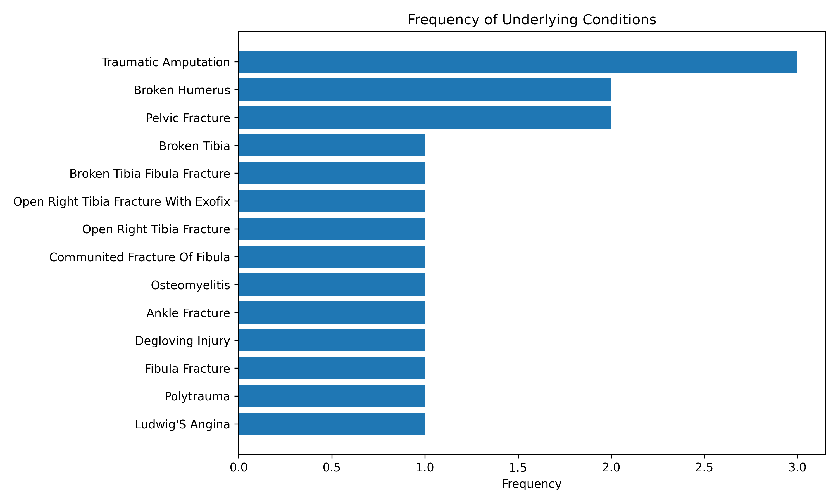
EPIDEMIOLOGICAL AND CLINICAL CHARACTERISTICS OF PARTICIPANTS
Underlying Medical Conditions: The majority of patients had underlying surgical or trauma-related conditions requiring hospitalization. Other documented comorbidities included chronic medical conditions such as diabetes mellitus, hypertension, although these occurred less frequently. Risk factors: invasive procedures, prolonged hospitalization, and frequent exposure to medical devices.
Age Distribution: The study included 18 hospitalized patients with a mean age of 33.2 ± 13.5 years. Participants ranged in age from 19 to 68 years, with a median age of 32 years, indicating that the study population was predominantly composed of young to middle-aged adults

Slide 10
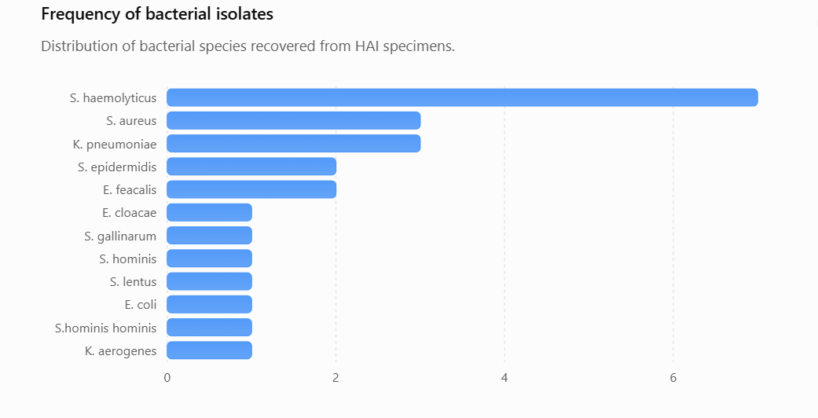
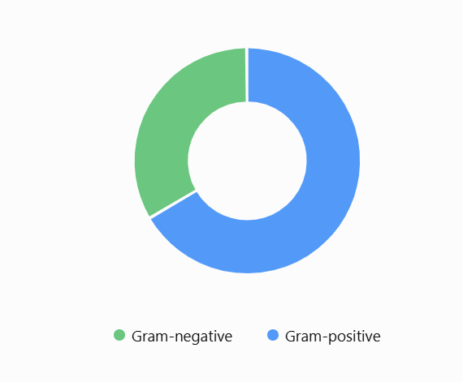
BACTERIAL ISOLATES
Staphylococcus haemolyticus was the most common isolate (29.2%), followed by Staphylococcus aureus and Klebsiella pneumoniae (12.5% each). Less frequently isolated organisms included Staphylococcus epidermidis, Enterococcus faecalis, Enterobacter cloacae, Escherichia coli, Klebsiella aerogenes, and other coagulase-negative staphylococci.

Slide 11
SECTION 04
06
Results / Key Findings
A total of 24/55 bacterial isolates have been identified so far.
Gram-positive bacteria predominated (66.7%), while Gram-negative organisms accounted for 33.3%.
The predominant isolate was Staphylococcus haemolyticus (7 isolates; 29.2%).
Staphylococcus aureus and Klebsiella pneumoniae were the second most frequent isolated organisms.
Urine and wound/swab specimens yielded the greatest diversity of organisms.
13TH IPNET KENYA CONFERENCE • 19–21 AUGUST 2026 • PRIDE INN PLAZA, NAIROBI
06

Slide 12
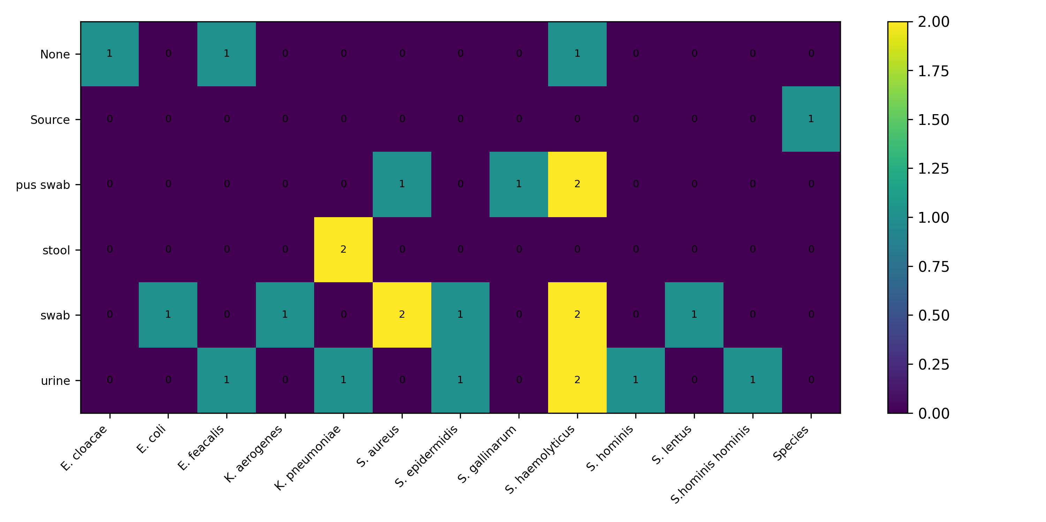
Specimens and organisms heat map
Heatmap demonstrated variability in the distribution of bacterial pathogens across different clinical specimen types. Wound-related specimens, particularly pus swabs and wound swabs, yielded the greatest diversity of bacterial isolates, with Staphylococcus haemolyticus being the predominant organism recovered

Slide 13
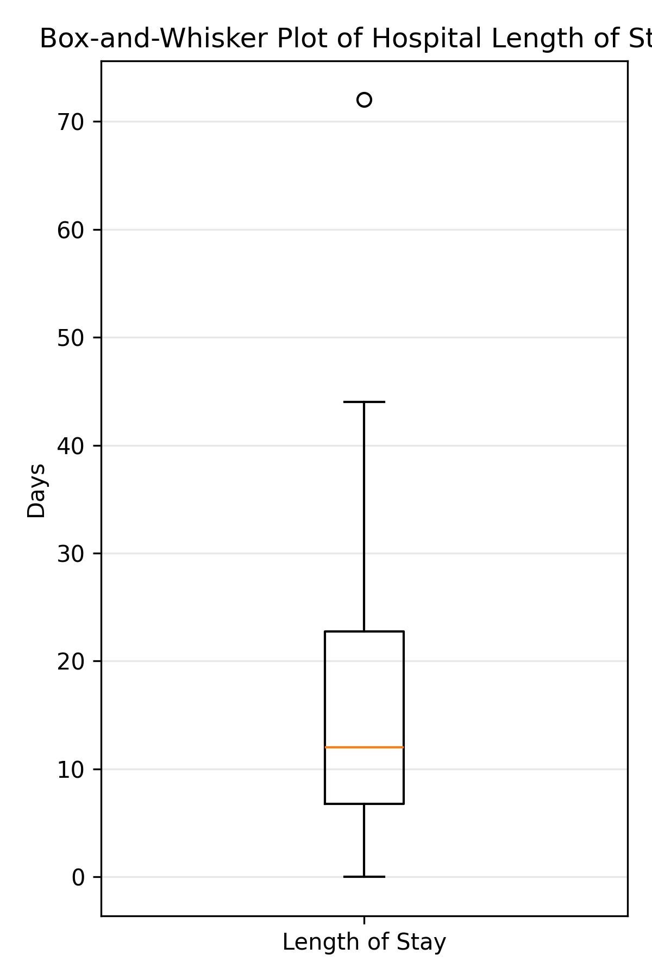
Length of Stay at Hospital
Length of Stay (LOS) = Date of Survey − Date of Admission (in days)
Maximum LOS: 72 days Mean LOS: 18.1 days Median LOS: 13 days

Slide 14
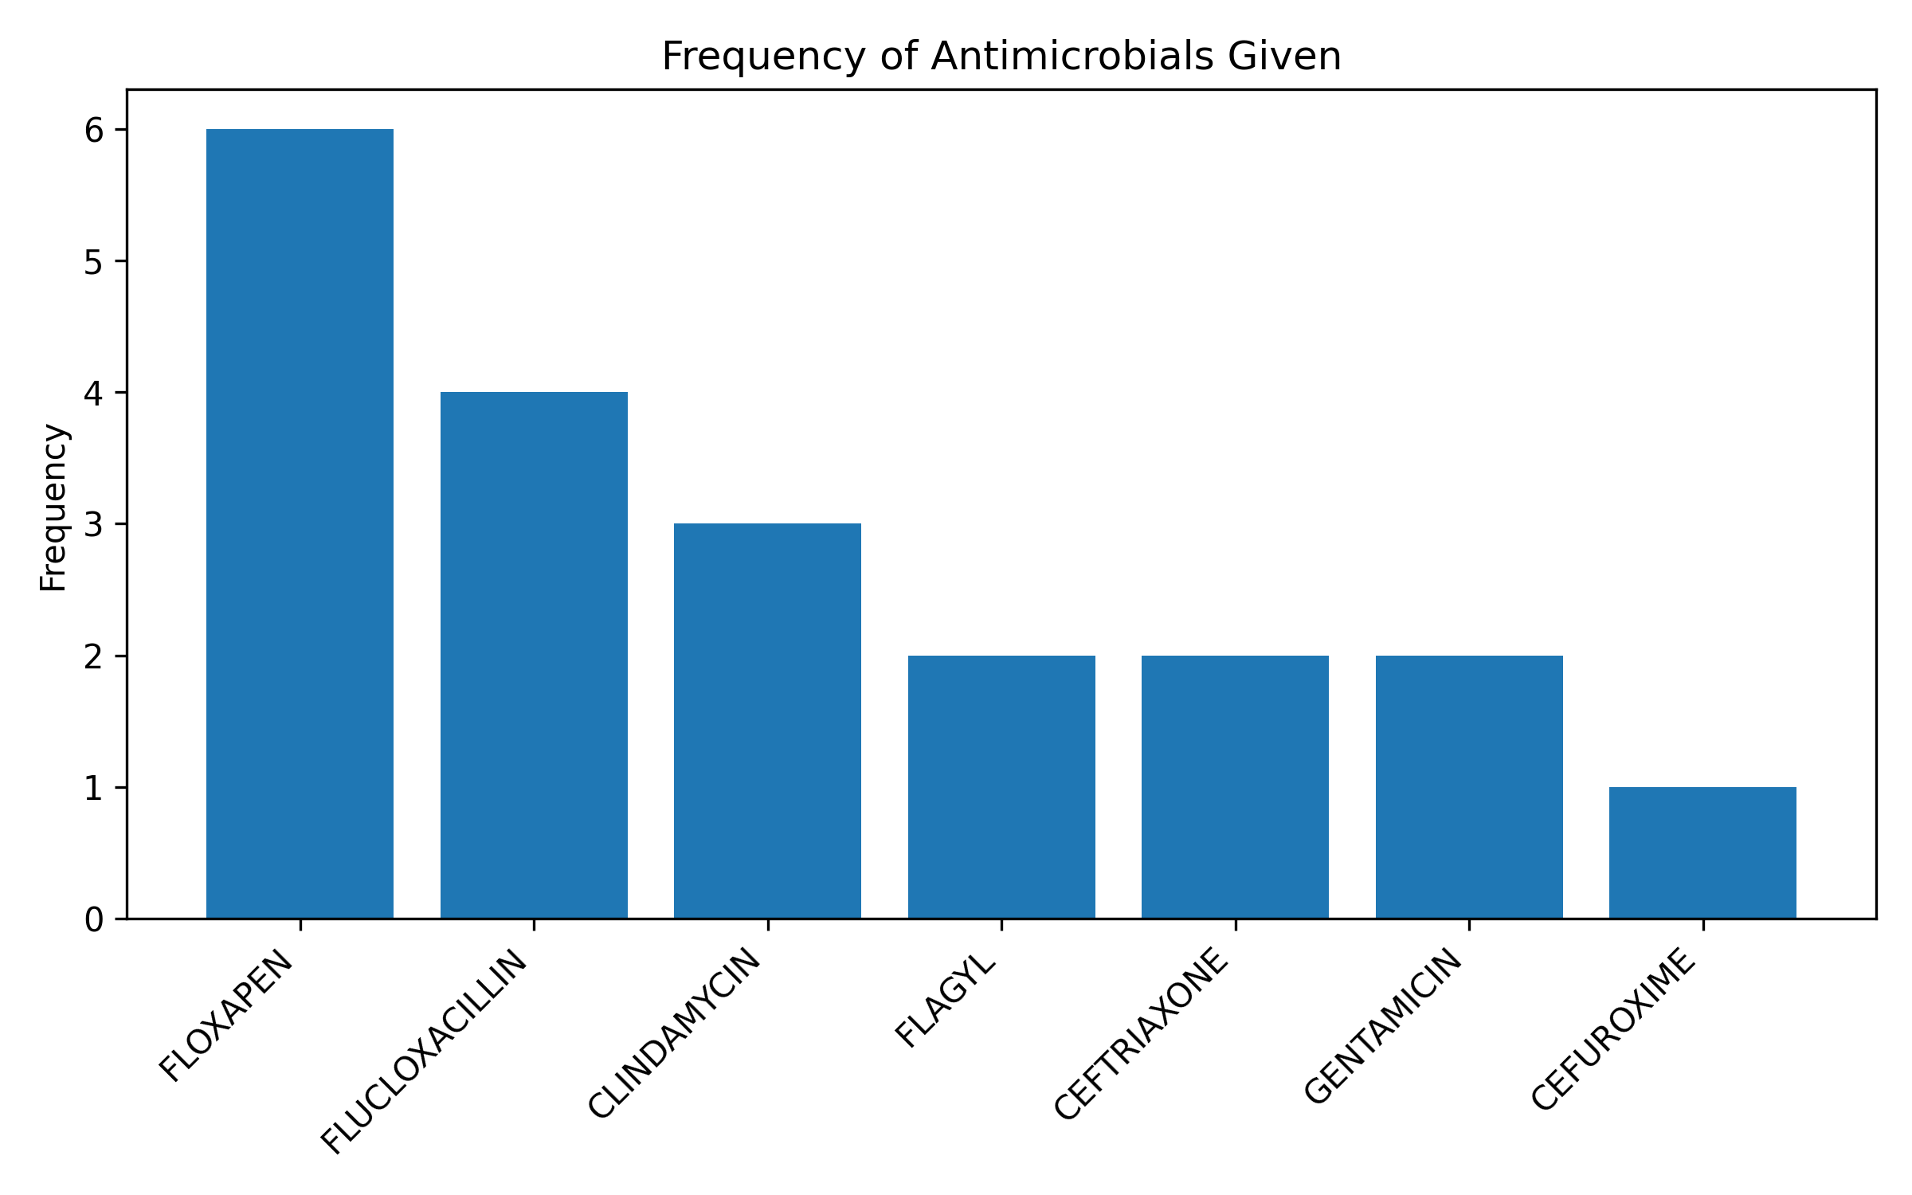
Antimicrobials prescribed
The antimicrobial prescribing pattern among the study participants demonstrated frequent use of broad-spectrum and anti-staphylococcal antibiotics.
Combination antimicrobial therapy was common, with several patients receiving two or more antibiotics concurrently
These prescribing patterns are consistent with empirical treatment strategies for orthopaedic trauma and suspected surgical site or bone infections

Slide 15
SECTION 05
07
Conclusion & Recommendations
This survey provides a snapshot of healthcare-associated infections (HAIs) in the study hospital, where routine HAI surveillance is not currently implemented.
Although the survey represents a single point in time and a relatively small number of patients, it demonstrates that HAIs are present among hospitalized patients and that clinically significant bacterial pathogens are circulating within the facility.
The recovery of shown organisms from multiple specimen types, particularly wound and urine specimens, suggests ongoing opportunities for healthcare-associated transmission suggesting that there’s need to strengthen infection prevention and control (IPC) practices.
The absence of a structured HAI surveillance programme presents a major challenge in accurately determining the true burden of HAIs.
The lack of continuous surveillance also limits the hospital's ability to identify high-risk wards, monitor antimicrobial resistance patterns over time, evaluate compliance with IPC measures, and guide evidence-based antimicrobial stewardship
13TH IPNET KENYA CONFERENCE • 19–21 AUGUST 2026 • PRIDE INN PLAZA, NAIROBI
07

Slide 16


Acknowledgements
Antony Kipkoech
Allan Muya
Simon Irungu
volunteer patients

Slide 17
THANK YOU
13th IPNET-Kenya Conference • 19–21 August 2026 • Pride Inn Plaza, Nairobi
www.ipnetkenya.org | info@ipnetkenya.org
08

