Slide 1



13TH ANNUAL CONFERENCE
Infection Prevention
Network – Kenya
Advancing Safe Care Through Infection Prevention & Control
CONFERENCE THEME
“Advancing IPC, AMR, and One Health:
Science, Policy, and Practice”
13TH IPNET KENYA CONFERENCE • 19–21 AUGUST 2026 • PRIDE INN PLAZA, NAIROBI
01

Slide 2

ABSTRACT INFORMATION
02
TITLE OF ABSTRACT: Thirty-Day Surveillance of Surgical Site Infection Following Caesarean Section in September 2025 at Meru Teaching and Referral Hospital.
PRESENTER NAME: REUBEN.M KAILIKIA
INSTITUTION / AFFILIATION: MERU TEACHING AND REFERRAL HOSPITAL
COUNTY: MERU
COUNTRY: KENYA
13TH IPNET KENYA CONFERENCE • 19–21 AUGUST 2026 • PRIDE INN PLAZA, NAIROBI
02

Slide 3
SECTION 01
03
Background / Introduction
An estimated one in five deliveries globally are by caesarean section(C/S) and it is expected to rise to one in three by 2030.
Surgical site infection (SSI) remains one of the most common healthcare-associated infections following caesarean section accounting to up to 15% of the deliveries.
SSI is documented to directly or indirectly contribute to increased maternal morbidity, prolonged hospital stay, and antimicrobial use.
Active post-discharge surveillance and adherence to evidence-based care bundles are essential components of infection prevention and control (IPC) programs proven to reduce the risk post C/S SSI.
13TH IPNET KENYA CONFERENCE • 19–21 AUGUST 2026 • PRIDE INN PLAZA, NAIROBI
03

Slide 4
SECTION 02
04
Objectives / Research Question
To determine the 30-day prevalence of post-caesarean section SSI at Meru Teaching and referral Hospital.
To assess compliance with perioperative care bundles.
To identify factors associated with SSI at Meru Teaching and Referral Hospital.
13TH IPNET KENYA CONFERENCE • 19–21 AUGUST 2026 • PRIDE INN PLAZA, NAIROBI
04

Slide 5
SECTION 03
05
Methodology
A cross-sectional prospective observational surveillance study was conducted among 53 systematically selected mothers who underwent caesarean section between 1st and 30th September 2025 at MeTRH.
Sample size was calculated using the Cochran sample size formula with a finite population of 121 and an estimated ssi rate of 6.6%
SSI was defined using the WHO criteria (infection occurring between day 2 and 30 of surgery).
Participants were assessed on postoperative day three and followed by telephone on days 14 and 30 for signs of infection either superficial, deep incisional or organ space.
Data was analyzed using MS Excel. Descriptive statistics were used to summarize findings while graphs and charts were used for visual representation.
13TH IPNET KENYA CONFERENCE • 19–21 AUGUST 2026 • PRIDE INN PLAZA, NAIROBI
05

Slide 6
SECTION 04
06
Results / Key Findings
The mean participant age was 25 years.
About half of participants had secondary education which potentially improved understanding of instructions.
Four mothers 7.5% developed SSI within 30 days.
Emergency cases accounted for 79.2% of procedures accounted for three quarters of the infections signaling reduced bundle adherence when time is limited.
Only 26% received timely antibiotic prophylaxis with all 4 SSI cases noncompliant to this bundle.
92% had hair removal done with a blade and for all the cases had adequate skin preparation and hand hygiene observed preoperatively.
13TH IPNET KENYA CONFERENCE • 19–21 AUGUST 2026 • PRIDE INN PLAZA, NAIROBI
06

Slide 7
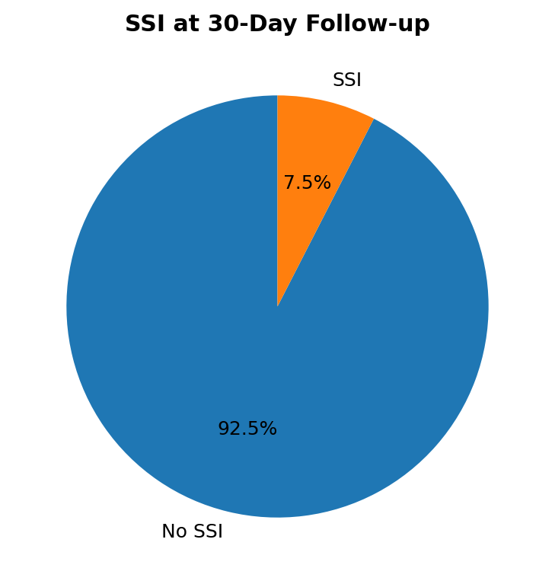
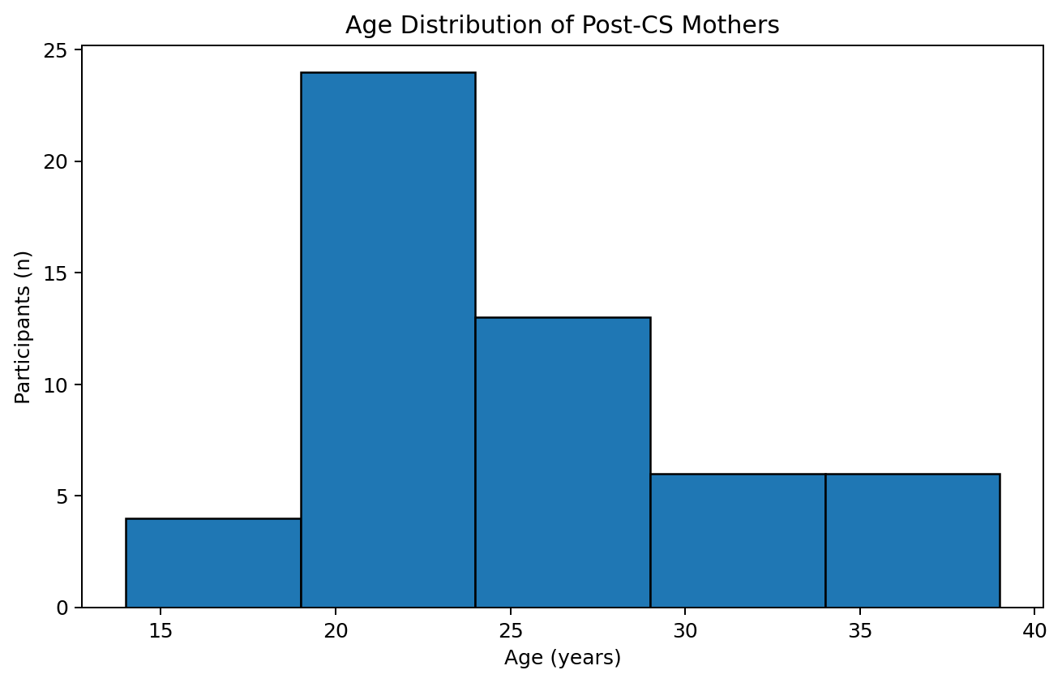
SECTION 04
06
Results / Key Findings
13TH IPNET KENYA CONFERENCE • 19–21 AUGUST 2026 • PRIDE INN PLAZA, NAIROBI
06

Slide 8
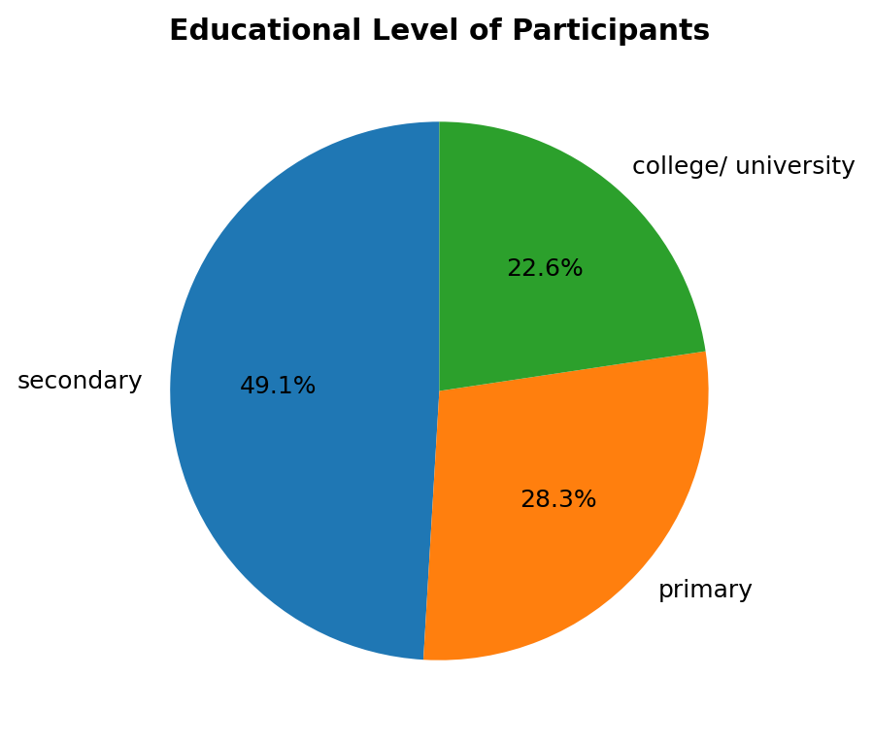
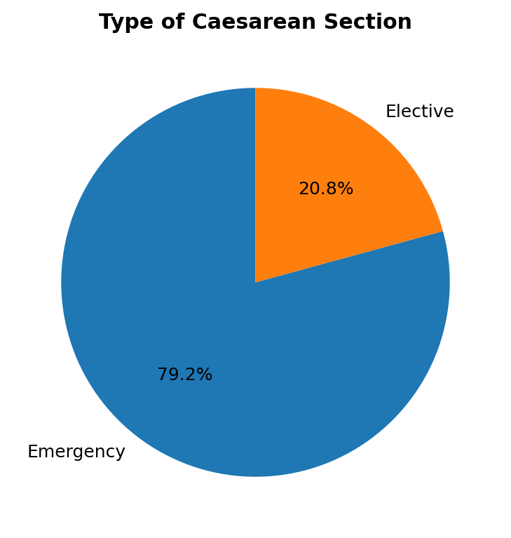
SECTION 04
06
Results / Key Findings
13TH IPNET KENYA CONFERENCE • 19–21 AUGUST 2026 • PRIDE INN PLAZA, NAIROBI
06

Slide 9
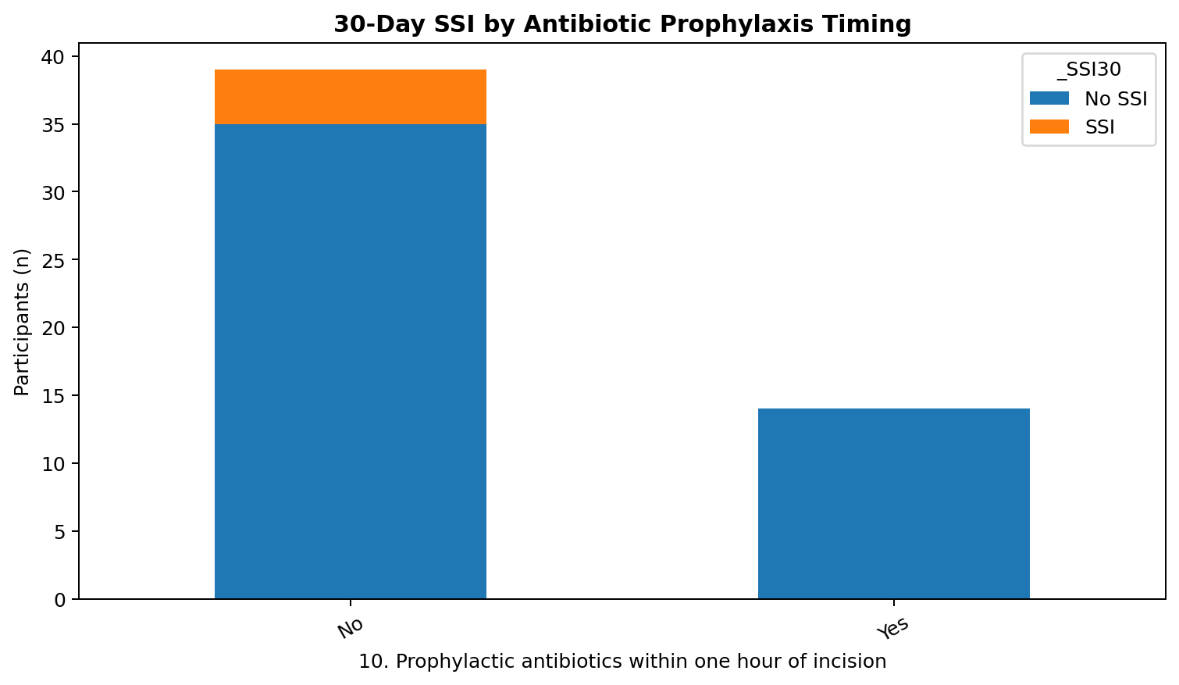
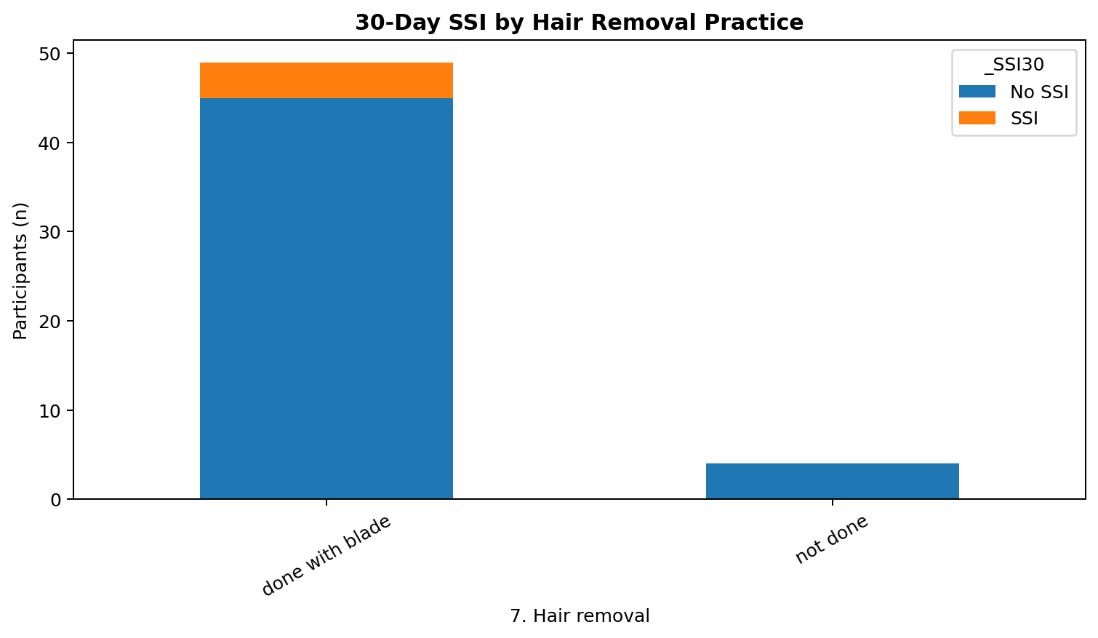
SECTION 04
06
Results / Key Findings
13TH IPNET KENYA CONFERENCE • 19–21 AUGUST 2026 • PRIDE INN PLAZA, NAIROBI
06

Slide 10
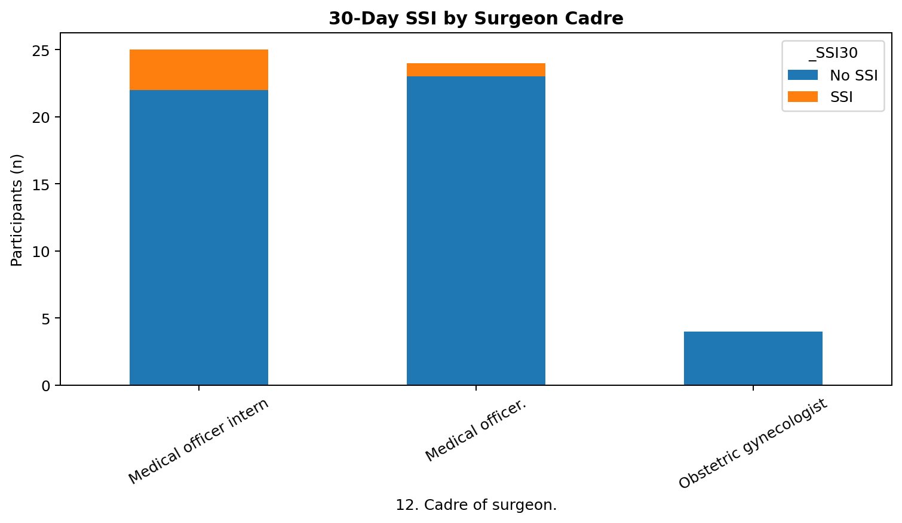
SECTION 04
06
Results / Key Findings
13TH IPNET KENYA CONFERENCE • 19–21 AUGUST 2026 • PRIDE INN PLAZA, NAIROBI
06

Slide 11
SECTION 05
07
Conclusion & Recommendations
A 7.5% post-caesarean SSI prevalence was identified.
Surveillance and care bundles implementation may strengthen IPC.
This study had a small sample and few cases, larger studies are recommended to confirm risk factors and guide interventions.
Routine post-discharge SSI surveillance and continuous monitoring of perioperative care bundle adherence are essential components of maternal healthcare IPC programs.
13TH IPNET KENYA CONFERENCE • 19–21 AUGUST 2026 • PRIDE INN PLAZA, NAIROBI
07

Slide 12
THANK YOU
13th IPNET-Kenya Conference • 19–21 August 2026 • Pride Inn Plaza, Nairobi
www.ipnetkenya.org | info@ipnetkenya.org
08

