Slide 1



13TH ANNUAL CONFERENCE
Infection Prevention
Network – Kenya
Advancing Safe Care Through Infection Prevention & Control
CONFERENCE THEME
“Advancing IPC, AMR, and One Health:
Science, Policy, and Practice”
13TH IPNET KENYA CONFERENCE • 19–21 AUGUST 2026 • PRIDE INN PLAZA, NAIROBI
01

Slide 2

ABSTRACT INFORMATION
02
Abstract Details
TITLE OF ABSTRACT: HIGH BURDEN OF MULTIDRUG RESISTANT ESCHERICHIA COLI IN INFORMAL WATER SOURCES IN KIBERA INFORMAL SETTLEMENTS
PRESENTER NAME: Teresia Nyaga¹ , Susan Githii¹ , Edinah Song’oro² Jenifer Njuhigu¹ , Peter Nthiga⁴, Leonard Kingwara¹ Jully Okonji³, Edwin Ochieng^{, 3}
INSTITUTION / AFFILIATION: ¹National Public Health Institute, ² Department of Medical Microbiology, COHES, JKUAT
³ Association of Public Health Laboratories, ⁴ University of the Free State - Next Generation Sequencing Unit
COUNTY: NAIROBI
COUNTRY: KENYA
13TH IPNET KENYA CONFERENCE • 19–21 AUGUST 2026 • PRIDE INN PLAZA, NAIROBI
02

Slide 3
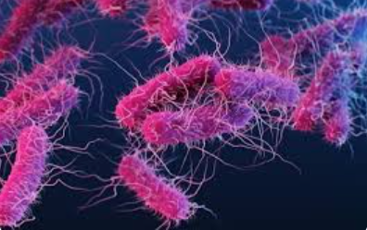
SECTION 01
Background / Introduction
03
E. coli is priority AMR pathogens and fecal contamination indicator according to WHO.
It causes 250 million infections and 65,000 deaths annually in Sub-Saharan Africa
Infections are spread through contaminated water, food, or fecal-oral routes.
Globally, about 2 billion people consume water contaminated with fecal matter, including over 50% of the population in sub-Saharan Africa and more than half of the population in Kenya.
13TH IPNET KENYA CONFERENCE • 19–21 AUGUST 2026 • PRIDE INN PLAZA, NAIROBI
03

Slide 4
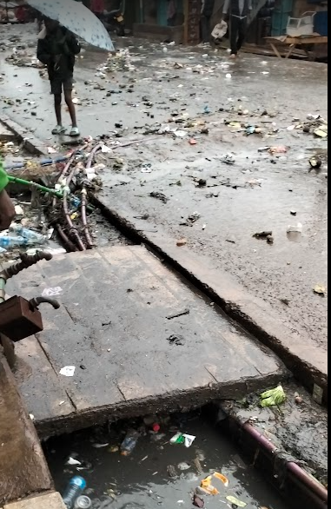
SECTION 01
Background / Introduction
03
Drinking contaminated water may result in waterborne infections and spread AMR
Waterborne diseases are common, accounting for 70% of epidemic-related emergencies in Kenya.
AMR deaths were 1.3M in 2019 and may be 10M in 2050.
WHO Global antibiotic resistance surveillance report 2025 indicate that 1 in 6 bacterial infection is caused by multidrug resistant pathogen especially in LMICs
AMR surveillance in Kenya neglects the environmental aspect
Informal water account for 98% of water consumed in Kibera informal settlements , however its quality is unknown
13TH IPNET KENYA CONFERENCE • 19–21 AUGUST 2026 • PRIDE INN PLAZA, NAIROBI
03

Slide 5
SECTION 02
04
Objectives / Research Question
Main objective
To determine the prevalence, pathotype distribution and anti microbial susceptibility profiles of E. coli isolated from informal water sources in Kibera.
Research questions
What is the prevalence of E. coli in informal water sources in Kibera informal settlements?
What is the antimicrobial susceptibility patterns of E. coli isolated from informal water sources in Kibera informal settlements?
Which pathotypes of E. coli are contaminating informal water sources in Kibera informal settlements
13TH IPNET KENYA CONFERENCE • 19–21 AUGUST 2026 • PRIDE INN PLAZA, NAIROBI
04

Slide 6
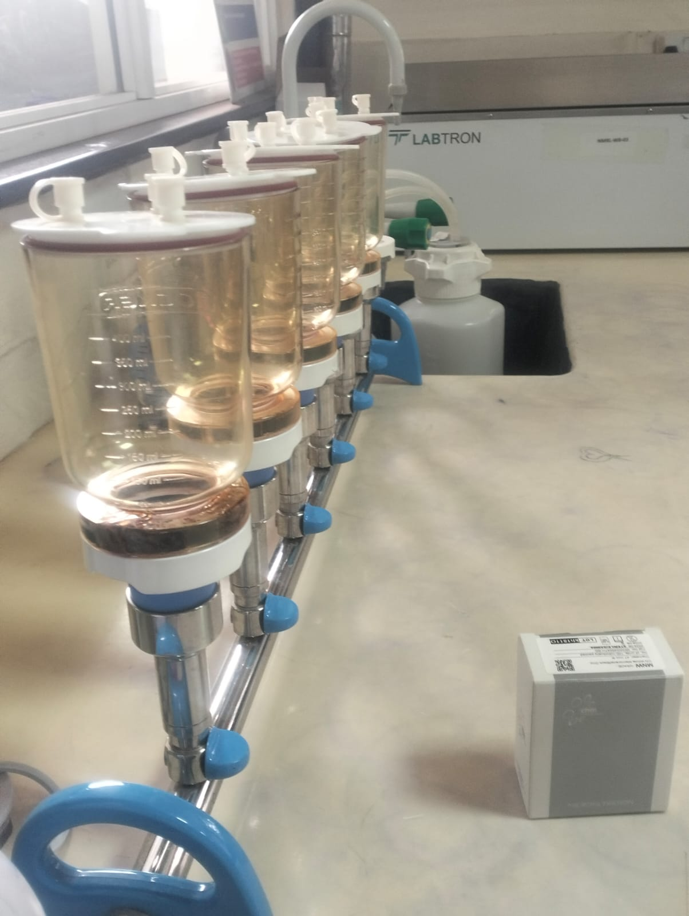
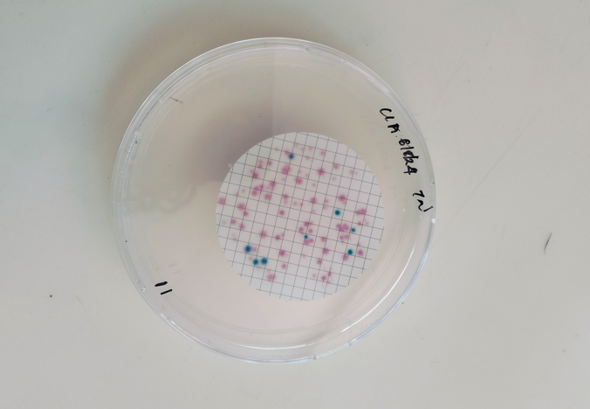
SECTION 03
Methodology
05
Cross-sectional study in Kibera informal settlements
72 water were purposefully sampled in July 2024 , 6 samples per village.
E. coli enumeration: membrane filtration
Confirmation of E. coli: biochemical tests, gram stain, TSI and SIM.
13TH IPNET KENYA CONFERENCE • 19–21 AUGUST 2026 • PRIDE INN PLAZA, NAIROBI
05

Slide 7
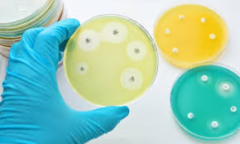
SECTION 03
Methodology
05
Antimicrobial Susceptibility Testing: disk Diffusion method using CLSI 2024.
Tested antibiotics:
  Ampicillin
  Trimethoprim-sulfamethoxazole
  Ciprofloxacin
  Ceftazidime
  Gentamicin
  Cefuroxime
  Cefepime
  Nalidixic acid
  Meropenem a
  Tetracycline
  Chloramphenicol
13TH IPNET KENYA CONFERENCE • 19–21 AUGUST 2026 • PRIDE INN PLAZA, NAIROBI
05

Slide 8
SECTION 03
Methodology
05
Molecular typing of E. coli:
DNA extraction by QIAamp DNA Mini kit
Real time multiplex PCR:
Data Analysis: Ms excel, WHONET (2024) and stata version 16
Pathotype
Enteropathogenic E. coli (EPEC),
Enteroaggregative E. coli (EAEC)
Enterohemorrhagic E. coli (EHEC)
Enteroinvasive E. coli (EIEC)
Enterotoxigenic E. coli (ETEC)
Diffusely Adherent E. coli (DAEC)
Target genes
eae (intimin)
aggR (aggregative adherence regulator)
stx1 and stx2 (Shiga toxins 1 and 2)
ipaH (invasion plasmid antigen H)
lt (heat-labile toxin) and st (heat-stable toxin)
daaE (Dr-binding adhesin family protein)
13TH IPNET KENYA CONFERENCE • 19–21 AUGUST 2026 • PRIDE INN PLAZA, NAIROBI
05

Slide 9
SECTION 04
Results / Key Findings
06
Description of informal water sources in Kibera informal settlements
Pollution sources
Pollution Sources | Exposed Samples | Percentage
Sewage | 36 | 50%
Public toilet | 4 | 6%
Dusty rooftop | 2 | 2%
None | 30 | 42%
13TH IPNET KENYA CONFERENCE • 19–21 AUGUST 2026 • PRIDE INN PLAZA, NAIROBI
06

Slide 10
SECTION 04
06
Results / Key Findings
Prevalence of E. coli
E. coli was detected in 21 out of 72 water samples (29.2%).
E. coli concentration ranged from 0 to 87 colony‑forming units (CFU) per 100 ml.
Overall mean was 4.5 CFU/100 ml.
Both the median and the mode were 0 CFU/100 ml
13TH IPNET KENYA CONFERENCE • 19–21 AUGUST 2026 • PRIDE INN PLAZA, NAIROBI
06

Slide 11
SECTION 04
06
Results / Key Findings
E. coli contamination by source, treatment and pollution source
13TH IPNET KENYA CONFERENCE • 19–21 AUGUST 2026 • PRIDE INN PLAZA, NAIROBI
06

Slide 12
SECTION 04
06
Results / Key Findings
Antimicrobial susceptibility profile of E. coli
Most effective antibiotics were:
gentamicin (95.2% sensitivity)
meropenem (93.7% sensitivity)
ciprofloxacin (85.7% sensitivity)
Highest resistance rates were observed in:
ampicillin (90.5%)
cefuroxime (76.2%)
cotrimoxazole (57.1%)
13TH IPNET KENYA CONFERENCE • 19–21 AUGUST 2026 • PRIDE INN PLAZA, NAIROBI
06

Slide 13
SECTION 04
06
Results / Key Findings
Pathotype | Detected target gene | Total
EAEC | aggR | 5 (24%)
EIEC | IpaH | 1(5%)
EPEC | Eae | 2(10%)
ETEC | lt/st | 3(14%)
ETEC/EAEC | lt/st/aggR | 3(14%)
EPEC/ETEC/EAEC | lt/st/aggR/eae | 1(5%)
EHEC | None | 0(0%)
DAEC | None | 0(0%)
Negative | None | 6(29%)
Four pathogenic E. coli pathotypes were identified:
  EAEC was the most frequent (24%)
  ETEC (14%)
  EPEC (10%)
  EIEC (5%)
  mixed types (19%)
Six samples were negative.
13TH IPNET KENYA CONFERENCE • 19–21 AUGUST 2026 • PRIDE INN PLAZA, NAIROBI
06

Slide 14
SECTION 05
07
Conclusion & Recommendations
Informal water sources in Kibera informal settlements were contaminated with E. coli at 29.2%.
Contamination was associated with acquisition of water through illegal means, inadequate treatment and pollution exposure as seen in other slums in Kenya
Contamination was strongly influenced by water source type, pollution exposure, and treatment methods.
E. coli contaminating these sources exhibited diverse antimicrobial resistance patterns, with high resistance to ampicillin and cefuroxime, while gentamicin and meropenem remained sensitive.
High levels of multidrug resistance (52.4%) and the emergence of carbapenem-resistant strains were also observed.
A significant proportion (71%) of the E. coli were pathogenic and belonged to diverse pathotypes
Informal water sources in Kibera harbor a substantial burden of multidrug-resistant and pathogenic E. coli, posing a significant public health risk,
13TH IPNET KENYA CONFERENCE • 19–21 AUGUST 2026 • PRIDE INN PLAZA, NAIROBI
07

Slide 15
THANK YOU
13th IPNET-Kenya Conference • 19–21 August 2026 • Pride Inn Plaza, Nairobi
www.ipnetkenya.org | info@ipnetkenya.org
08

