Slide 1



13TH ANNUAL CONFERENCE
Infection Prevention
Network – Kenya
Advancing Safe Care Through Infection Prevention & Control
CONFERENCE THEME
“Advancing IPC, AMR, and One Health:
Science, Policy, and Practice”
13TH IPNET KENYA CONFERENCE • 19–21 AUGUST 2026 • PRIDE INN PLAZA, NAIROBI
01

Slide 2

ABSTRACT INFORMATION
02
Abstract Details
TITLE OF ABSTRACT: Antimicrobial Susceptibility Profile of Escherichia coli Isolates Received in National Microbiology Reference Laboratories (NMRL) for Retesting Between 2022 And 2023
PRESENTER NAME: Teresia Nyaga¹ George Muchiri¹, Josiah Njeru¹, Susan Githii², Jedidah Kahura¹, Jennifer Njuhigu² Jully Okonji³ ¹NPHL/KNPHI ²NASIC ³APHL,
INSTITUTION / AFFILIATION: National Microbiology Reference Laboratory/ NPHL/KNPHI
COUNTY: Nairobi
COUNTRY: Kenya
13TH IPNET KENYA CONFERENCE • 19–21 AUGUST 2026 • PRIDE INN PLAZA, NAIROBI
02

Slide 3
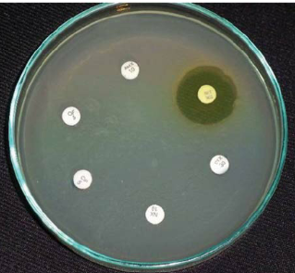
SECTION 01
03
Background / Introduction
Antimicrobial resistance (AMR) remains a major global health threat and is ranked among the top ten risks to human health.
One in every six bacteria infections is caused by an antibiotic resistant bacteria.
Impacts of resistance to antimicrobials include:
  Increased morbidity and mortality
  Increased healthcare costs
  Complicating treatment options
  Prolonged hospital stay
13TH IPNET KENYA CONFERENCE • 19–21 AUGUST 2026 • PRIDE INN PLAZA, NAIROBI
03

Slide 4
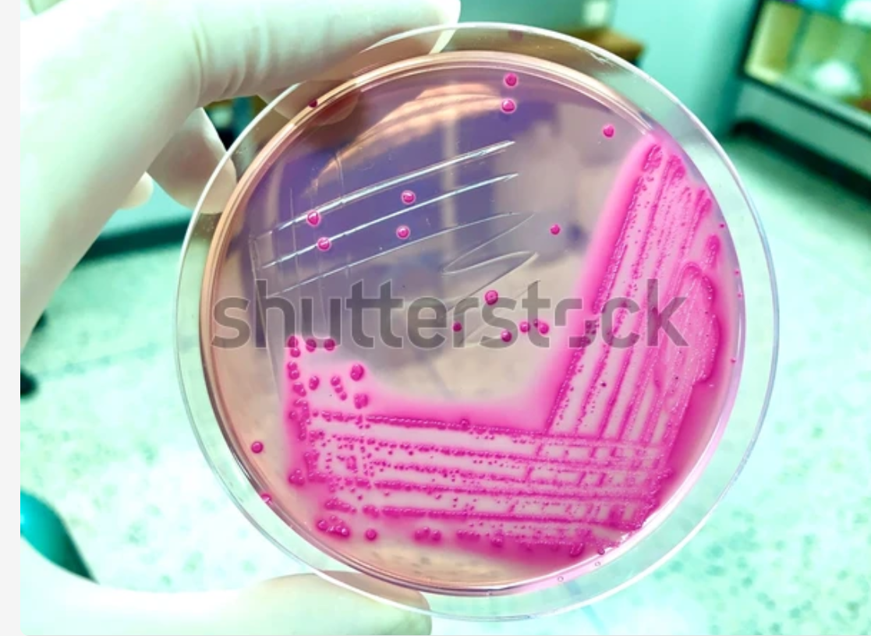
SECTION 02
04
Background / Introduction
E. coli is a priority AMR pathogens
It’s a key one health indicator organism
Cause community and hospital acquired infections
E. coli causes 250M infections and 65,000 deaths annually
Certain strains have developed
13TH IPNET KENYA CONFERENCE • 19–21 AUGUST 2026 • PRIDE INN PLAZA, NAIROBI
04

Slide 5

SECTION 03
05
Objectives / Research Question
To determine the antimicrobial susceptibility profile of Escherichia coli isolates received in National Microbiology Reference Laboratory for retesting between 2022 and 2023
13TH IPNET KENYA CONFERENCE • 19–21 AUGUST 2026 • PRIDE INN PLAZA, NAIROBI
05

Slide 6
SECTION 03
05
Methodology
Isolates received at NMRL.
Identification
using
MALDI TOF MS
Bacteria pathogenic at the site
AST using Vitek 2 Compact
Bacteria not pathogenic at the site
Biobanking
Sentinel sites
CLSI
Kenya AMR surveillance strategy
Data analysis
Ms Excel,WHONET
13TH IPNET KENYA CONFERENCE • 19–21 AUGUST 2026 • PRIDE INN PLAZA, NAIROBI
05

Slide 7
SECTION 04
06
Results / Key Findings
653 out of 1931 isolates
34 % E. coli isolates
12 AMR sites
Urine had the highest numbers
Tissues had the least number
13TH IPNET KENYA CONFERENCE • 19–21 AUGUST 2026 • PRIDE INN PLAZA, NAIROBI
06

Slide 8
SECTION 04
06
Results / Key Findings
Antimicrobial susceptibility profile of E. coli in percentage
13TH IPNET KENYA CONFERENCE • 19–21 AUGUST 2026 • PRIDE INN PLAZA, NAIROBI
06

Slide 9
SECTION 05
07
Conclusion & Recommendations
There alarming levels of antimicrobial resistance to commonly used antibiotics
A significant number (28%) of E.coli strains are MDR
There is urgent need for the following to combat AMR:
  Surveillance of AMR patterns
  Judicious antibiotic use
  Effective infection control measures
  Development of novel therapeutic strategies
  Molecular characterization of isolates( PCR and genomics)
13TH IPNET KENYA CONFERENCE • 19–21 AUGUST 2026 • PRIDE INN PLAZA, NAIROBI
07

Slide 10
THANK YOU
13th IPNET-Kenya Conference • 19–21 August 2026 • Pride Inn Plaza, Nairobi
www.ipnetkenya.org | info@ipnetkenya.org
08

