Slide 1



13TH ANNUAL CONFERENCE
Infection Prevention
Network – Kenya
Advancing Safe Care Through Infection Prevention & Control
CONFERENCE THEME
“Advancing IPC, AMR, and One Health:
Science, Policy, and Practice”
13TH IPNET KENYA CONFERENCE • 19–21 AUGUST 2026 • PRIDE INN PLAZA, NAIROBI
01

Slide 2

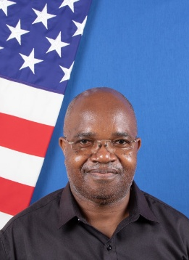



Panel Discussion
02
Panel Discussion
MODERATOR
PANELIST
PANELIST
PANELIST
Linus Ndegwa
US CDC-Kenya, Health Quality Promotion Lead
Jacqueline Safstrom, MPH
US CDC-HQ,
International Infection Control Branch,
Epidemiologist
Selamawit Gebreegziabher
US CDC-Ethiopia,
Public Health Specialist, IPC
Joseph Muendo
ICAP-Kenya,
DARE AMR Project Lead
13TH IPNET KENYA CONFERENCE • 19–21 AUGUST 2026 • PRIDE INN PLAZA, NAIROBI
02
Notes:
Linus:
Dr. Linus Ndegwa is a Senior Healthcare Epidemiologist, at US CDC, Kenya office specialized in IIPC and AMR. A clinician with over 30 years of experience. Founder member of Infection Prevention Network Kenya (IPNET-K) and former board member of ICAN, IFIC and served as a member of external affairs, Society of Healthcare Epidemiology of America (SHEA). A member of APUA and One Health Trust Africa Boards.
Has led responses to major public health emergencies, including COVID-19 and Sudan Ebola Virus Disease outbreaks, and has received numerous international awards for innovation and leadership in healthcare epidemiology, including 1st International SHEA ambassador award (2009). He has published over 50 articles in peer reviewed journals and book chapters.
Jackie:
Jacqueline Safstrom is an Epidemiologist with the International Infection Control Branch in the Division of Healthcare Quality Promotion (DHQP) at the Centers for Disease Control and Prevention (CDC). Over the past six years at CDC, her work has focused on providing technical expertise in infection prevention and control (IPC), water, sanitation, and hygiene (WASH), and antimicrobial use and resistance. She collaborates with partners to strengthen countries’ capacity to deliver safe healthcare, support rapid responses to healthcare-associated and infectious disease outbreaks, and advance innovative solutions in resource-limited settings. Her current portfolio spans countries across Africa and South America, with previous experience supporting public health programs in the Middle East and Central/South Asia, as well as STD/HIV prevention work in the United States.
Selamawit:
Selamawit Gebreegziabher is a public health professional with 15 years in national and refugee emergency health program. She is a Public Health Specialist - Infection Prevention and Control in US-CDC Ethiopia. Her prior roles include positions at the WHO, Refugee and Returnee Service, and Debre Markos University, with technical expertise in IPC, AMR surveillance, PH, SRH, and TB/HIV. She is a member of National Incident management system for PH emergency operating center and national IPC task force.
Joseph:
Dr. Joseph Muendo leads the Detection and Response to antimicrobial resistance (DARE AMR) project at ICAP in Kenya. He is a medical doctor with a postgraduate degree in infectious diseases. His work focuses on AMR mitigation through antimicrobial stewardship, infection prevention and control, and healthcare-associated infection surveillance.

Slide 3






SECTION 01
03
The Global Action In Healthcare Network (GAIHN):
A collaborative global RAPID ACTION network coordinated by CDC
Network Mission
The Global Action in Healthcare Network-Healthcare Associated Infections Module (GAIHN-HAI) is a global collaborative of healthcare facility networks with the mission to support infection prevention and control (IPC) for the protection of patients and healthcare workers through the development and implementation of validated approaches for the systematic collection, analysis, interpretation, and use of health-related data that are feasible across a broad range of healthcare facility capacities.
13TH IPNET KENYA CONFERENCE • 19–21 AUGUST 2026 • PRIDE INN PLAZA, NAIROBI
03
Notes:
I'll now take you through a specific initiative under our umbrella—the Global Action in Healthcare Network, or GAIHN, focusing particularly on our Healthcare-Associated Infections Module, GAIHN-HAI. This global collaborative is dedicated to enhancing infection prevention and control to protect patients and healthcare workers. We do this by developing and deploying validated methodologies for systematic data handling that are adaptable across diverse healthcare settings. Our mission is to ensure these practices are feasible and effective, regardless of facility resources, thereby bolstering global health security and improving outcomes worldwide.

Slide 4
SECTION 01
03
GAIHN-HAI Network Goals
Develop Accessible Surveillance Tools - Create and validate HAI surveillance methods and tools that are feasible in resource-limited settings and adaptable for diverse patient populations, ensuring equitable access.
Build Sustainable Detection Frameworks - Establish frameworks to sustainably detect and characterize emerging pathogens and infections among inpatients and healthcare workers.
Implement Evidence-Based Strategies - Drive the implementation of targeted, evidence-based strategies to prevent HAIs.
Enhance Data Utilization - Improve the capacity of healthcare facilities globally to collect and use actionable HAI surveillance data effectively.
Reduce HAI Rates - Decrease the prevalence and incidence of HAIs across participating healthcare facilities.
13TH IPNET KENYA CONFERENCE • 19–21 AUGUST 2026 • PRIDE INN PLAZA, NAIROBI
03
Notes:
The goals of the GAIHN network directly support and enhance global HAI surveillance, with a special focus on low-resource settings:
First, we prioritize developing accessible surveillance tools. Tailored to be practical and widely applicable, these methods ensure that all network members, regardless of resource levels, can enhance their surveillance capabilities. This makes our approach universally adaptable.
Second, by building sustainable detection frameworks, we boost the ability of network members to effectively monitor and characterize emerging pathogens in real-time. This capability is crucial for maintaining dynamic and responsive surveillance systems.
Third, enhancing data utilization supports our partners in collecting and leveraging actionable surveillance data. This improvement is vital for informed decision-making and effective management of HAIs.
Finally, our ultimate aim to reduce HAI rates underscores the effectiveness of these practices. By applying robust surveillance data, we help decrease infection prevalence and improve health outcomes across participating facilities.
Each goal is designed to boost the surveillance capacities of network participants, ensuring that together, we can achieve safer healthcare environments globally.

Slide 5
SECTION 02
04
Objectives / Research Question
GAIHN-HAI recognizes 6 foundational steps of HAI surveillance and provides resources and support at each of these steps:
13TH IPNET KENYA CONFERENCE • 19–21 AUGUST 2026 • PRIDE INN PLAZA, NAIROBI
04
Notes:
On this slide, we outline the six foundational steps of HAI monitoring that the GAIHN-HAI network recognizes and actively supports, tailored to the constraints of limited resource settings:
Planning: Tailored planning that accommodates the unique needs of diverse healthcare settings.
Data Collection: Systematic collection using standardized tools, designed to be practical across various environments.
Data Management: Ensuring data integrity and security, even in resource-limited contexts.
Data Analysis: Analyzing data to identify trends and issues, with methods feasible for all facility types.
Interpretation / Visualization: Turning complex data into clear, actionable insights, suitable for facilities with varying capabilities.
Action Response: Implementing data-driven interventions that are realistic and effective in enhancing safety.
These steps are visually represented in a sequential arrow graphic, illustrating how the network is working to develop and deploy tools across each step of the surveillance process, ensuring effective monitoring and intervention.

Slide 6
SECTION 02
04
Objectives / Research Question
Protocol
Canvas trainings (videos and PowerPoints)
Preparation checklists
REDCap
Progressive WebApp
REDCap
Progressive WebApp
SOPs
R Studio
R Shiny
Webapp reporting module
HTML outputs
Presentation templates
Report templates
Quality improvement resources
13TH IPNET KENYA CONFERENCE • 19–21 AUGUST 2026 • PRIDE INN PLAZA, NAIROBI
04

Slide 7

SECTION 03
05
GAIHN HAI Point Prevalence Survey (PPS)
Describe and monitor HAIs for burden estimation and targeting of infection prevention and quality improvement
Describe antimicrobial use, the prevalence of invasive devices, and the microbiology of infections
Describe key structures and processes for the prevention of HAIs at the health facility and ward levels to provide context for results interpretation
13TH IPNET KENYA CONFERENCE • 19–21 AUGUST 2026 • PRIDE INN PLAZA, NAIROBI
05

Slide 8
SECTION 04
06
Methodology
4 most common HAI in LMIC health facilities:
  Pneumonia, UTI, BSI, SSI
Algorithmic case determination
  Parsimonious data collection of objective definitional elements
  Case status is determined based on the global HAI surveillance case definitions
Tiered case definitions allow applicability at various capacity levels
Ancillary data provides information with relevance for IPC and diagnostic stewardship
  Proportion of patients on antibiotics without diagnostic testing
  Ward volume, length of stay, invasive device utilization
13TH IPNET KENYA CONFERENCE • 19–21 AUGUST 2026 • PRIDE INN PLAZA, NAIROBI
06

Slide 9
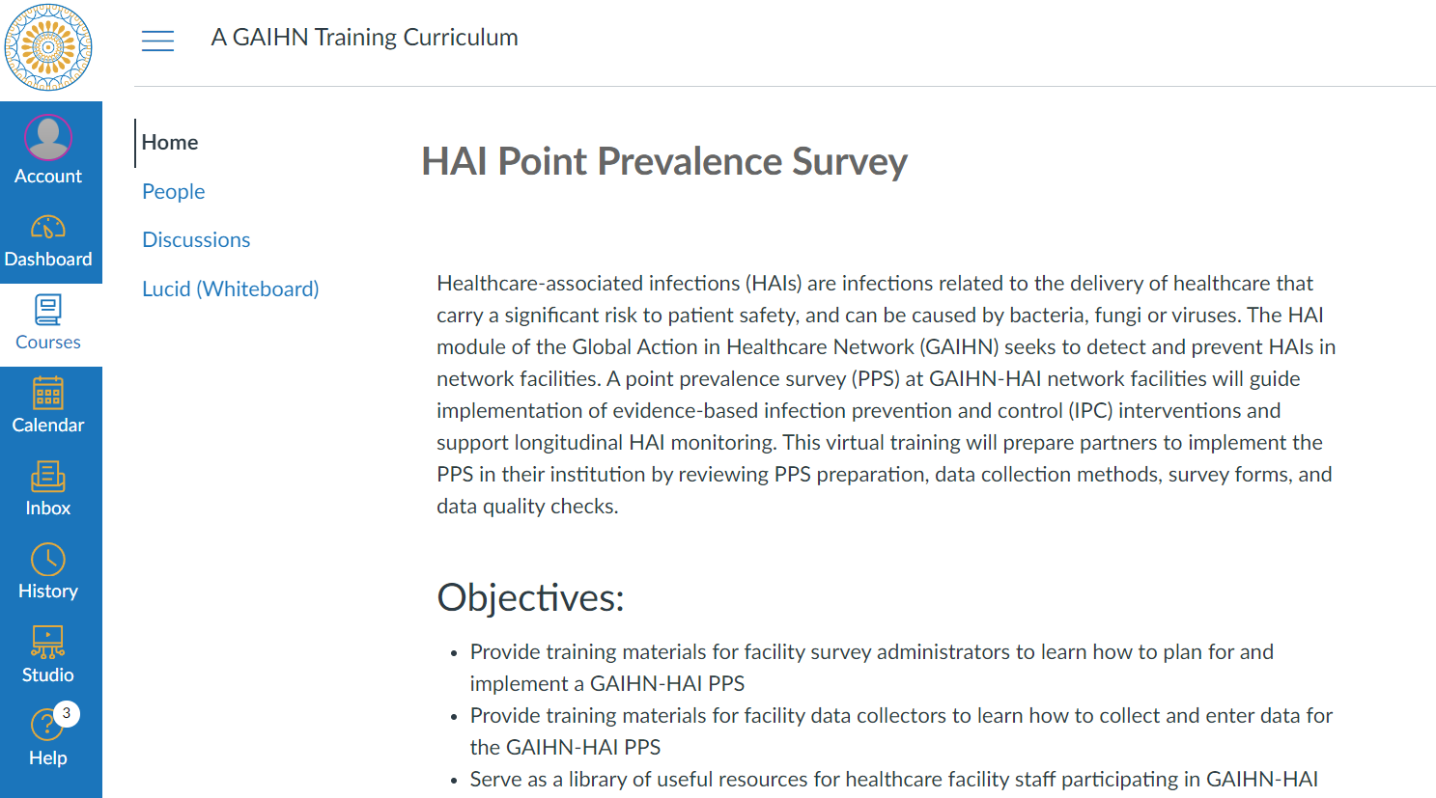
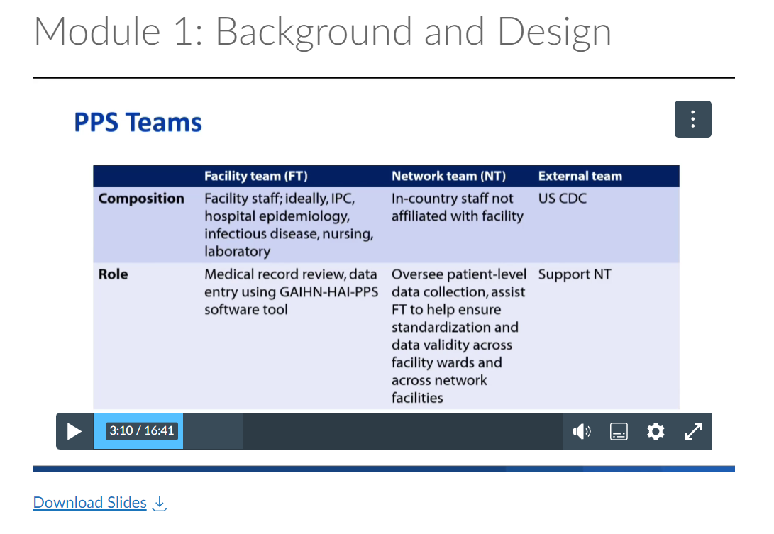
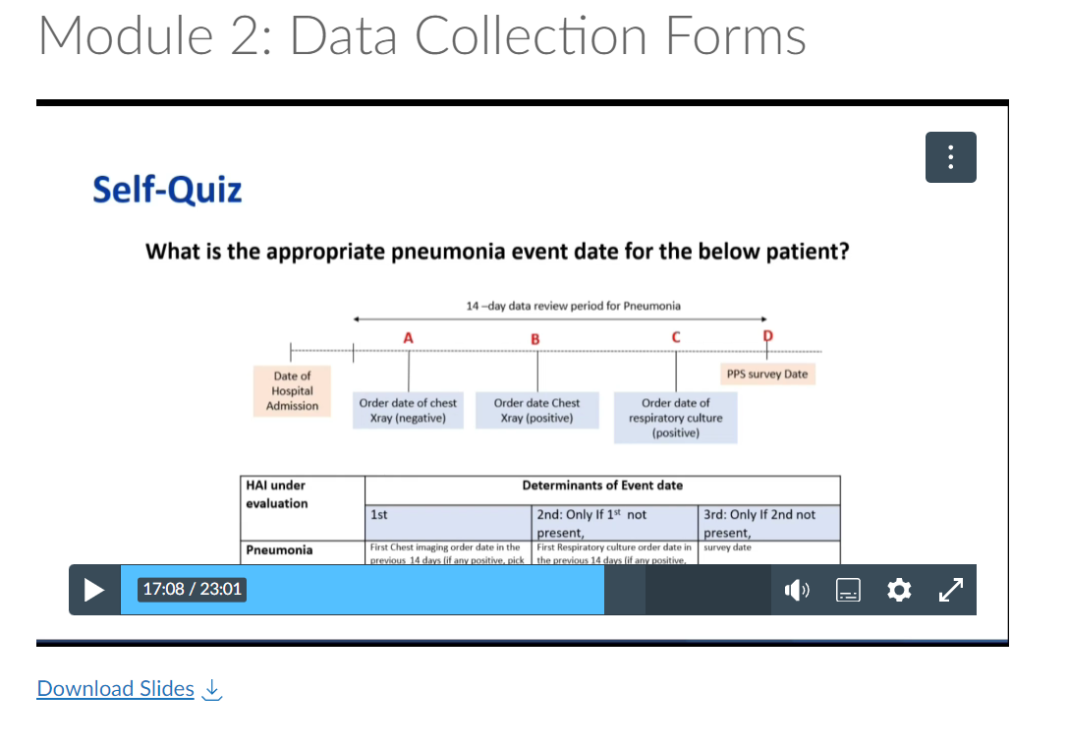
SECTION 04
06
Training platform
Training curriculum hosted on HSP canvas instance for:
  Data collectors
  Survey administrators
Six video modules
Self-quizzes
Additional documents
  FAQ
  SOPs
  Data quality checklists
  Mock cases
13TH IPNET KENYA CONFERENCE • 19–21 AUGUST 2026 • PRIDE INN PLAZA, NAIROBI
06

Slide 10
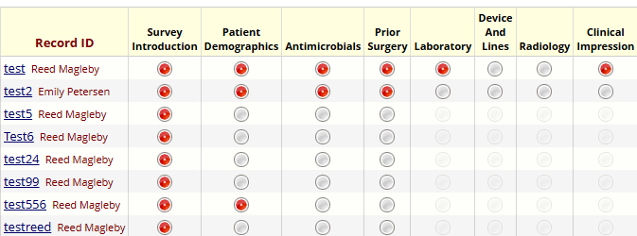
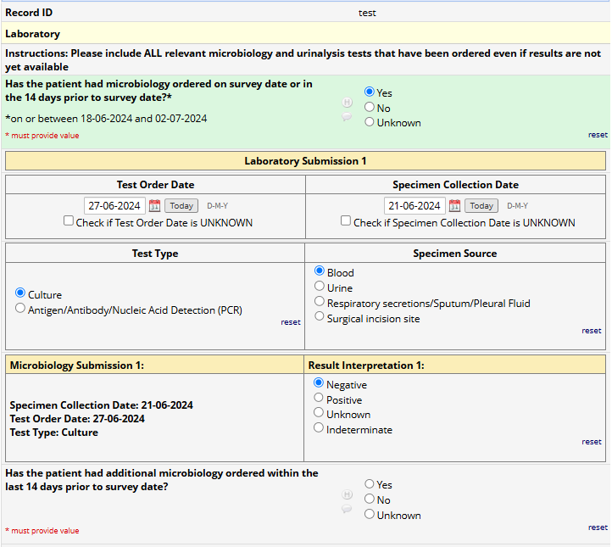
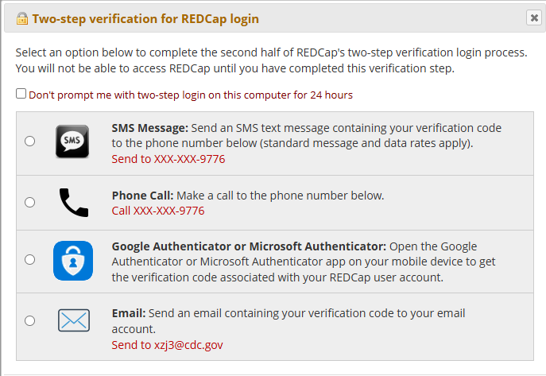
SECTION 04
06
Data Collection: REDCap
13TH IPNET KENYA CONFERENCE • 19–21 AUGUST 2026 • PRIDE INN PLAZA, NAIROBI
06

Slide 11
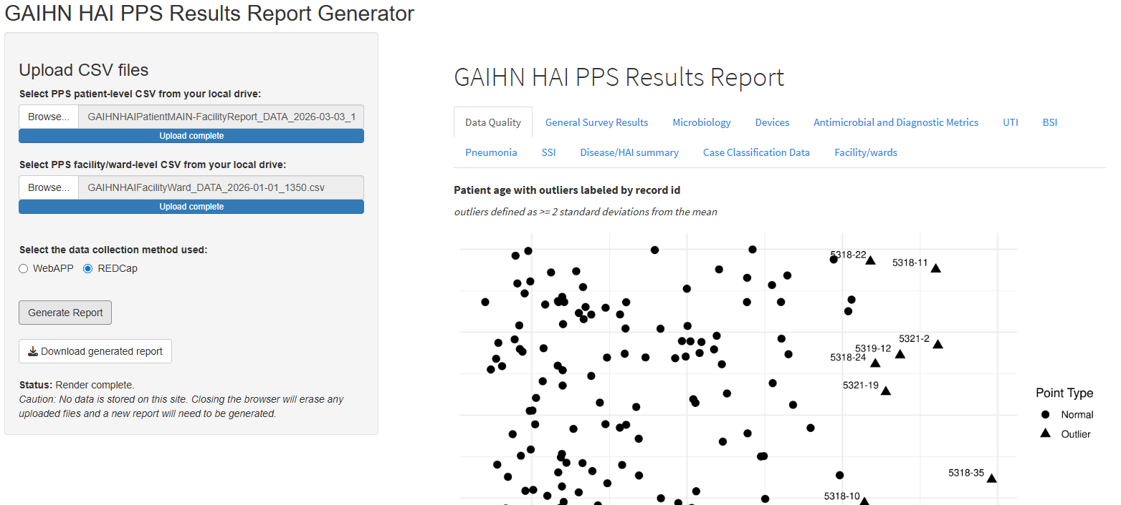
SECTION 04
06
Data Analysis: Report Generation via R or R shiny
13TH IPNET KENYA CONFERENCE • 19–21 AUGUST 2026 • PRIDE INN PLAZA, NAIROBI
06

Slide 12
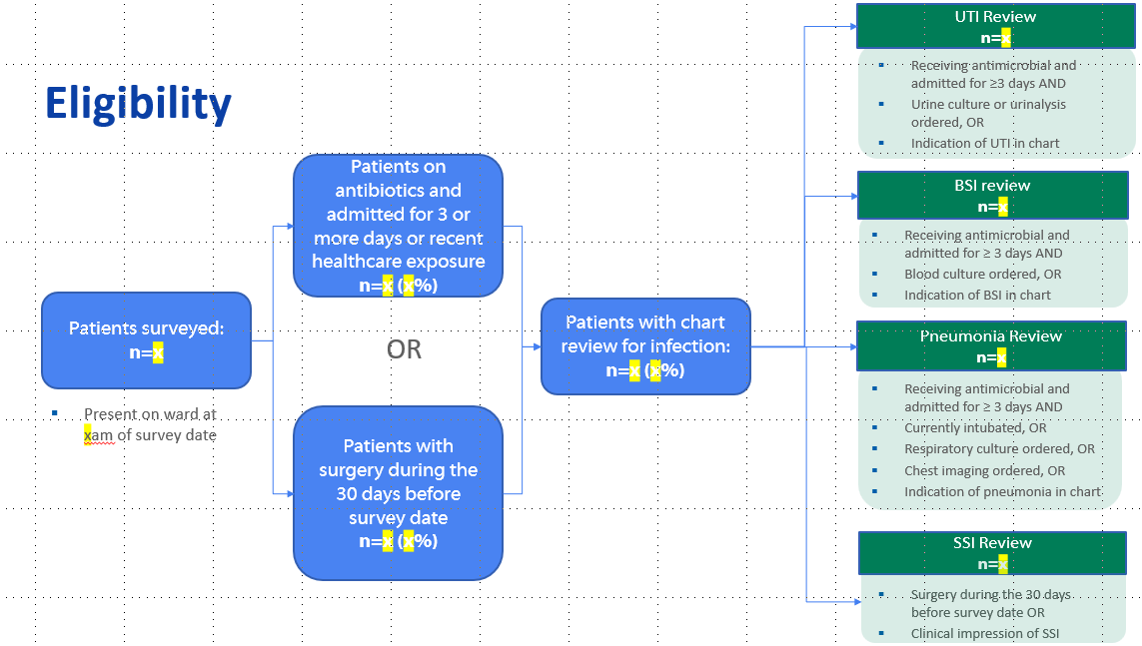
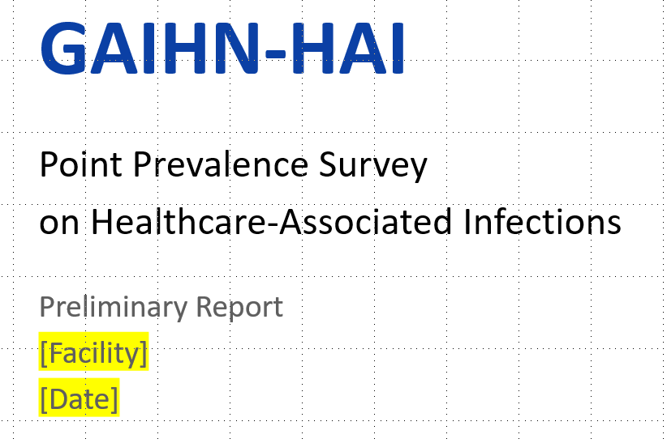
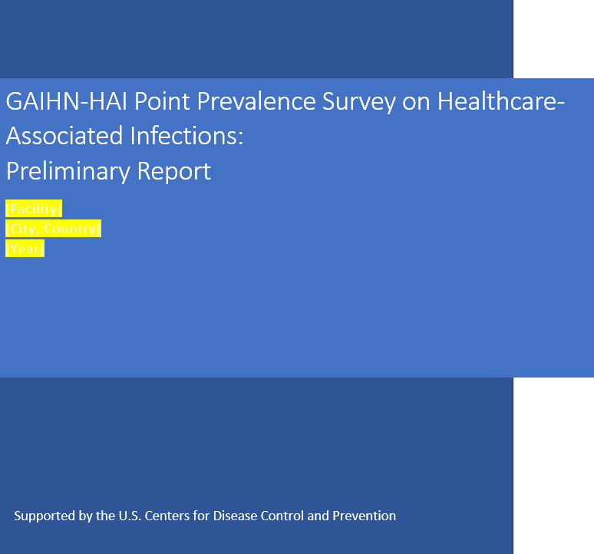
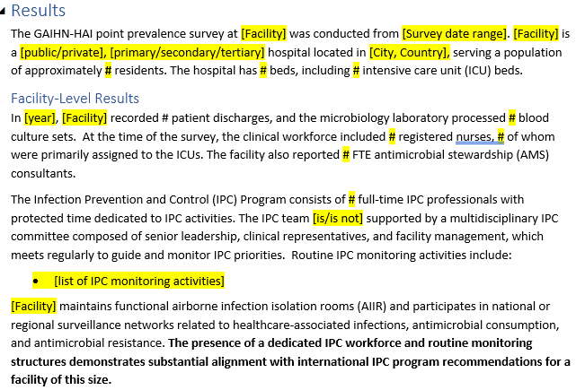
SECTION 04
06
Reporting: Templates
Presentation template for findings
Report and appendix template for findings
13TH IPNET KENYA CONFERENCE • 19–21 AUGUST 2026 • PRIDE INN PLAZA, NAIROBI
06

Slide 13
SECTION 05
07
Panel Questions
Could you provide an overview of your experiences implementing HAI point prevalence surveys in your countries?
How has the experience been different using GAIHN-HAI methodology versus the previous HAI PPS implementation process?
Overall, how valuable was the PPS to the facilities? What did you find to be most valuable?
Among measurements of antimicrobial and diagnostic test use, device use, and HAI burden estimate, which outputs of the PPS did you find to be most valuable?
What were some challenges you faced in the implementation of the PPS? What were some of the solutions that were implemented?
What are your thoughts or suggestions on how findings from PPS can be used to inform IPC improvement at healthcare facilities?
What recommendations do you have for other facilities that may be interested in implementing GAIHN-HAI?
13TH IPNET KENYA CONFERENCE • 19–21 AUGUST 2026 • PRIDE INN PLAZA, NAIROBI
07

Slide 14
THANK YOU
13th IPNET-Kenya Conference • 19–21 August 2026 • Pride Inn Plaza, Nairobi
www.ipnetkenya.org | info@ipnetkenya.org
08

Slide 15
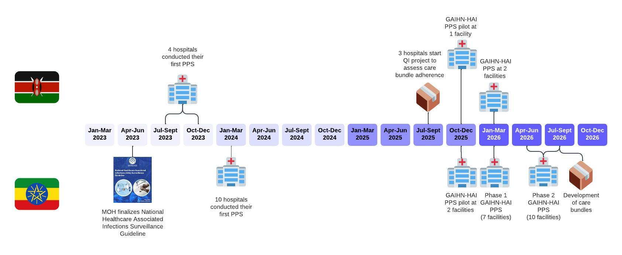
Timeline of implementation

