Slide 1



13TH ANNUAL CONFERENCE
Infection Prevention
Network – Kenya
Advancing Safe Care Through Infection Prevention & Control
CONFERENCE THEME
“Advancing IPC, AMR, and One Health:
Science, Policy, and Practice”
13TH IPNET KENYA CONFERENCE • 19–21 AUGUST 2026 • PRIDE INN PLAZA, NAIROBI
01

Slide 2

ABSTRACT INFORMATION
01
Abstract Details
TITLE OF ABSTRACT: Applying the WHO Hierarchy of Controls to Strengthen Infection Prevention and Occupational Safety at Valley Hospital
PRESENTER NAME: BONFACE THURANIRA DOUGLAS
INSTITUTION / AFFILIATION: VALLEY HOSPITAL
COUNTY: NAKURU
COUNTRY: KENYA
13TH IPNET KENYA CONFERENCE • 19–21 AUGUST 2026 • PRIDE INN PLAZA, NAIROBI
02

Slide 3
BACKGROUND
02
Introduction
Infection Prevention and Control (IPC) is a critical component of patient and healthcare worker safety.
Traditionally, IPC programs rely heavily on administrative controls and PPE, which are susceptible to variability in compliance and human factors.
The WHO hierarchy of controls provides a structured framework for prioritizing higher-level, more effective interventions — particularly substitution and engineering controls.
Valley Hospital adopted the WHO hierarchy of controls to embed system-level change into routine clinical workflows.
13TH IPNET KENYA CONFERENCE • 19–21 AUGUST 2026 • PRIDE INN PLAZA, NAIROBI

Slide 4
THE CASE FOR CHANGE
03
Problem Statement
At Valley Hospital, several routine clinical practices posed preventable infection and occupational exposure risks:
Razor blades
Iodine-based antiseptics
Conventional cannulas
Repeated venipuncture
Preoperative hair removal
Skin preparation
Exposed needles
Cannulation & phlebotomy
IPC practices largely depended on administrative controls and PPE, with limited application of higher-level controls.
13TH IPNET KENYA CONFERENCE • 19–21 AUGUST 2026 • PRIDE INN PLAZA, NAIROBI

Slide 5
BASELINE FINDINGS
04
Identifying Opportunities for Safer Care
HAZARD | RISK
Razor blades | Skin trauma during preoperative preparation
Conventional cannulas | Cannula-related needlestick injuries
Difficult vascular access | Multiple attempts, patient discomfort and higher costs
Traditional antisepsis | Opportunity to align with evidence-based practice
Risk
13TH IPNET KENYA CONFERENCE • 19–21 AUGUST 2026 • PRIDE INN PLAZA, NAIROBI

Slide 6
BASELINE FINDINGS
05
Healthcare Worker Safety — Before Intervention
BASELINE TOTAL
14 NSIs
3 cannula-related
Combines 2024 (12 months) and Jan–Jul 2025 (7 months) — 19 months of pre-intervention data.
13TH IPNET KENYA CONFERENCE • 19–21 AUGUST 2026 • PRIDE INN PLAZA, NAIROBI

Slide 7
BASELINE FINDINGS
06
Patient Safety & Efficiency — Before Intervention
EXTERNAL-ASSISTED CANNULATIONS
PATIENT COSTS
63
KSh 189,000
Jan – Jul 2025
Jan – Jul 2025
BEFORE VEIN-FINDING DEVICES
Repeated venipuncture attempts were common for difficult venous access.
Each failed attempt meant more consumables, more time, and greater patient discomfort — plus higher costs from external assistance.
13TH IPNET KENYA CONFERENCE • 19–21 AUGUST 2026 • PRIDE INN PLAZA, NAIROBI

Slide 8
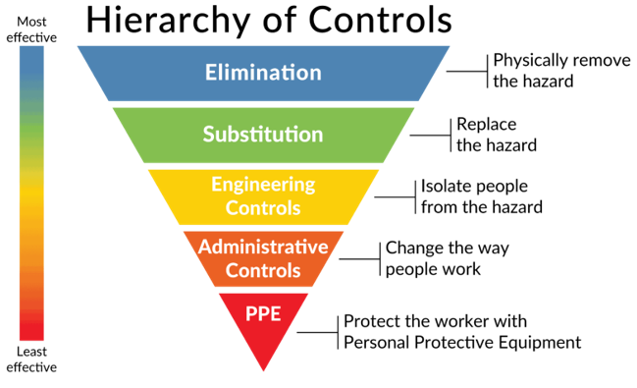
GUIDING FRAMEWORK
07
The WHO Hierarchy of Controls
A framework used to prioritize workplace hazard control measures from most to least effective, protecting workers by reducing or eliminating exposure to hazards.
PROJECT FOCUS
This project focused on Substitution and Engineering Controls to achieve proactive, sustainable risk reduction — the two most effective levels that don't depend on individual behaviour.
Engineering Control
Higher-level controls reduce reliance on perfect human behaviour by redesigning the system itself.
13TH IPNET KENYA CONFERENCE • 19–21 AUGUST 2026 • PRIDE INN PLAZA, NAIROBI

Slide 9
PURPOSE
08
Aim & Objectives
AIM
To strengthen patient and healthcare worker safety by applying substitution and engineering controls in line with the WHO hierarchy of controls.
OBJECTIVES
1
Reduce infection and exposure risks associated with invasive procedures
2
Transition from lower-level IPC controls to substitution and engineering controls
3
Standardize safer clinical practices across departments
4
Improve staff confidence and consistency in performing invasive procedures
13TH IPNET KENYA CONFERENCE • 19–21 AUGUST 2026 • PRIDE INN PLAZA, NAIROBI

Slide 10
STUDY DESIGN
09
Methods
STUDY DESIGN
Hazards
Identified
→
Baseline
Assessment
→
Leadership
Engagement
→
Procurement
Quality Improvement Initiative
Staff
Training
→
Implementation
→
Monitoring
→
Evaluation
FRAMEWORK
WHO Hierarchy of Controls
Indicator
Baseline
Post-Intervention
DATA SOURCES
IPC audit reports · NSI reporting forms · Cannulation records · Billing records · Clinical observations
Needlestick injuries
2024 – Jul 2025
Aug 2025 – Jul 2026
Vein finder
Jan – Jul 2025
Aug 2025 – Feb 2026
Clippers & chlorhexidine
Baseline practice
Ongoing monitoring
Baseline data were drawn from routine hospital surveillance; the same indicators were compared descriptively pre- and post-intervention.
13TH IPNET KENYA CONFERENCE • 19–21 AUGUST 2026 • PRIDE INN PLAZA, NAIROBI

Slide 11
INDICATORS
10
How Did We Measure Success?
Process Indicators
Outcome Indicators
Balancing Indicators
Adoption of electric clippers
Total needlestick injuries
Staff acceptance
Adoption of chlorhexidine-alcohol
Cannula-related needlestick injuries
Device availability
Safety cannula use
External-assisted cannulations
Supply continuity
Vein finder use
Patient costs
Staff competency
Staff sensitization
Practice adherence
Procedure delays
Improvement was evaluated using process, outcome, and balancing measures.
13TH IPNET KENYA CONFERENCE • 19–21 AUGUST 2026 • PRIDE INN PLAZA, NAIROBI

Slide 12
Why the Interventions?
13TH IPNET KENYA CONFERENCE • 19–21 AUGUST 2026 • PRIDE INN PLAZA, NAIROBI

Slide 13
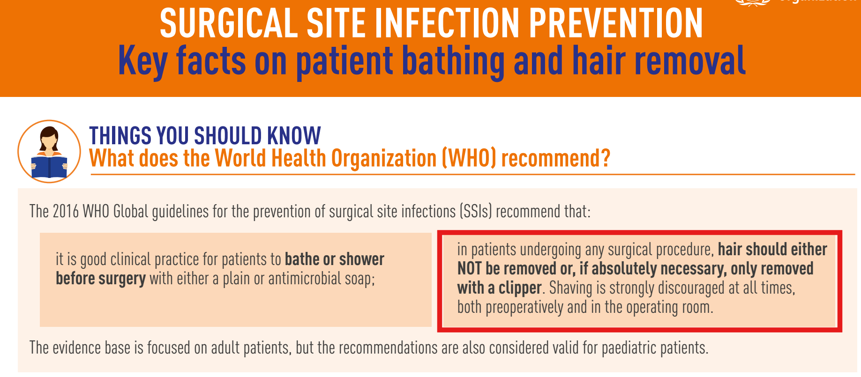
Razor Blades to Electric Clippers
WHY THE INTERVENTIONS?
13
13TH IPNET KENYA CONFERENCE • 19–21 AUGUST 2026 • PRIDE INN PLAZA, NAIROBI

Slide 14
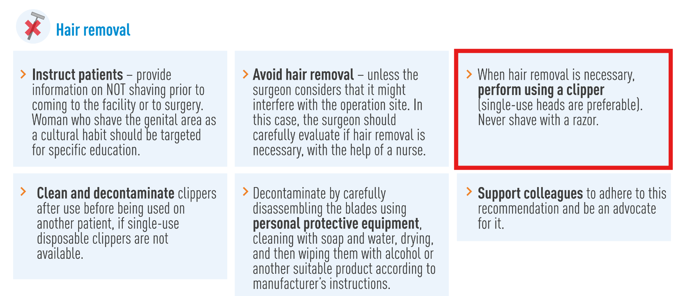
WHY THE INTERVENTIONS?
Razor Blades to Electric Clippers
13
13TH IPNET KENYA CONFERENCE • 19–21 AUGUST 2026 • PRIDE INN PLAZA, NAIROBI

Slide 15
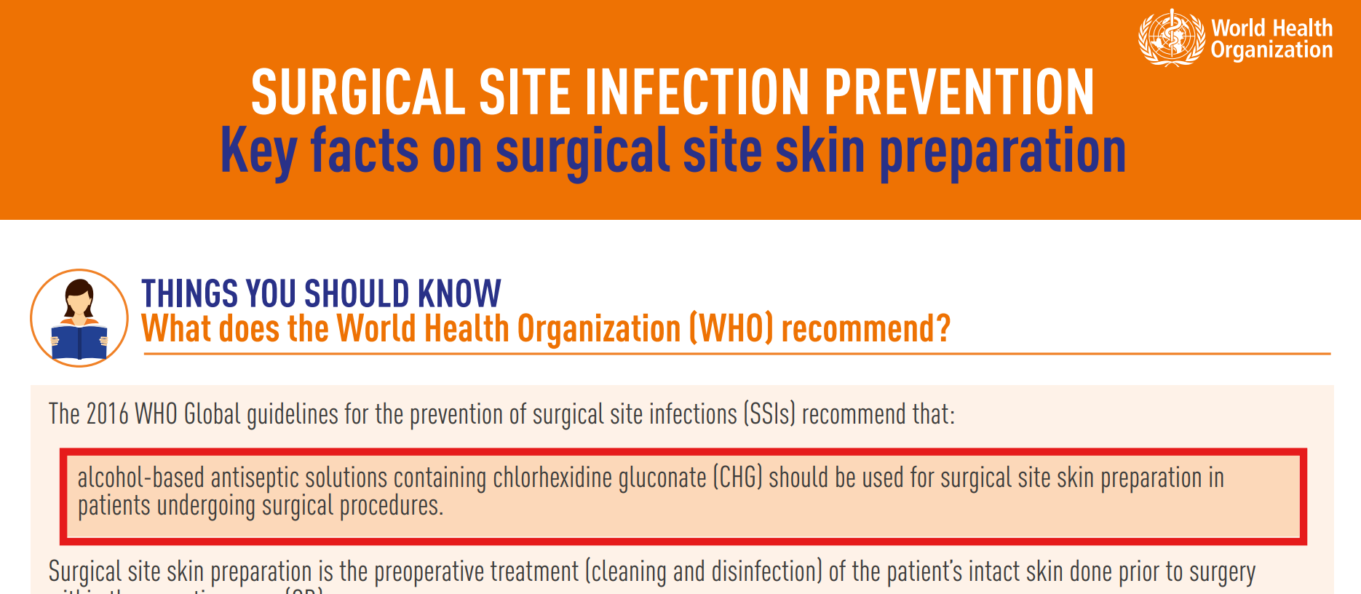
WHY THE INTERVENTIONS?
Iodine/Povidone to 2% Chlorhexidine – 70% Isopropyl Alcohol
14
13TH IPNET KENYA CONFERENCE • 19–21 AUGUST 2026 • PRIDE INN PLAZA, NAIROBI

Slide 16
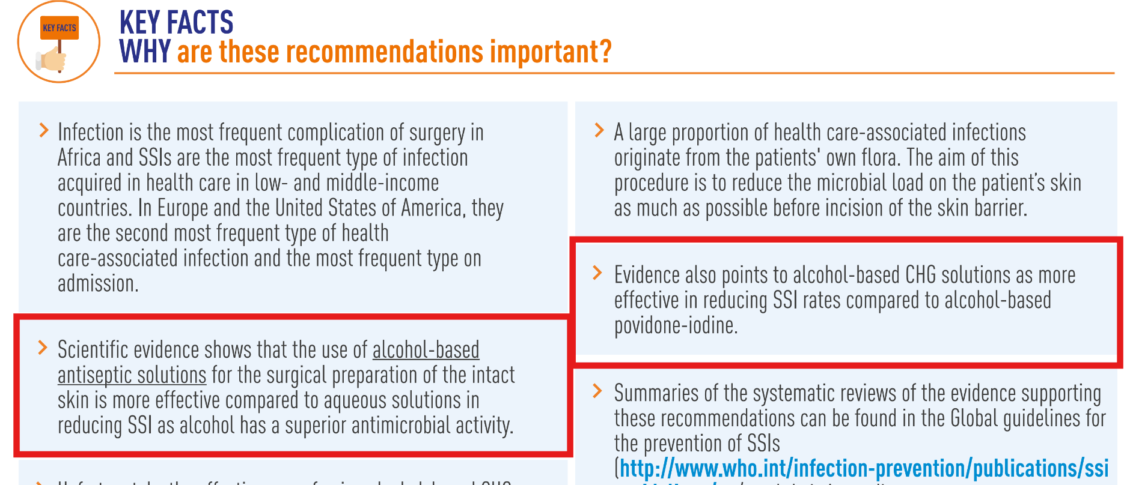
WHY THE INTERVENTIONS?
15
Iodine/Povidone to 2% Chlorhexidine – 70% Isopropyl Alcohol
13TH IPNET KENYA CONFERENCE • 19–21 AUGUST 2026 • PRIDE INN PLAZA, NAIROBI

Slide 17

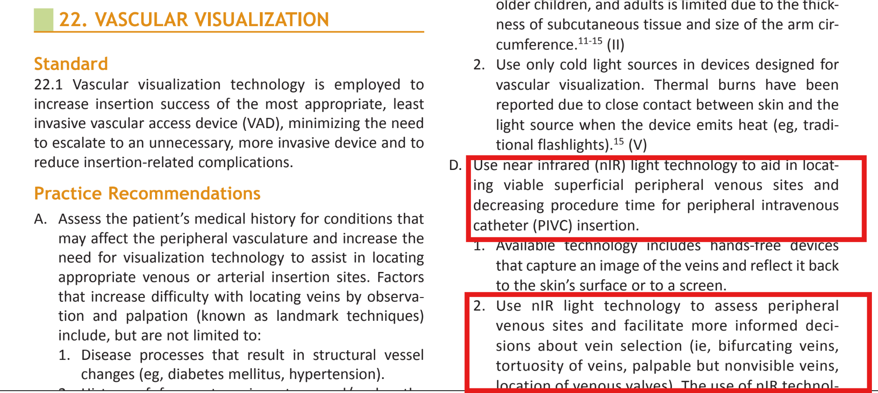
Vein Finders
16
13TH IPNET KENYA CONFERENCE • 19–21 AUGUST 2026 • PRIDE INN PLAZA, NAIROBI

Slide 18
Project Implementation
13TH IPNET KENYA CONFERENCE • 19–21 AUGUST 2026 • PRIDE INN PLAZA, NAIROBI

Slide 19
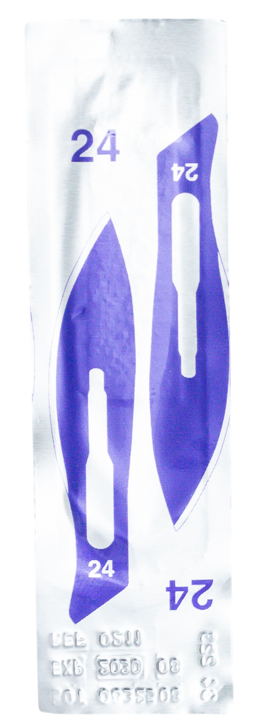
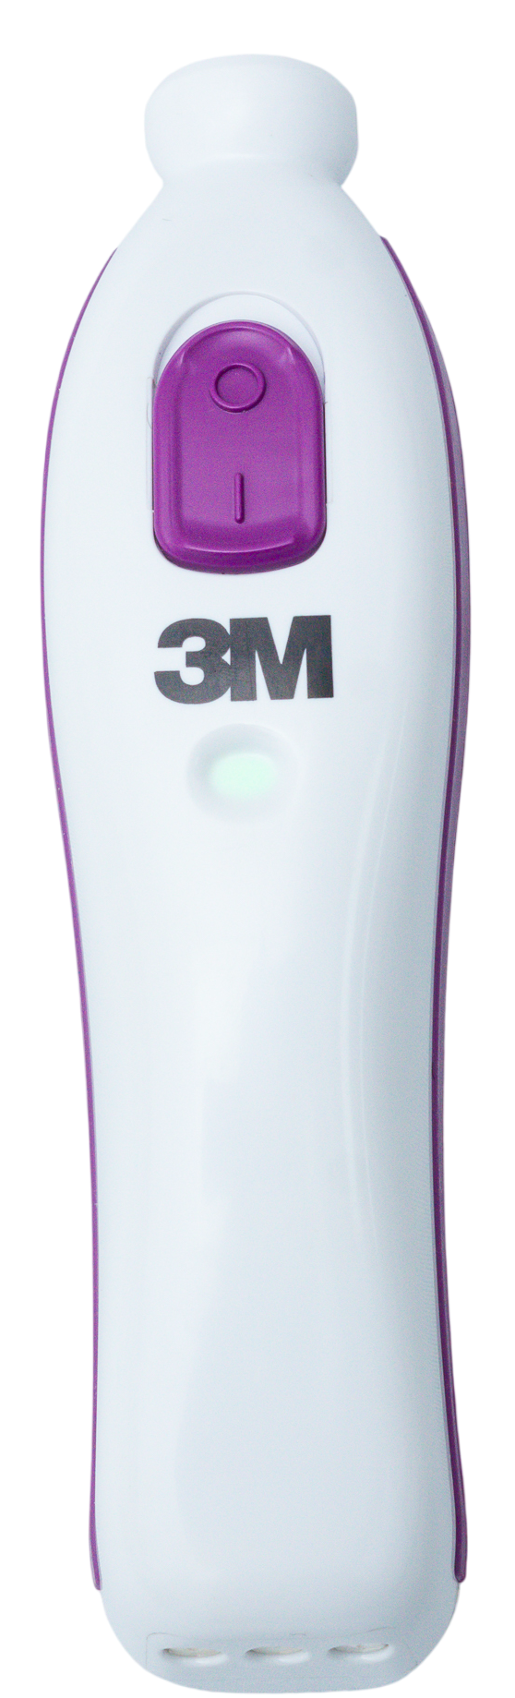
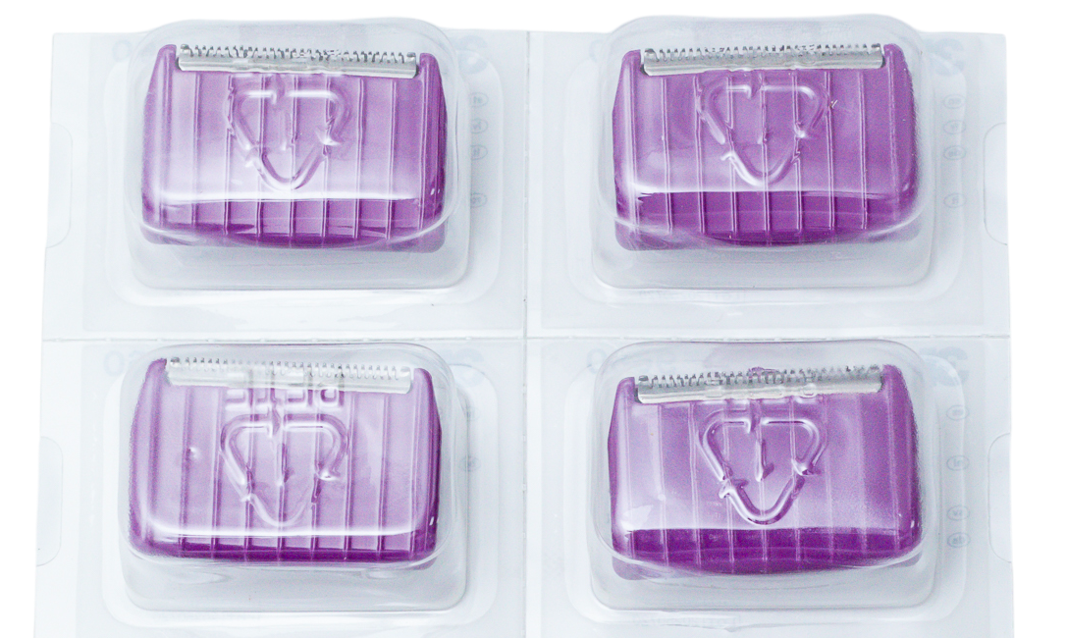
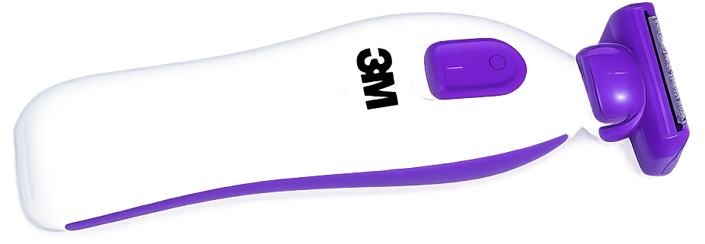
PROJECT IMPLEMENTATION
Single-use clipper heads
13TH IPNET KENYA CONFERENCE • 19–21 AUGUST 2026 • PRIDE INN PLAZA, NAIROBI​

Slide 20
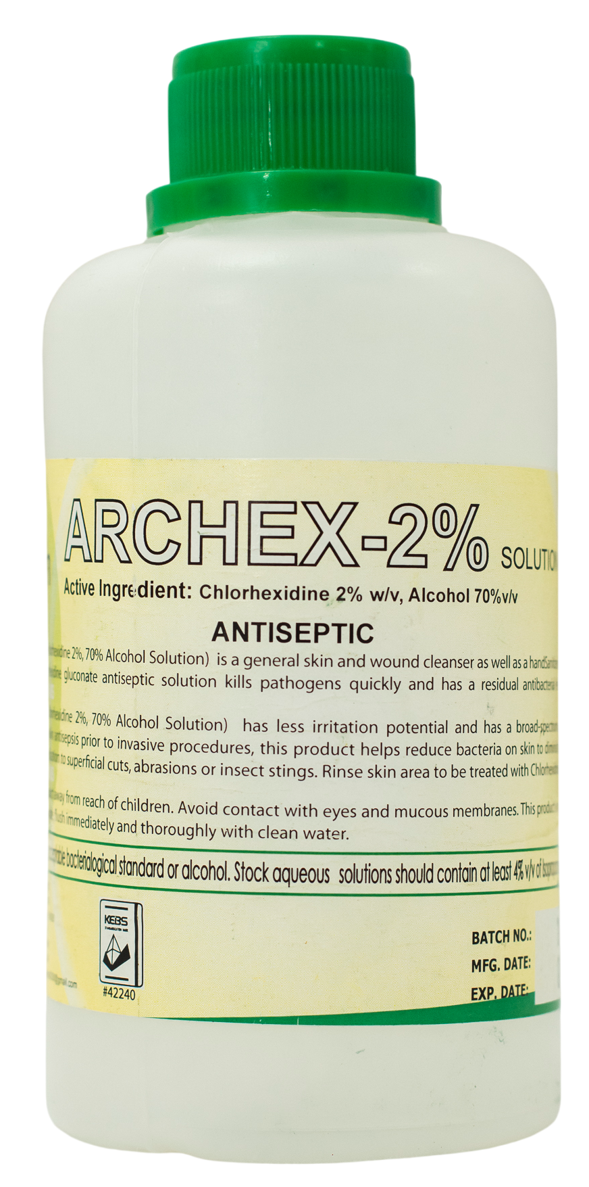
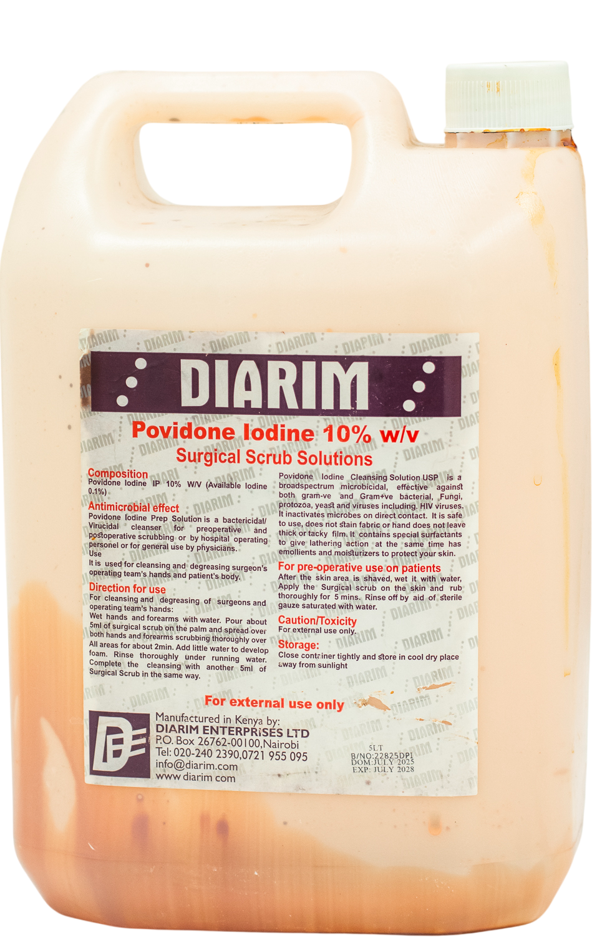
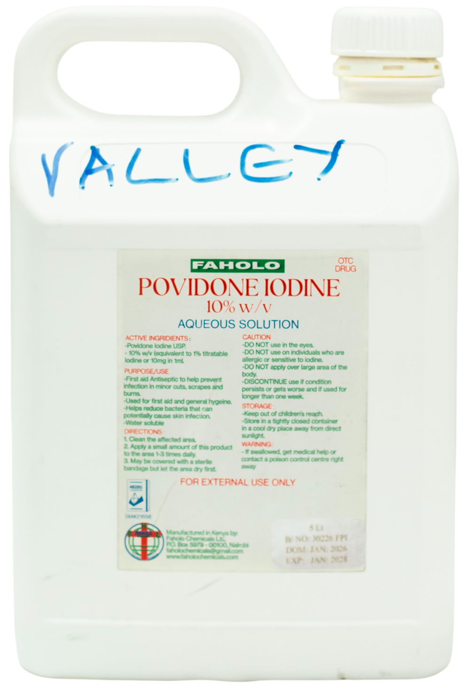
PROJECT IMPLEMENTATION
13TH IPNET KENYA CONFERENCE • 19–21 AUGUST 2026 • PRIDE INN PLAZA, NAIROBI​

Slide 21
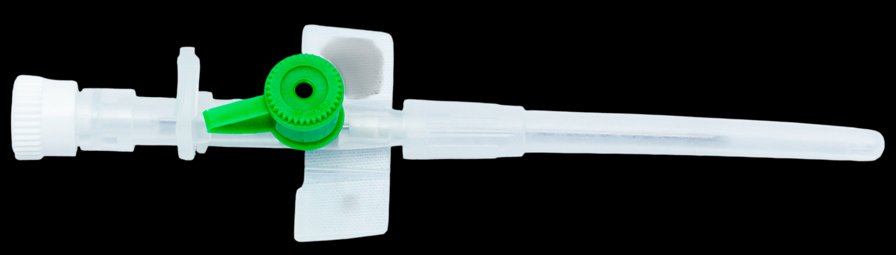
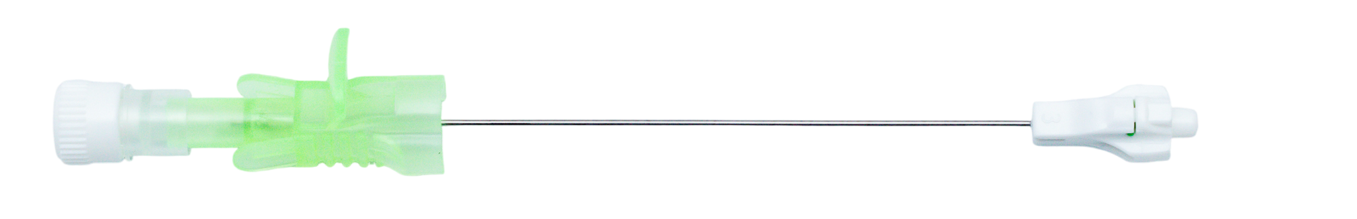
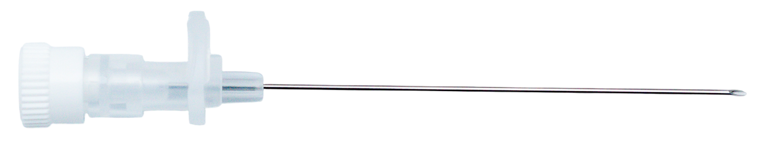
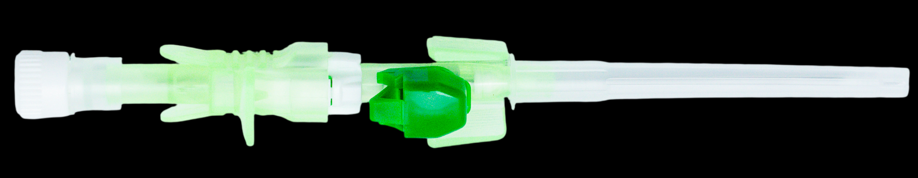
13TH IPNET KENYA CONFERENCE • 19–21 AUGUST 2026 • PRIDE INN PLAZA, NAIROBI​

Slide 22
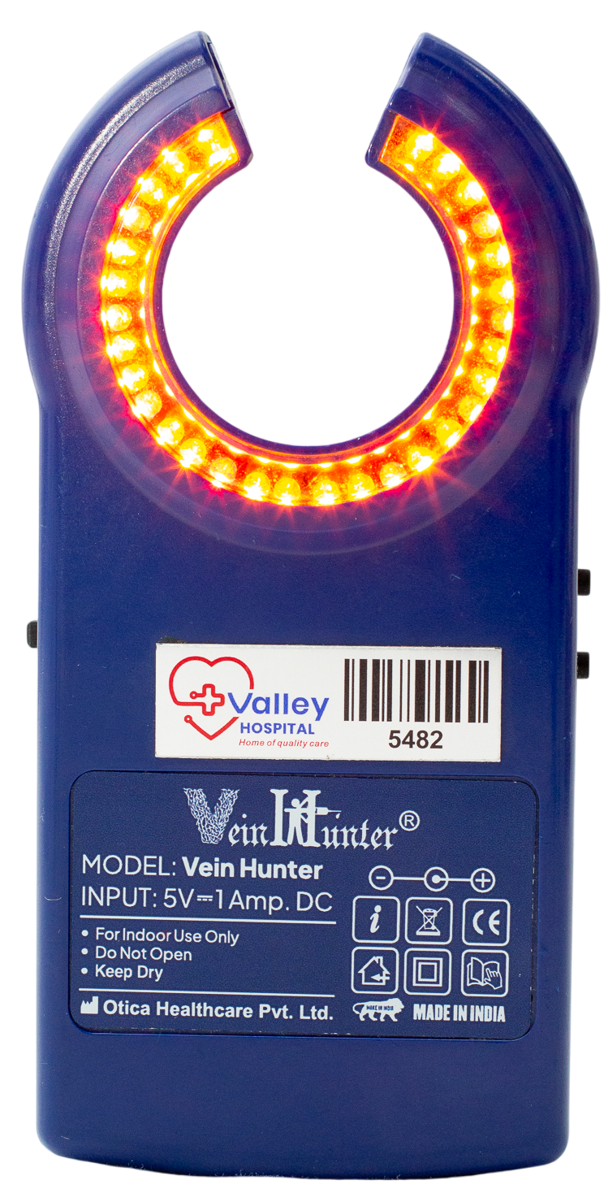
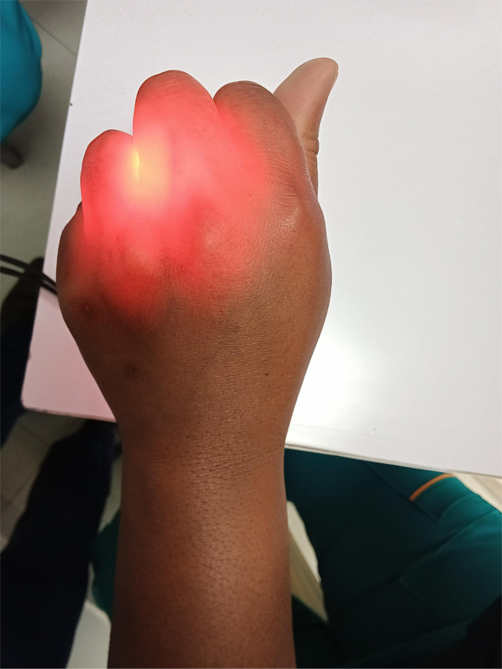
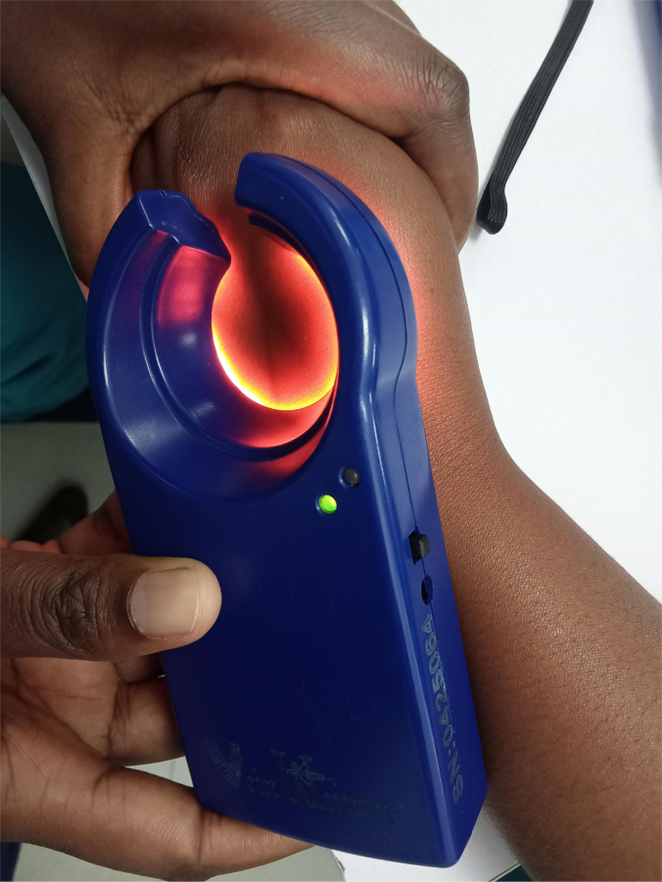
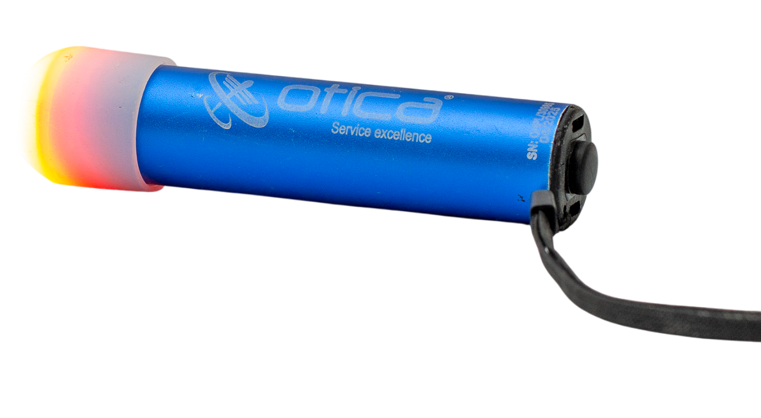
ADULTS
PAEDIATRICS
13TH IPNET KENYA CONFERENCE • 19–21 AUGUST 2026 • PRIDE INN PLAZA, NAIROBI​

Slide 23
Results and Early Observations
13TH IPNET KENYA CONFERENCE • 19–21 AUGUST 2026 • PRIDE INN PLAZA, NAIROBI

Slide 24
RESULTS & EARLY OBSERVATIONS: SAFETY ENGINEERED CANNULAS
Healthcare Worker Safety — Baseline vs Post-Intervention
0
cannula-related needlestick injuries after implementation (Aug 2025–Jul 2026)
KEY OBSERVATIONS
Reduced reliance on behaviour-dependent IPC measures
Fewer opportunities for sharps and blood exposure
Increased staff confidence during invasive procedures
Engineering controls reduced occupational exposure associated with intravenous cannulation.
Baseline combines 2024 (Jan–Dec) and Jan–Jul 2025 — 19 months total, vs 12 months post-intervention.
Valley Hospital · IPC Quality Improvement Project
13TH IPNET KENYA CONFERENCE • 19–21 AUGUST 2026 • PRIDE INN PLAZA, NAIROBI​

Slide 25
RESULTS & EARLY OBSERVATIONS: VEIN FINDERS
Patient Safety & Efficiency — Baseline vs Post-Intervention
Comparable 7-month periods: Baseline (Jan–Jul 2025) vs Post-Intervention (Aug 2025–Feb 2026)
59% REDUCTION
in external-assisted cannulations, driven by vein-finder adoption
Valley Hospital · IPC Quality Improvement Project
13TH IPNET KENYA CONFERENCE • 19–21 AUGUST 2026 • PRIDE INN PLAZA, NAIROBI​

Slide 26
PRACTICE CHANGE
25
Practice Improvement
Before
After
Razor blade
Electric clipper
Povidone iodine
Chlorhexidine-alcohol
OBSERVATIONS
Improved adherence to evidence-based practice
Good staff acceptance
Ongoing SSI surveillance
Adoption has been strong — it is too early to attribute SSI change to these interventions.
13TH IPNET KENYA CONFERENCE • 19–21 AUGUST 2026 • PRIDE INN PLAZA, NAIROBI

Slide 27
RESULTS SUMMARY
26
From Hazard to Safer System
Hazard
WHO Control
Valley Hospital Solution
Outcome
Razor blades
Substitution
Electric clippers
Safer preoperative hair removal
Povidone iodine
Substitution
Chlorhexidine-alcohol
Improved guideline adherence
Conventional cannulas
Engineering
Safety-engineered cannulas
Zero cannula-related NSIs
Difficult vascular access
Engineering
Vein finder
Fewer failed cannulations, lower costs
Every intervention began with a hazard — not with a product.
13TH IPNET KENYA CONFERENCE • 19–21 AUGUST 2026 • PRIDE INN PLAZA, NAIROBI

Slide 28
REFLECTION
27
Lessons Learnt
Leadership willingness alone is insufficient to drive IPC improvement without strong technical guidance.
1
Effective implementation was achieved when leadership support was complemented by informed IPC advocacy capable of translating policy intent into actionable, evidence-based interventions.
2
Embedding substitution and engineering controls into routine workflows enhanced acceptance and sustainability.
3
13TH IPNET KENYA CONFERENCE • 19–21 AUGUST 2026 • PRIDE INN PLAZA, NAIROBI

Slide 29
WHAT'S NEXT
28
Scale-Up Plan
1
2
3
4
Gradual expansion of interventions to all clinical departments
Integration of new practices into standard operating procedures (SOPs)
Inclusion of revised practices in staff orientation and continuous medical education
Ongoing monitoring through IPC audits to support expansion
→
→
→
13TH IPNET KENYA CONFERENCE • 19–21 AUGUST 2026 • PRIDE INN PLAZA, NAIROBI

Slide 30
LONG-TERM VIEW
29
Sustainability Plan
Procurement & Supply Chain
Policy Integration
Embedding procurement of approved IPC devices into routine supply chains
Incorporation of substitution and engineering controls into hospital IPC policies
Leadership Engagement
Monitoring & Feedback
Continuous leadership engagement to support resource allocation
Regular IPC audits and feedback to maintain adherence
13TH IPNET KENYA CONFERENCE • 19–21 AUGUST 2026 • PRIDE INN PLAZA, NAIROBI

Slide 31
SUMMING UP
30
Conclusion
Applying substitution and engineering controls, guided by the WHO hierarchy of controls, is feasible and effective in strengthening IPC and occupational safety.
System-level interventions provide sustainable risk reduction and offer a scalable model for similar healthcare facilities.
13TH IPNET KENYA CONFERENCE • 19–21 AUGUST 2026 • PRIDE INN PLAZA, NAIROBI

Slide 32
CALL TO ACTION
31
Recommendations
Healthcare facilities should:
1
Apply the WHO Hierarchy of Controls when designing IPC programmes
2
Prioritize substitution and engineering controls where feasible
3
Strengthen leadership support for safer technologies
4
Monitor implementation using process, outcome, and balancing indicators
5
Scale successful interventions across departments
Design safer systems — not just safer behaviour.
13TH IPNET KENYA CONFERENCE • 19–21 AUGUST 2026 • PRIDE INN PLAZA, NAIROBI

Slide 33
GRATITUDE
32
Acknowledgements
Valley Hospital Board & Management
Biomedical Engineering Department
Infection Prevention and Control Committee
Quality Improvement Team
Clinical Teams
IPNET Kenya
Procurement & Finance Department
All Valley Hospital staff who supported implementation
13TH IPNET KENYA CONFERENCE • 19–21 AUGUST 2026 • PRIDE INN PLAZA, NAIROBI

Slide 34
SOURCES
33
References
1.
World Health Organization. Infection Prevention and Control (IPC). WHO.
2.
World Health Organization. WHO Best Practices for Injections and Related Procedures Toolkit. WHO.
3.
World Health Organization. Global Guidelines for the Prevention of Surgical Site Infection. WHO; 2018.
4.
Centers for Disease Control and Prevention. Core Infection Prevention and Control Practices for Safe Healthcare Delivery in All Settings. CDC; 2024.
5.
Centers for Disease Control and Prevention. Guidelines for the Prevention of Intravascular Catheter-Related Infections. CDC; 2011.
13TH IPNET KENYA CONFERENCE • 19–21 AUGUST 2026 • PRIDE INN PLAZA, NAIROBI

Slide 35
THANK YOU
13th IPNET-Kenya Conference • 19–21 August 2026 • Pride Inn Plaza, Nairobi
www.ipnetkenya.org | info@ipnetkenya.org

