Slide 1

IMPROVING HAND HYGEINE COMPLIANCE USING CONTINOUS QUALITY IMPROVEMENT FRAMEWORK IN KILIFI COUNTY (2021-2023)
FLORENCE M. LUGHANJE
COUNTY IPC FOCAL PERSON
KILIFI COUNTY GOVERNMENT

Slide 2

INTRODUCTION
IPC is defined as a process where policies, procedures and activities are designed to prevent spread of infections i.e. health care associated infections in the health care setting and communities (National IPC guidelines for healthcare services in Kenya,2015)
Infection prevention and control (IPC) is a critical issue because millions of patients develop HAIs at the hands of health care providers in both developed and developing countries.(WHO)
Hand hygiene(HH) is one of elements of standard precautions in preventing and controlling the spread of hospital-acquired infections (HAIs)
Evidence suggests that by performing hand hygiene, HCWs break the chain of transmission of the pathogens between patients and the healthcare environment and can result in a reduction of 15% to 30% of HCAIs . However, hand hygiene compliance in sub-Saharan African countries is as low as 21.1% due to the varied factors
Hand hygiene compliance among healthcare workers in Kenya is generally low, ranging from 15% to 54.1% depending on the facility, department, and available resources. (sciencedirect)

Slide 3
INTRODUCTION….2
The WHO (2009) recommended direct observation based on the 5 moments for hand hygiene as a gold standard technique for monitoring hand hygiene practices among HCWs during patient care and remains widely used and reliable method.
The 5 moments for hand hygiene states that there are five moments when HCWs should practice hand hygiene during patient care to prevent HCAIs: (1) before touching a patient, (2) before a clean/aseptic procedure, (3) after exposure to body fluids risk, (4) after touching a patient, and (5) after touching patient surroundings[8].
PDSA: Plan-Do-Study-Act , is a 4-step process for quality improvement. During the planning stage, objectives and desired outcomes are defined. The 'do' phase allows for the implementation of the plan from the first stage. During the 'study' phase, results are gathered and analyzed to determine the plan's effect. Finally, during the 'act' stage, if the process has achieved the goal, it is controlled to ensure continued compliance; if it has not, a new PDSA cycle is implemented to better meet the outcomes
Continuous Quality Improvement (CQI) is a progressive incremental improvement of processes, safety, and patient care. The goal of CQI may include improving operations, outcomes, systems, processes, the work environment, or regulatory compliance. Process improvement may be "gradual" or "breakthrough" in natureA CQI approach can be an effective strategy towards improving HH compliance

Slide 4

OBJECTIVE / STUDY SITE
To determine the effect of CQI on hand hygiene compliance amongst health care workers in Kilifi County.
The CQI project was initiated in two hospitals in Kilifi County and targeted increasing HH compliance.
Kilifi county referral Hospital(KCRH)
Malindi Subcounty Hospital (MSCH)

Slide 5
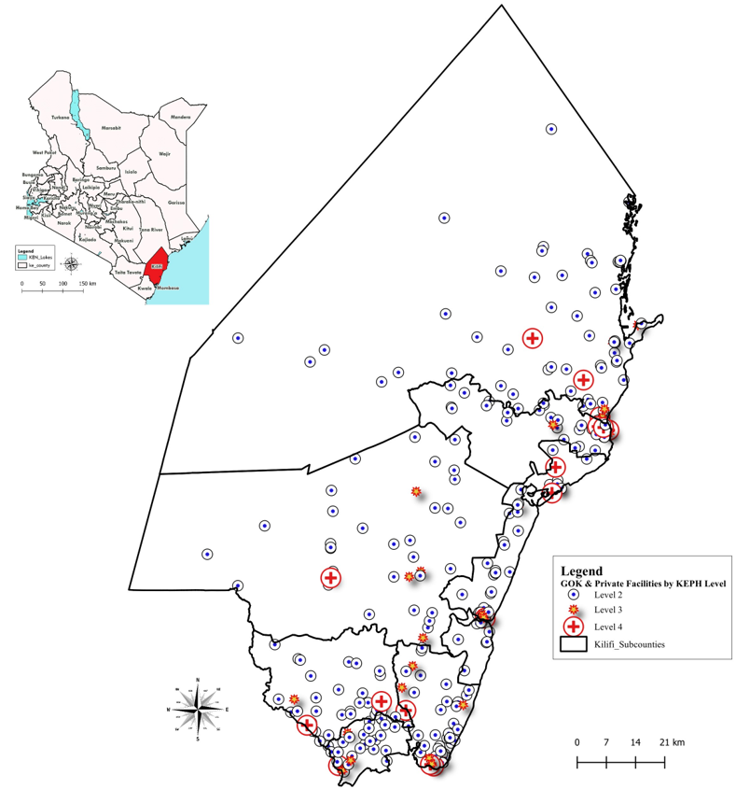
CONTEXT

Slide 6
STUDY DESIGN /METHODOLOGY
A PRE-POST INTERVENTION Study design was used.
Baseline assessment for core components of IPC program was conducted in February 2021,in two hospitals in Kilifi county to identify gaps and prioritize support, by MTaPS Kenya, in collaboration with the MOH Patient and Health Worker Safety Division (National AMR secretariat) and the Kilifi County Health Department
Primary data was collected using structured ICAT questionnaires, analyzed descriptively and presented in charts.
The findings of the survey were presented based on measured variables under 5 modules, health facility information, IPC programs, occupational health, waste management and surgical area practices
The findings were shared and IPC committees’ technical and managerial capacity were strengthened through IPC training. IPC teams from the two hospitals were trained on IPC, CQI and Workplans for the 5 modules were prepared

Slide 7
IMPLEMENTATION STRATEGY FOR HAND HYGEINE AUDITS
CQI • PDSA • FEEDBACK • ADAPT
The teams used the PDSA cycle to design and implement interventions.
Data for hand hygiene was collected using the WHO “five moments for hand hygiene” tool, where HH opportunities were observed, recorded and subsequent compliance among staff calculated between May 2021 and May 2023. In total, four Hand hygiene audits were done in each of the facilities during this period.
The findings were shared with the HCWs and interventions undertaken to improve performance.
The interventions included HCW training, mentorship, provision of posters and hand-washing commodities and supplies.
Quarterly supportive supervision was done by the county and MTaPS teams, where PDSA methodology was used to review the CQI workplan implementation process , evaluate the implementation of CQI workplans, and identify challenges, then brainstorming solutions and updating the workplan .
Data was analyzed using Microsoft Excel.

Slide 8
RESULTS OF IPC ASSESSMENT at baseline using ICATT
SCORE | RATE | EXPLAINATION
>75% | A | Recommended practices followed consistently and thoroughly
50%-70% | B | Recommended practices usually
<50% | C | Training and follow-up needed on recommended practices
The mean IPC assessment score was 44% (C rating), in the two selected facilities in Kilifi
No facility was reported to be thoroughly, consistently compliant with the recommended practices.
Training and follow-up is needed on recommended practices

Slide 9
HAND HYGEINE WORKPLANS
KILIFI COUNTY REFERAL HOSPITAL
MALINDI SUBCOUNTY HOSPITAL

Slide 10
Results of HH compliance
Hand hygiene compliance increased from 30% to 49.2% (KCRH) and 12% to 50%(MSCH) as shown in figure 1.
There was a decline in Mar 2023 in both facilities likely due to staff transitions with the entry of new interns.
These were subsequently oriented to the IPC reforms and hand hygiene IEC materials were strategically placed, bringing the compliance gradually up to 50%.

Slide 11
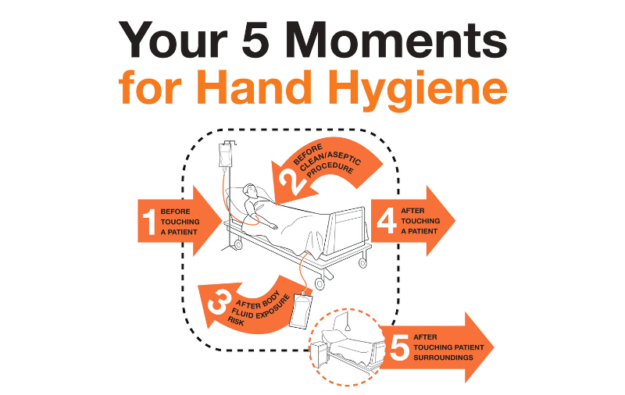
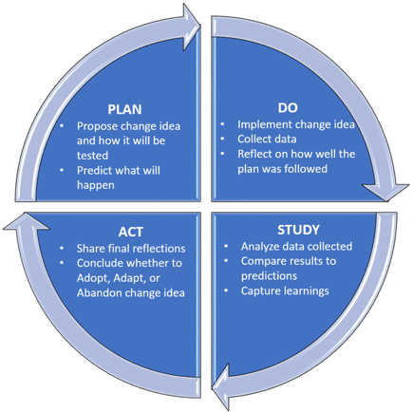
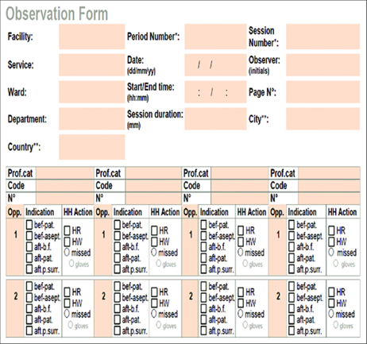

Slide 12
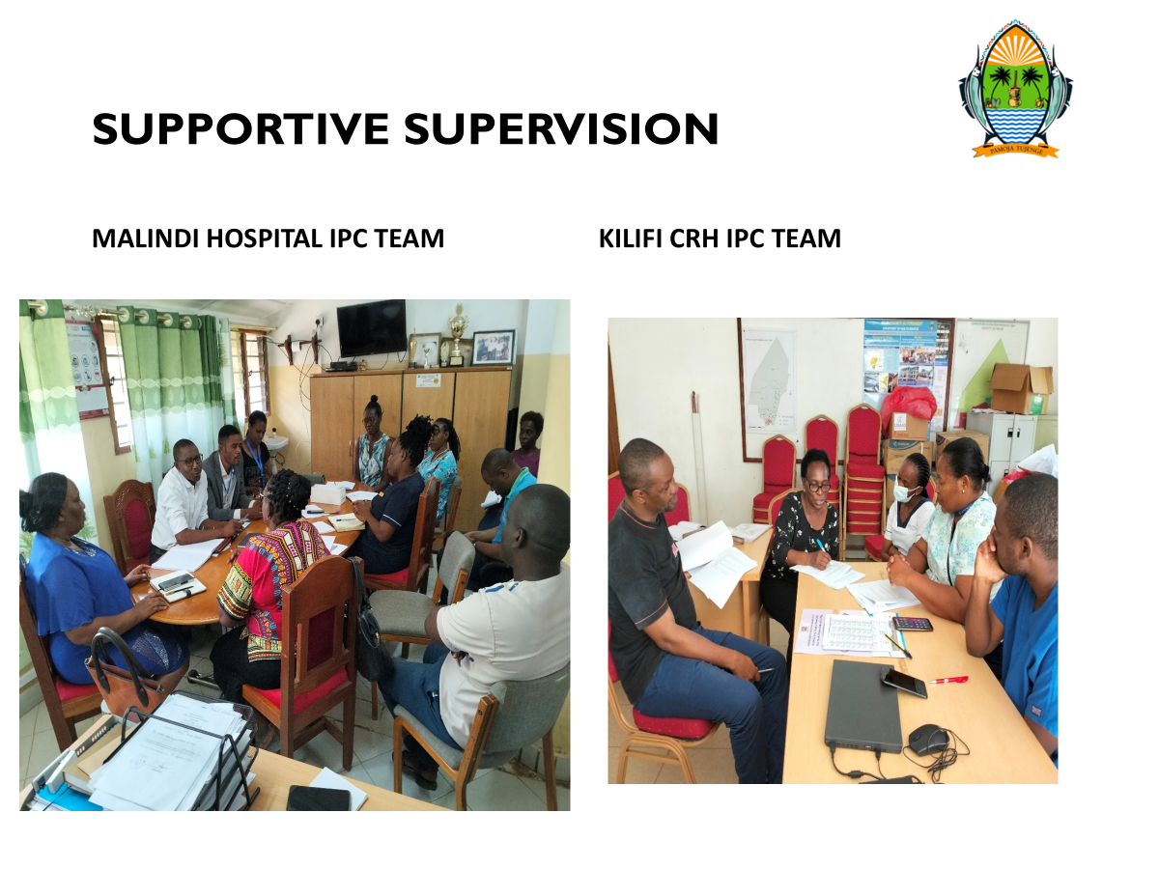
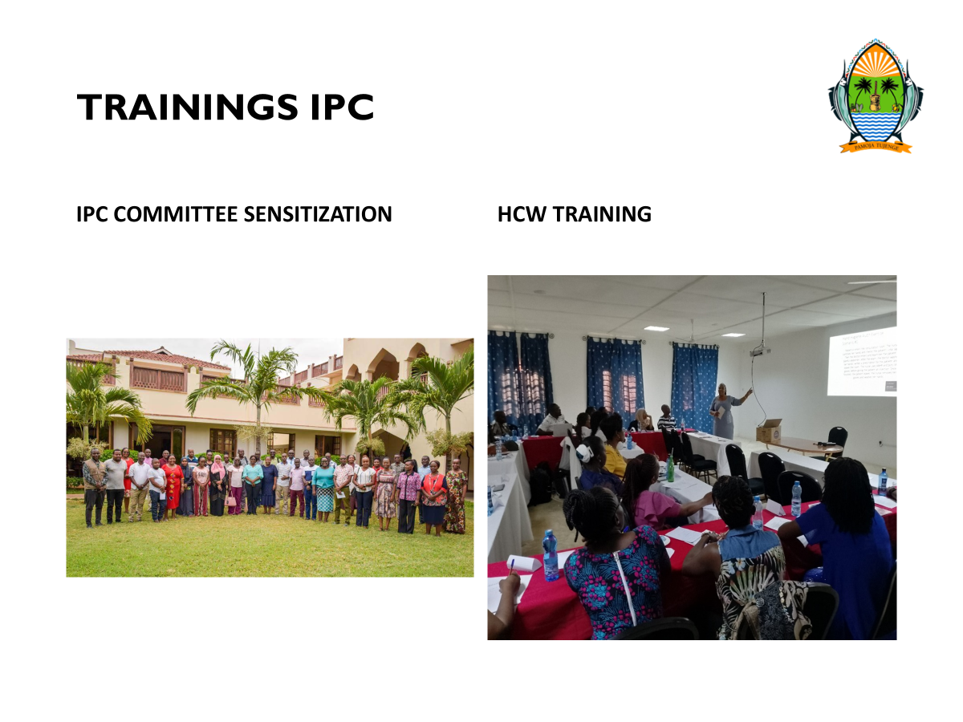

Slide 13
SUCCESS FACTORS
Administrative /management support
Technical support from USAID MTaPS
Strengthened IPC governance
Availability of IPC commodities.
Provision of SOPs and job aids
Provision of IPC audit tools in soft copy
Dedicated and committed IPC committees and HCWs

Slide 14
CHALLENGES
Multiple roles for County and facility IPC focal persons- little time for IPC activities
Lean staffing in facilities
High workload in the health facilities
Few HCWs trained in IPC

Slide 15
CONCLUSION
HH compliance among health care workers can be improved through information, education, and communication with constant monitoring using the Continous quality improvement(CQI) approach.
Key message: Continuous quality improvement can turn routine hand-hygiene monitoring into sustained action and measurable improvement.

Slide 16
ACKNOWLEDGMENT
Kilifi county health management team,
MOH Patient and Health care worker Safety
Malindi Sub County hospital
Kilifi County Hospital
USAID MTaPS Kenya

