Slide 1



13TH ANNUAL CONFERENCE
Infection Prevention
Network – Kenya
Advancing Safe Care Through Infection Prevention & Control
CONFERENCE THEME
“Advancing IPC, AMR, and One Health:
Science, Policy, and Practice”
13TH IPNET KENYA CONFERENCE • 19–21 AUGUST 2026 • PRIDE INN PLAZA, NAIROBI
01

Slide 2

ABSTRACT INFORMATION
02
Abstract Details
Adaptation and evaluation of training materials to improve environmental cleaning knowledge at five hospitals in Migori County Kenya
PRESENTER NAME: Evelyn Makena Mugambi
On behalf of Carrie Ripkey, Raymond Odinoh, Lorna Maru, Jared Oremo , Victoria Trinies, Isaac Ngere
INSTITUTION / AFFILIATION: Washington State University Global Health- Kenya
COUNTY: Migori
COUNTRY: Kenya
13TH IPNET KENYA CONFERENCE • 19–21 AUGUST 2026 • PRIDE INN PLAZA, NAIROBI
02
Notes:
Good morning
My name is Evelyn Makena, I am a {Regional WASH Advisor working with [Washington State University – Global Health Kenya],
This morning, I will be sharing with you on adaptation and evaluation of training materials to improve environmental cleaning knowledge at five hospitals in Migori County Kenya.

Slide 3
SECTION 01
03
Proper environmental cleaning (EC) in healthcare facilities (HCFs) requires adequate supplies and the knowledge of how to use these supplies
There are gaps in access to environmental cleaning supplies and training
36% of HCFs globally lack disinfectants
Only 7% of HCFs in Kenya provide basic environmental cleaning services (protocols & training)
Estimated proportion of HCFs in Kenya providing basic EC services, 2022
13TH IPNET KENYA CONFERENCE • 19–21 AUGUST 2026 • PRIDE INN PLAZA, NAIROBI
03
Notes:
Environmental Cleaning is a core component of Infection, prevention and control and is crucial to keeping patients, healthcare workers, and the wider community safe.
Proper environmental cleaning in healthcare facilities requires both adequate supplies and knowledge of how to use these supplies properly.
However, evidence shows that globally there are gaps in both access to supplies and training for environmental cleaning (EC).
For example, [click], based on previous estimates, 36% of healthcare facilities (HCFs) globally lack disinfectants (a key environmental cleaning supply),
and [click] based on a 2022 estimate, only 7% of HCFs in Kenya provided basic environmental cleaning services (protocols are available & all staff with cleaning responsibilities have received training).

Slide 4
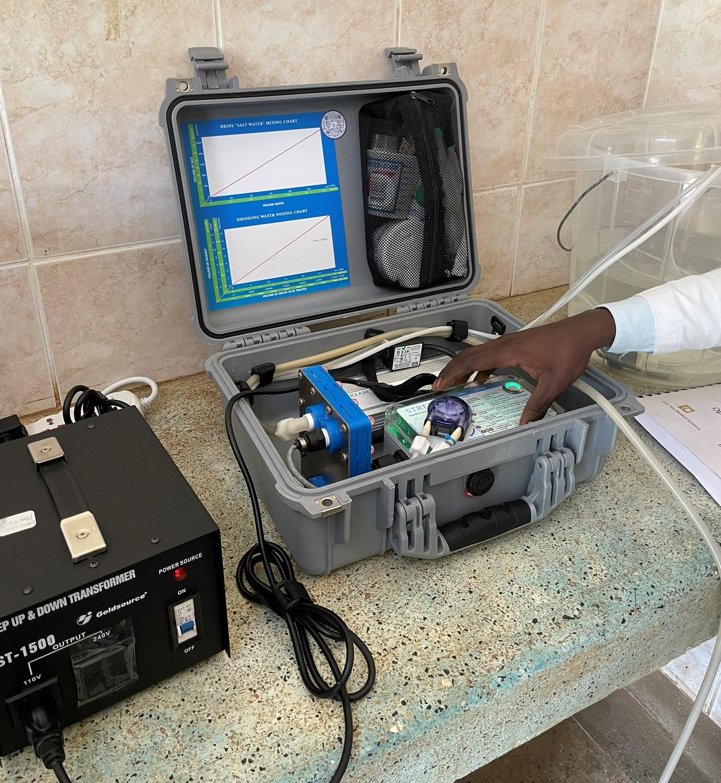
SECTION 02
04
Is a complementary environmental cleaning training effective in improving knowledge?
Objectives:
Develop an environmental cleaning training to complement a pilot of on-site chlorine generators (STREAM Device) at five hospitals in Migori County, Kenya, and
Evaluate the effectiveness of the training on increasing knowledge of use of chlorine-based disinfectants
STREAM Disinfectant Generator at Hospital in Migori County
13TH IPNET KENYA CONFERENCE • 19–21 AUGUST 2026 • PRIDE INN PLAZA, NAIROBI
04
Notes:
To address this gap, we partnered together with the county government of Migori, Safe Water and Aids Project, and the US Centers for Disease Control and Prevention to design and evaluate a pilot intervention to address these gaps. This included both provision of an on-site chlorine generator, using the STREAM device, as well as complementary environmental cleaning trainings,
the latter will be the focus of the presentation today.
We wanted to know if this complementary environmental cleaning training was effective in improving short-term knowledge among participants in the training.
To understand this, we had two sequential objectives for this work.
First [click] to develop an environmental cleaning training to complement the pilot of on-site chlorine generators, the STREAM device, which you can see on the right side of the screen.
Second [click] to evaluate the training’s effectiveness at increasing environmental cleaning knowledge, with a particular focus on use of chlorine-based disinfectants.
So, how did we go about this?

Slide 5
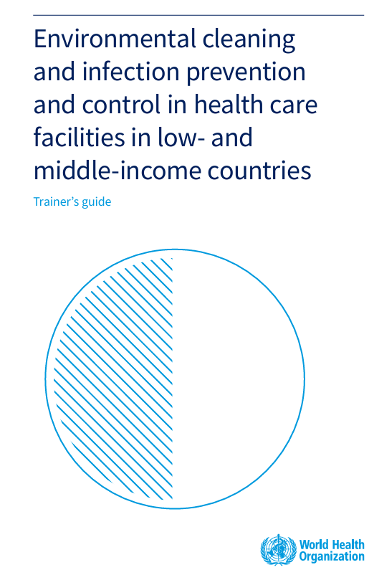
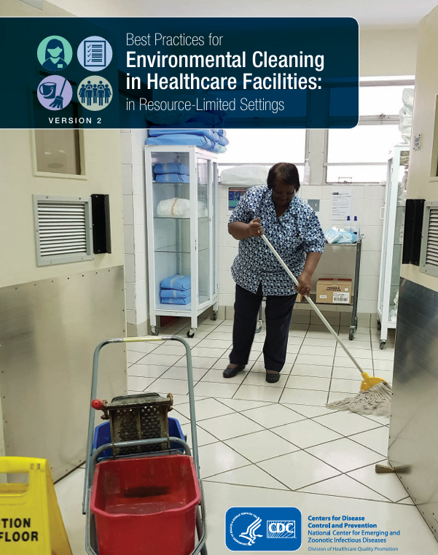
SECTION 03
05
We adapted existing best practice training materials to address identified knowledge gaps
Training Needs Assessment
Curriculum Adaptation
Training Implementation
March 2025
At 5 hospitals in Migori county
With 52 hospital staff (cleaning staff, clinical staff, other health practitioners)
6 Environmental Cleaning knowledge questions
May 2025
Training of Trainers, cascade training to staff at 5 hospitals in Migori County
Trainings reached approximately 100 learners (cleaning staff, clinical staff, other health practitioners)
Training Modules:
  Intro to EC
  Personal Protective Equipment,
  Key activities for EC
  Supportive Supervision of EC (supervisors)
13TH IPNET KENYA CONFERENCE • 19–21 AUGUST 2026 • PRIDE INN PLAZA, NAIROBI
05
Notes:
In order to develop a training curriculum that was both complementary to the on-site chlorine generators and meet participant’s needs, [click] we first conducted a training needs assessment as part of a knowledge, attitudes and practices survey conducted at the baseline of the second year of this project.
This was conducted in March of 2025 and was conducted with 52 clinical and cleaning staff across the 5 participating facilities.
We specifically looked at the results from six environmental cleaning knowledge questions,
Questions where less than 80% of the participants answered incorrectly serving as the starting point for key training topics. [Click]
Then we reviewed existing best practice documents and training materials and adapted them to reflect the Kenyan context and focus on our key areas of interest, namely, and introduction to infection prevention and control or IPC, use of personal protective equipment or PPE, and key activities for cleaning and disinfection.
Those with supervisory oversight also received a module on conducting supportive supervision for environmental cleaning activities.
Then, in May of 2025, materials were rolled out. With WSU and SWAP providing an initial training of trainers who were then responsible for cascading the training to their respective facilities. In total the trainings reach approximately 100 staff, a mix of cleaning staff, clinical staff, and other health practitioners.

Slide 6
SECTION 03
06
Participants completed pre- and post- training tests to measure knowledge changes and evaluate training delivery
What did we measure and how?
Who was represented by these tests?
How did we evaluate changes in knowledge?
14 knowledge questions on general IPC/EC, PPE, and chlorine preparation and use
Pre & Post Training Test
Composite knowledge score= # questions correct/14
Post training survey included sections for feedback on training and intention to apply learnings
57 participants with matched pre-post surveys
From 5 Hospitals with a few unaffiliated participants (e.g., County Public Health Staff)
Various Cadre Groups
  51% Cleaning Staff
  21% Clinical Staff
  26% Other Public Health Practitioners
Paired t-tests for matched, composite knowledge scores pre- and post-training
ANOVA and linear regression models used to evaluate significance of learning differences across facilities, cadre groups, and pre-training knowledge scores
13TH IPNET KENYA CONFERENCE • 19–21 AUGUST 2026 • PRIDE INN PLAZA, NAIROBI
06
Notes:
We used pre and post training tests to evaluate knowledge changes and solicit feedback on training delivery. [click]
The test was in the form of an electronic survey that included 14 knowledge questions on general IPC/EC, PPE, and chlorine preparation and use.
The same knowledge questions were included on both pre and post test, but the post test also included sections for feedback on the training and their intention to apply learnings from the training.
Our key metric of interest was composite knowledge scores , based on how many of the 14 questions were answered correctly.
[Click] After removing individuals who did not have both pre and post tests, we ended up with 57 participants from the 5 hospitals (4 level 4 &1 level 5). Just over half of the participants were cleaning staff, 21% were clinical staff, and 26% were other public health practitioners.
[click] To assess changes in knowledge, we compared participants’ pre-training and post-training scores using a paired t-test. We then used ANOVA and linear regression to examine whether learning gains differed by facility, by staff cadre, and pre-training knowledge scores. Statistical significance was set at p value of 0.05 ( p< 0.05).

Slide 7
SECTION 04
07
Participants had higher EC knowledge scores immediately after training and improved across each topical domain
Changes in mean proportion of questions answered correctly, by topical domain, pre- and post- training
89%
82%
There were statistically significant improvements from pre- to post-test for six of the fourteen knowledge questions.
81%
Pre-training mean score (n=57)
Post-training mean score
(n=57)
Topical Domain
13TH IPNET KENYA CONFERENCE • 19–21 AUGUST 2026 • PRIDE INN PLAZA, NAIROBI
07
Notes:
Prior to the training the mean knowledge score for all learners across all the topical domains was 75%, which rose to 86% immediately after training, a statistically significant change.
To better understand if knowledge changes differed across topics, we evaluated the mean proportion of questions answered correctly by topical domain, as shown on the left-hand side of the screen.
This increased for all the topical domains, with the largest gains within the chlorine preparation and use category which rose from a mean of 65% of questions answered correctly during the pretest and 81% answered correctly during the post test. [click]
To understand knowledge changes in greater detail, we also assessed significance of changes in proportion of individuals correctly answering each individual question pre- and post-training, using McNemar’s test. There were statistically significant improvements from pre- to post-test for six of the fourteen knowledge questions.

Slide 8
SECTION 04
08
Knowledge gains were relatively uniform across demographic factors; largest learning gains seen among those with lowest pre-test scores
No significant differences in knowledge changes across:
Specific Hospitals:
What predicted knowledge gain?
Facility 3*
Other
Facility 2
Facility 4
Facility 5
Facility 1
Pre-test score was a statistically significant predictor of knowledge gain, with the largest gains seen among those with the lowest pre-test scores
Mean Change: +21%
Mean Change: +15%
Mean Change: +13%
Mean Change: +13%
Mean Change: +9%
Mean Change: +7%
Trainers & Frontline Staff
Cadre Groups
Trainer
Frontline Staff
Other Health Professionals
Cleaning Staff
Clinical
Staff
Mean Change: +12%
Mean Change: +11%
Mean Change: +13%
Mean Change: +12%
Mean Change: +11%
13TH IPNET KENYA CONFERENCE • 19–21 AUGUST 2026 • PRIDE INN PLAZA, NAIROBI
08
Notes:
Given the diversity of training participants, we wanted to understand if different types of participants had different changes in their pre and post-training knowledge. We hypothesized that there may be differences across specific facilities (perhaps due to different approaches to cascading training materials), trainers and frontline staff, again, perhaps due to different approaches to cascading training materials, and cadre groups, which were broken up into cleaning staff, clinical staff, and other public health professionals.
[Click]
While we observed some variations in pre-test knowledge (mean scores ranging from 71-82%) and post-test knowledge (mean scores ranging from 78-96%) (See table 3) across facilities, this variation was determined to not be statistically significant at the p=.05 level using ANOVA.
[click] Similarly, the difference observed in mean change between pre-test and post-test for trainers and frontline staff was also determined to not be statistically significant at the p=.05 level
[click] Finally, The difference observed in mean change between pre-test and post-test for cadre groups was also not significant at the p=0.05 level (F=.79, p=.46).
[click] However [click] using linear regression, we found that knowledge gain was significantly associated with baseline knowledge score. Participants with lower baseline test scores had larger knowledge gains than those with higher pre-test scores with baseline knowledge explaining 35% of the variance in knowledge gain.

Slide 9
SECTION 04
09
After training, participants reported themselves more knowledgeable on EC, found the training highlight relevant, and intended to apply what they learned on the job
Self-Reported Environmental Cleaning knowledge before and after training among 57 participants
87% of participants reported they would definitely use what they learned from this training at work
Chlorine preparation and use was frequently reported as being the most helpful component of the training, as well as a topic that participants intended to apply to their daily tasks
13TH IPNET KENYA CONFERENCE • 19–21 AUGUST 2026 • PRIDE INN PLAZA, NAIROBI
09
Notes:
Beyond measuring knowledge scores, we were also interested in measuring changes in self reported knowledge of environmental cleaning. Before the training, [click] most participants rated themselves as moderately knowledgeable, with 54% of participants rating themselves as moderately knowledgeable. After the training [click] the majority of participants rated themselves as very knowledgeable, with 63% rating themselves as such.
During the post test we also asked questions about participants intentions to apply learnings from the training to their everyday work, and [click] 87% reported they would definitely use what they learned from this training at work. With most of the remaining respondents indicating they would probably apply what they learned.
We also asked which component of the training was most helpful and which components participants intended to apply to their daily tasks, and chlorine preparation and use emerged as a common response for both these questions.

Slide 10
SECTION 05
10
Feedback and lessons learned will guide future iterations of this training and other EC-related activities within Migori County
Participant feedback and post-test knowledge scores are informing next steps
Additional Questions to Explore
Do training participants retain this knowledge post-training?
Do training participants apply this knowledge post-training?
Do training participants who also have an on-site disinfectant generator at their facility have greater improvements in EC practices than their counterparts who do not have on-site chlorine generators?
Revision to training curriculum:
  Increase training length
  Add more practical activities
  Revise language/content for topics that did not meet the competency threshold
Additional actions:
  Develop refresher curriculum to address topics that did not meet the competency threshold
  Cascade the full, revised training to additional facilities
13TH IPNET KENYA CONFERENCE • 19–21 AUGUST 2026 • PRIDE INN PLAZA, NAIROBI
10
Notes:
[click] Participants were asked several questions about their experiences with the training on the post-test survey. Based on a descriptive analysis of these responses, several suggestions for revision to the curriculum emerged, these included:
Increasing the training length
Adding more practical/hand on activities
Additionally, we had established a competency threshold of 80% of the participants answering a question correctly during post-test (similar to how we determined key topics during the training needs assessment), so questions which did not meet this threshold both suggest opportunities current curriculum, as perhaps these topics to revise and strengthen the weren’t clear, as well as develop refresher modules on these topics to share with participants who have already gone through the training.
Additionally, in the open-ended feedback portion of the survey, many participants suggested these trainings be further cascaded to all facilities in the county.
While this analysis did answer our question if this training curriculum improved short-term environmental cleaning knowledge, we remain with several areas for further evaluation [click]
First, do training participants retain this knowledge post-training? We recognize that a test provided immediately after training may not reflect long term knowledge retention.
Second, do participants apply this knowledge post training? We recognize that just because someone has knowledge on proper environmental cleaning practices doesn’t mean that they are able to apply this knowledge, and at the end of the day, it is the proper practice of environmental cleaning and disinfection activities that ultimately ensures a safe healthcare environment for patients and staff.
Finally, as we noted several times, this training is intended to be complementary to an on-site chlorine generator which works to increase access to disinfectants. To evaluate the combined impacts, we are interested in understanding if training participants who also have an on-site disinfectant generator at their facility have greater improvements in EC practices than their counterparts who do not have on-site chlorine generators? We were unable to evaluate this during this phase of the work as all the training participants were also from a facility that received an on-site chlorine generator.

Slide 11
THANK YOU
13th IPNET-Kenya Conference • 19–21 August 2026 • Pride Inn Plaza, Nairobi
www.ipnetkenya.org | info@ipnetkenya.org
08
Notes:
In conclusion, This training was associated with improved short-term knowledge among clinical and cleaning staff,
The greatest gains among those with the lowest pre-training knowledge.
Additional evaluation is needed to understand long-term impacts on EC knowledge and behaviors, and the return on investment for providing complementary training alongside initiatives to improve access to EC supplies.
Thank you so much for your time and I am happy to take any questions.

