Slide 1
Use Of The Infection Control Assessment Tool To Monitor The Progress Of The Infection Prevention Control Program At Kitale County Referral Hospital
Nancy Koech
Faith Muthoni
Stella Mamuti

Slide 2
Introduction
Infection Prevention and Control (IPC) key aspect of patient care
IPC cornerstone in;
  prevention of nosocomial infections
  response to infectious disease outbreak
  prevention of antimicrobial resistance.
Implementing IPC programs in LMICs frequently hampered by;
  financial constraints,
  limited laboratory capacity, and
  inadequate staff training in the IPC areas

Slide 3
Monitoring objectives
Need systematic monitoring approach
  Detect IPC practice deficiencies
  Implement effective, affordable solutions
Study aim
    To monitor progress of the IPC program at Kitale County Referral Hospital (KCRH).

Slide 4
Methods
A cross sectional survey, December 2022.
Infection Control Assessment Tool (ICAT) used
interviews, -Observations
document reviews
All IPC key areas assessed including;
The IPC program -Pharmacy
Isolation standards -Waste management
Ward practices- hand hygiene, injection safety, catheters, IV fluids and medication
Data was summarized in proportions
Findings compared to previous results; 2016 (baseline), 2017 and 2019
Occupational safety and health

Slide 5
RESULTS

Slide 6
IPC average Performance trends, 2016 - 2022
Notes:
Infection Prevention and Control Program: Responsibilities and Authority
Infection Prevention and Control Committee
Key Infection Prevention and Control (IPC) Personnel
Infection Prevention and Control Education Programs
Outbreak Investigation and Healthcare associated Infection Surveillance

Slide 7
Trends in IPC Precautions and occupational health, 2016-2022
Notes:
Isolation Policies and Precautions
Supplies for Isolation Precautions
Precautions for Other Airborne Diseases
Contact Precautions e.g. Ebola, Marburg Viral Diseases
Droplet Precautions
***
General Information
Occupational Health Activities
Employee Exposures
Control of Sharp Instruments
Employee Health Records

Slide 8
Trends in Pharmacy and waste management, 2016-2022
Notes:
Pharmacy- prophylactic antibiotic use & antibiotic use guidelines-strenthen AMS
Key Personnel
Pharmacy Services
Antibiotic Control Program
Antibiotic Use, Monitoring and Reporting
***
Policies Regarding Health Care Waste
Segregation of Health Care Waste
Waste Disposal

Slide 9
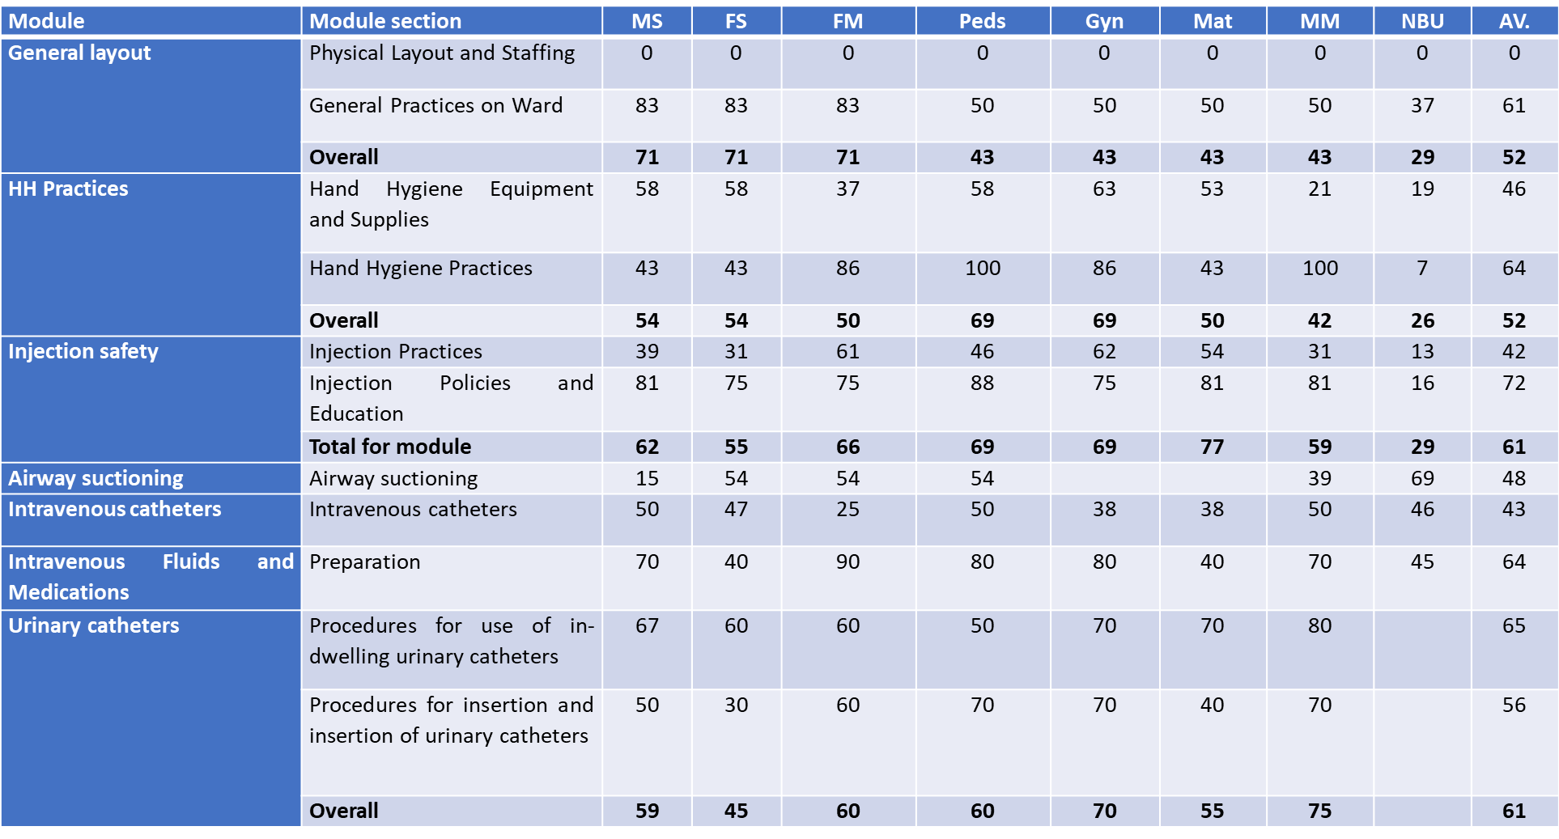
Summary of ward practices

Slide 10
Mann-Kendall trend test
The Mann-Kendall statistical test for trend:
  increase in the trend of the IPC program over the years (p=0.089).
  no change in occupational health and isolation and standard precautions
  slight increase in healthcare waste management (p=0.308).
Though not statistically significant.

Slide 11
Conclusion and recommendations
ICAT tool:
standardized monitoring IPC program progress
Simple and practical approach for assessing existing IPC practices
Continuous monitoring for:
Progress documentation for information and motivation
timely identification of gaps and intervention of any program
Sustenance of achievements
Notes:
It identifies the gaps and recommendations for improvement.

Slide 12
Acknowledgement
KCRH
IPC team
Transnzoia County Government
MOH-Kenya
ITECH

