Slide 1

Strategies for improving hand hygiene compliance among health care workers in Naromoru health Centre, Nyeri County
Zaweria Wambugu , Wanjiru Wahome, Jenifer Kamau, ,Helen Wangai,Peter Mithamo, John Kariuki
Naromoru H/C
Kieni Sub-county
USAID Medicines, Technologies, and Pharmaceutical Services program (MTaPS)

Slide 2
Presentation outline
Background and objectives
Methodology
Results
Conclusions

Slide 3
Background and objectives
Infection Prevention and Control (IPC) is a set of practices, protocols, and procedures executed to prevent infections
Unclean hands of health care workers may
carry harmful pathogens and may be responsible for transmission of up to 80% of Health Care Associated Infections (HAIs).
IPC practices are divided into standard and transmission based precautions

Slide 4

Background and objectives cont’d
Hand hygiene is one of the components of standard precautions.
It refers to the action of cleaning hands either by using soap and water commonly called hand washing, or Alcohol Based Hand Rub (ABHR) referred to as hand sanitizing.
The overall objective of this study was to assess the effectiveness of the strategies employed in improving hand hygiene compliance in Naromoru health Centre.

Slide 5
Methodology
An interventional study that was carried out between February 2022 and January 2023 following a training on application of principles and concepts of CQI in IPC programs.
A work plan detailing the activities to be carried out to improve HH compliance was developed.
The IPC committee conducted monthly HH audits, disseminated findings and identified gaps.

Slide 6
Methodology cont’d
Strategies employed to improve HH included:
integration of IPC with AMS and Quality Improvement Team (QIT)
training of health care workers & inductions of new staff,
Monthly HH audits and quarterly ward infrastructure surveys
quantification of HH supplies, repair and installation of additional HH stations and introduction of single use reusable hand drying towels.

Slide 7
Methodology cont’d
Use of the Plan-Do-Study-Act (PDSA) cycle
quarterly joint supportive supervision sessions supported by County teams and USAID MTaPS to track compliance and monitor implementation of the work plans.
WHO hand hygiene observation tool which captures the 5 moments of hand hygiene was employed during audits
Descriptive statistics was used during data analysis and findings presented in figures, numerical and narratives.

Slide 8
Results
The overall Hand hygiene compliance rate increased from 19% in February 2022 to a high of 75% in July 2022 and 71.8 % in September 2022.
The most missed moments of HH were before performing a clean or aseptic procedure and after touching the patients surrounding but improved by 20% and 25% respectively over time.
The laboratory was leading among 17 departments as it realized 100% compliance.

Slide 9
Moment before a septic procedure

Slide 10
Moment after patient surrounding

Slide 11
Results

Slide 12
Results cont’d
The supply of ABHR and liquid soap increased from 15-500mls bottles and 20litres per fortnight to 30 bottles and 40litres respectively.
37 out of 51 HCWs, 28 students and 17 selected departmental HH champions were sensitized on HH.
2 new hand hygiene stations were installed and 7 repaired.
100 single use reusable towels were introduced but their use failed due to misuse and loss.

Slide 13
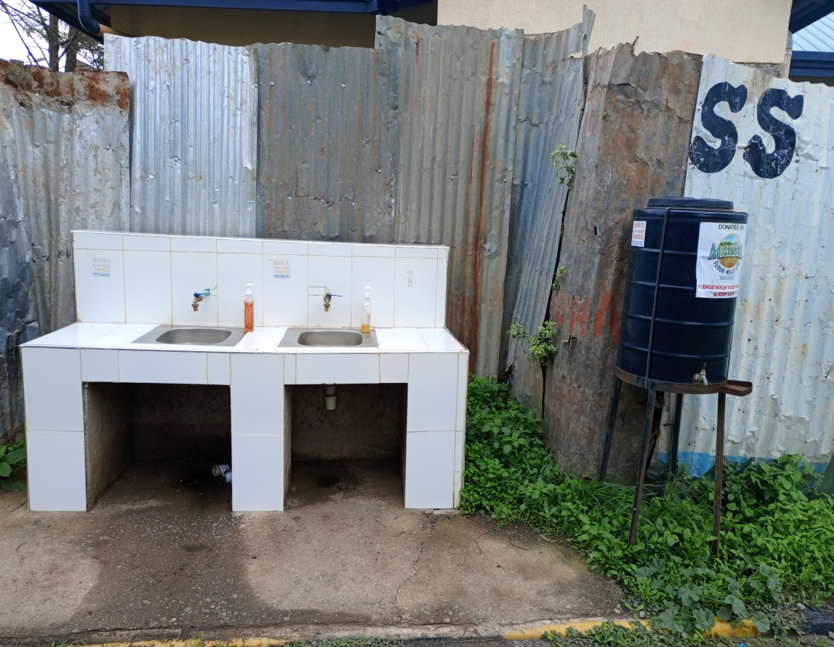
Results cont’d
Left: One of the 2 new HH stations that were installed in the facility

Slide 14
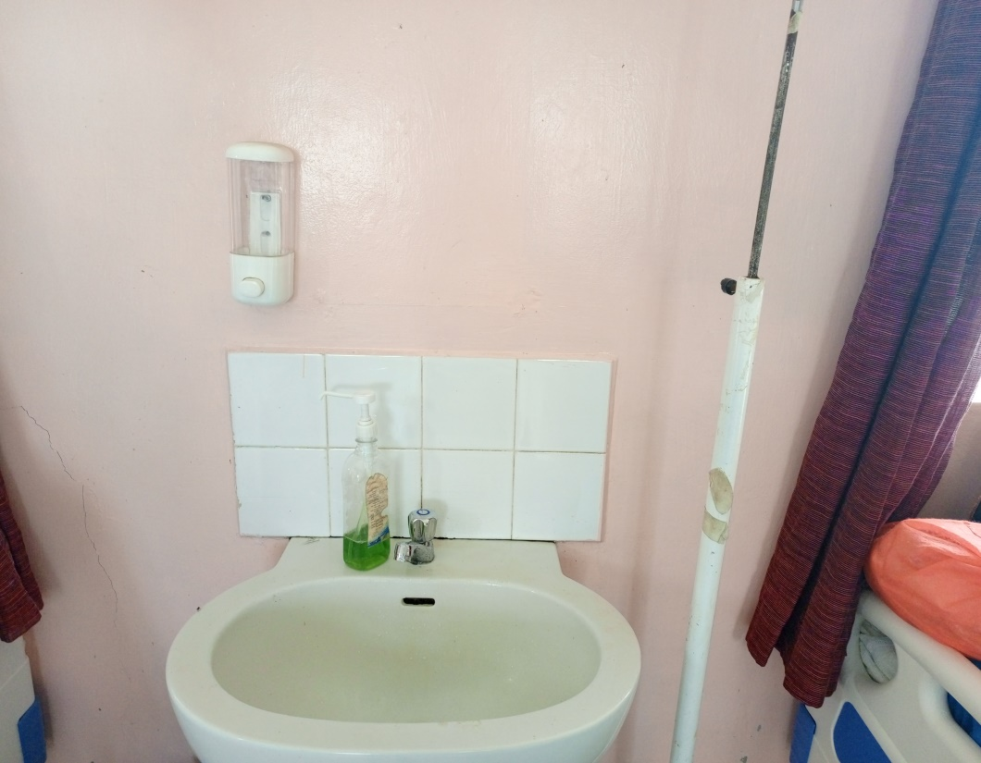
Results cont’d
Left: One of the 7 hand hygiene stations (in Maternity unit) that were repaired in the facility through facility management

Slide 15
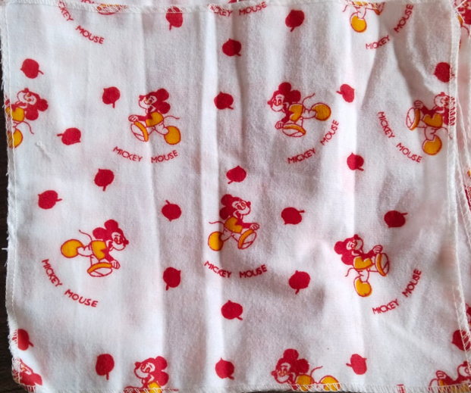
Results cont’d
Left: A sample of the single use reusable towels introduced in the facility.

Slide 16
Conclusions
Facility based interventions with support from the management yield more output on adherence and compliance to best practices on hand hygiene
Functional IPC structures, management support and consistent support supervision by facility and county management are key in strengthening conformity to guidelines and best practices.

Slide 17
Acknowledgement
Management of Naromoru health centre
IPC, MTC and QI committees
Co-authors
USAID Medicines, Technologies, and Pharmaceutical Services program (MTaPs)
Department of health services Nyeri County
IPNET KENYA

Slide 18
THANK YOU

