Slide 1
ROLE OF QUALITY ASSURANCE IN AMR SURVEILLANCE AT THIKA LEVEL 5 MICROBIOLOGY LABORATORY
AUTHOR: FAITH J. MAINA, BRIAN M. MUGWE
AFFILIATION: THIKA LEVEL 5 MICROBIOLOGY LABORATORY

Slide 2

INTRODUCTION
Thika Level 5 Microbiology Laboratory is dedicated to combating antimicrobial resistance by promoting IPC as a diagnostic arm in AMR
Microbiology lab key role in AMR surveillance at the hospital:
  Support IPC team in monitoring and evaluating AMR surveillance protocols
  Practice up-to-date microbiology techniques for rapid diagnostics

Slide 3

INTRODUCTION
This study evaluates the role of quality assurance in the laboratory's ability to effectively monitor and track antimicrobial resistance at TL5H microbiology laboratory

Slide 4

METHODOLOGY
Retrospective analysis was used to assess
quarterly performance of the:
National Public Health Laboratory External Quality Assessment (NPHL- EQA)
AMR Surveillance Isolate Retesting reports sent to NPHL.

Slide 5
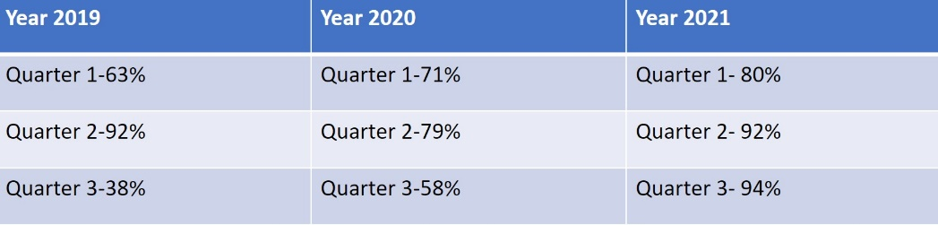
RESULTS:
.NPHL-EQA Performance

Slide 6
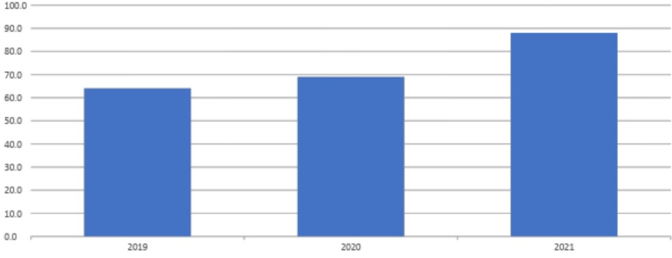
RESULTS:
.Average NPHL-EQA Score

Slide 7
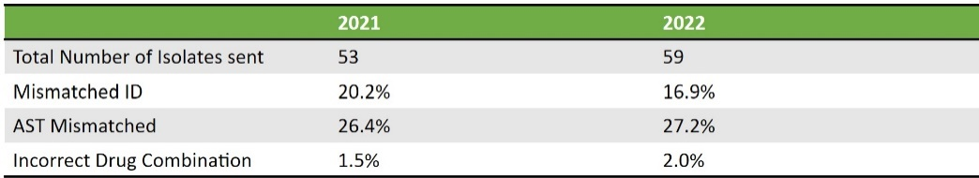
RESULTS:
.AMR Surveillance Isolate Retesting Report

Slide 8
Recommendations
While there has been improvement in quality assurance, antibiotic susceptibility poses a major challenge in AMR surveillance. Thika Level 5 Microbiology Laboratory will continue to work with stakeholders to enhance its infrastructure, capacity building for laboratory staff, and participation in External Assessment programs to combat antimicrobial resistance

Slide 9


Slide 10
Thank You
This work is supported by US Centers for Disease Control and implemented in collaboration with the Ministry of Health and Kiambu County Health Department.
The findings and conclusions in this presentation are those of the author(s) and do not necessarily represent the views of the Centers for Disease Control and Prevention/Agency

