Slide 1


Prevalence of Respiratory Tract Infections amongst HIV Clients Admitted at Homabay County Referral Hospital, Western Kenya
Authors: O Corneleous, M Odhiambo, S Jebitok, F Onyango
Presenter: Okal Corneleous
Venue: IPNET Conference SAI Rock Hotel
12th May 2023

Slide 2
Introduction
People Living with HIV (PLHIV) not on antiretroviral therapy (ART) and virally non-suppressed are more susceptible to opportunistic infections: tuberculosis (TB), pneumonia, upper respiratory tract infections (RTIs), and diarrheal diseases.
The extent to which these infections are preventable with community or health facility (HF) infection prevention control (IPC) measures remains unclear.
We assessed the prevalence of RTIs among PLHIV admitted at Homa Bay County Teaching and Referral Hospital (HCTRH).
Notes:
Globally, in 2018, 37.9 million people were living with HIV,23.3 million on ART(1)
Africa had 25.7 million people living with HIV, with 16.4 million on ART(1)
In Kenya,1.6 million people were living with HIV,1 million were on ART

Slide 3
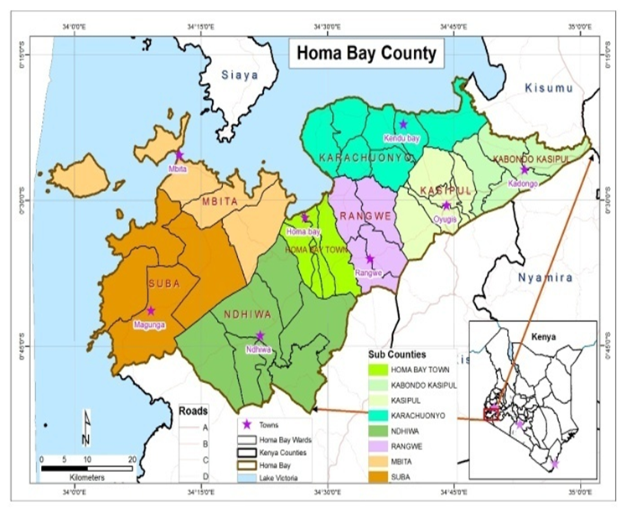
Study site
Homabay County Hospital is the main referral site for the County
Catchment population 28640
Bed Capacity of 273
Has 7147 patients active on ART in the CCC
HBCTRH

Slide 4
Methods
Cross-sectional study:
A retrospective review of Records of patients admitted in Medical Wards in 2021
Study population:
HIV-positive patients admitted to the medical ward in 2021
Respiratory infections:
We defined respiratory infections to include Tuberculosis, Covid 19 and pneumonia

Slide 5
Data Management
The primary data source was the inpatient Ministry of Health registers
Sociodemographic and clinical variables were abstracted from Ministry of Health registers into a database with enforced data quality checks.
We conducted descriptive data analysis and assessed the prevalence of RTIs

Slide 6
Characteristics of People Living with HIV admitted at Homabay County Hospital 2021(n =1007)
RESULTS
Variable | Frequency %
Age | The overall median age was 42 years (interquartile range (IQR) 32-51)
Female | 54% (540/1007)
Currently on ART On ART for > 12 months | 69% (690/1007) 59% (408/690)
Viral load uptake VL results VL < 200 copies VL > 200 copies | 59% ( 408/690) 75% (304/408) 25% (104/408)

Slide 7
Prevalence of RTIs amongst HIV Clients Admitted at Homabay County Referral Hospital in 2021(n =1007)
Variable | Frequency (%) | P value
TB Diagnoses
On ART | 4.3% (30/690) | p-value=0.243
Not on ART | 6% (19/317)
Pneumonia diagnoses
On ART | 6.7% (46/690) | p-value=0.675
Not on ART | 6.0% (19/317)
Covid 19 Cases
On ART | 2.0% (14/690) | *p-value<0.001
Not on ART | 7.3% (23/317)
*PLHIV on ART were less likely to be diagnosed with COVID-19 than those not on ART.
Overall PLHIV on ART were less likely (12.2% (84/690) vs 16.7% (53/317), p-value=0.027) to be diagnosed with RTIs than those not on ART

Slide 8
Conclusion/Recommendation
RTIs contributed to about 14% of hospital admissions amongst PLHIVs
PLHIV not on ART were more likely to be diagnosed with COVID-19 and with any RTIs.
There is a need to assess the implementation of IPC measures among PLHIV in both community and HF.

Slide 9



Acknowledgement
IPNET Mentors- Dr. Paul Musingila, Dr. Raphael Odondo, Dr. Ernest Makokha, Francis Omondi
HBCTRH

Slide 10

EROKAMANO

