Slide 1

PREVALENCE AND PRACTICE TOWARDS RATIONAL DRUG USE AT MARIAKANI SUB-COUNTY HOSPITAL (MSCH) BASED ON WORLD HEALTH ORGANISATION CORE DRUG USE INDICATORS
Presented By :Dr. Peter Ngugi

Slide 2
Introduction
Rational Drug Use (RDU) is essential for achieving quality healthcare provision and Universal Health Coverage (UHC).
RDU ensures appropriate prescribing, dispensing, and use of medicines.
Occurrences of irrational use of medicines can lead to poor patient outcomes and contribute to antimicrobial resistance (AMR).
Mariakani Sub-County Hospital (SCH) in collaboration with USAID Medicines, Technologies and Pharmaceutical Services (MTaPS) program conducted a study to assess practice towards rational drug use.
USAID MTaPS Program
USAID MTaPS Program

Slide 3
Objective
To assess medicine use patterns in the outpatient departments of Mariakani SCH (secondary care hospital) by employing the standard World Health Organization (WHO)/The International Network for Rational Use of Drugs (INRUD) drug use indicators
To determine the level of rational use of medicines using the WHO/INRUD core drug use prescription, patient, and facility indicators

Slide 4
Methodology
Key Outputs
Prescribing indicators (retrospective study):
600 prescription encounters were taken for Mariakani SCH (based on WHO recommendations)
Reporting period: July 2021 to June 2022
Total 6,006 prescriptions received in the in Mariakani SCH outpatient pharmacy from July 2021 to June 2022
Using systematic random sampling, every tenth (10th) prescription was sampled in Mariakani SCH.
Patient indicators (prospective study):
100 outpatient attendants (encounters) in Mariakani SCH interviewed (WHO recommends) this was assessed by prospective convenient sampling.
Facility indicators (prospective study):
Availability of the 22 essential medicines as per the Kenya Health Products and Technologies (HPT) tracer products list*.
Prescribing indicators:
Average number of medicines per encounter,
% of generic medicines prescribed,
% of prescriptions with antibiotics,
% of prescriptions with injections,
% of prescribed medicines from KEML were determined.
Patient indicators:
Average dispensing time
2. Average consultation time
Total drugs prescribed
% Medicines dispensed
% Medicines labelled appropriately
Facility indicators:
% of tracer medicines available in the facility
% of prescribers with access to the KEML

Slide 5
Prescribing Indicators - Sociodemographic Characteristics
Variables |  | Number of Patients | Percentage
Type of patient | Adult > 18 years | 440 | 73%
 | Pediatric < 18years | 160 | 27%
Sex | Male | 196 | 33%
 | Female | 404 | 67%
Majority of prescriptions received by Mariakani SCH were for adult patients; 46% more adult prescriptions compared to pediatrics
There were 34% more female patients receiving medicines in the outpatient department compared to males

Slide 6
Key findings – Prescribing indicators
Prescribing Indicators | Frequency | Percentage | WHO Standard
Total number of medicines prescribed | 1604
Medicines prescribed by generic name | 1185 | 74% | 100%
Medicines prescribed from EML | 1529 | 95% | 100%
Prescriptions with ≥ one antimicrobial | 414 | 69% | <30 (20%–26.8%)
Total number of antimicrobials prescribed | 445 | - | -
Injections prescribed | 48 | 6%* | (13.4%–21.1%)
Average medicines per prescription | 2.7 |  | ≤2 (1.6%–1.8%)
WHO prescribing standards NOT met
Medicines prescribed by generic name – 63% (target 100%)
Medicines prescribed from EML – 91% (target 100%)
% of antimicrobial encounters – 28% (target <30%)
WHO prescribing standards met
% of injection encounters – 6%* (target <21.1%)
* Note: only represents outpatient prescriptions

Slide 7
Key findings – Prescribing indicators
Key findings:
Average number of medicines prescribed per prescription – 2.7

Slide 8
Deep-dive into antimicrobial prescribing trends
Key findings:
69% of prescriptions contained at least one antimicrobial medicine
Female patients were 38% more likely to be prescribed an antimicrobial medicine

Slide 9
Key findings – Prescribing indicators
Key findings:
Average number of antimicrobials prescribed per prescription with antimicrobials – 1.1

Slide 10
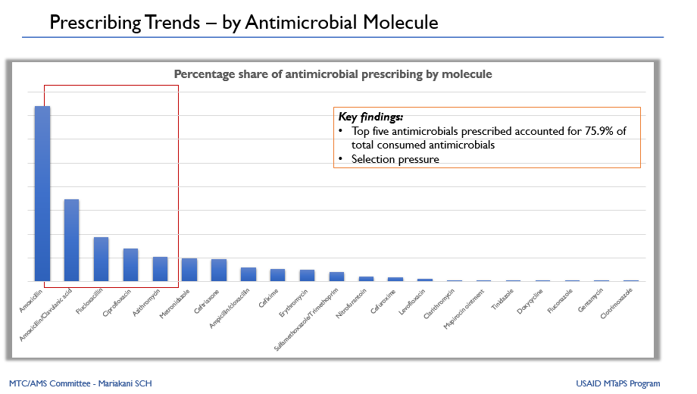

Slide 11
Patient Indicators - Sociodemographic Characteristics
Type of patient | Count | Percentage
Adult | 73 | 73%
Pediatric | 27 | 27%
Sex of patient | Count | Percentage
Female | 49 | 49%
Male | 51 | 51%
Majority of patients observed were adult patients; 73% adult attendees vs 27% pediatrics
There were more male patients observed in the outpatient department compared to females, i.e., 51% vs 49%

Slide 12
Patient Indicators – Findings
 | Average Dispensing Time | Average Consultation Time | Total Drugs Prescribed | Total Dispensed Drugs | Total Labeled Drugs
Count | 17583 | 1174 | 250 | 229 | 212
Result | 175.8 seconds | 11.7 mins | 250 | 229 (91.6%) | 212 (92.6%)
WHO standards | >180 seconds | 10 minutes | — | 100% | 100%
Average consultation and dispensing times in the present study were 11.7 minutes and 175.8 seconds, respectively
From a total of 250 medicines prescribed, 229 (91.6%) were dispensed, of which only 92.6% were adequately labeled

Slide 13
Facility Indicators – Findings
Parameter | Count | Percentage
In stock essential medicines | 19 | 86%
Out of stock essential medicines | 3 | 14%
Antimicrobials out of stock | 2 | 25% (of total antimicrobials on list)
Out of the 22 essential medicines as per the MOH HPT tracer products list – 19 medicines (86%) were in stock and 3 (14%) recorded as out of stock
Out of the 3 out of stock medicines, 2 were antimicrobial medicines i.e., Benzyl penicillin 1 MU (IV) & Amoxicillin 500mg (PO)

Slide 14
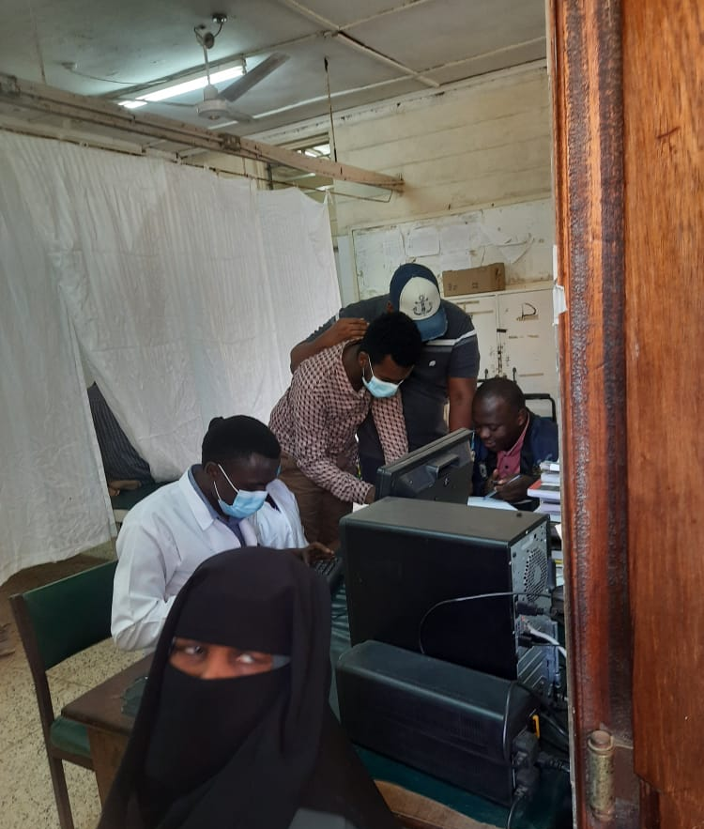
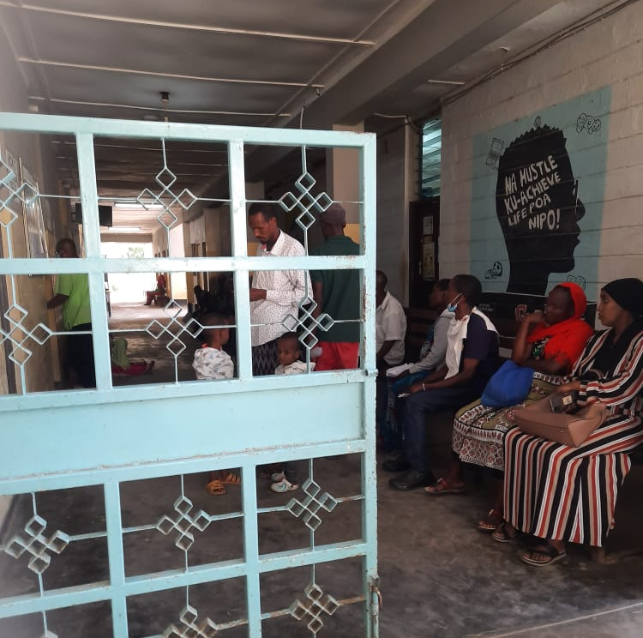
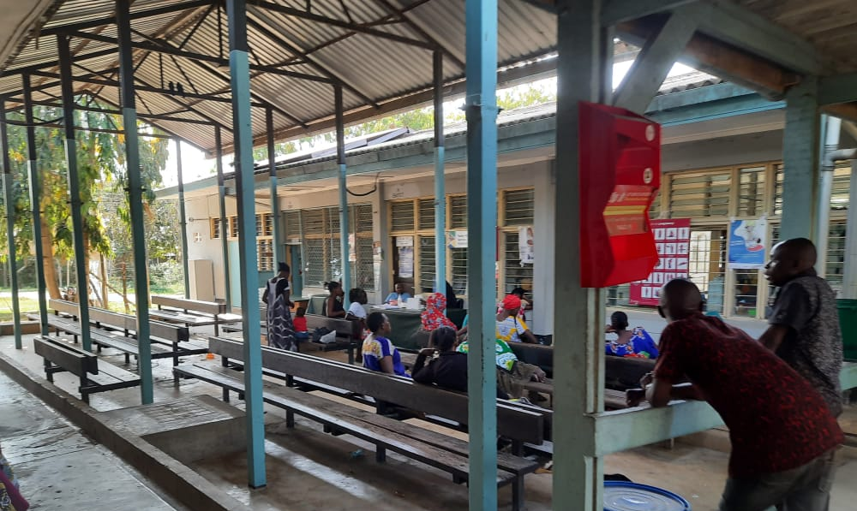
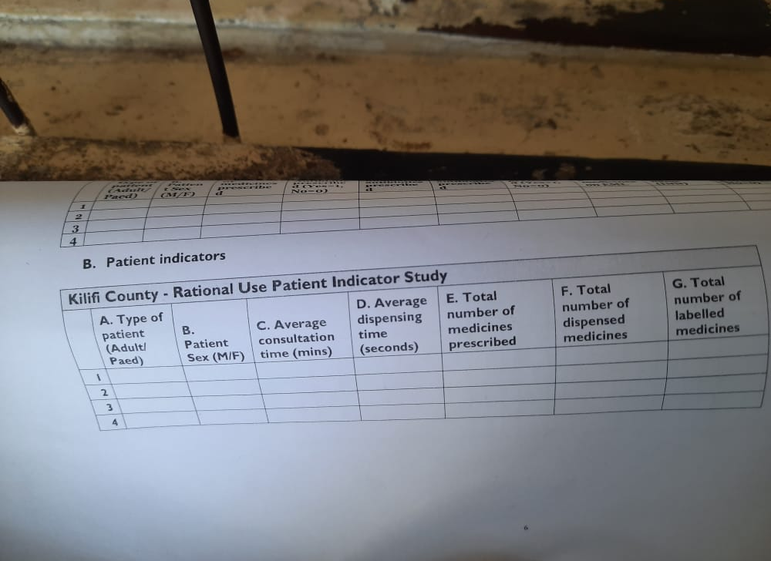
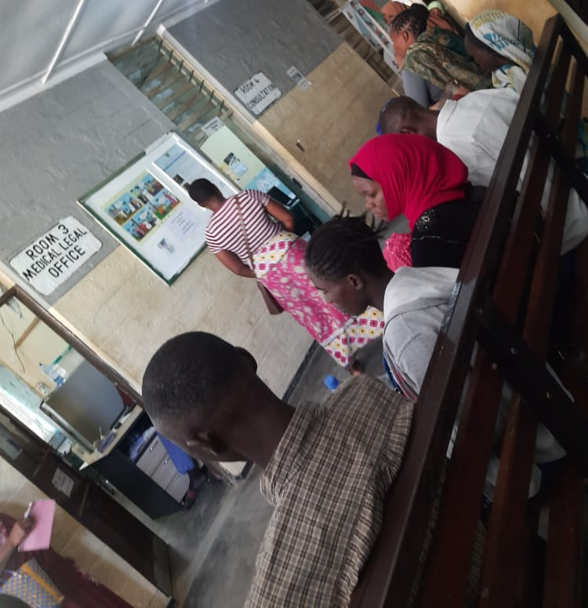
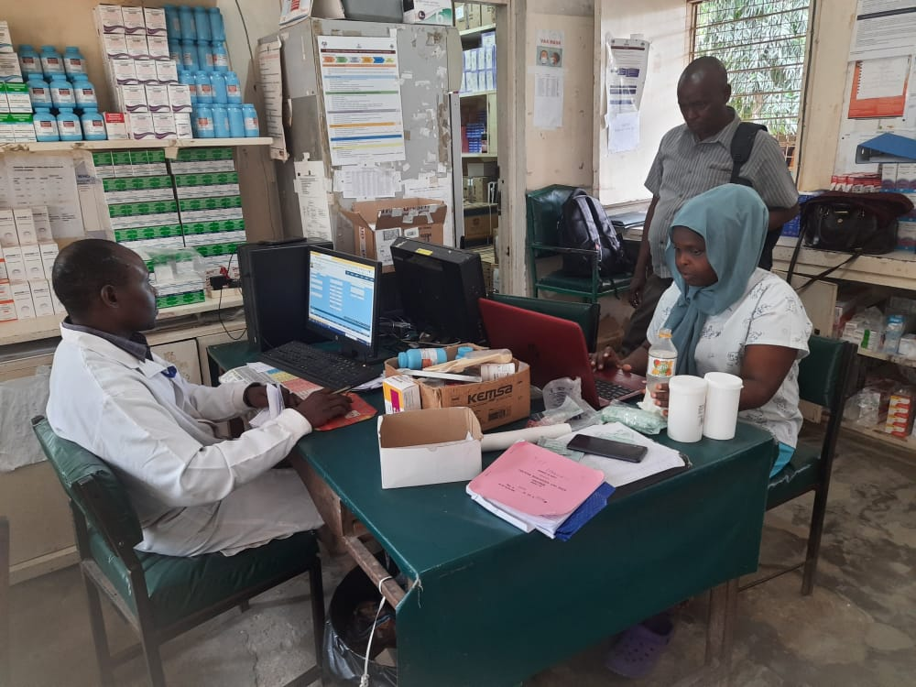

Photo Gallery
Top Left: Pharmacy outpatient department – Dispensing time observation for patient indicators. Top Center: Data collectors compiling data. Top Right: Mariakani Outpatient department: Data collection of RDU Patient indicators – Consultation time. Bottom Left: Consultation time data collection for Patient indicators. Bottom Center: Data Collection tool. Bottom Right; Data collection team. Photo Credit: Peter Ngugi – Mariakani SCH

Slide 15


Acknowledgements
Kilifi County – through the support of the County AMS focal person
Mariakani Sub-County Hospital
MTC/AMS Committee at Mariakani SCH
USAID MTaPS team

Slide 16


THANK YOU
Asanteni
Questions?

