Slide 1


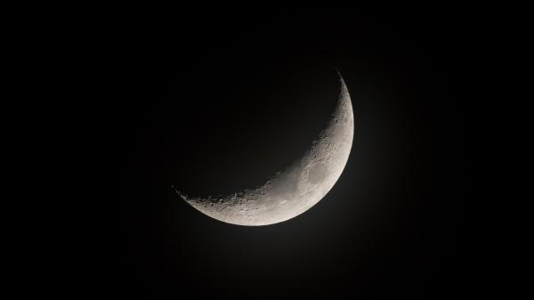



Moonlight Covid19 Vaccination Success Story
Pata Chanjo!
Kaa chonjo!
IPNET Kenya 10th Annual Scientific Conference
Sai Rock Hotel-MOMBASA
Imani Baraka
Sub County EPI Coordinator
Co-Authors: Pauline Oginga, Florence Wachuka & Isaac Jewa
Kisauni & Nyali

Slide 2
Introduction;
Vaccination STOPs COVID19 spread
-Kisauni and Nyali/ 6 sub counties- Mombasa
-Insecurity cahllenges
-Hesitance among AYP
-Increased number of missed opportunities (night revellers, those busy in the day
threatens public health
-Business unusual approach
Objectives;
-Increase awareness
-Increase access by boosting vaccination effort with 20%
-Serve under privileged
Beneficiaries:
-Community/ clients
-Health care providers
-Health sector
-Government of Kenya
-Global impact

Slide 3
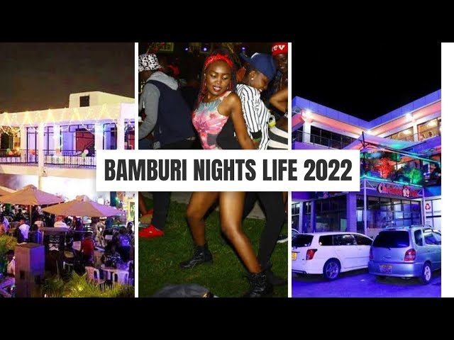
Key Highlights:
Higher activities around the recreation places over the weekends
(Friday, Saturday and Sunday), hence influx of population in such
areas and overcrowding increasing the chances of spreading the
infection.

Slide 4
Method: Moonlight Vaccination
Collaboration
HCWs
Communication
Advocacy meetings
Coordination
ACSM
Logistics
Cooperation
Vaccination Team movement
Security
Mobilizers
MOI & NGAOs
Bar, Night Clubs, Markets, men joints
Partners
Media houses
County leadership
Letters
Whatsapp
Performance reviews
Vaccination teams
Security teams
Community
Recreational joints
Celebrities
DoHS
House holds
Documentary

Slide 5
Results:
Feb 2022-Feb 2023 (all doses)
Kisauni- 35,290 people received;
2,313 (6.6%) received the vaccine at various health facilities,
3,280 (9.2%) received the vaccine
during the day outreaches,
29,697 (84.2%) received
vaccine through the moonlight strategy.
Nyali- 37,811 people received;
3,951 (10.5%) received the vaccine at various health facilities,
12,534 (33.1%) received the vaccine
during the day outreaches,
21,326 (56.4%) received
vaccine through the moonlight strategy.

Slide 6
Summary:
Vaccine Hesitance;
-In a relaxed mood, HCWs have addressed so many concerns from different cohorts (men, youths, family members, key populations)
-Awareness increased
Vaccination options;
-Facility
-Door step vaccination- day or night
-Bridged missed opportunities gaps
Moonlight set target;
20%- 70%
Surpassed by 50%
Cohesion;
Relationship strengthened among other key stakes;
Community key gate keepers,
Entertainment joints
National security organs
community
Intervention diffusion;
Experience sharing
-Likoni SC,
-Changamwe SC,
-Kwale County,
Conclusion;
Moonlight has contributed immensely in our overall performance
Can be adopted by other Counties, Countries and other programs

Slide 7
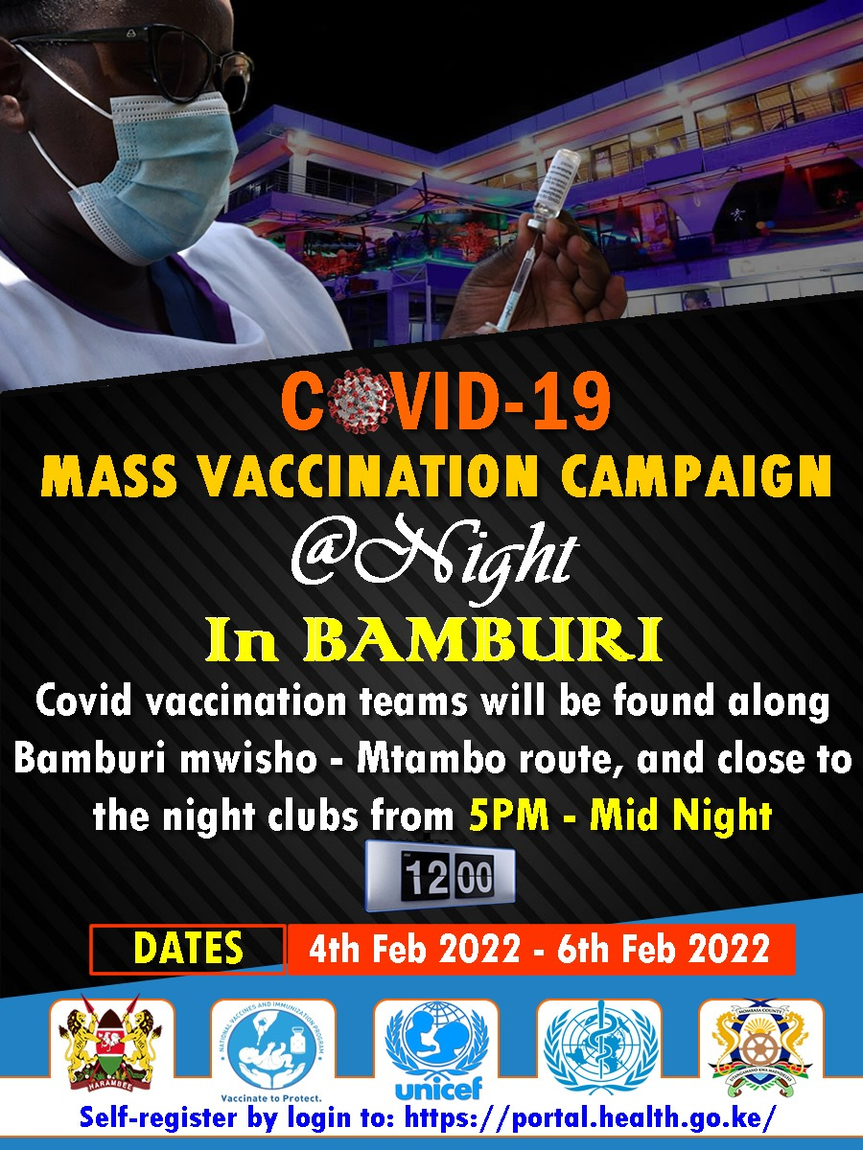
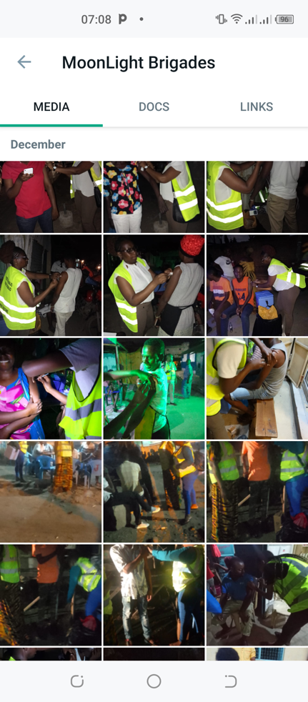

Slide 8
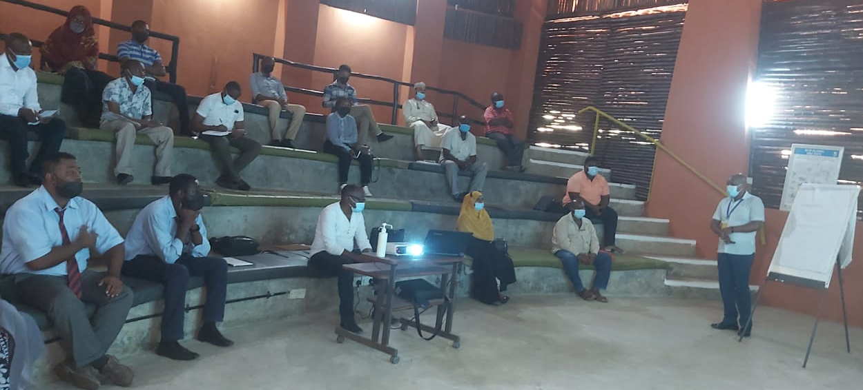
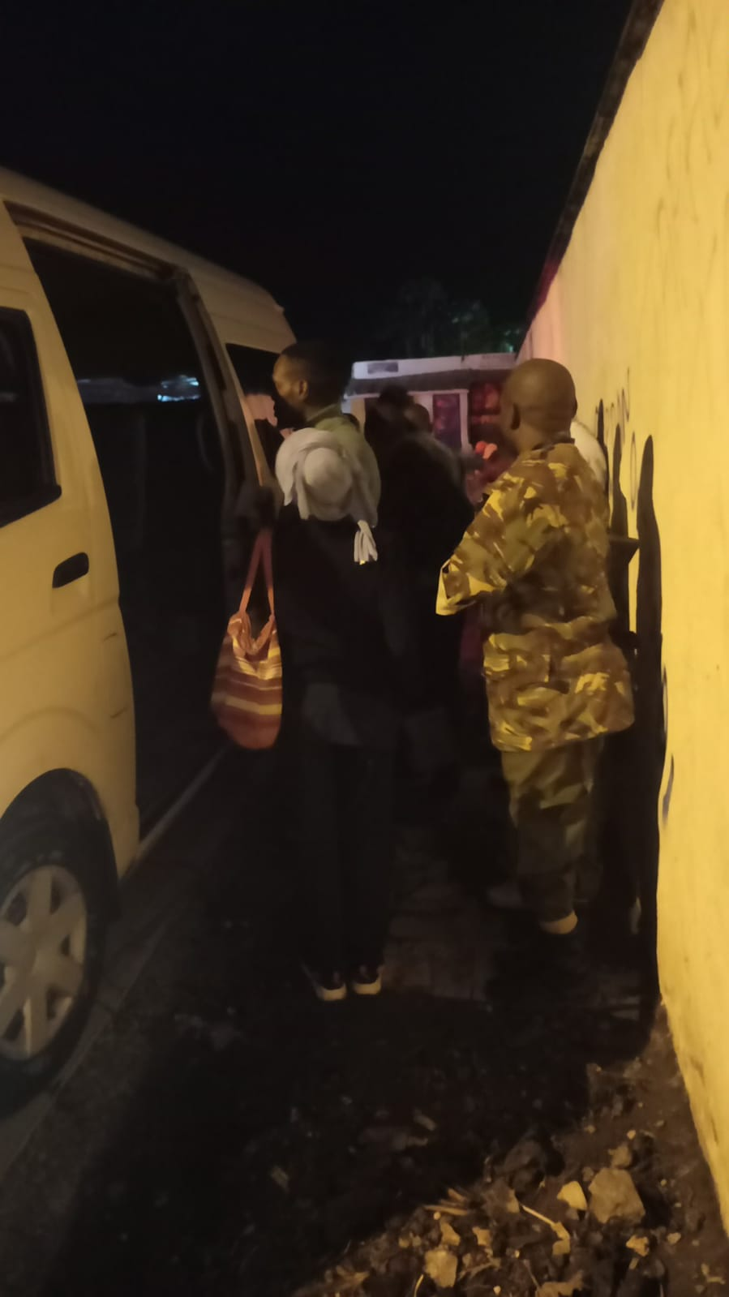
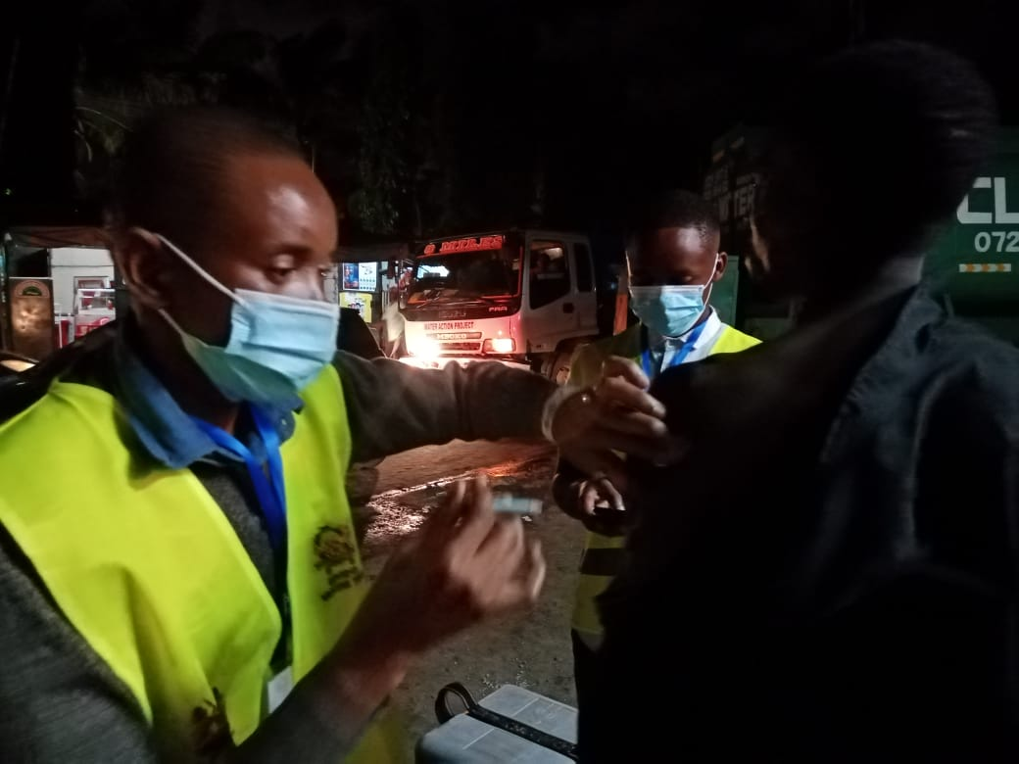

Slide 9
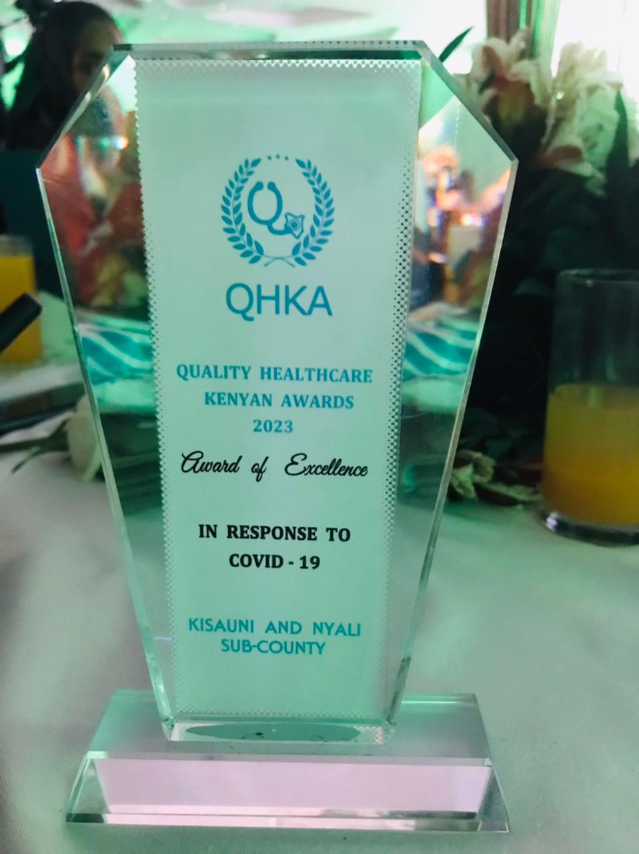
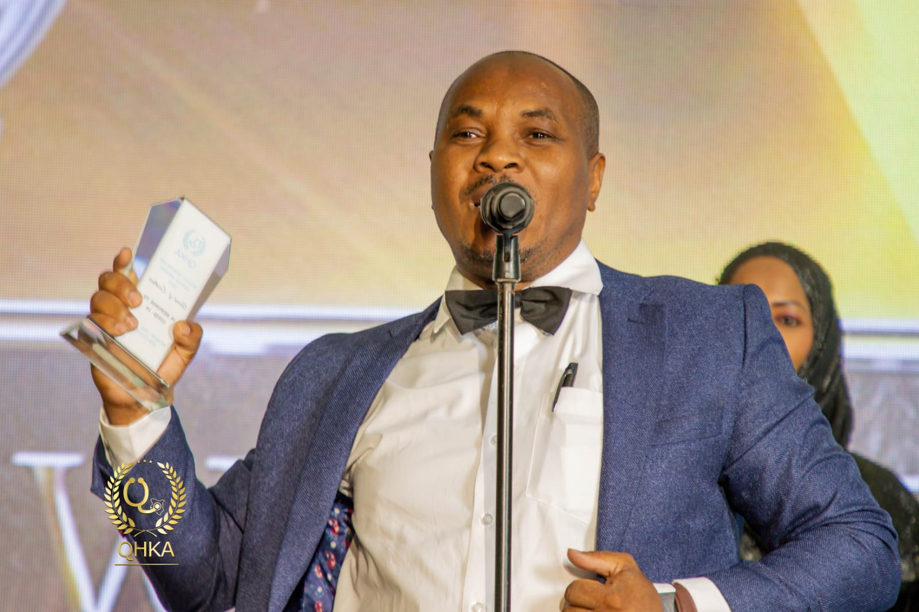
National Recognition 2023:
Award of excellence in Response to COVID19

Slide 10
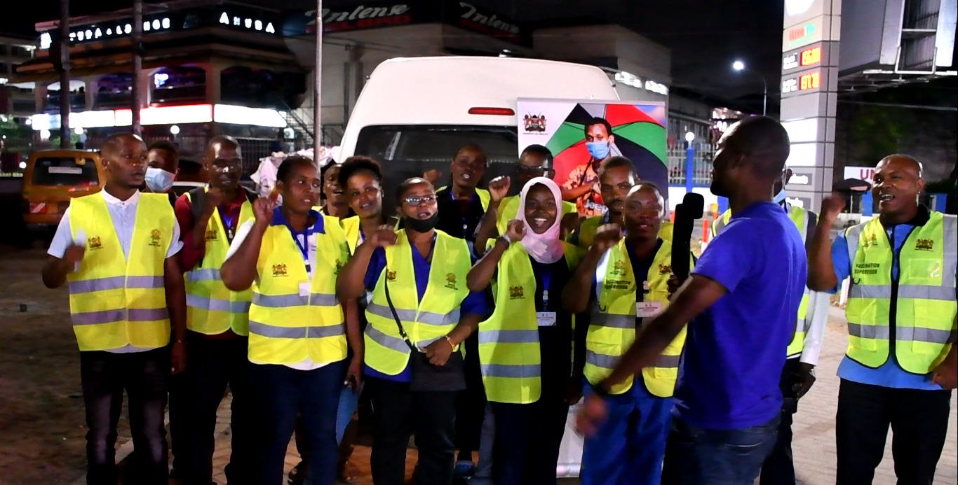
Documentary link- 4 minutes
Acknowledgement:
County Leadership
WHO
AMURT Jitegemee
USAID Stawisha
JSI-Insupply
Amref
PSK
MOI & NGAOs
Community leadership
QHKA
IPNET Kenya
WSU
https://youtu.be/WfTLZwchKfg

Slide 11
Pata Chanjo, Kaa Chonjo!
Thank you!

