Slide 1



KNOWLEDGE, ATTITUDES AND PRACTICES OF ANTIBIOTICS USE AMONG PATIENTS AT KAYOLE II HOSPITAL, EMBAKASI WEST SUB-COUNTY, NAIROBI CITY, KENYA
10th IPNET CONFERENCE, 9th to 12 May 2023
Presenter: Esther Sankale

Slide 2
Authors
Esther Sankale RCN/BScPH, Sub-County IPC Coordinator Embakasi West. branicesan@gmail.com IPC MENTOR |  | Stanley Maburi, Facility Health Records I. Officer Kayole 2 SC Hospital, (smaburi84@gmail.com)
Gladys Kioko Embakasi West Sub-county Pharmacist, Nairobi County gladyskioko@gmail.com
 |  | Carolyne Magiri, County IPC Coordinator Nairobi County (cmagiri@gmail.com)

Slide 3
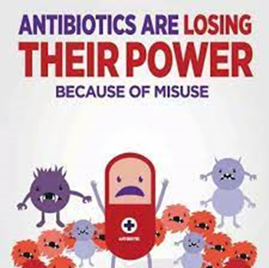

outline
Introduction
Methods
result
Conclusion
Antibiotic overuse: a key driver of antimicrobial resistance

Slide 4
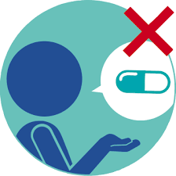

Introduction
Infection causing bacteria’s are becoming increasingly resistant to the antibiotics used to treat them, and antimicrobial resistance is becoming a global public health challenge, which has been accelerated by the inappropriate use of antibiotics worldwide

Slide 5

Methodology
A cross-sectional descriptive study was employed to obtain a sample size of 850 patients visiting the facility for 2months
A purposive sampling was done to pick the facility and a structured questionnaire was used to collect the data which included demographic information and antibiotic use
Data was entered and analyzed using Excel
A total of 788 patients fulfilled the inclusion criteria, and were included in the study

Slide 6
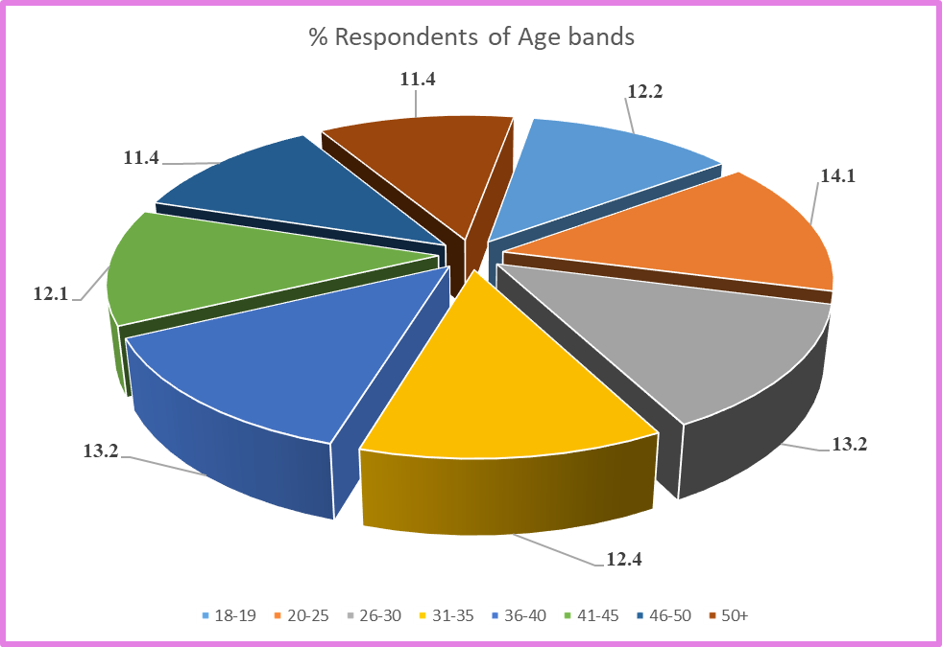
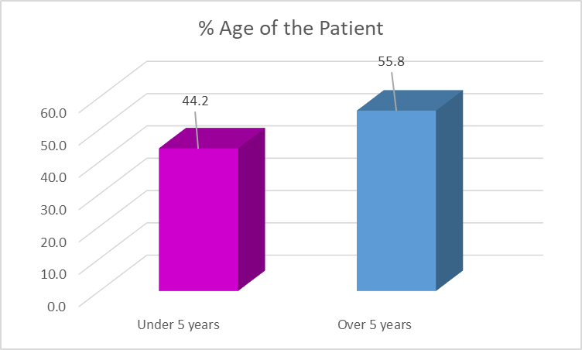

Results
The age band of 20-25 years 14.1% (111) of respondent were the most patients who attended the facility
about (40%) were in the age between 20 and 35 years (n = 313). Whereas, on patients, children with age less than 5 years were the minority 44.2% (n = 348), and 55.8% (n = 440) were over 5 years old

Slide 7
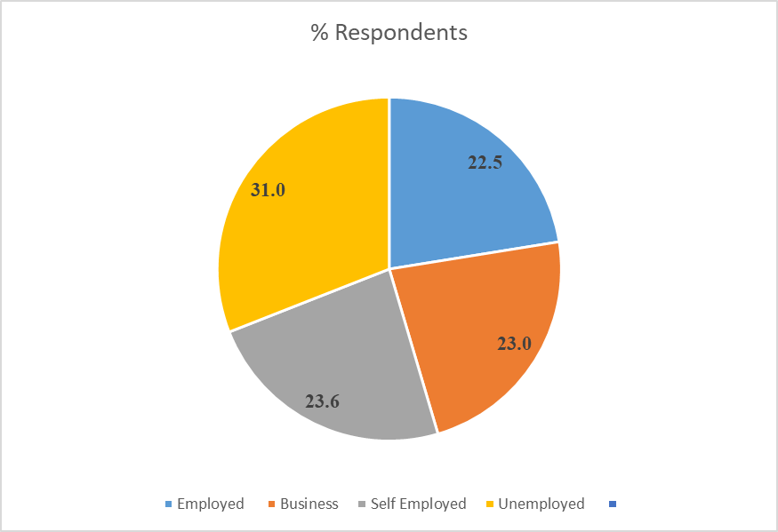
Results
A Total of unemployed patients 31.0% (244) patients who attended the facility during the period with the self-employed representing 23.6% (186)

Slide 8
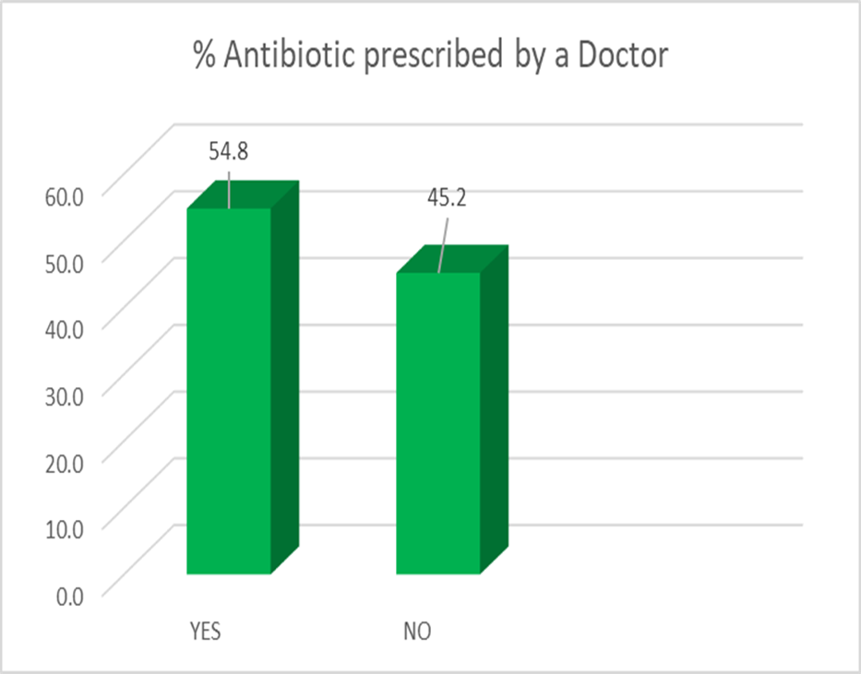
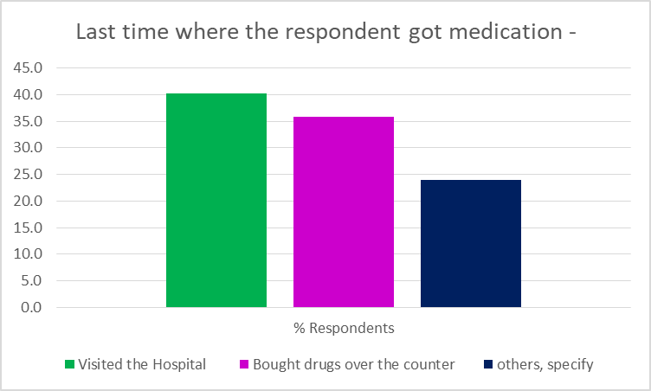
Results

Slide 9
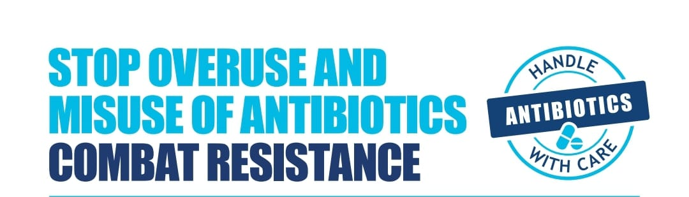
Results
Prevalence of anti-microbial misuse was 44.0% (N=350) among participants with primary education level and 23% (n = 182) among participants with tertiary education level
Respondents practice on the inappropriate use of antibiotics was as follows; used without doctor’s prescription 45.2% (n=356), non-adherence 36.7 (n=289), used left-over 48% (n=407) and share antibiotics 46.8%
Only 10.1% (n = 80) had the knowledge that misuse of antibiotics can lead to antimicrobial resistance

Slide 10




Recommendations
Stop overuse and misuse of antibiotics by:
Seek advice from qualified health professional before antibiotics use and adhere to advice
Support a multi-sectoral national action plan on AMR
Develop and enforce regulations to stop overuse/misuse
Educate family and friends about AMR
Prevent the spread of infection by: Washing hands regularly, hygienic food preparation and vaccinations
Data driven decision making

Slide 11


Conclusion
Most respondents had low knowledge on antibiotic resistance and inappropriate practice towards antibiotics use.
Holistic approach to promote proper use of antibiotics should take into account all implementers; healthcare providers & community, including parents/guardians, urge for educational programs using all means reduce antimicrobial resistance

Slide 12
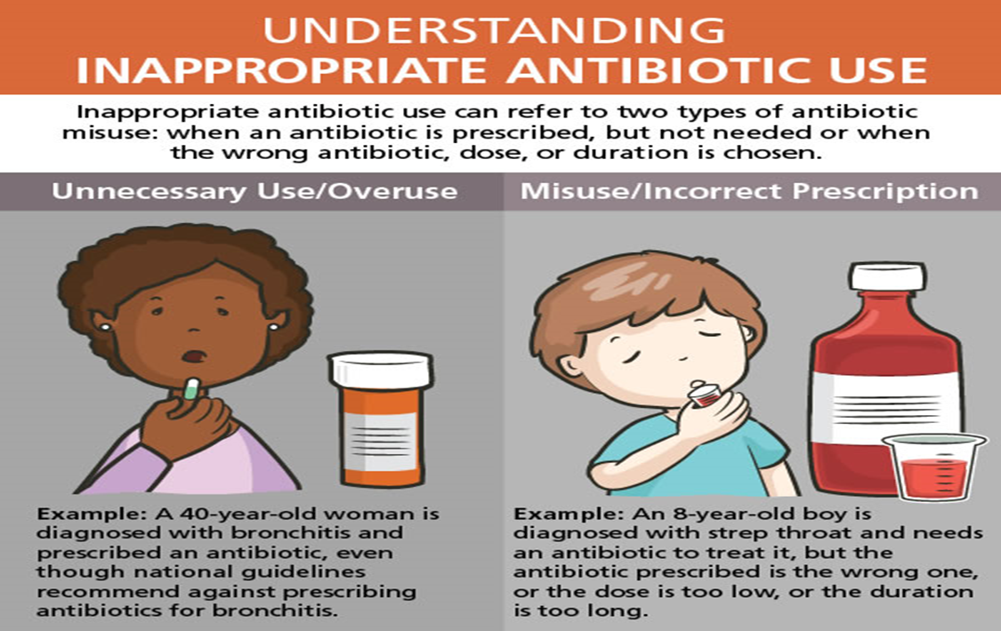
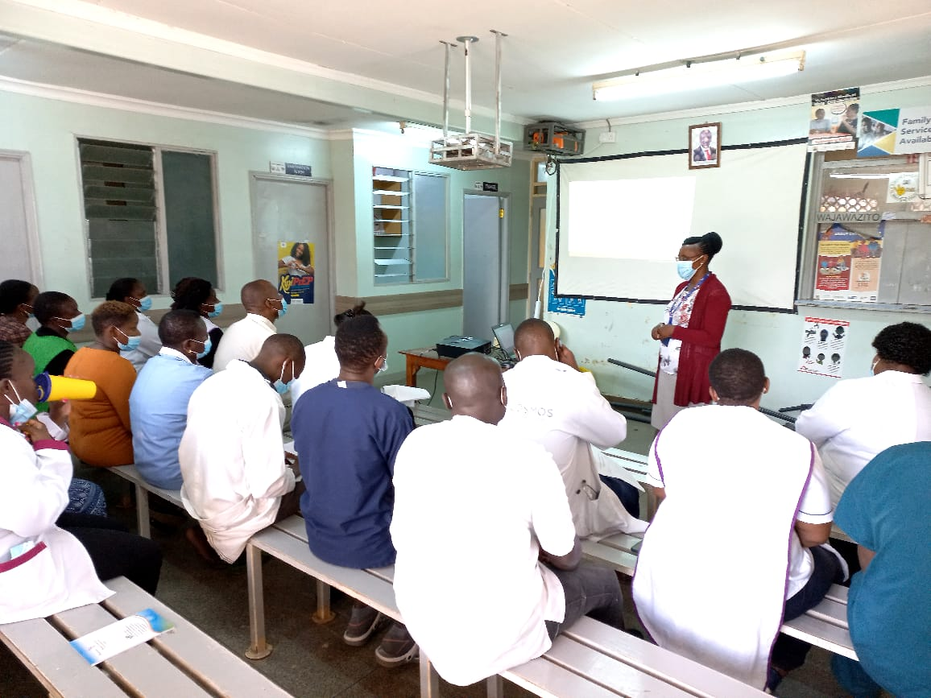
Evidence-based interventions
CME on AMR

Slide 13



