Slide 1
IPC QUALITY IMPROVEMENT IN INTENSIVE CARE UNIT AT THIKA LEVEL 5 HOSPITAL.
By Vivian Onyango
Thika level 5 Hospital

Slide 2
INTRODUCTION
Globally, 5-15% of hospitalized patients acquire infections often caused by antimicrobial resistant microbes due to inadequate infection prevention and control (IPC) measures.

Slide 3
Objective
To assess IPC practices in Thika Level 5 Hospital, ICU department
2. Improve and standardize IPC practices in ICU

Slide 4
Methodology
Study site: Thika level 5 Hospital, ICU department
Study period: Sept 2022- February 2023
Assessment and interventions were done on:
Hand hygiene compliance
PPE usage
Environmental cleaning and disinfection of reusable medical equipment
Tracking of invasive devices
Sharp safety
Waste disposal

Slide 5

ASSESSMENT AND FINDINGS

Slide 6
1. Hand Hygiene Compliance : Avg 26.5%

Slide 7
2. Personal Protective Equipment Usage
Wearing of gloves, face mask and gowns was at 100%
Overuse of gloves
Poor disposal of gowns

Slide 8
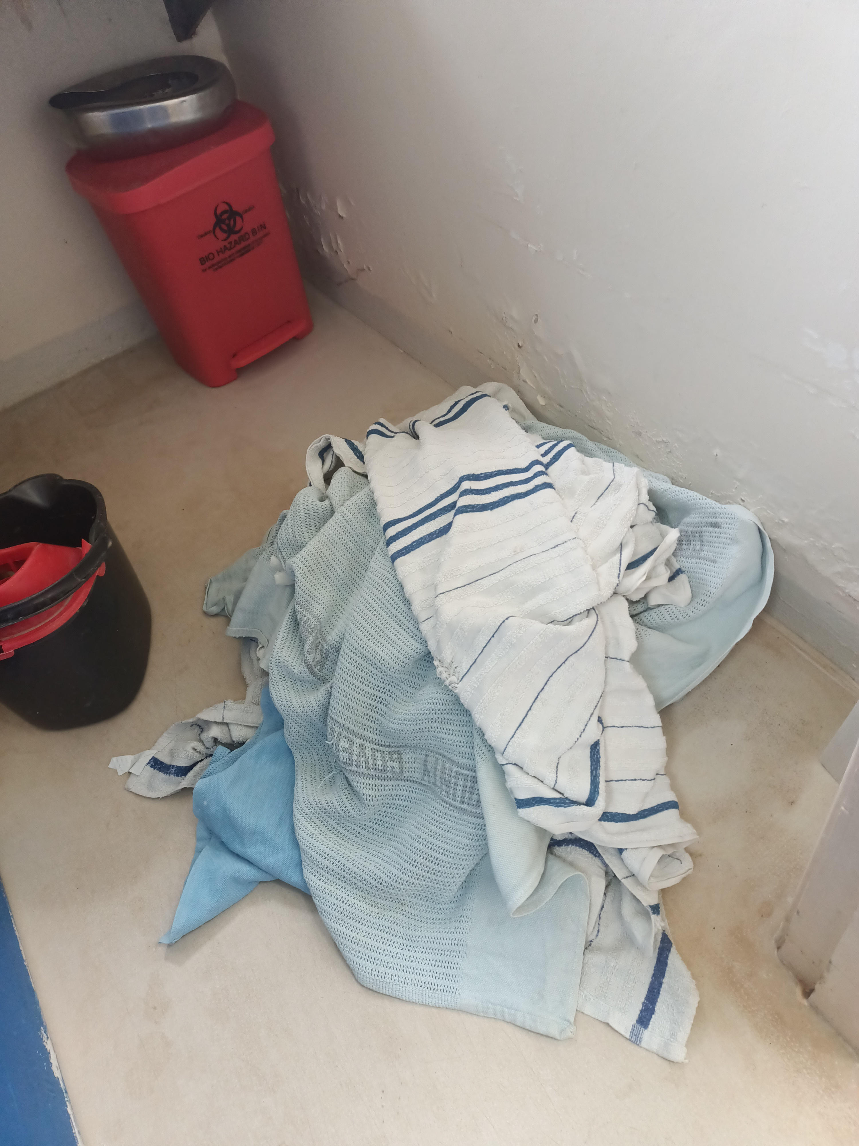
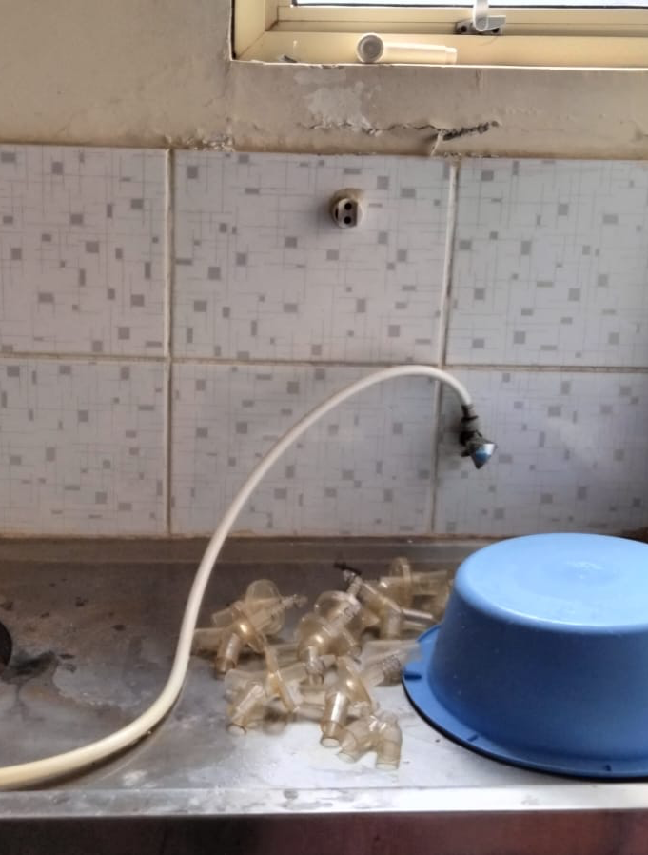
3. Environmental cleaning and disinfection of medical equipment
a) No standard operating procedure for dilution of disinfectants
b)No cleaning schedule for the unit
c) Dirty linen on the floor at the sluice room
d)No designated clean area for drying

Slide 9
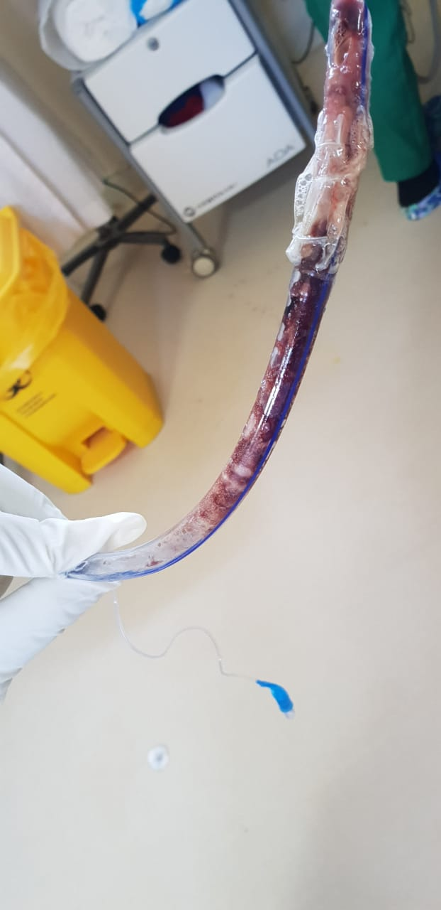
4. Tracking of Invasive devices
IPC chart for tracking invasive devices e.g. catheters, IV cannulas, ETT, nasogastric tube, CVC available.
Not being utilized

Slide 10
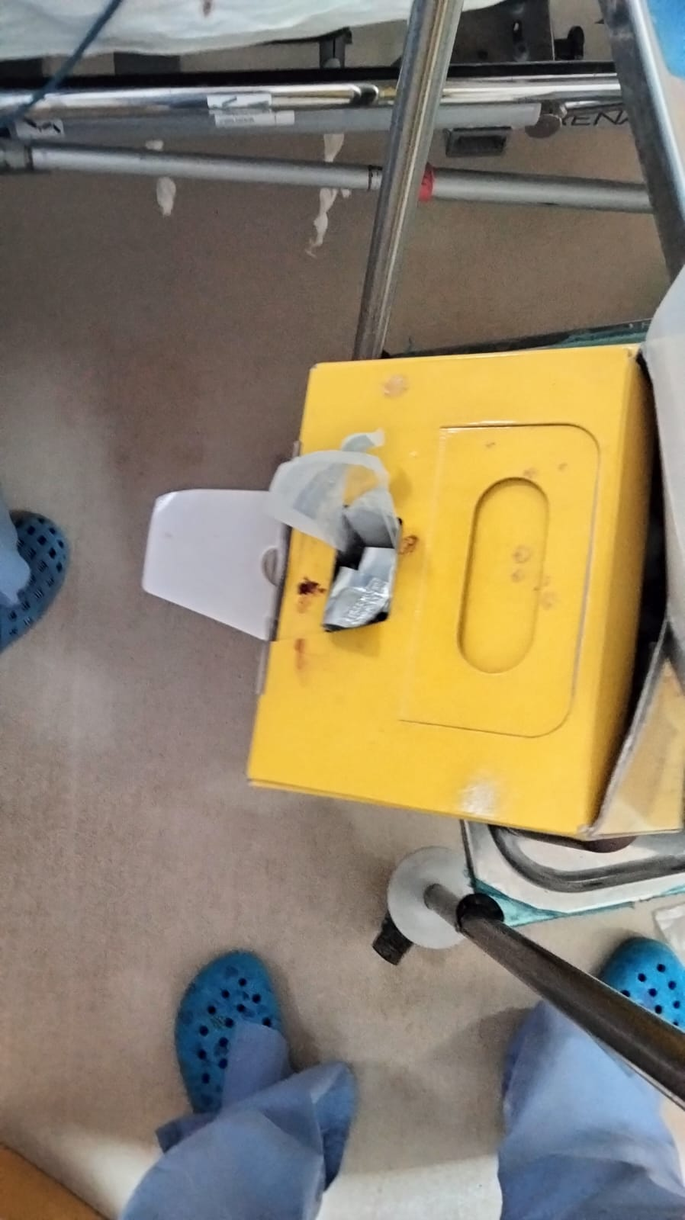
5. Sharps safety
Adequate safety boxes
Exceeding the ¾ fill rule

Slide 11
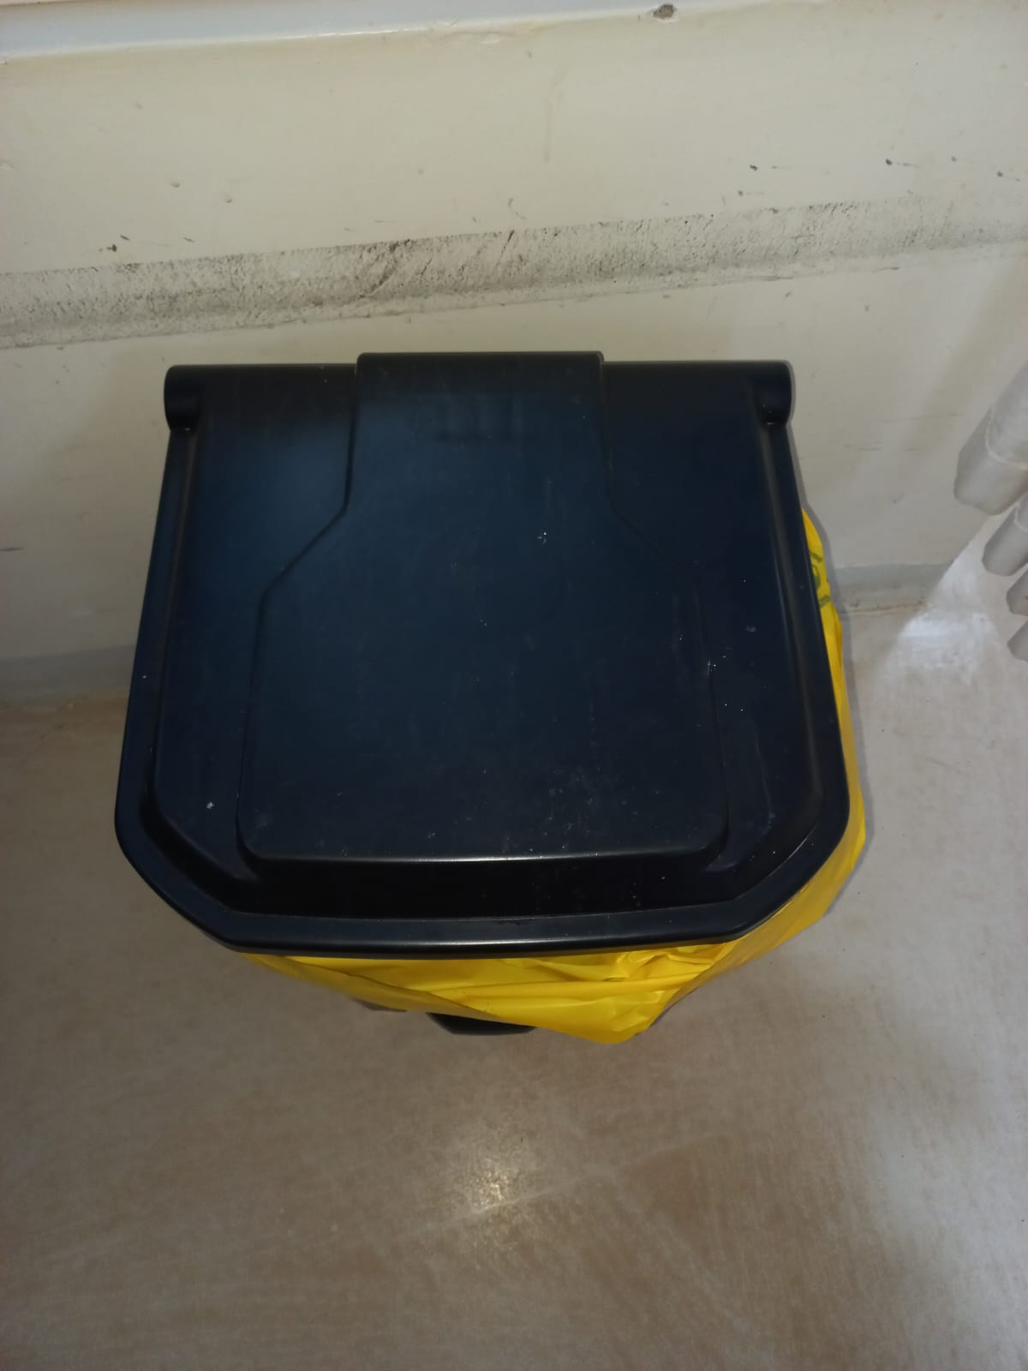
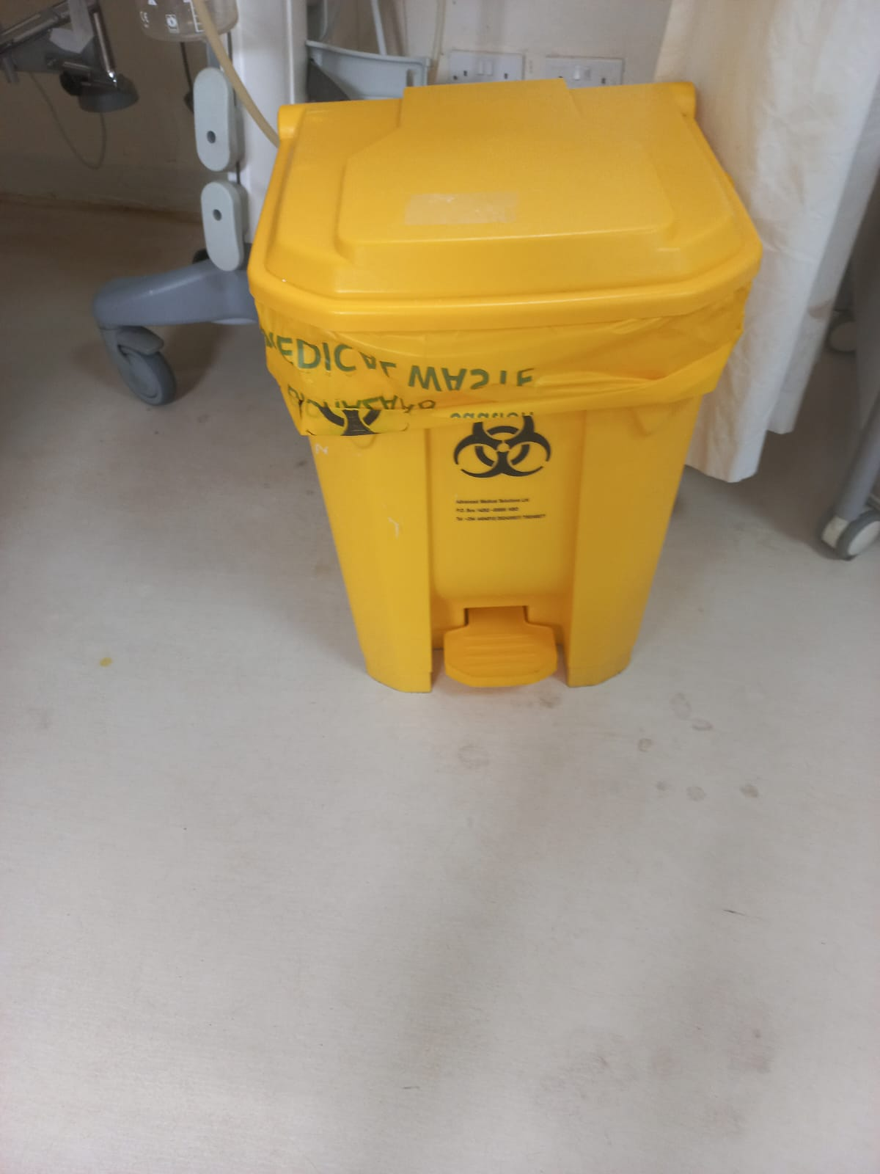
6. Waste disposal
Adequate color-coded pedal operated bins with liners
Poor waste segregation

Slide 12

INTERVENTIONS

Slide 13

1. Hand Hygiene
i) Sensitization and training of staff on hand hygiene practices
Visitors were guided on entrance and at exit
Students – IPC orientation by IPC champion
ii) Reminder posters on hand hygiene
iii) Commodities for hand hygiene
  Ensure availability at respective points

Slide 14
2. PPE over use and disposal
Sensitization
Prompt disposal after use
Designated place for safe hanging

Slide 15
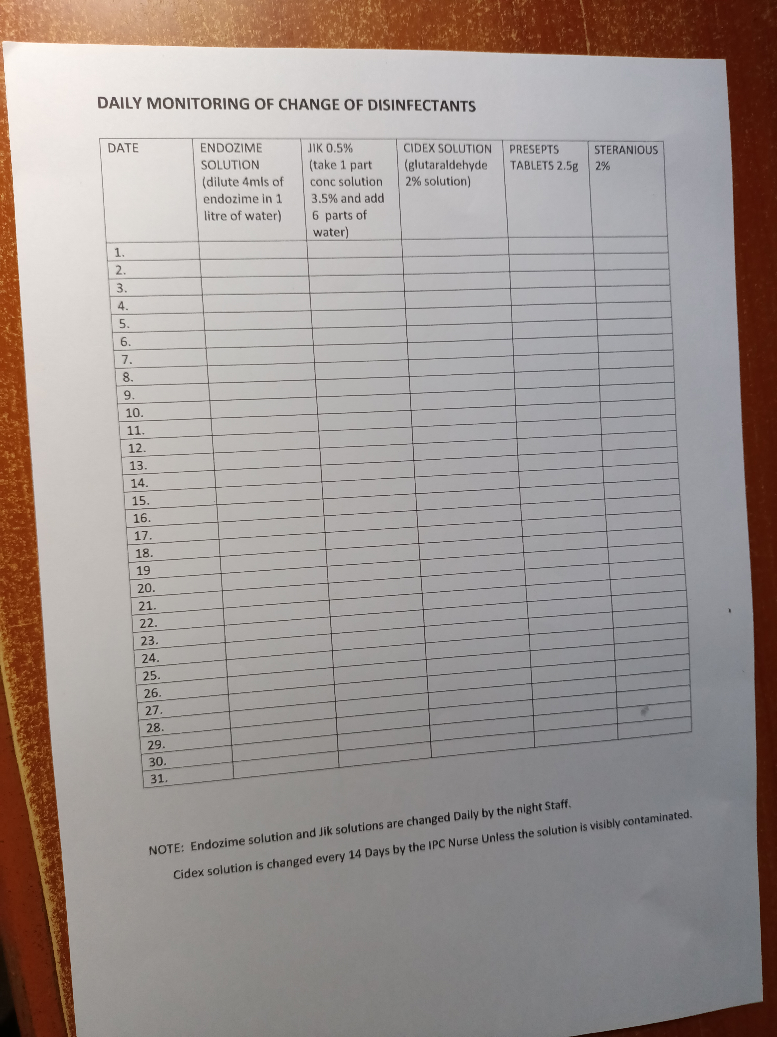
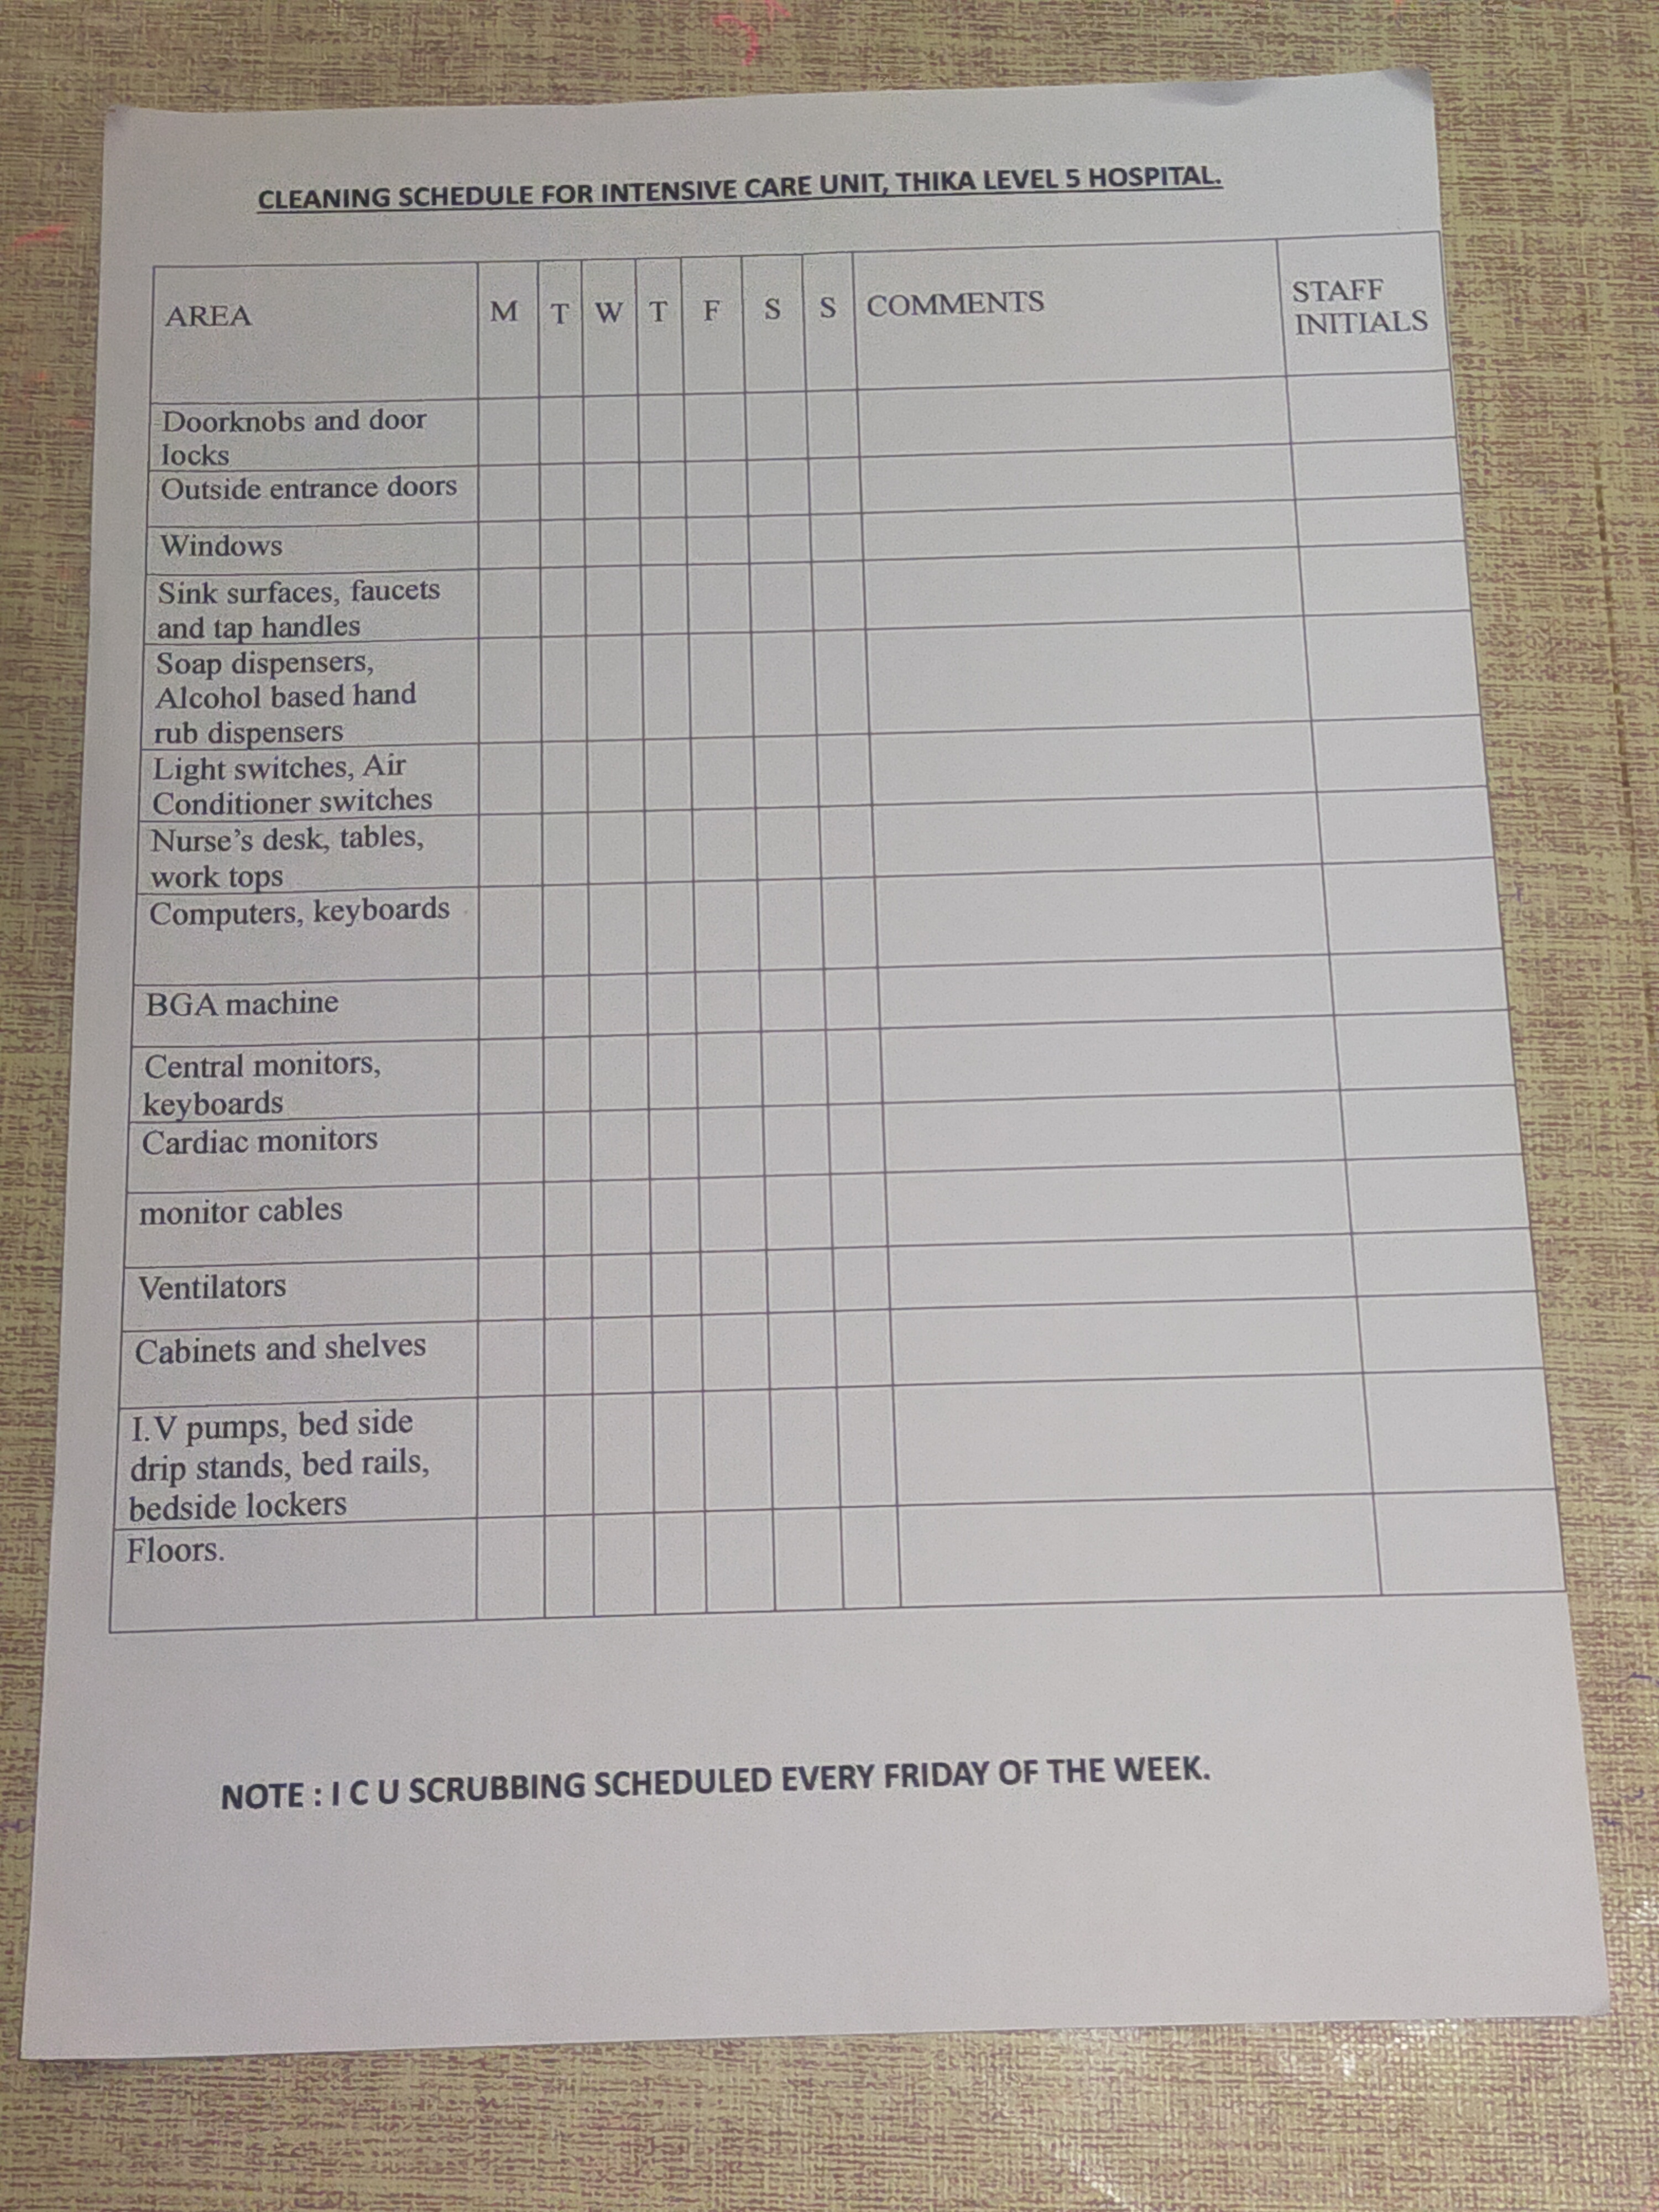
3. Environmental cleaning and disinfection of medical equipment
i) Introduced a daily monitoring tool for change of disinfectants with respective dilutions
ii)Developed a cleaning schedule for the Unit
Dump dusting done every day
Unit cleaned x 3 per day
Weekly scrubbing of the Unit

Slide 16
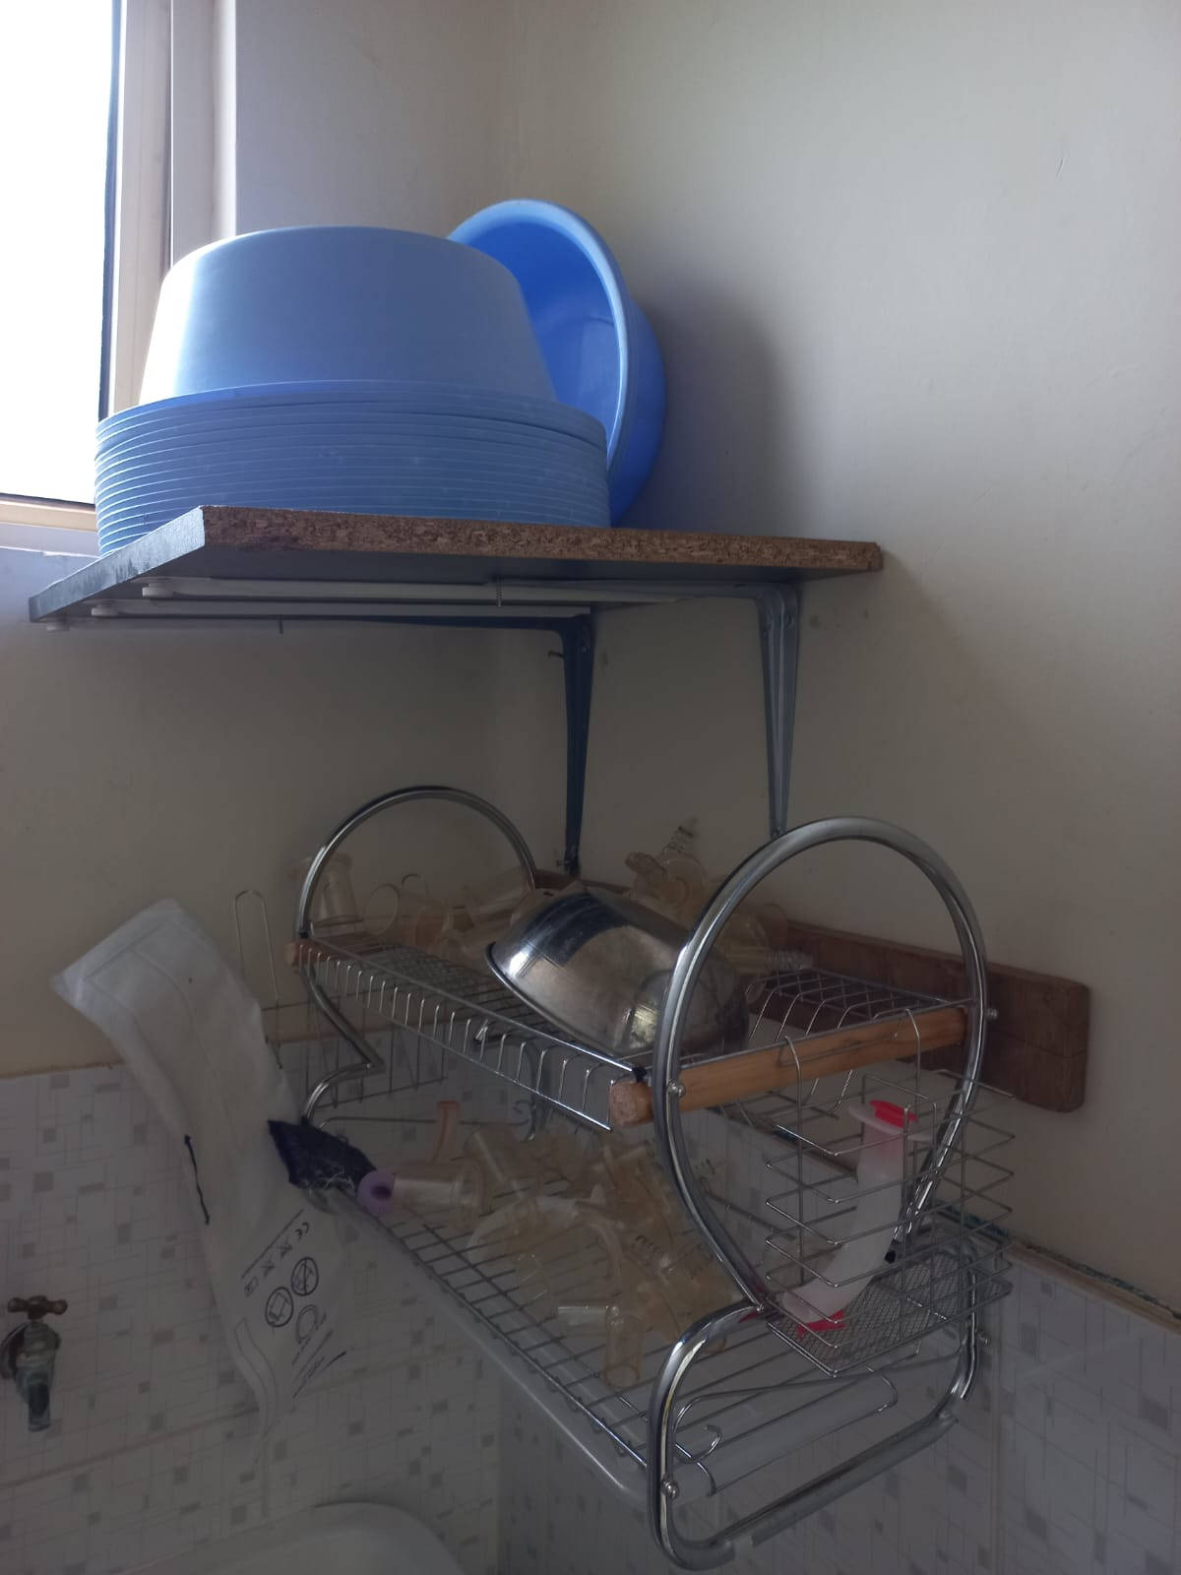
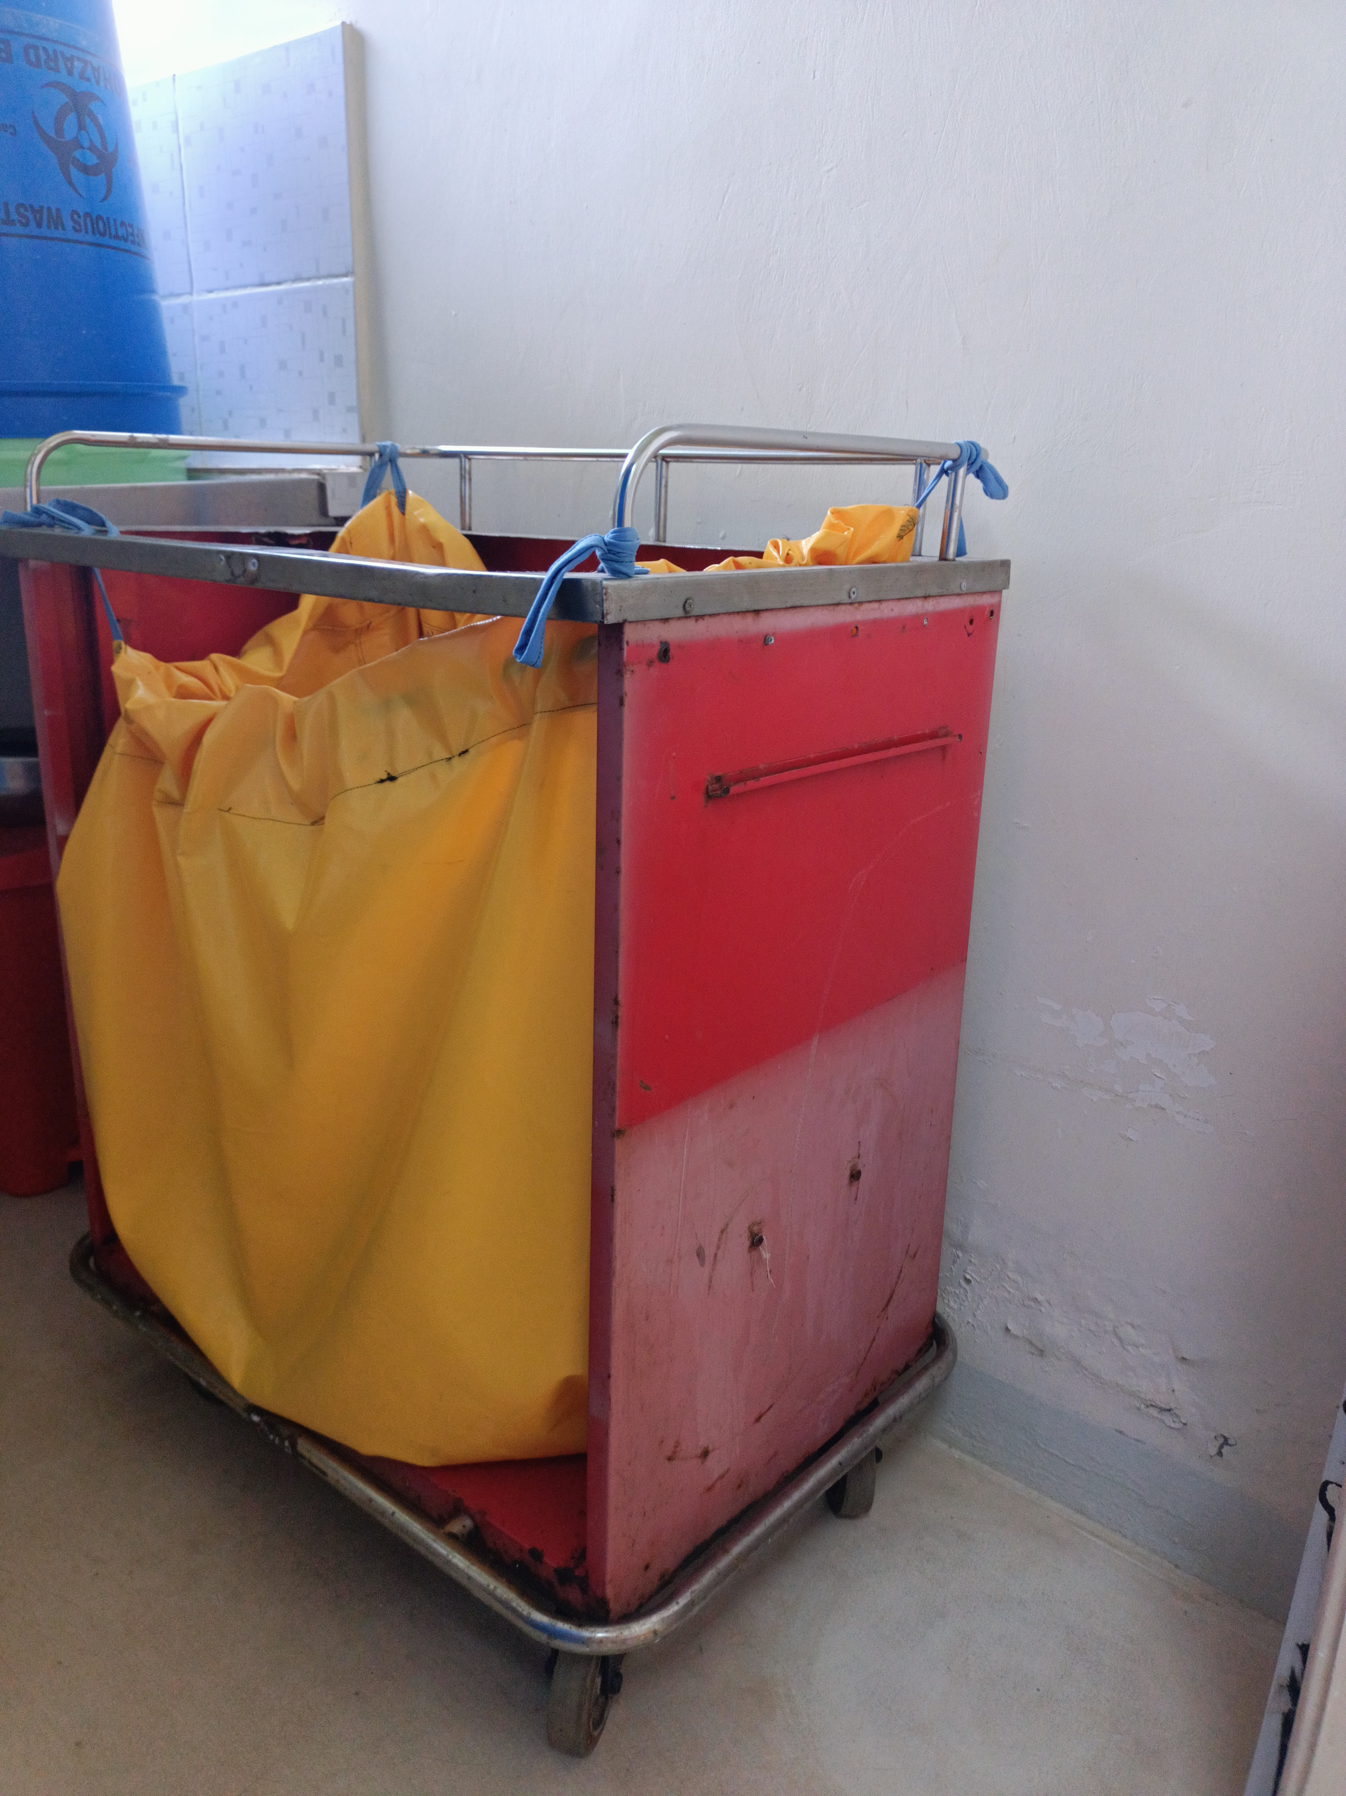
3. Environmental cleaning and disinfection of medical equipment cont..
iii) Mounted Drying rack
iv) Improvised mobile dirty linen trolley

Slide 17
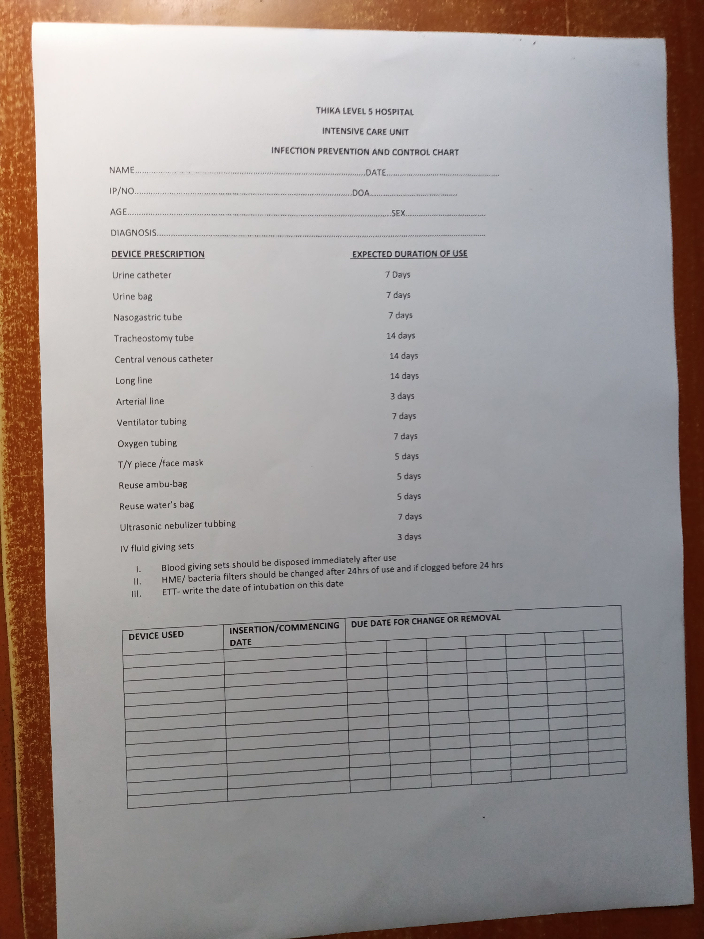
4. Tracking of Invasive devices
Reinstated tracking tool for invasive devices
Continuous sensitization

Slide 18
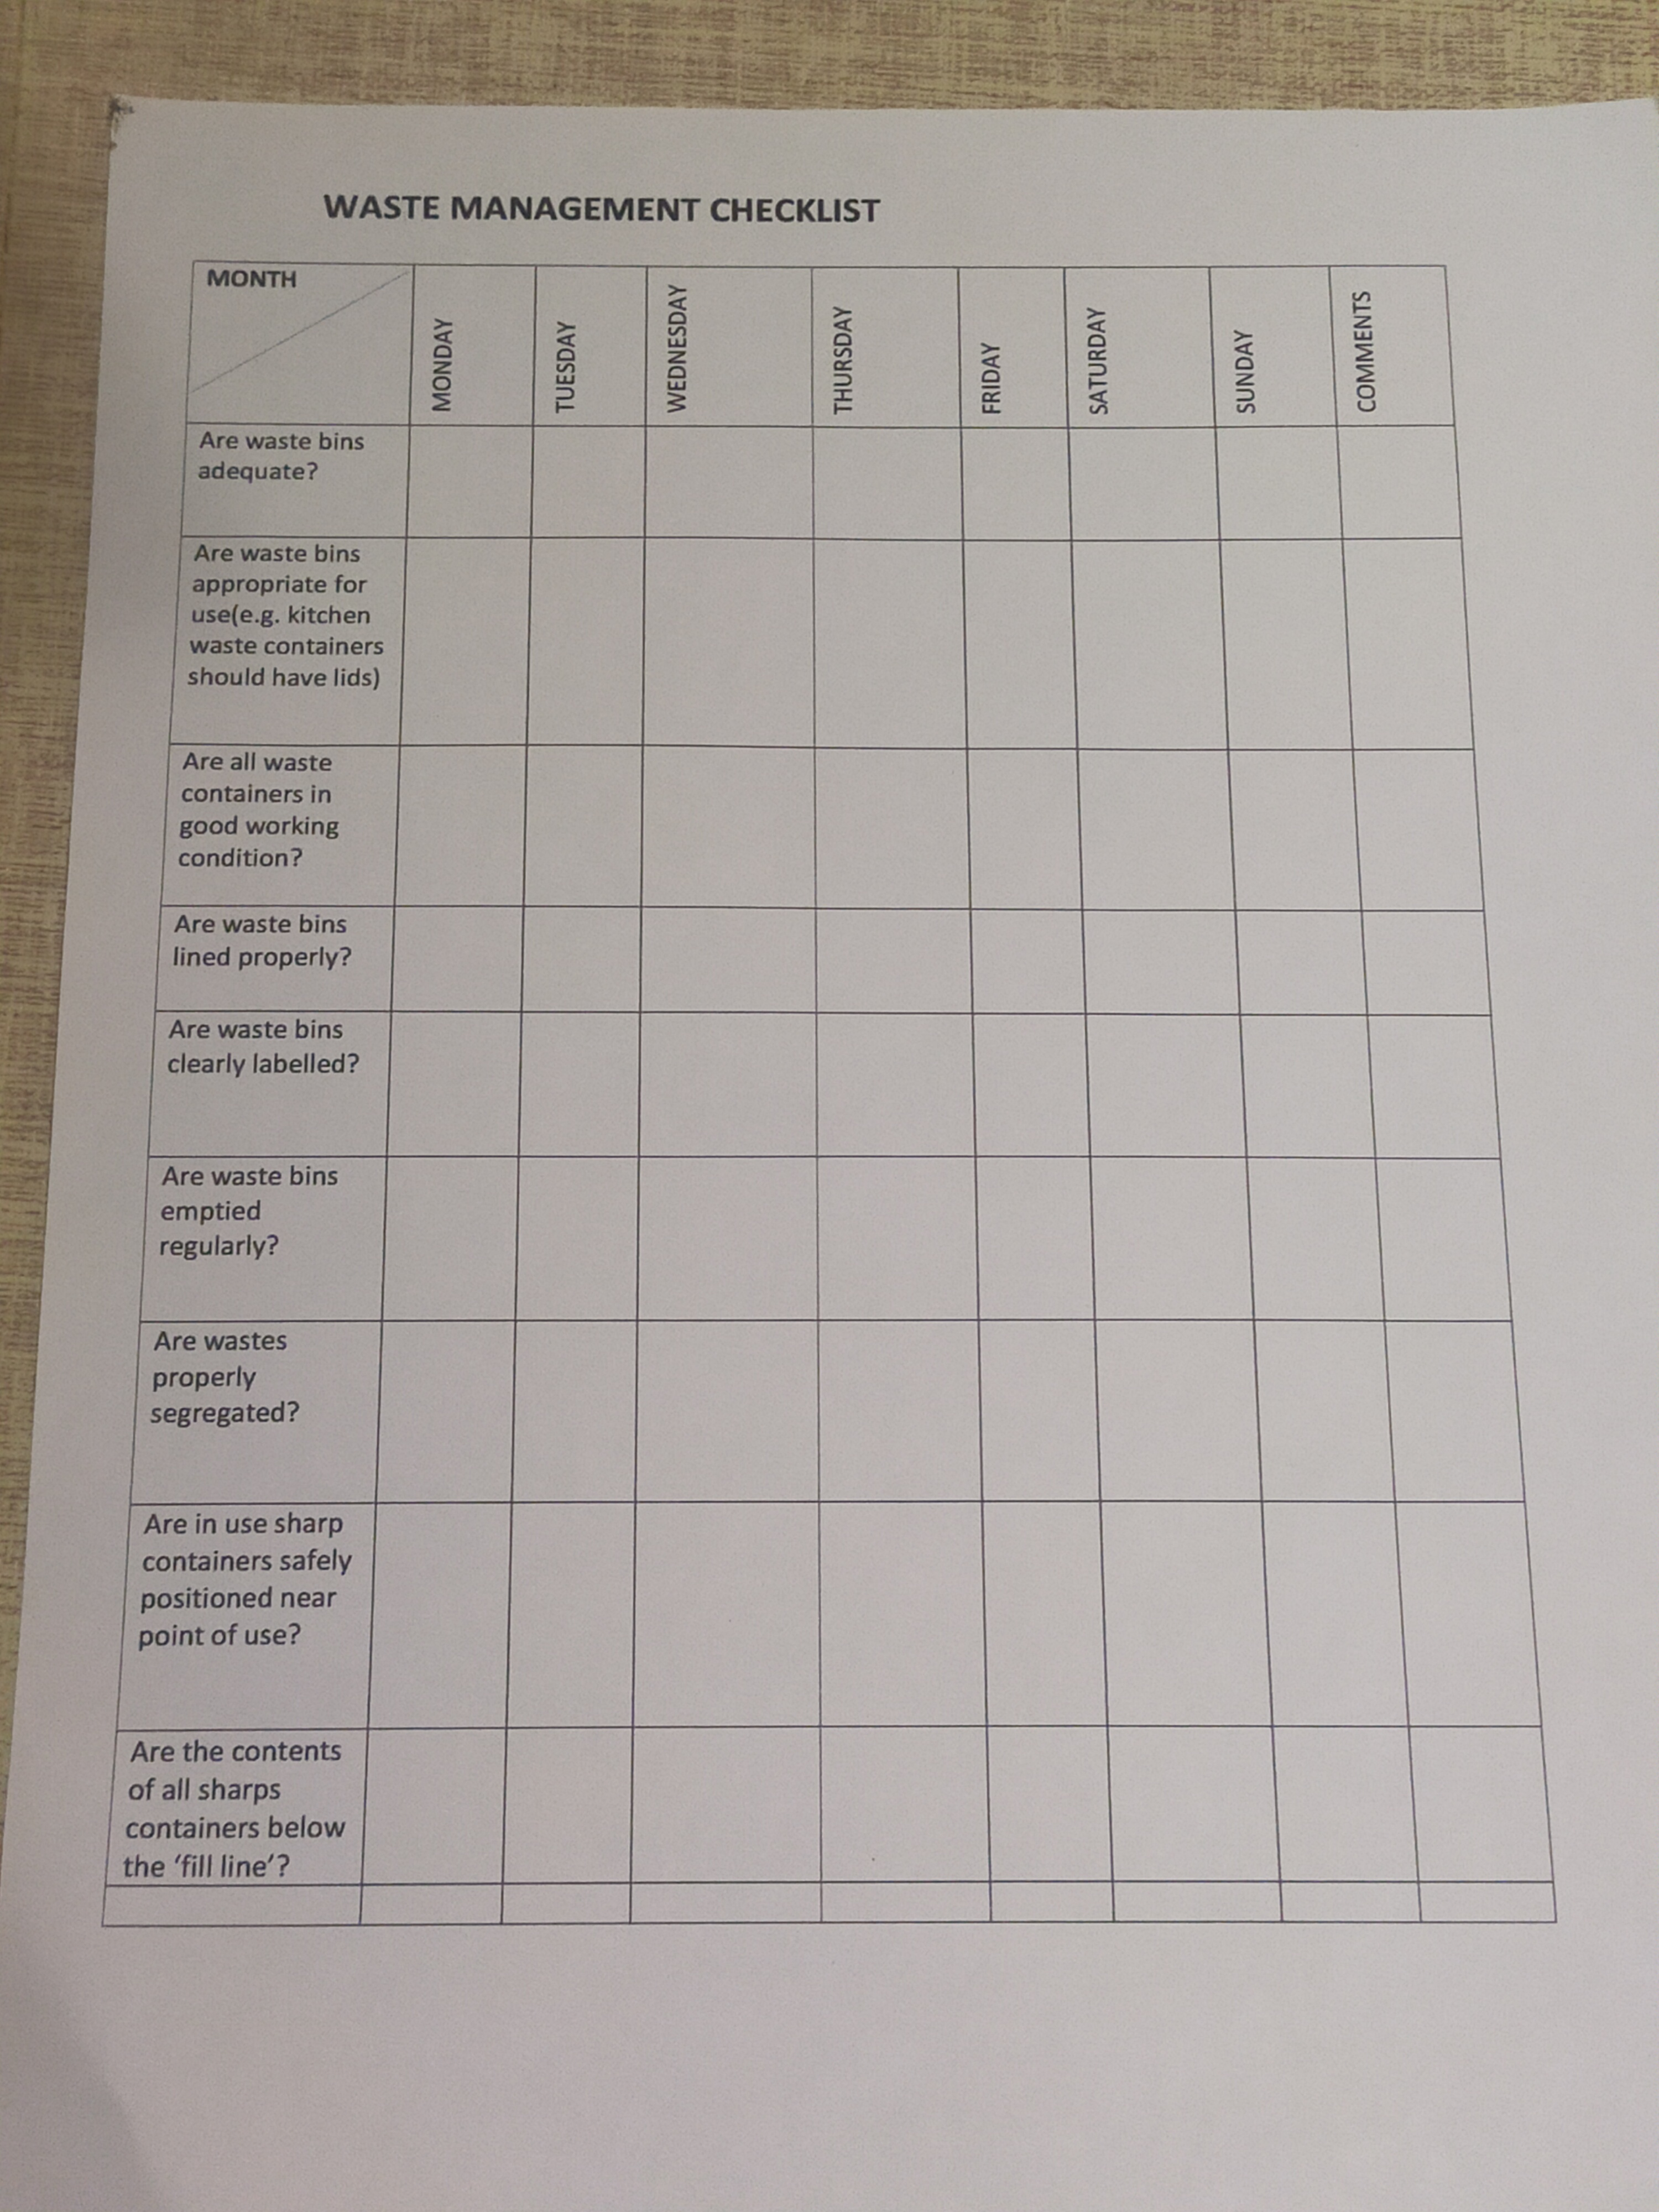
5. Sharps safety
Introduced a check list tool to ensure:
Appropriate positioning at point of use
Contents are below fill line

Slide 19
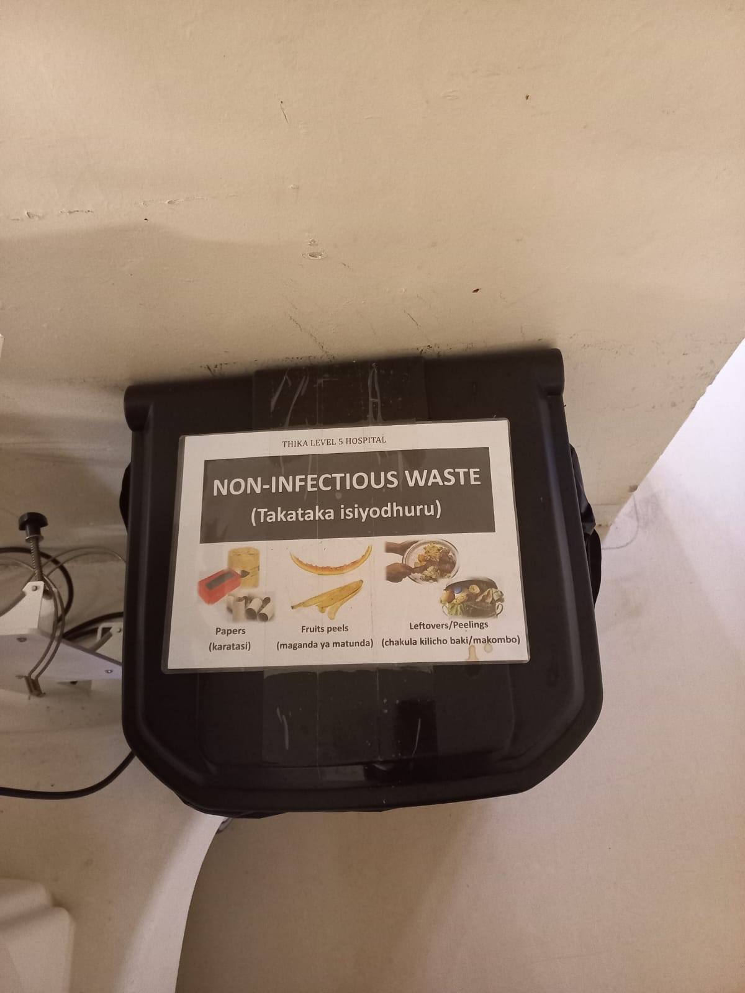
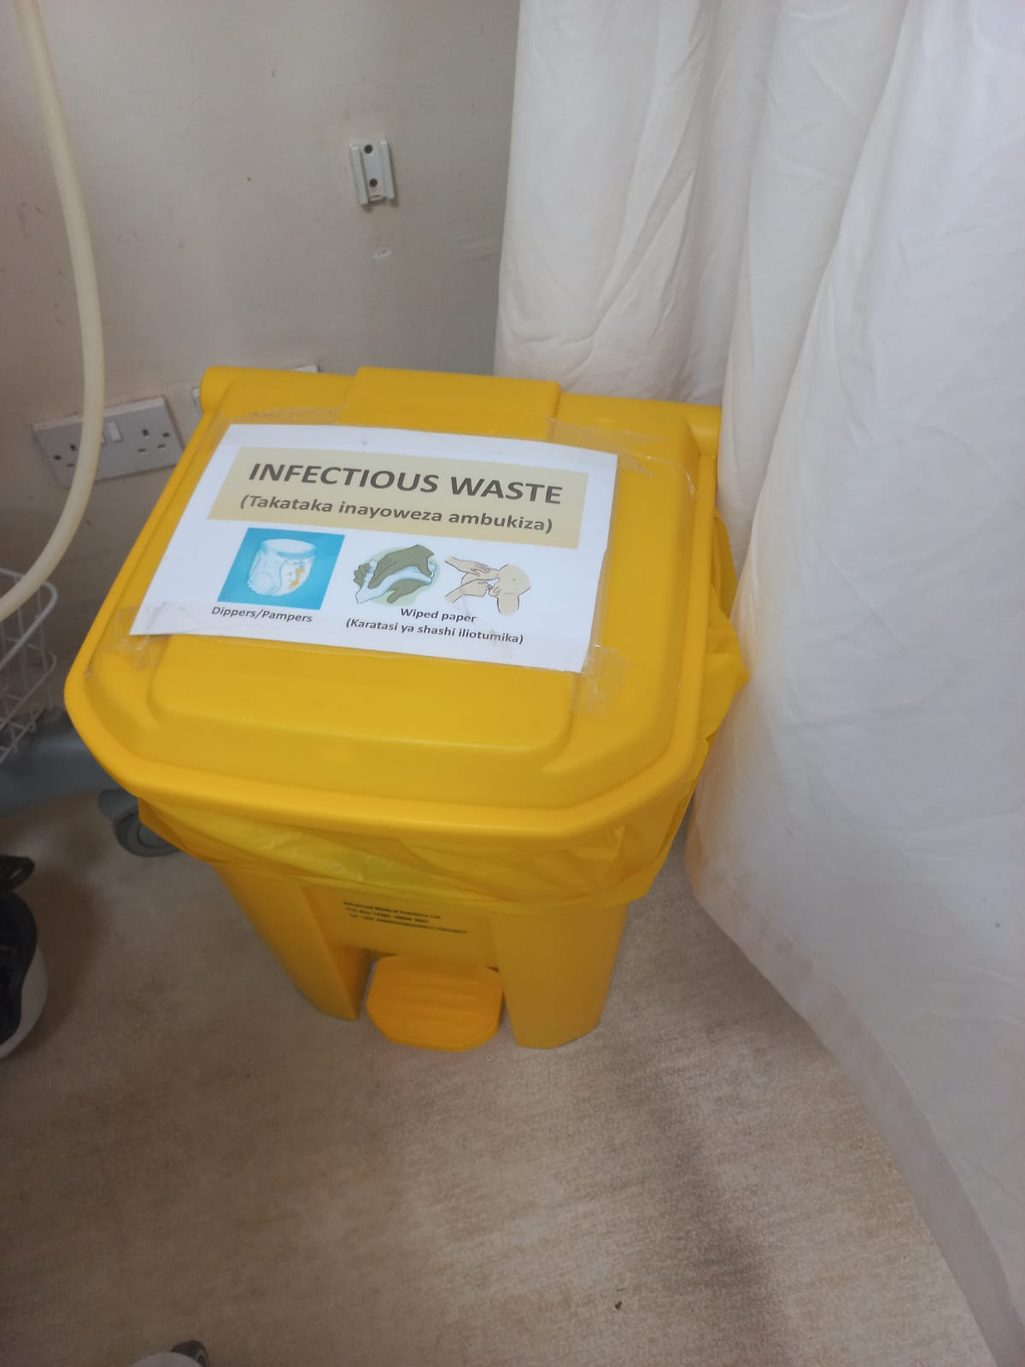
6. Waste disposal
Printed and laminated labels
Labelling the waste bins

Slide 20
Conclusion and Recommendation:
Simple Steps in Quality Improvement has Great impact on IPC

Slide 21

ACKNOWLEDGMENT
IPNET
I-TECH
MOH
THIKA LEVEL 5 HOSPITAL ICU STAFF
KIAMBU COUNTY GOVERNMENT
THANK - YOU

