Slide 1
Incidence, knowledge and practice of healthcare workers regarding needle stick injuries
in a private medium level facility in Kajiado County, Kenya: a culture of silence.
Samuel Otieno
IPNET-Kenya 2023 Scientific Conference
Sai-Rock Mombasa.

Slide 2
Background
CDC estimates ~385,000 sharps injuries annually among hospital-based healthcare personnel (>1,000 injuries/day)
Risk of infection with:
  HBV 6% to 30%
  (for those not immune to HBV)
  HCV 1.8% (range 0% to 7%)
  HIV 0.3%

Slide 3
Background……..2
There is minimal data on needle stick injuries (NSI) in private facilities
The study was carried out in a medium size facility:
  40-bed hospital with about 100 outpatients per day
  25 staff including 17 clinical and 8 non-clinical staff
  Has an active IPC committee and QA officer
  Waste management is outsourced

Slide 4
Methods
A cross-sectional survey was conducted between November and December 2022 at Topcare Nursing Home Kitengela targeting 25 HCWs.
A structured questionnaire was used to collect data on NSI incidence in the preceding 12 months, practices of HCWs in handling sharps, training on sharps disposal and HBV vaccination status.
Simple frequency analysis were run on the data.

Slide 5
One fifth of healthcare workers had a needle stick injury

Slide 6
Two of those with needle stick injury did not report

Slide 7
Needle Stick Injuries among Healthcare Workers by Cadre, N=25

Slide 8
Needle stick injury by gender

Slide 9
HBV Vaccination Status

Slide 10
Healthcare Workers training on disposal of Sharps and Clinical Waste

Slide 11
Conclusions
Needle stick injuries were a common underreported occupational hazard at Topcare Nursing Home .
The study results provide information that can be used to monitor injuries and compliance to NSIs prevention strategies in the private hospitals.
Vaccination for HBV should be offered for free to staff.
Training on safe waste disposal should be reinforced.
Safety-engineered devices should be considered.
Notes:
Encourage reporting of injuries / exposures
Streamline post-exposure management

Slide 12
Acknowledgement
Co-authors-Ruth Njuguna,Edna Komen,Said Omar,Purity Ochieng and Mercy Njeru .
Management of Topcare Nursing Home.
IPNET Kenya.

Slide 13
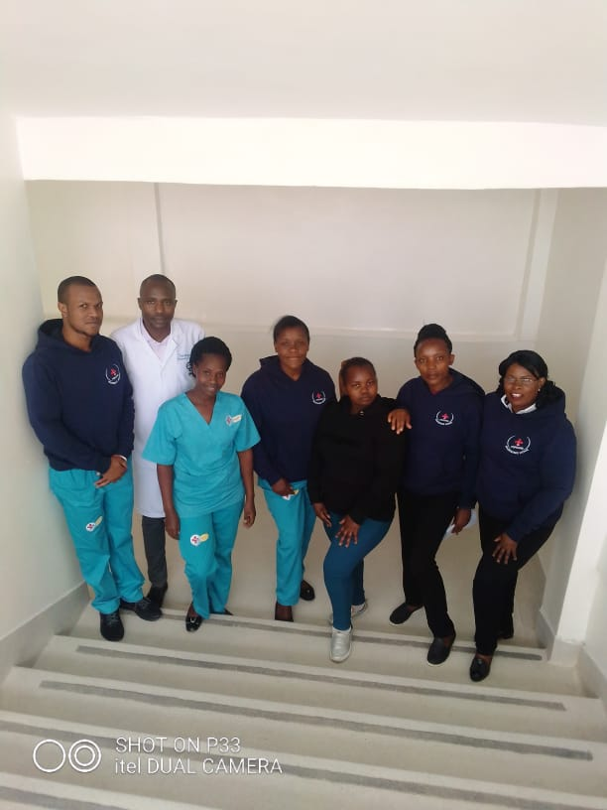
It takes a team to end needle stick injuries
Thank you

