Slide 1
In-service healthcare workers capacity development through a self-paced AMR e-learning course hosted on MOH Virtual Academy.
Authors: Josiah Njeru¹, Joshua Odero¹, Charles Mugambi², Vivian Korir², Robert Oboko², Susan Githii^{3,4}, Emmanuel Tanui^{3,5}, David Mungai¹, David Mutonga¹
¹Infectious Disease Detection and Surveillance Project of USAID
²USAIDHealthIT project
³National Antimicrobial Stewardship Interagency Committee
⁴National Public Health Laboratories
⁵Division of Patients and Health Workers Safety, Ministry of Health Kenya
10th IPNET Conference, May 9-12, 2023

Slide 2
Disclaimer and Attribution of Support
This work is produced with the support of the United States Agency for International Development (USAID), Global Health under the terms of the Infectious Disease Detection and Surveillance contract GS00Q14OADU119
The findings and conclusions in this presentation are those of the authors and do not necessarily represent the official position of the USAID or the United States government

Slide 3
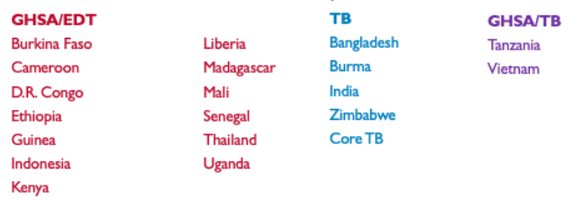
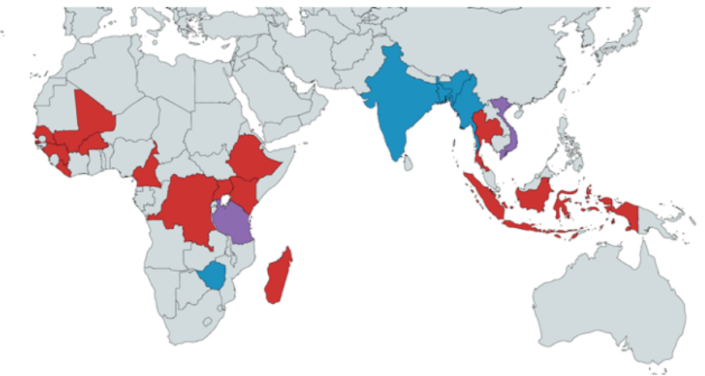
IDDS Project
USAID funded five-year Project under GHSA
  Detection of diseases of public health
  Improve the quality of real-time surveillance systems
  Innovative solutions to strengthen diagnostic networks
Kenya: Bungoma, Kilifi, Murang’a, Nyeri and Trans-Nzoia
IDDS project countries and areas of focus

Slide 4
Background
A recognized global public health threat
The effect of AMR is projected to be harsher in developing countries.
Kenya has laid policies and firm actions to contain emergence and spread of AMR among them AMR surveillance and monitoring, and public awareness and education.
In-service healthcare workers capacity building identified a priority both in the NAP and National AMR surveillance strategies
USAID projects, Infectious Disease and Surveillance (IDDS) and Health IT collaborated with the National Antimicrobial Stewardship Interagency Committee (NASIC) to have the national AMR surveillance training course, earlier developed, hosted on the Ministry of Health Virtual Academy (MOH VA).

Slide 5
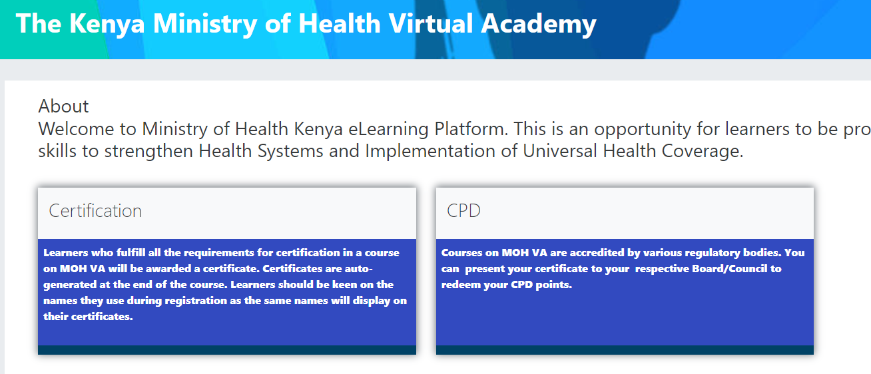
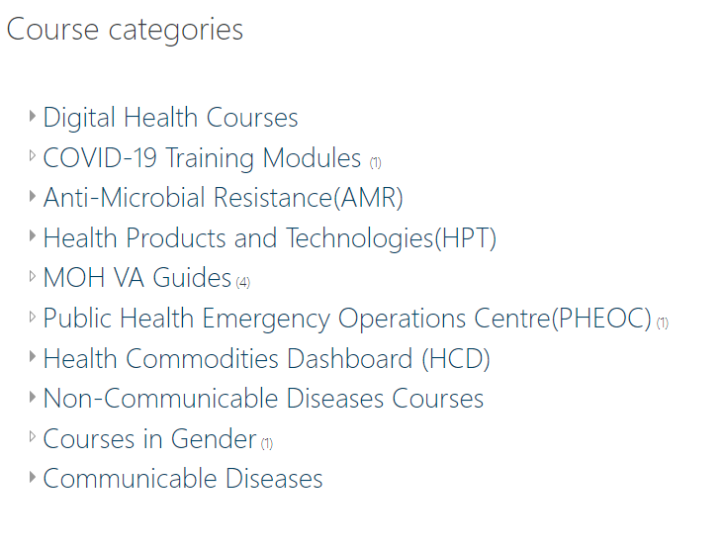
Background
https://elearning.health.go.ke/

Slide 6
Methods
An initial workshop that brought together Instructional Design and AMR subject matter experts was convened to digitize course materials for e-learning mode.
A second stakeholders’ workshop was convened for validation of the materials, -aligning to MOH VA guidelines and uploading of the course materials to the academy.
The course went live in November 2021.
Fliers were later developed to publicize the course
Professional regulatory bodies pursued to accredit the course for award of continuing professional development points.

Slide 7
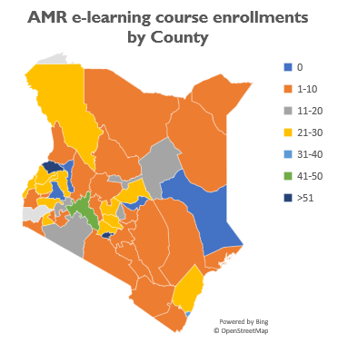
Results
A total of 12 course modules were digitized and hosted on the MOH virtual academy, organized into three tracks: laboratory, health professionals and veterinary.
The course has been accessed by 1276 (458 female) learners as of December 13, 2022, with a completion rate of 29.3%.
Notes:
Main Message:
43/47 counties have at least 1 participant enrolled
Nairobi accounts for 25% of all enrollments, followed by Trans Nzoia at 7%
Counties with zero enrollments: Garissa, Tharaka Nithi, Nandi, Elgeyo Marakwet

Slide 8
Results
Development and distribution of a course flier increased enrollment by 38% between June and December 2022.
The laboratory track is the most accessed with 562 learners (44%). The course has been accredited by six regulatory bodies alongside other courses hosted at the academy.
Professional bodies
KMPDC
COCK
NCK
PPB
PHOTC
KVB
Course enrolments after distribution of e-flier
Notes:
Main Message:
Sharing assessment findings challenged leaders to take initiative to restart services in one of the laboratories even before the project could offer complementary support with equipment and reagents
No service interruptions have been reported unlike before across the 5 laboratories
The uptake of bacteriology tests has been on steady rise although volumes are still below target, partly due to COVID-19 pandemic.
-Significant data quality improvements have been noted spurring interests in use of AMR data locally.

Slide 9
Conclusion
The e-learning option has increased access to the AMR course by participants from across the country and beyond with minimal resources.
Hosting of the course on the MOH VA guarantees sustainability beyond projects’ life.
While the uptake of the course by healthcare workers has steadily increased, the course completion rates remain low.
Interventions such as auto reminders to learners, enhanced learners’ support by teachers, gamification and re-organization of course to levels are being implemented to increase completion rates and further improve the course.
Notes:
To increase utilization, coverage of access- specimen referral systems
Note 2: keeping up with quality requirements for bacteriology tests in a fully decentralized model may prove challenging in developing countries. Using regional hubs with efficient specimen referral systems may work better. Raising a cadre competent in supporting bacteriology services- takes time

Slide 10


Acknowledgement
NASIC, NPHL, DPHWS, DHI

