Slide 1
Improving Quality of Prescriptions at the Coast General Teaching and Referral Hospital using Prescription Audits
Kassam Yusuf, Wanjiru Korir, Rafida Ahmed,Payal ved, Salma Jabir, Everlyne Sumbi
IPNET conference
Sai rock Hotel
9th to 12th May 2023

Slide 2
Background
Antimicrobial resistance (AMR) is a global public health threat (world health organisation (WHO), 2019)
Rational prescribing of antibiotics is key to fighting AMR
Prescription audits monitor rationality and completeness of prescriptions

Slide 3
Prescription audit
A facility level quality improvement tool
Aims to improve patient care and outcomes
Detection of prescribing errors with their reasons
To reduce the irrational usage of antibiotics, syrups, injections, etc.
To identify opportunities for the improvement

Slide 4
Objectives
To determine Prescription rationale and completeness at Coast general teaching and referral hospital (CGTRH) as at March 2022
To monitor Prescription rationale and completeness at Coast general teaching and referral hospital (CGTRH) over 4 quarters in the year 2022

Slide 5
Methods
This was a retrospective study
A prescription audit team was formed
Prescriptions were selected randomly from all outpatient dispensing points
96 prescriptions were audited every quarter
A prescription audit tool was used to capture the data

Slide 6
Methods
WHO indicators were used
For prescription completeness
  Name and signature of prescriber, age, sex, weight, diagnosis, medicine schedule, dose and duration
For rationality
  The number of medicines prescribed, antibiotics, injections, and generic names used
Data was analysed in form of percentages using excel and presented in form of graphs

Slide 7
Methods continued
The exercise was conducted over 4 quarters
A report was prepared after every audit performed
This was presented to the hospital management
The hospital management put in measures to improve prescription quality such as
  Updating the prescription format
  Sensitization of prescribers
  Writing of MEMOs on appropriate prescribing

Slide 8
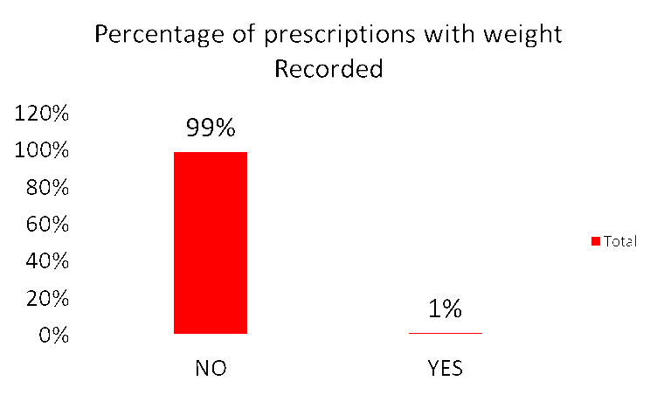
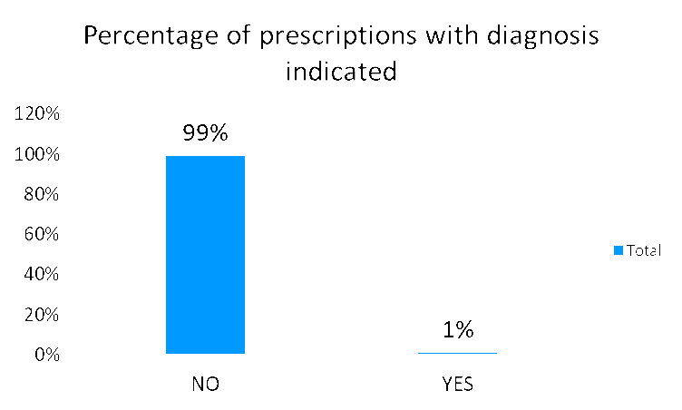
Baseline prescription audit results

Slide 9
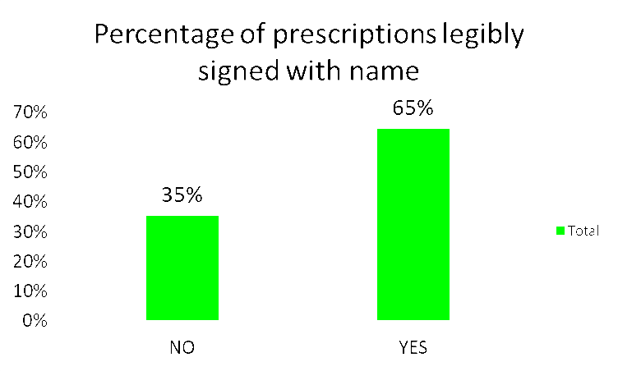
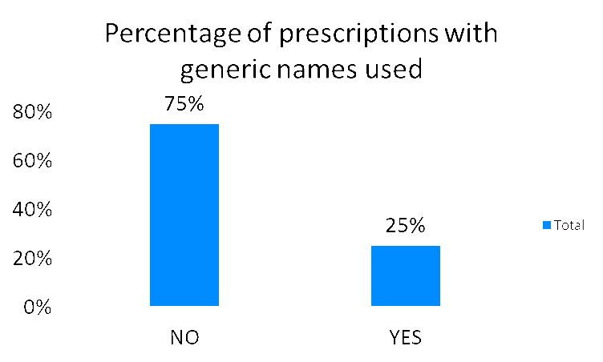
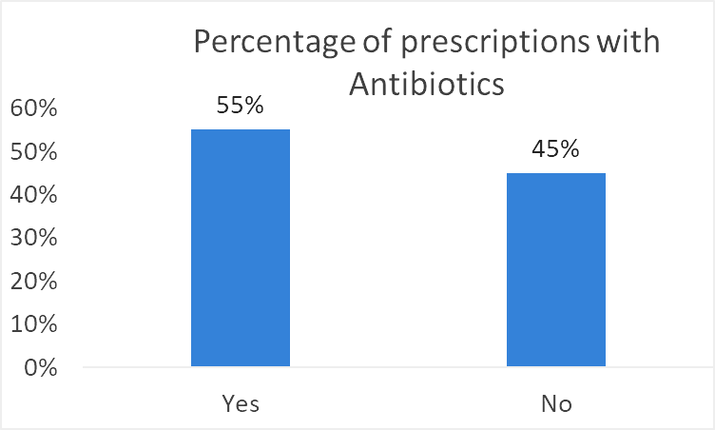
Baseline prescription audit results

Slide 10
Interventions put in place by hospital administration
Updated prescription format to include weight and diagnosis(After Quarter 1)
Sensitization of departmental heads (After Quarter 1)
Memo on rational prescribing sent to all departments(After Quarter 3)
Sensitization on rational prescribing during staff induction(After Quarter 3)

Slide 11
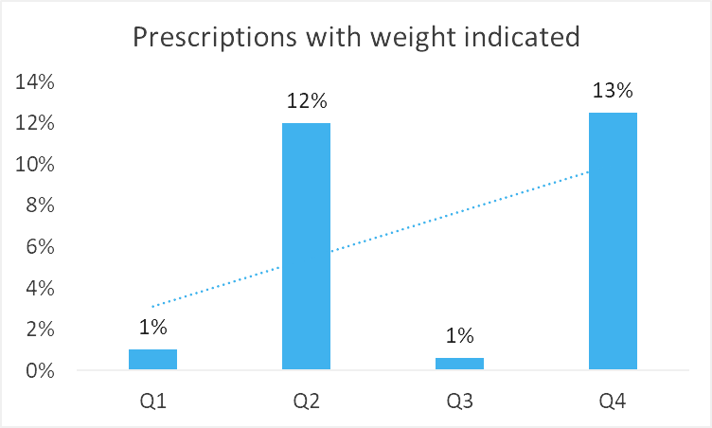
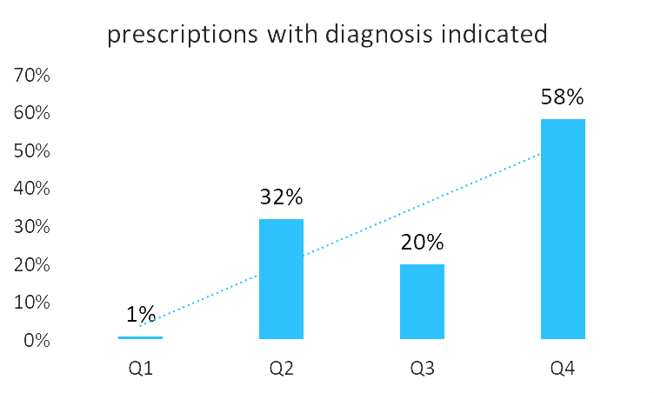
Trends over the year

Slide 12
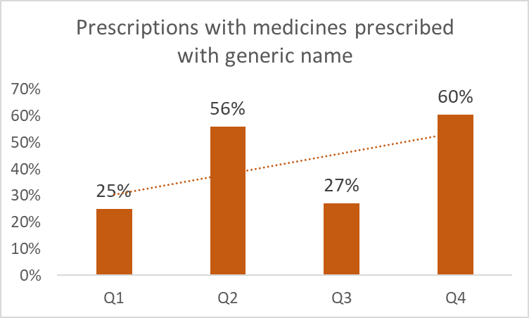
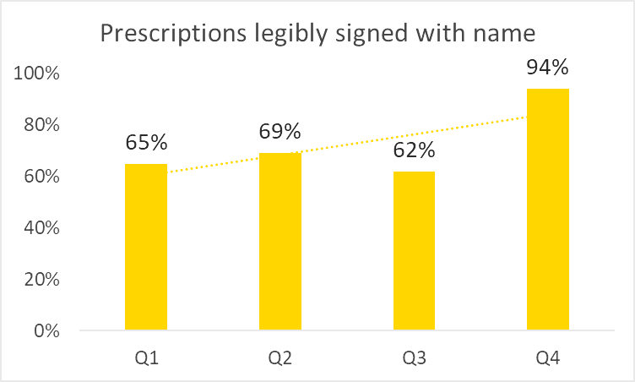
Trends over the year

Slide 13
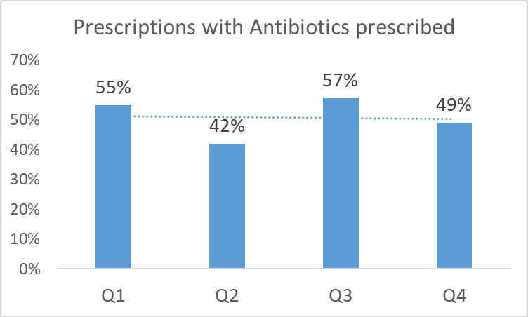
Trends over the year

Slide 14
Conclusion
Prescription audit report was well received by hospital management
Improvement was only seen in the quarters when interventions were made
Audits need to be done consistently to change prescribing culture among prescribers
Further root cause analysis and interventions are required to improve the indicators at CGTRH

Slide 15
Way forward
Continue quarterly audits and reports
Brainstorm better interventions to improve quality of prescriptions
Using the data on diagnosis, improve surveillance on antibiotic use and promote rational use of antibiotics

Slide 16
Acknowledgement
Co-authors
  Dr Wanjiru Korir, Dr Rafida Ahmed, Payal ved, Dr Salma Jabir, Dr Everlyne Sumbi
Mentors
  Dr Paul Musilinga, Dr Ernest Makokha, Dr Raphael Odondo
Special Thanks
  County dept of health, CGTRH management, Ann Mumbua, Dr Irine Muramba, Florence Wachira, Washington State university (WSU)

