Slide 1


Improving Hand Hygiene Practice In Resource Strained Health Care Setting - A Case Of Murang'a County Referral Hospital Murang’a County Kenya
Shiguri F¹ P. Karanja¹ B. Kimani ¹ E. Kitangala ²
Murang’a County, Department of Health
USAID Medicines, Technologies and Pharmaceutical Services (MTaPS) program

Slide 2
Background
Hand hygiene is key in reductions of HAIs.
80% of HAIs are transmitted via HCWs' hands.
Globally 1 in 6 health facilities lack basic hygiene facilities (2019 WHO/UNICEF).WHA resolution 2019
Over 90% HCWs do not adhere to recommended hand hygiene practices
62% of HFs in Kenya lack functional HH stations at point of care

Slide 3
Background cont.....
Hence risk of HAIs and poor quality of service contrary to the National IPC guidelines 2021.
Initial situation at MCRH
Availability of functional HH stations at points of care - 50%,
HH reminders displayed at key areas - 43%
Level of knowledge on HH - 35%
Negative attitude on HH - 14%
Hand hygiene compliance - 31%

Slide 4
Objectives
Broad objective:
To describe the improvements made on hand hygiene among HCWs in Murang'a County Referral Hospital
Specific Objectives
To describe the initial level of HH compliance among HCW in Murang'a County Referral Hospital

Slide 5
Objectives con…
Specific Objectives ....
To describe the interventions implemented to improve hand hygiene compliance within Murang’a County Referral Hospital
To describe the improvement achieved in hand hygiene compliance among health care workers in Murang’a County Referral Hospital

Slide 6
Methodology
Study area - Murang'a County Referral Hospital
Descriptive study design was adopted
Quantitative and qualitative data collected using
the facility WASH-Fit assessment tool
Knowledge and attitude -A standard questionnaire
equitably distributed among departments used

Slide 7
Methodology cont....
Sample size-60 health care workers
HH compliance - Observation sessions done using WHO HH observation tool
Participants randomly selected from service providers during observation sessions
  Data analysis done using MS excel 2010
  descriptive frequencies we're calculated

Slide 8
Interventions
Training, Inductions, sensitization and CMEs
Display of reminders
Periodic audits and feedback
Local production of soap and sanitizer
Enhanced supportive supervision - Weekly hospital
IPC rounds, link persons
Advocacy for repair of hand washing facilities

Slide 9
Results
Variable | Before | After | Variation
Availability of functional H H stations at all points of care with | 50% | 52% | 2%
Hand hygiene reminders clearly displayed at key areas | 43% | 100% | 57%
Knowledge - on HH | 35% | 65% | 30%
Attitude(negative) | 14% | 5% | 9%
Hand hygiene compliance | 31% | 54.2% | 23.2%

Slide 10
Results con…
41 and126 participants involved in March 2022 and Jan 2023 observation sessions respectively
77 and 191 HH actions performed out of 248 and 352 opportunities March 2022 and January 2023 respectively

Slide 11
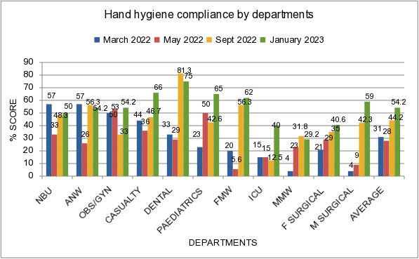
Results cont...

Slide 12
Discussion
Improved Hand hygiene compliance attributed to:
Minimized forgetfulness due to increased display of
reminders
Increased knowledge on HH due to education activities
Consistent commodity availability due to local
production

Slide 13
Discussion cont...
Periodic audits and feedback created motivation and
competition
Change in attitude enabled utilization of favorable
environment to practice HH more
Scheduled rounds and engagement of link persons increased adherence
There was significant improvement in HH compliance despite minimal change towards availability of functional HH stations at all points of care

Slide 14
Conclusion
Remarkable hand hygiene improvement can be realized in resource strained situations if low cost interventions are adopted. However, optimal and more sustainable achievements require multimodal approach which calls for extra resources.

Slide 15
Acknowledgement
Hospital Management Team of Murang’a County Referral hospital
Hospital IPC committee
Co-authors
USAID Medicines, Technologies, and Pharmaceutical Services program (MTaPs)

Slide 16


