Slide 1

Improving Compliance with Personal Protective Equipment(PPE) Standards Among Health Care Workers in Kenyatta University Teaching Research and Referral Hospital(KUTRRH)
Ms.Caroline Mwangi
Ms. Lilian Misati

Slide 2
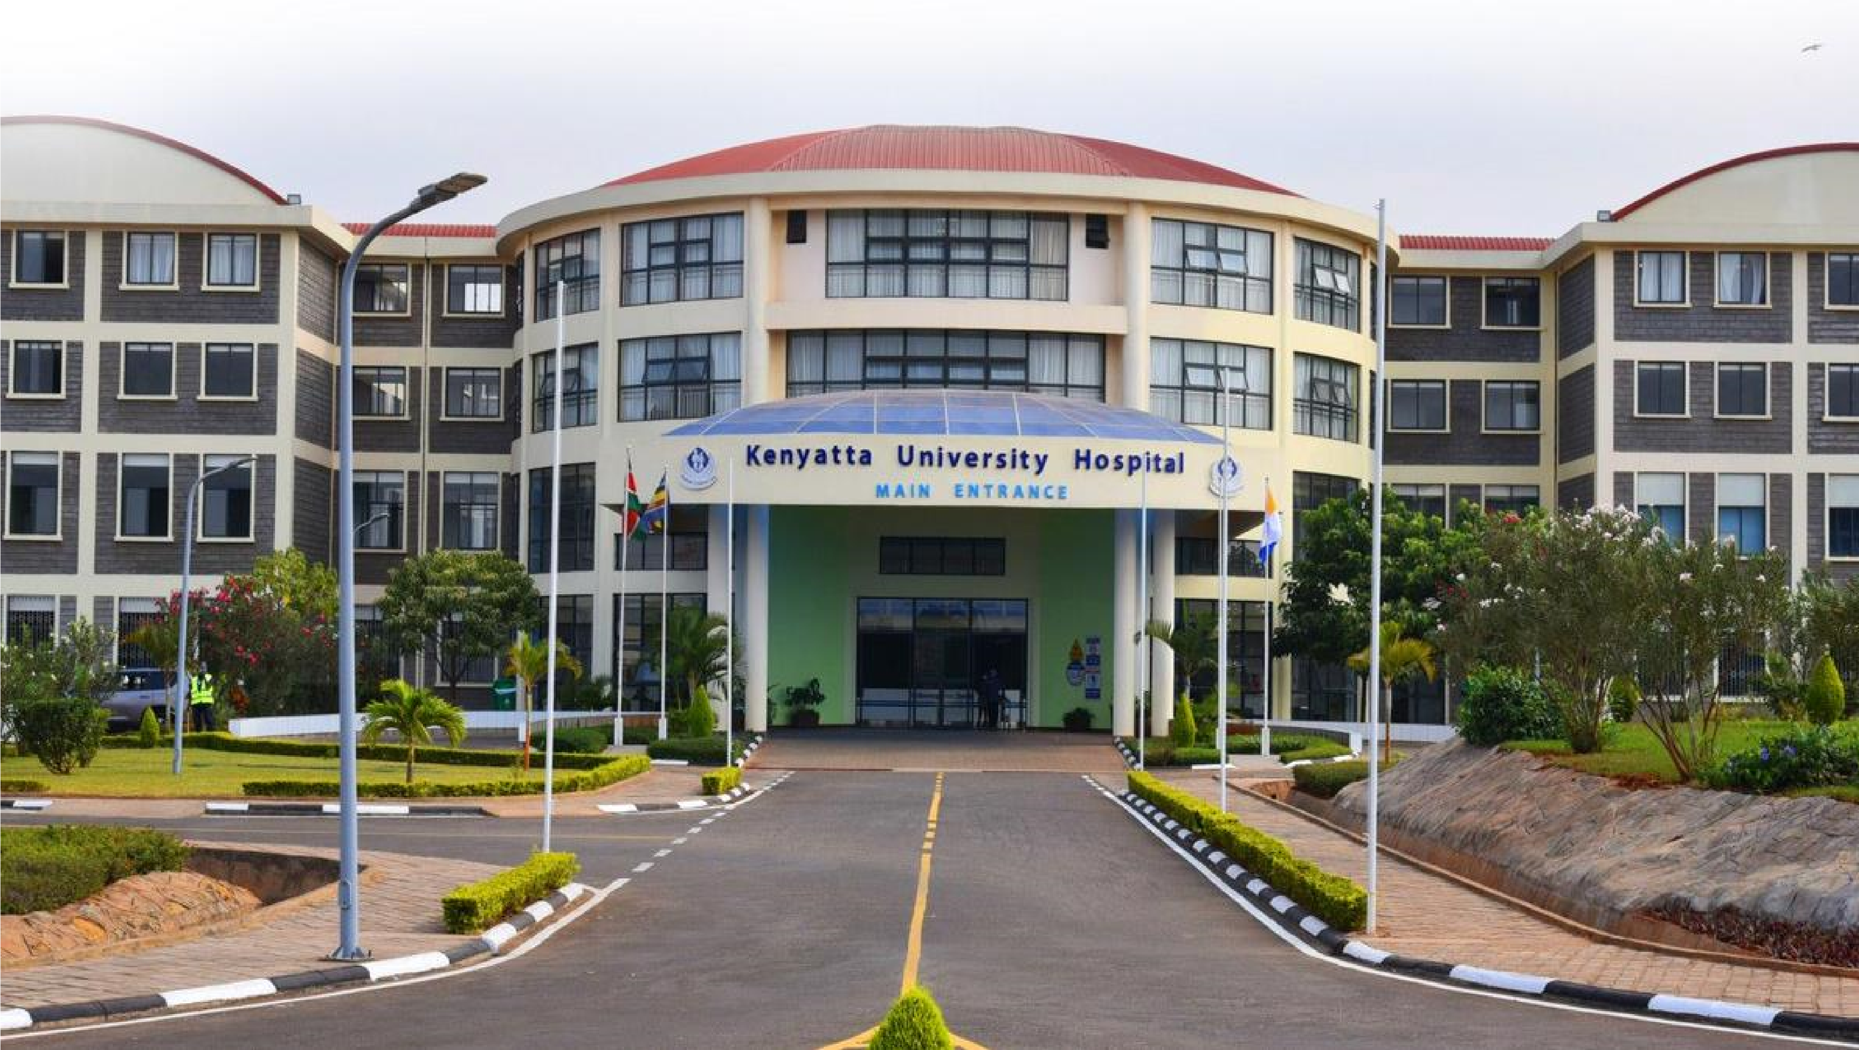
Introduction
•
KUTRRH is one of three regional referral
hospitals located in Nairobi County, Kenya.The
Hospital has a bed capacity of 650 with
62
intensive care unit beds, and serves
approximately 3200 outpatients per month ,
the majority attending specialized clinics.
East Africa IPC Community of Practice

Slide 3
Background Information.
Quality Improvement (QI) collaborative on the appropriate use of PPE
Domains: System and Health Care Worker practice
Assessment on the appropriate use of PPE was conducted in four wards (oncology, A&E, Maternity, and Isolation wards)
A minimum of 4 Health Care Workers (HCW) in each ward/ month were observed on the appropriate use of PPE – sample size of 96 HCWs

Slide 4

Aim Statement
To increase appropriate use of PPE in KUTRRH from 55% to 95 % from October 2022 to March 2023

Slide 5
QI Project Drivers Diagram
Have monitoring system in place to ensure no periodical stockouts.eg (IPC gowns, gloves)
PPE
Supplies / Equipment
Aim
Conducting frequent clinical rounds/quality observations of appropriate PPE use and hand hygiene among HCWs by IPC and QI Team.
Frequent Training /CMES of HCWs on proper selection/donning and doffing of PPE.
Assign manpower depending on workload.
To increase appropriate use of PPE from 55% -95%
Health care workers
Appropriate use of PPE culture (people)
Regular monitoring and evaluation of appropriate PPE use among HCWs.
Establish hospital SOPS/ instructions on the use/ reuse of PPE and standard/ Transmission Based precautions in the wards.
Dissemination of PPE policy at all workstations
Leadership (Process)
Infrastructure
(Environment)
Ensure patient doors have signs/posters on indications for PPEs ( Standard/ Transmission Based precautions)
Primary Drivers
Change Ideas

Slide 6
Change Ideas Tested
Tested and Successful | Tested and Not Successful | Not Tested.
1.Have monitoring system in place to ensure no periodical stockouts.eg (IPC gowns, gloves) | 1. Assign manpower depending on workload. | None
2.Conducting frequent clinical rounds/quality observations and regular monitoring & Evalution on appropriate PPE use and hand hygiene among HCWs by IPC and QI Team.
3. Frequent Training /CMES of HCWs on proper selection/donning and doffing of PPE.
4.Establish hospital SOPS/ instructions on the use/ reuse of PPE and standard/ Transmission Based precautions in the wards.
5. Disseminating of PPE policy at all workstations
6.Ensure patient doors have signs/posters on indications for PPEs ( Standard/ Transmission Based precautions)

Slide 7
Rating Change Idea
Change idea tested | Number of wards that tested change idea | Relative importance[ How important was the change][1-5] | Simplicity [ How easy was it to implement the change idea] [1- 5] | Scalability [ How easy would it be to scale the change idea to the whole hospital] [1-5] | Total score [Max 15] | Average score [ total/3] | Number the change idea from highest average score to lowest
1. Monitoring system of PPE Stock. | 4 | 4 | 4 | 4 | 12 | 4 | 2
2.Supervision on PPE Use. | 4 | 5 | 4 | 2 | 11 | 3.7 | 3
3.Training /CMES of HCWs. | 4 | 5 | 3 | 2 | 10 | 3.3 | 4
4.Develop hospital SOPS/ instructions on PPE. | 4 | 4 | 2 | 3 | 9 | 3 | 5
5.Creating Awareness of PPE policy. | 4 | 5 | 2 | 1 | 8 | 2.7 | 6
6. PPE Signs/posters developed/ displayed. | 4 | 5 | 5 | 5 | 15 | 5 | 1
7. Manpower | 4 | 5 | 0 | 0 | 5 | 1.7 | 7

Slide 8
Change Package For Scale Up
Change Idea Implemented | Implementation Steps [ Steps To Introducing Change Idea] | How, Who, When And Where [ Define The Above Areas For Each Step To Provide Clarity For Implementation] | Resources And Documents Required
1. Monitoring system for PPE Stock | Ensure stock availability Stock Monitoring inventory Timely requisition Issuing out stock | HOD Daily Nurse incharge Procurement Officer | PPE Stock Computer HMIS System –Mapping tag Human Resource
2.Supervision on PPE Use | Create a QI checklist on PPE Form a QI team Sensitization of the QI team Monitoring and evaluation of the PPE use Feedback meeting and action plan | HOD monthly IPC Manager IPC Officer. Ward IPC champions Nurse incharge | PPE Checkllist Human Resource Stationary Data collection tools Airtime.
3Training /CMES of HCWs | Identify targeted HCW Schedule a date for the training Assemble training aids. Facilitator | IPC Manager IPC officer Ward IPC Champion HCWs | SOP/Job aids Facilitator Venue of the Training Stationary Laptop Projector Refreshments

Slide 9
Cont’d
4. Develop hospital SOPS/ instructions on PPE. | Develop SOPs as per the Hospital Template. Get approval from the Quality assurance. Share the SOPs on share point to be accessed by the Hospital staffs. | QA Manager IPC Manager. IPC Officer. | The developed SOP Computer Internet
5.Creating Awareness of PPE policy. | Identify the champions from various wards. Sensitizations of the champions on the policy . The champions to cascade the policy at their wards | HOD Nurse in charge IPC Manager. IPC Officer. Ward IPC Champion | PPE Policy document Venue of the Training Stationary Laptop Projector Refreshments
6. PPE Signs/posters developed/ displayed. | Develop & Design Signs /Posters. Get approval from the IPC Committee. Printing & Lamination of the posters. Dissemination of posters on the various wards. | IPC Committee IPC Manager. IPC Officer. Ward IPC Champion ICT- graphics Designer. | Sample of the poster /signs Printer Printing papers Lamination porch Computer Internet.

Slide 10
QI Project Progress-Annoted Run Charts

Slide 11

Challenges
Staff resistance to change – Negative attitude
Competing priorities among HCW’s e.g. during emergency/ work overload
No consistency in Hand hygiene practice before donning the PPE.
Knowledge gaps on the appropriate use of PPE ( New staff)

Slide 12
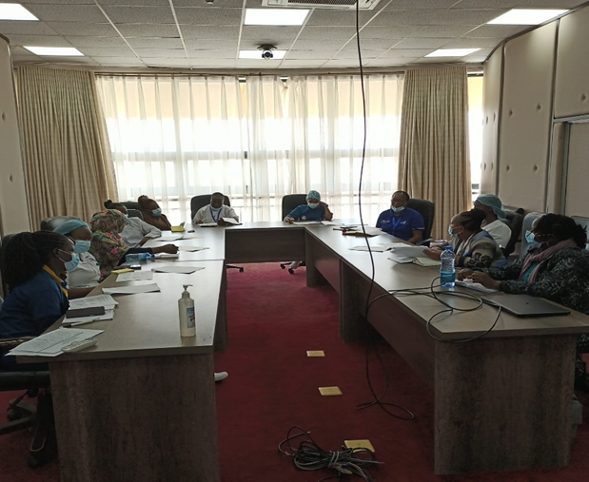
Scale Up Plan
Rationale For Scale Up: To improve both staff and patients safety in the entire hospital through appropriate use of PPE.

Slide 13
Cont’d
Area of Focus (Current Gap ) | Activity (Define activity to be carried out for each area of focus ) | Timeline | Person Responsible
Resistant to change-Negative attitude | Behavioral change sessions Performance rewards | Ongoing | HOD Nurse in charge Ward IPC champions
Leadership and stakeholder involvement | Sensitization meeting Sharing performance report | April 2023 May 2023 | IPC Manager IPC Officer
Staff Training (define Staffing needs for scale up plan ) | Training on appropriate use of PPE | Quarterly Training | IPC Manager IPC Officer
Communication of scale up plan package to staff | Feedback meetings CME’s | May 2023 Quarterly CME’s | IPC Manager IPC Officer
Monitoring and Evaluation of scale up activites | Data analysis | Ongoing | HOD Nurse in charge IPC Manager IPC Officer

Slide 14
Sustainability Plan
Find project champions in each unit
Regular monitoring and evaluation of appropriate use of PPE among HCWs
Share best practices - Frequent Training/CME of HCWs on appropriate use of PPE including new staff, students and interns
Fast tracking on the procurement process of PPE supplies
Strengthening IPC practice in hospital by designing other QI projects and implementing best experiences from this ongoing project on PPE use
Celebrate wins
4/20/2023
EA IPC Network - QI Project Progress Update

Slide 15

THANK YOU
Acknowledgment

