Slide 1
Implementing WHONET Software for AMR Surveillance Data Management and Analysis at Murang’a County Referral Hospital
Authors: Samuel Ithathu, Sophia Nteere, Loise Kariuki, Esther Mbugua and Romano Kang’ethe
Authors affiliation: Murang’a County
Presenter: Samuel Ithathu
10th IPNET Kenya Conference (May 9-12, 2023)

Slide 2
Background
Antimicrobial resistance (AMR) is growing global public health treat.
In 2019 an estimated 1.27 million deaths globally were due to AMR and 5 million deaths associated (GRAM Report, 2019).
Surveillance and monitoring is one of the strategic objectives in prevention and containment of AMR (GAP, NAP)
AMR surveillance data produced through bacterial culture and antimicrobial susceptibility testing presents numerous challenges in managing it and analysis.
We show the utility of the WHO open source, WHONET software in managing and analysing AMR surveillance data for antimicrobial stewardship decisions at Murang’a county referral hospital.

Slide 3
Methods
Installation and training on use of the software at Murang’a level 5 Hospital was done in November 2021 by National public health laboratories and infectious diseases detection and surveillance,
Data entry into the application in real-time
Periodic data review for quality and analysis using the data analysis functionality of the software.
Reporting to stakeholders

Slide 4
Findings
The software has enabled us to manage a total of 1,850 records entered since start of its use up to December 31st 2022, capturing all AMR surveillance variables and correct pathogen-antibiotic combination.
The quick and detailed data analysis functionalities have enabled us to periodically analyse data for AMR trends.
A total of 684 (37%) samples had a pathogen isolated and comprised S. aureus (22%), E. coli (15.5%), Proteus sp. (13%), Pseudomonas spp (9%), Klebsiella spp (8%), Acinetobacter spp (4%), among other isolates.

Slide 5
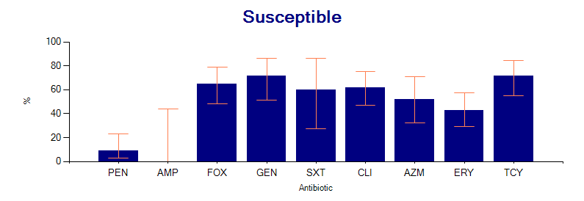
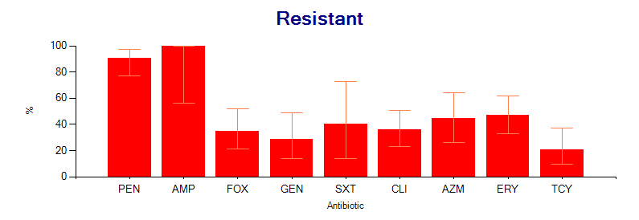
Antibiograms: Staphylococcus aureus Isolated from Pus
S. aureus was found highly sensitive to gentamicin, Tetracycline and clindamycin (>70% sensitivity)
highly resistant to penicillin.
MRSA screen was positive in 28% of isolates.

Slide 6
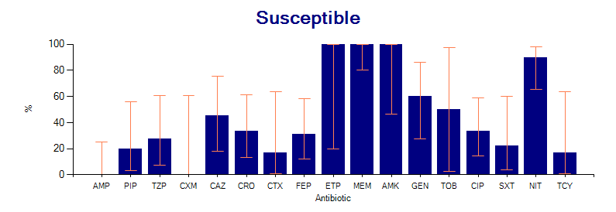
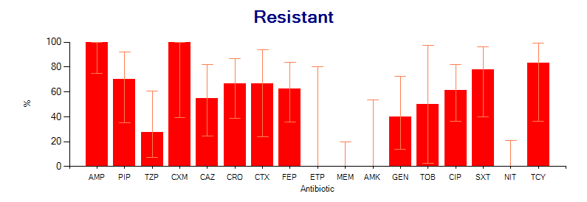
Antibiograms: Escherichia coli Isolated from Urine
E. coli was found highly sensitive to Nitrofurantoin, amikacin, meropenem and Ertapenem (>80%).
highly resistant to penicillin and 2nd generation Cephalosporins (>70%).
moderately resistant to Fluoroquinolones, 3rd and 4th Cephalosporins (40-70%).

Slide 7
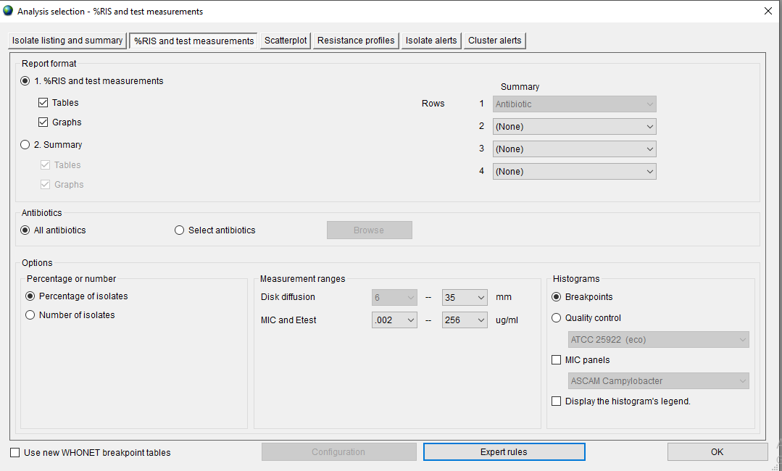
WHONET Software Advantages (Flexible data analysis capabilities)
Isolate list and summary: They include; number of samples, organisms and patients. One can also convert drug zone size to interpretation values.
resistance and test measurement: Indicates the susceptibility patterns and the number of isolates which can be done singly or in groups.
scatter plot: Allow comparison of two drugs

Slide 8
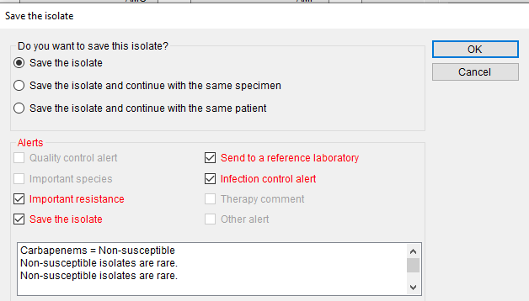
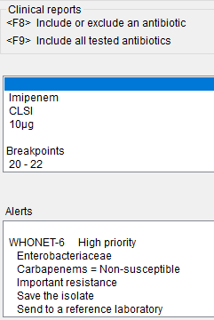
WHONET Software Advantages (Isolate Alerts)
They can assist in the identification of typing errors, prompt notification of resistance results, and educational information on recommended laboratory testing practices.

Slide 9
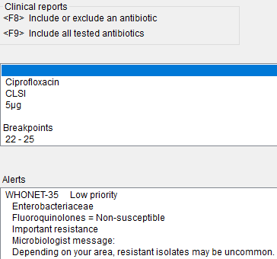
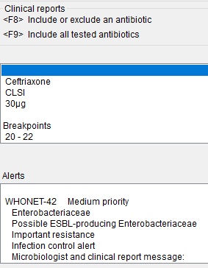
WHONET Software Advantages (Isolate Alerts)
These alert has pre- defined or user defined expert rules that can benefit the user in data entry and clinical reporting.
Rules are flagged according to the following alert categories
Quality assurance alerts
Microbiological alerts
Clinical alerts
Priority alerts

Slide 10
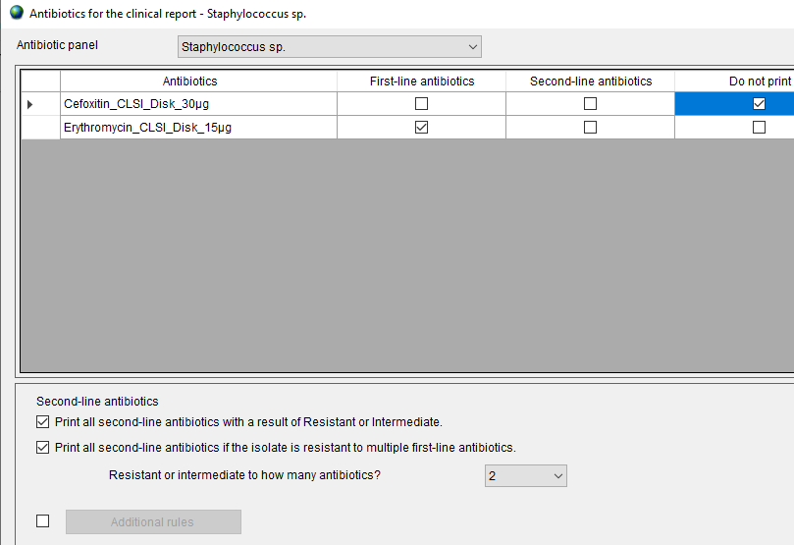
WHONET Software Advantages (Selective Reporting)
It has the ability to selectively report or suppress certain antimicrobials which important in supporting rational drug use and guiding clinical therapy decisions.
In the antibiotic panels, drugs can be customized according to the isolates

Slide 11
WHONET Software Advantages (BacLink)
The purpose of this software is the conversion and standardization of microbiology data from existing system into WHONET. BacLink can convert data from the following systems
Standard desktop softwares and text files. It can directly import data files with the following formats: Microsoft Access, dBASE, and EpiInfo.
Laboratory organism identification and susceptibility test instruments: It is compatible with the following commercial systems. – MIC systems: ATB, MiniAPI, Microscan, Pasco, Sceptor, Sensititre, Vitek, Wider – Disk diffusion readers: Aura, Biomic, Osiris, SirScan, Videobac, Wider

Slide 12
Conclusion
WHONET software has improved the efficiency of our lab in managing and analysing AMR surveillance data for emerging trends and those that require further monitoring.
One can monitor the resistant pattern of single or group of bacteria and can also give the frequency of bacteria isolated at a given time.
It also allows filtering options by various variables.
Critical resistance alerts per WHO such as ESBL, MRSA and carbapenem resistant organisms are flagged by the software.
We highly recommend adoption of the software by microbiology laboratories to ease AMR data management.
The software is however limited to handling microbiology data, thus cannot substitute the role of other laboratory information systems. Also intensive user training is required on set-up, data entry and analysis.

Slide 13



Acknowledgement
Murang’a- Health Department
MCRH Laboratory Staffs
National Public Health Laboratories
USAID IDDS

Slide 14
References
Murray, C. J., Ikuta, K. S., Sharara, F., Swetschinski, L., Robles Aguilar, G., Gray, A., Han, C., Bisignano, C., Rao, P., Wool, E., Johnson, S. C., Browne, A. J., Chipeta, M. G., Fell, F., Hackett, S., Haines-Woodhouse, G., Kashef Hamadani, B. H., Kumaran, E. A. P., McManigal, B., Naghavi, M. (2022). Global burden of bacterial antimicrobial resistance in 2019: a systematic analysis. The Lancet, 399(10325), 629–655. https://doi.org/10.1016/S0140-6736(21)02724-0
World Health Organization (WHO). (2014). Antimicrobial Resistance. 30(4), 619–635. https://doi.org/10.1016/j.giec.2020.06.004
https://whonet.org.

Slide 15
Thank you

