Slide 1
10th IPNET-K CONFERENCE
9th – 12th May 2023
SAI ROCK HOTEL ,MOMBASA ,KENYA

Slide 2

Identification of Mycobacterium species causing pulmonary tuberculosis in sputum samples from three health facilities in Nairobi county, Kenya.
Jeremiah Ndeto¹, Robi Chacha¹, Pascah Bulia¹, Dorcas Wanjiru¹, Geoffrey Okallo¹, Paul Mwangi¹, Janice Endsley², Evans Amukoye¹, Asiko Ongaya¹
1. KEMRI Centre for Respiratory Diseases Research
2. University of Texas, Medical Branch (UTMB)-Galveston USA

Slide 3
BACKGROUND
Tuberculosis is the leading cause of death in the world especially in the sub-Saharan Africa. In 2021 9.1 million people were estimated to have developed TB whereby 1.5million people died of the same disease.(WHO 2021)
Kenya is among one of the African countries with highest TB burden with an incidence of 558/100,000 population which is much more to that of global average.(Kenya tuberculosis prevalence survey 2016).
The global TB targets aim at a 95% reduction in TB deaths, 90% reduction and 0% TB affected families facing catastrophic costs due to TB by 2035(WHO 2015)

Slide 4
CONT:
Pulmonary tuberculosis is caused by Mycobacterium tuberculosis
Laboratory diagnosis is necessary for identifying Mycobacterium tuberculosis.
Non-Tuberculous Mycobacterium(NTMs) species are also known to cause a disease with similar clinical characteristics to pulmonary tuberculosis.
Techniques that are able to differentiate between infections due to MTBC and non-tuberculous mycobacteria (NTM) are therefore necessary (Shuaib et al. 2018).

Slide 5
OBJECTIVE
This study aimed to identify Mycobacterium species in sputum samples to enhance improved treatment and management of TB.

Slide 6
METHODOLOGY
Study Design:
This is across-sectional study.
Study site
Mbagathi Hospital, AHF Mathare clinic and Rhodes TB clinic in Nairobi Kenya.
Sample size
287 LJ culture positive sputum samples were analysed.

Slide 7
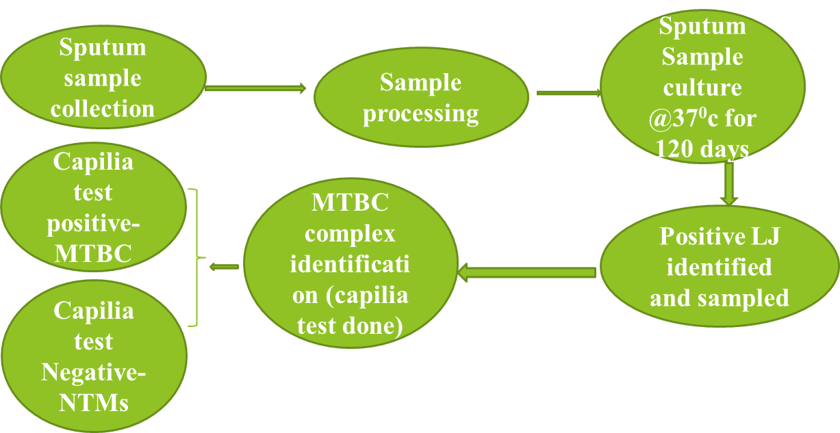
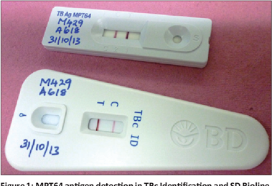

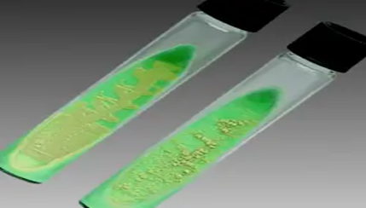
WORK FLOW FOR THE STUDY
Tropical doctor 2020

Slide 8
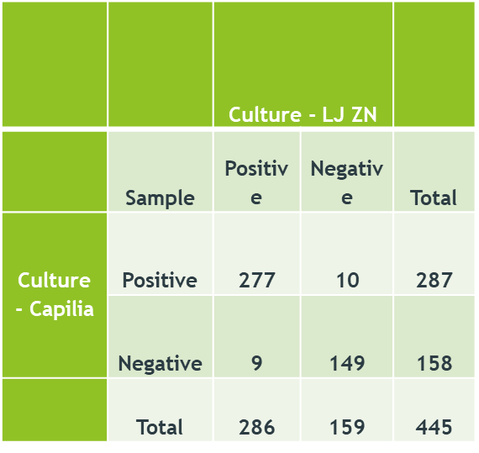
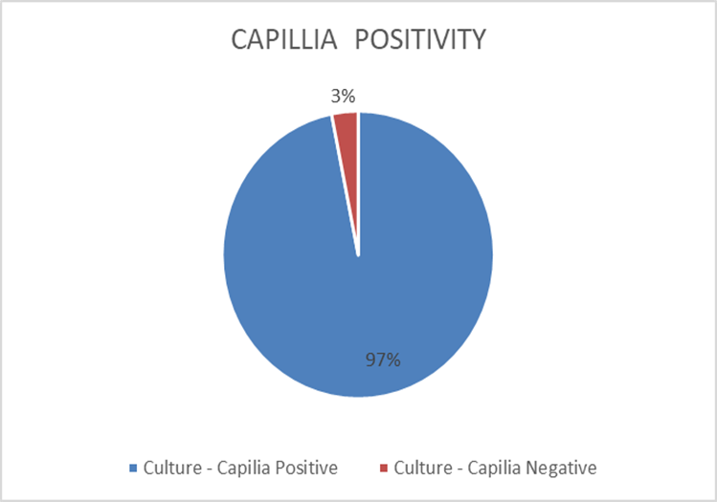
RESULTS:
Total positive and total Negative results of LJ and CAPILLIA TEST
Positivity Rate
P-value = 0.001

Slide 9
DISCUSSION AND CONCLUSION
96.5% of the total samples analyzed had Mycobacterium tuberculosis complex.3.1% were identified as NTMs which forms a respiratory health concern to the population.
A study in Germany indicated a growing incidence of NTM(Felix C. et al 2014).
Studies have shown that diagnostic tools have been designed to identify Mycobacterium tuberculosis complex only which causes majority of infections and not identifying the Non-Tuberculous Mycobacterium.

Slide 10
RECOMMENDATIONS
Characterization of Mycobacterium species in clinical samples is necessary to avert misdiagnosis and misuse of anti-TB drugs thus controlling the emergence of MDR strains.
A prevalence survey to identify mycobacterium species causing TB is key for better understanding of the circulating species and also their transmission dynamics.
A laboratory diagnostic tool that is able to identify NTMs is necessary in clinical setup to enhance better management of patients.

Slide 11

ACKNOWLEDGEMENT
                AHF Mathare clinic
                Mbagathi Hospital
                Rhodes chest clinic
                Geoffrey Okallo for data management

