Slide 1
Hepatitis B Vaccination uptake among Health Care Workers at three Level IV Hospitals in Kabondo Sub-county Homabay County, Kenya
Everlyne Akinyi Mboga¹
¹Homabay county Government
Corresponding author: evemboga6@gmail.com
10th IPNET Conference, Sai Rock Hotel, Mombasa
May 9-12, 2023

Slide 2
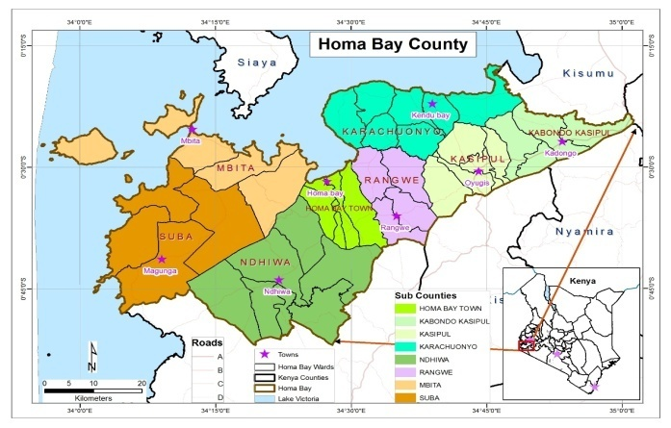
BACKGROUND
Kabondo sub-county is among the 9 sub-counties in Homabay County, Kenya.
It has a total of 28 public facilities of which:
9 Private hospitals (3 are Level IV)
15 Health centers
10 Dispensaries

Slide 3
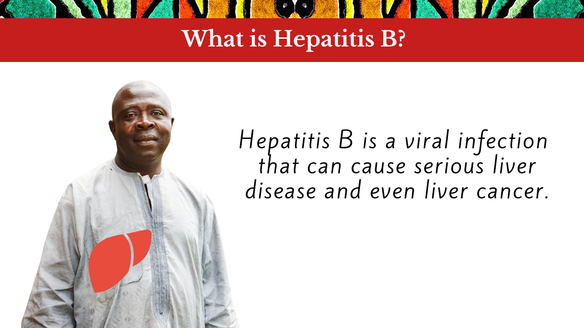
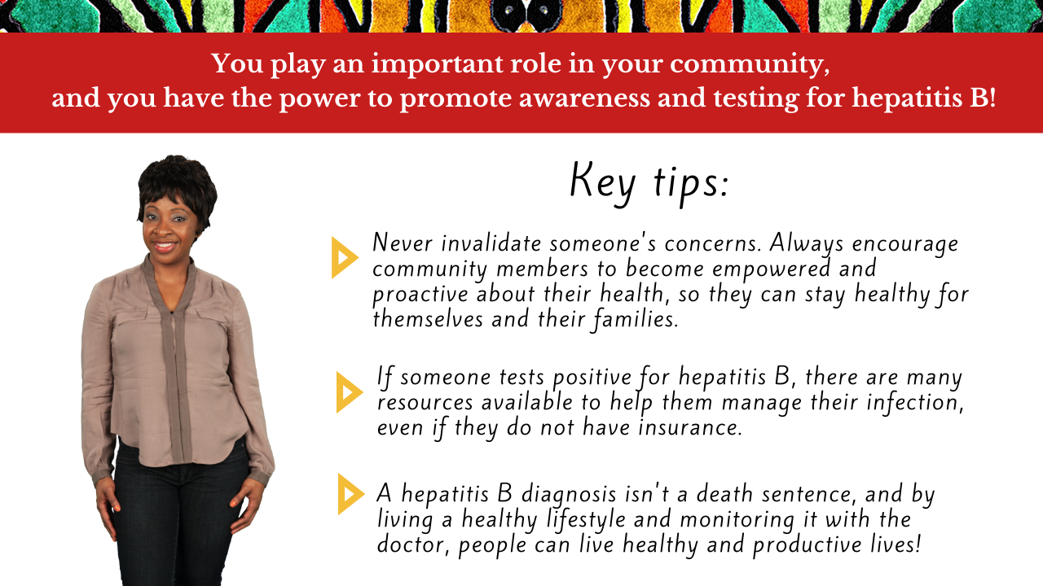

Slide 4
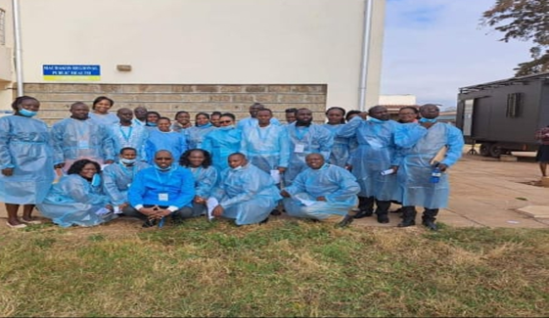
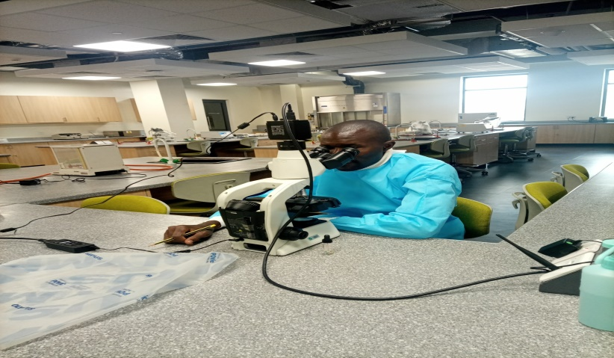
Introduction
Health care workers are constantly exposed to the dangers of acquiring hepatitis B due to contact with blood and body secretions of patients.
HBV can be prevented by vaccination
A study by WHO in 2010 showed that a majority of healthcare workers (54%) in Sub-Saharan Africa had not received any dose of Hepatitis B vaccine
HBV is among the leading public health issues that needs urgent attention and creation of awareness about its existence.

Slide 5
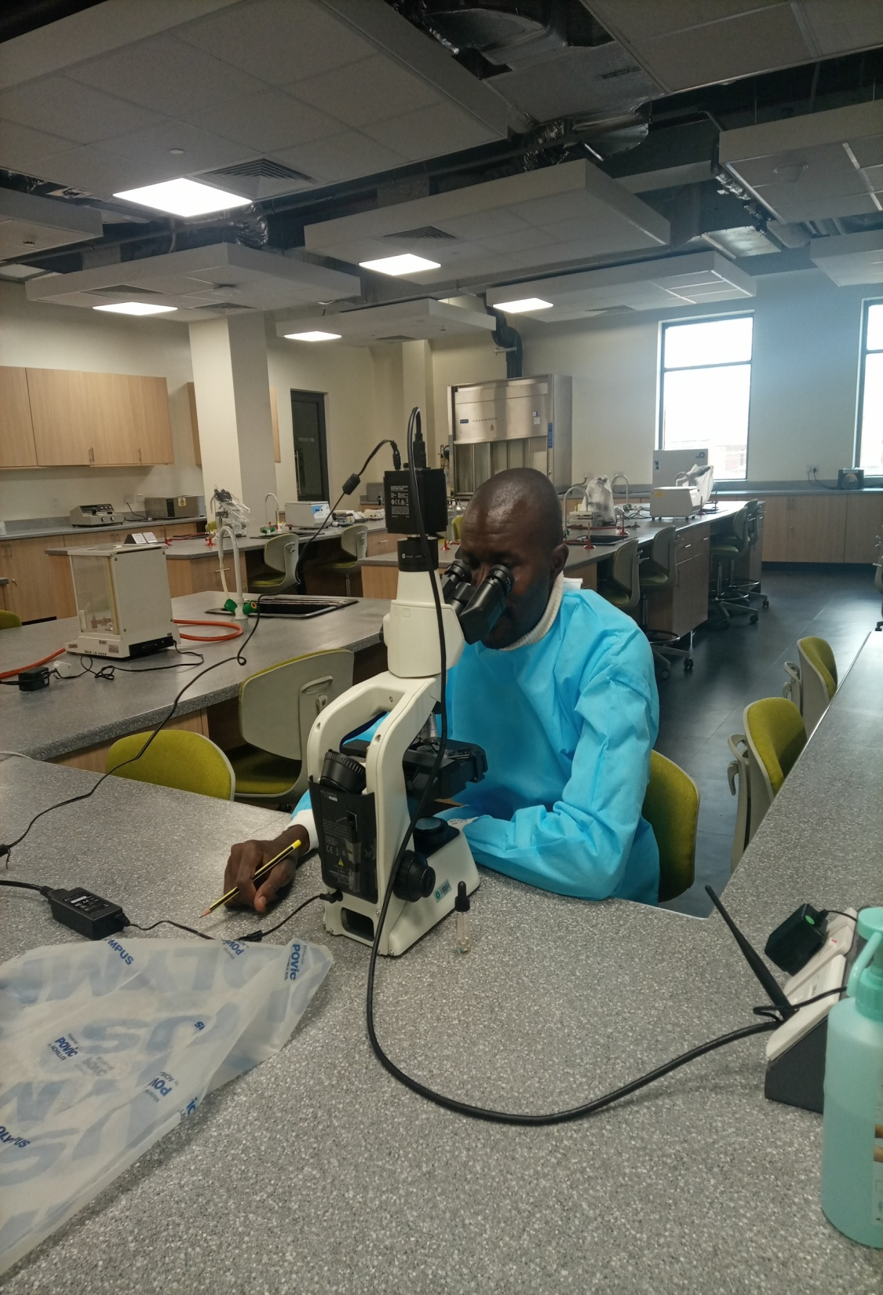

Materials and Methods
This was a descriptive cross-sectional study among HCWs between June and October 2022.
Used a structured questionnaires were used to collect data on sociodemographic, vaccination information from 153 consenting respondents.
We assessed vaccination uptake in Othoro, Ober and Kabondo Level IV hospitals in Homabay county.
Chi-square test was performed to establish association between variables

Slide 6
Study Results

Slide 7
Study Results

Slide 8
Study Results
N=153, Complete (n=15), Partial (n=16)

Slide 9
Study Results
More male, young HCWs and Lab techs had better HBV uptake, p < 0.001

Slide 10
Study Results
Vaccine availability and management support lead to increased HBV uptake

Slide 11
Conclusion
The study found that attitude affects uptake while knowledge affects attitude.
Therefore, the study recommends that institutions should put in place measures of increasing the knowledge of hepatitis B which will in turn improve the attitude of the health care workers towards hepatitis B.
This will in ultimately increase the uptake of hepatitis B vaccination among the health care workers.

Slide 12


Acknowledgment.

Slide 13

THAN

