Slide 1


Evaluation of The IPC Program, During The COVID-19 Pandemic 2021-2022 in Nyeri County
Christine Mumbi¹, Boniface Macharia¹, Erick Kitangala^{2,} Helen Wangai²
Nyeri County Department of Health
USAID Medicines, Technologies and Pharmaceutical Services (MTaPS) Program

Slide 2

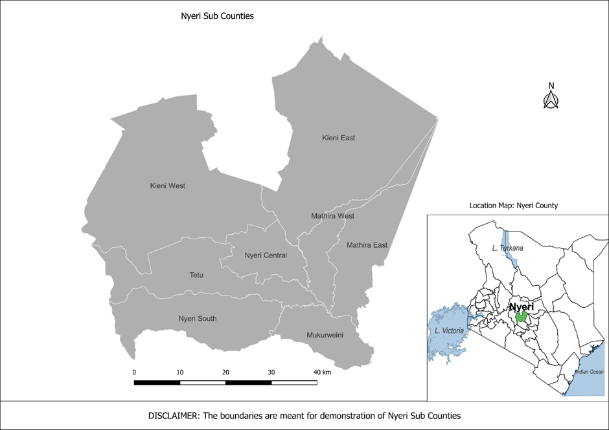
Background
Nyeri county is located in the central region of Kenya.
It covers an approximate area of 3,325 square kilometers.
Total County Population as projected from 2019 census-810,195
Subdivided into eight (8) sub-counties and thirty (30) electoral wards.
Has 129 County Government facilities( 5.
Population can access a health facility within a radius of at least 5- 7 Km.

Slide 3
Methodology
This was a cross-sectional study design.
The study is a follow-up done by the county after several interventions were put in place by MOH,USAID/MTaPs .
12 facilities were assessed, across 6 sub counties.
The study assessed 8 domains namely: Coordination, Communication& Reporting, Supplies, Training, Screening, Preparing For A Surge, Monitoring HCWs, and Environmental Cleaning and Disinfection.

Slide 4
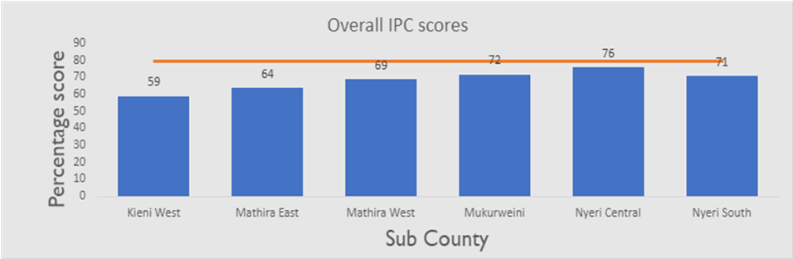
Results
The overall mean score across the 8 COVID-19 IPC domains assessed was 70%. IPC Domain Mean Scores Per Sub-county ranged from 59-76%

Slide 5
Results cont’d
The highest score, 78% for the coordination domain was recorded in Mathira and Nyeri sub-counties while the least was 0% recorded in Kieni West.
Mukurweini sub-county scored the highest, 100% in Communication and reporting
On Supplies Mathira East and Nyeri Central sub-counties scored the highest, 88% while Mukurweini scored the least at 64%
Triage and screening was well done across the sub-counties with the highest score of 82% and lowest of 68%.

Slide 6

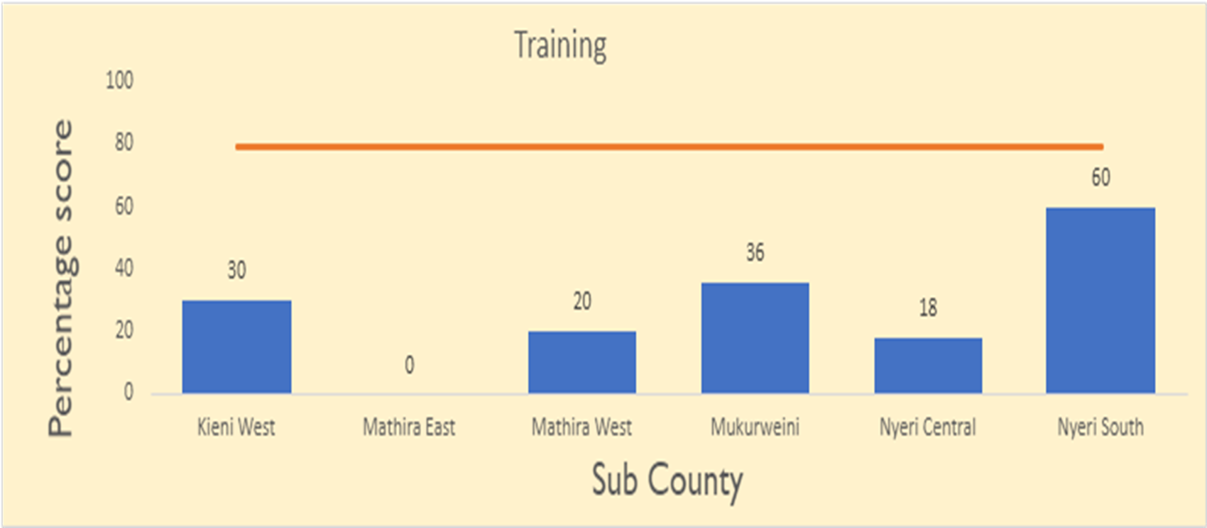
Results Cont’d
The training uptake was generally poor with the highest score of 60% achieved in Nyeri South Sub-county while Mathira East having not been training at all.

Slide 7
Results Cont’d
On surge preparedness the score across 5 sub-counties was between 50-69% except Kieni West that scored 15%
Monitoring of COVID-19 infection among HCW and In-patients, Mukurweini scored 100% while monitoring was not done in Mathira West.
Across the 6 sub-counties, environmental cleaning and disinfection was well done ranging between 73 and 100%

Slide 8
Conclusions
Overall performance across the Domains was good. Communication and reporting, supplies, and environmental cleaning and disinfection are the three domains that appear to be well-established in Nyeri County. There are apparent gaps in monitoring HCWs, inpatients, and training with both scoring less than 50%.

Slide 9
Recommendations
Increase coverage of trained HCWs on covid-19 IPC across the county.
Improve monitoring HCWs and inpatients at the facility level to reduce facility-based transmissions.
Overall work on ensuring IPC practices should be given priority across all the facilities in the county

Slide 10
Acknowledgement
Department of Health Services Nyeri County
All the Sub- County Heads of the 6 participating sub-counties
USAID Medicines, Technologies and Pharmaceutical Services (MTaPS) Program

Slide 11


