Slide 1


THE 10TH IPNET KENYA CONFERENCE
VENUE: THE SAI ROCK HOTEL MOMBASA
THEME: INNOVATIVE INTEGRATION OF IPC IN DISEASE OUTBREAKS AND ROUTINE HEALTHCARE SERVICES.
SUB THEME: IPC PRACTICE: IMPLEMENTATION, MONITORING & QUALITY IMPROVEMENT
TITLE: EFFECT OF HAND HYGIENE PROGRAM ESTABLISHMENT ON HAND HYGIENE COMPLIANCE AT MERU TEACHING AND REFERRAL HOSPITAL-KENYA.
AUTHORS: REUBEN MURIANKI, OSCAR IRERI, FAITH KINYA, DORIS MURIUKI

Slide 2
BACKGROUND
MeTRH is a level 5 county referral hospital serving the regional counties of Meru, Marsabit, Isiolo, Laikipia, and Tharaka Nithi. It offers many specialized services and serves as a teaching hospital for MUST and KEMU universities as well as many colleges. The hospital has a bed capacity of 330 beds and an average occupancy rate of between 95 and 125%.
IPC program gaps were identified in February 2020 following the MOH IPC facility assessment. Then there was no IPC committee, no dedicated focal person, and no hand hygiene program, and hand hygiene compliance among healthcare workers was at 9%.
Without a vibrant IPC program, the hospital was in an unpleasant state with bad smells, dirty surfaces, and poor hand hygiene compliance, all of which put patients, healthcare workers, and the community at high risk of contracting infections. Hand hygiene is the single most effective IPC practice accounting for over 80% of HAIs.

Slide 3
OBJECTIVES
BROAD OBJECTIVE: To Improve healthcare workers’ hand hygiene compliance at MeTRH from 9% to 60% by June 2022.
Specific objectives.
To train and sensitize 70% of healthcare workers on hand hygiene.
To provide adequate infrastructure and supplies for hand hygiene.
To monitor hand hygiene compliance among healthcare workers.

Slide 4
METHODS
On site and off site healthcare workers training and sensitization using MOH curriculum, conducting IPC audits, support supervision, and feedback reports.
Needs assessment audits and implementation of recommendations.
Audit of hand hygiene compliance by healthcare workers using the WHO hand hygiene observations tool.

Slide 5
results

Slide 6
results

Slide 7
results

Slide 8
results

Slide 9
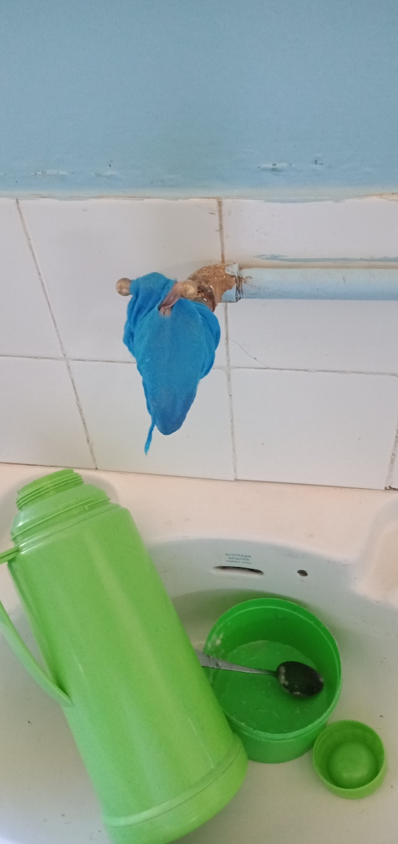
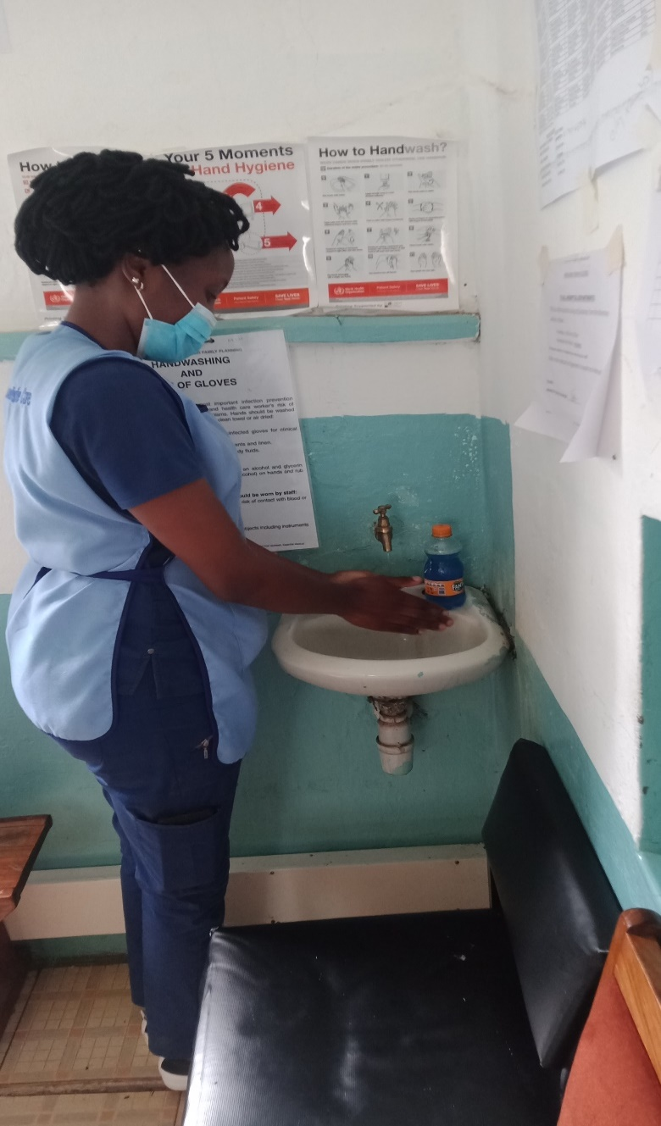
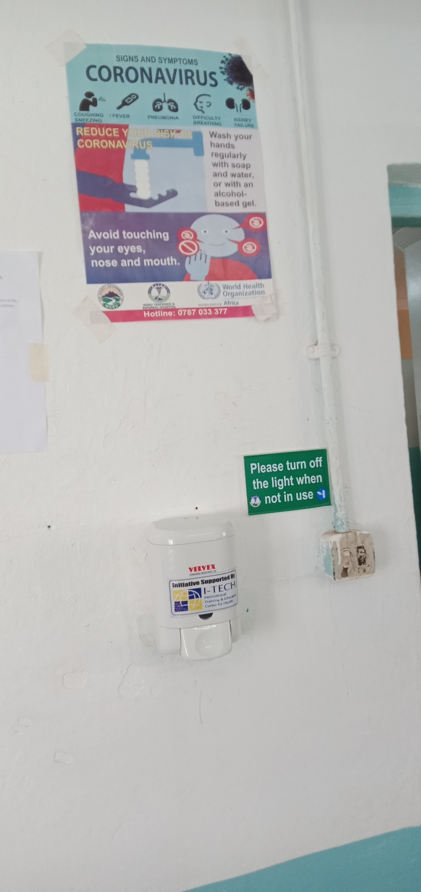
Results
BEFORE
Broken hand-washing sinks.
AFTER
Functional handwashing station.
AFTER
Hand rub dispenser.

Slide 10
CHALLENGES
Personnel’s change resistance.
Staff IPC practices knowledge gaps.
Inadequate IPC budget to facilitate activities.
Lengthy IPC commodities procurement process creating occasional stock outs and inconsistent IPC practices implementation.
Suboptimal IPC infrastructure to implement hand hygiene.

Slide 11
OPPORTUNITIES
An existing IPC knowledge however limited was the little candle light that was worked on to make a light house.
Administrative and managerial support from the top leaders in the facility provided a fertile ground to cultivate the IPC culture.
Receptive attitude by majority of the staff enabled the program to be adopted with ease.
Government and partners technical and material inputs has been a major booster that has catalysed the IPC transformation process.

Slide 12
conclusion
The establishment of a hand hygiene program in healthcare settings improves healthcare workers’ compliance to hand hygiene.
The monitoring component provides data that is useful in target setting.

Slide 13
ACKNOWLEDGEMENT
We are grateful to the MeTRH administration for the support of the program and facilitation to attend this event.
We acknowledge the County Government of Meru has, through the CIPCC supported the program at our facility in a big way.
We Recognize the MOH for the trainings and technical support to establish a committee at our facility and a myriad other ways they have supported us.
We are grateful to our partners MTaPS and ITECH among others who have held our hand from infancy to this stage also exposing us to conferences and advise as we make this debut presentation.

Slide 14
references
National Infection Prevention And Control Guidelines 2015
MOH MeTRH IPCAT report,Febuary 2020.
MOH MeTRH COVID-19 facility readiness assessment report 2022
MeTRH July 2022 IPC audit report.
WHO hand hygiene protocols.

Slide 15
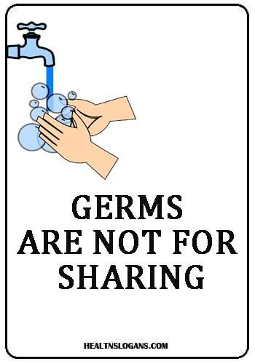
Thank you

