Slide 1
Cost Saving Aspect of Antimicrobial Stewardship: A Perspective from Rural Hospitals in Makueni County, Kenya
Presenter: Gavin Orangi
Orangi Gavin¹, Caroline Mwanthi ¹, D Muteti¹, C. Nzomo¹, J. Kanyange ^{1,} E.Tanui², I. Kamau², A. Shah³, S. Gachoka³, B. Kinuthia³
County Government of Makueni -Dept of Health Products and Technology Unit (HPTU)
Ministry of Health
Foundation for Innovative New Diagnostics (FIND)

Slide 2
Key Words
Antimicrobial consumption
Antimicrobial stewardship (AMS)
Antimicrobial Use
Antimicrobial resistance (AMR)
Notes:
AMC average maintenance dose per day for a drug for a specific indication measured in form of DDD
AMU use of a medication to treat infection in humans

Slide 3
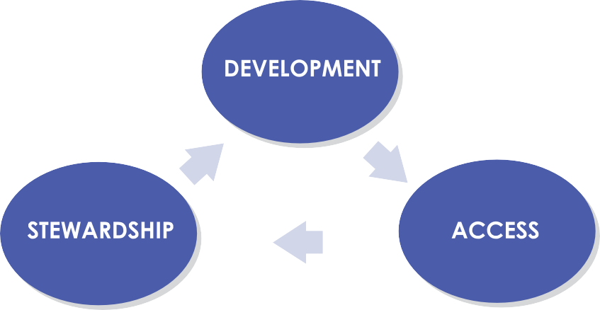
Framework for antimicrobial stewardship
Notes:
Development involves advancing new antimicrobials.
Access entails establishing doorways for millions of people to obtain antimicrobials when they need them.
Stewardship hinges on efforts to maintain the effectiveness of existing medicines.

Slide 4
NAP on AMR
1. Improve awareness and understanding of AMR
Risk communication
Education
IPC in health care
Community level prevention
4. Optimize the use of antimicrobial medicines in human & animal health
5. Ensure sustainable investment through research & development
Use in veterinary sector and agriculture
Access to quality antimicrobial medicines, regulation, AMS
Animal health: prevention and control
Measuring the burden of AMR
Assessing investment needs
Establishing procedures for participation
3. Reduce the incidence of infection through effective hygiene & IPC
Research and development
Laboratory capacities
National AMR surveillance
2. Strengthen knowledge through surveillance and research
hhttp://www.who.int/antimicrobial-resistance/publications/global-action-plan/en/

Slide 5
Introduction
Irrational fixed dose combination of antimicrobials
Poor Infection Prevention & Control
inadequate capacity for culture and sensitivity testing
Irrational Ceftriaxone use
Poor pharmaceutical regulatory mechanisms
lack of clear antimicrobial empirical treatment guidelines
overuse of antimicrobials
Inappropriate use
Notes:
To mitigate this, Makueni County Department of Health through the Health Products and technologies Directorate has been keen to increase awareness on AMR and has actively supported AMS activities in its level 4 and 5 hospitals since 2020 through various AMS activities including laboratory capacitation, trainings, and auditing of antimicrobials prescriptions.

Slide 6
To mitigate this, Makueni County Department of Health through the Health Products and technologies Directorate has been keen to increase awareness on AMR.
This is through active support for AMS activities in its level 4 and 5 hospitals since 2020 through various AMS activities including laboratory capacitation, trainings, and auditing of antimicrobials prescriptions.

Slide 7
Objective
To investigate consumption of ceftriaxone before and after AMS implementation at Makueni County Referral Hospital (MCRH) and Sultan Hamud Level-4 Hospital (SHSCH)

Slide 8
METHODOLOGY
FORMATION OF AMS COMMITTEE AND TEAMS
AMS interventions
second review
Ceftriaxone consumption review
Thematic workshops
IPC
Surgical prophylaxis
antimicrobial ward round
sample collection
Various select community acquired infections
January 2020- December 2021 SHSCH
February 2022- April 2022 MCRH.
March 2019 to December 2019 at SHSCH
July 2021 to September 2021 at MCRH

Slide 9
METHODOLOGY
Data sources:
Bin cards
Funsoft tool
Data entry and analysis
MS-Excel

Slide 10
Findings
With the average cost of ceftriaxone vial in Kenya being Ksh. 50 shillings, average savings of a total of 42,900/= per month was realized from AMS implementation.

Slide 11
Conclusion
There was a marked reduction in the consumption of ceftriaxone after implementation of AMS, leading to annual savings of approximately 500,000/= in the two hospitals for ceftriaxone.
There is need to strengthen antimicrobial stewardship which will reduce the healthcare costs while slowing down the burden of AMR.

Slide 12
NAP on AMR
1. Improve awareness and understanding of AMR
Risk communication
Education
IPC in health care
Community level prevention
4. Optimize the use of antimicrobial medicines in human & animal health
5. Ensure sustainable investment through research & development
Use in veterinary sector and agriculture
Access to quality antimicrobial medicines, regulation, AMS
Animal health: prevention and control
Measuring the burden of AMR
Assessing investment needs
Establishing procedures for participation
3. Reduce the incidence of infection through effective hygiene & IPC
Research and development
Laboratory capacities
National AMR surveillance
2. Strengthen knowledge through surveillance and research
hhttp://www.who.int/antimicrobial-resistance/publications/global-action-plan/en/

Slide 13
Investment in IPC
Employment of ID specialists
Investment in AMS
Economic case for AMR
??
Employment of staff
??

Slide 14
References
Antimicrobial resistance now kills more people than HIV or malaria. (n.d.). Retrieved March 23, 2022, from https://www.openaccessgovernment.org/antimicrobial-resistance-hiv/127952/
Commission on Safety, A., & in Health Care, Q. (n.d.). AURA 2021: Fourth Australian report on antimicrobial use and resistance in human health. Retrieved from www.safetyandquality.gov.au/publications-and-
D’Arcy, N., Ashiru-Oredope, D., Olaoye, O., Afriyie, D., Akello, Z., Ankrah, D., … Versporten, A. (2021). Antibiotic Prescribing Patterns in Ghana, Uganda, Zambia and Tanzania Hospitals: Results from the Global Point Prevalence Survey (G-PPS) on Antimicrobial Use and Stewardship Interventions Implemented. Antibiotics 2021, Vol. 10, Page 1122, 10(9), 1122. https://doi.org/10.3390/ANTIBIOTICS10091122
Murray, C. J., Ikuta, K. S., Sharara, F., Swetschinski, L., Robles Aguilar, G., Gray, A., … Naghavi, M. (2022). Global burden of bacterial antimicrobial resistance in 2019: a systematic analysis. The Lancet, 399(10325), 629–655. https://doi.org/10.1016/S0140-6736(21)02724-0
Razzaque, M. S. (2021). Implementation of antimicrobial stewardship to reduce antimicrobial drug resistance. Expert Review of Anti-Infective Therapy, 19(5), 559–562. https://doi.org/10.1080/14787210.2021.1840977
REPUBLIC OF KENYA NATIONAL POLICY ON PREVENTION AND CONTAINMENT OF ANTIMICROBIAL RESISTANCE. (2017). Retrieved from www.health.go.ke

Slide 15
shukran

