Slide 1
Comparative analysis of national and hospital-based antibiograms for the year 2021: lessons learned and conclusions drawn.
Jumba Sande Godfrey
Warda Mohammed
Henry M Ogaro
KITALE COUNTY HOSPITAL, TRANS NZOIA COUNTY
10th IPNET KENYA CONFERENCE SAI ROCK HOTEL, MOMBASA

Slide 2
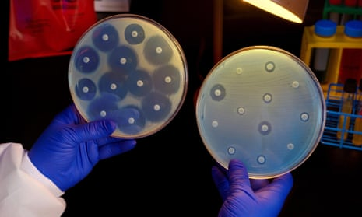

Slide 3
OBJECTIVES
To compare the Kitale County hospital(County) antibiograms with the national antibiograms for specific organisms.
To determine whether the National antibiogram can be used to predict the Hospital (County) antibiogram, allowing for extrapolation.

Slide 4
INTRODUCTION
In vitro Antibiotic susceptibility testing (AST) assess the likelihood that a particular antimicrobial agent will treat an infection caused by a particular organism.
The overall profile of antimicrobial susceptibility testing results of a specific microorganism against a battery of antimicrobial drugs is called an antibiogram. (Joshi, 2010)
Antibiograms help guide the clinician and pharmacist in selecting the best empiric antimicrobial treatment in the event of pending microbiology culture and susceptibility results.
They are also useful tools for detecting and monitoring trends in antimicrobial resistance, allowing for their investigation

Slide 5
METHOD
A retrospective analysis of available AST data was done to compare Cumulative AST data at Kitale County Hospital and National Antibiogram for the year 2021 (Courtesy of the MOH AMR Surveillance TWG), for four organisms namely:
  Staphylococcus aureus,
  Acinetobacter baumanii,
  Escherichia coli and
  Pseudomonas aeruginosa,
Data analysis done using Microsoft excel and Statistical Package for the Social Sciences (SPSS).

Slide 6
S. aureus antibiogram

Slide 7
E.coli antibiogram

Slide 8
Pseudomonas aeruginosa antibiogram

Slide 9
Acinetobacter baumanii antibiogram comparison

Slide 10
Whether The National antibiogram can be used to predict the hospital-based (county) antibiogram
ORGANISM | P VALUE (acceptable <0.05) | INTERPRETATION
Staphylococcus aureus | 0.021 | Model significant
Escherichia Coli | 0.002 | Model sgnificant
Pseudomonas aeruginosa | 0.157 | Model not significant
Acinetobacter baumanii | 0.032 | Model significant

Slide 11
CONCLUSION
There are significant variations in the antibiotic susceptibility profile of organisms circulating in different regions.
There is a need to also focus on creating localized county and hospital-based antibiograms to augment the steps so far achieved in creating a national antibiogram.

Slide 12
REFERENCES
About antibiograms - health.state.mn.us. (n.d.). https://www.health.state.mn.us/diseases/antibioticresistance/abx/antibiograms.pdf
Joshi, S. (2010). Hospital antibiogram: A necessity. Indian Journal of Medical Microbiology, 28(4), 277–280. https://doi.org/10.4103/0255-0857.71802

Slide 13




Acknowledgement

