Slide 1
Characterization of carbapenem-resistant gram negative bacterial isolates from Thika level 5 hospital, Kenya
Presenter: Patrick Maina Wakaba
(Centre for research in infectious diseases – MKU)
10th Infection Prevention Network – Kenya Conference
10th May 2023

Slide 2
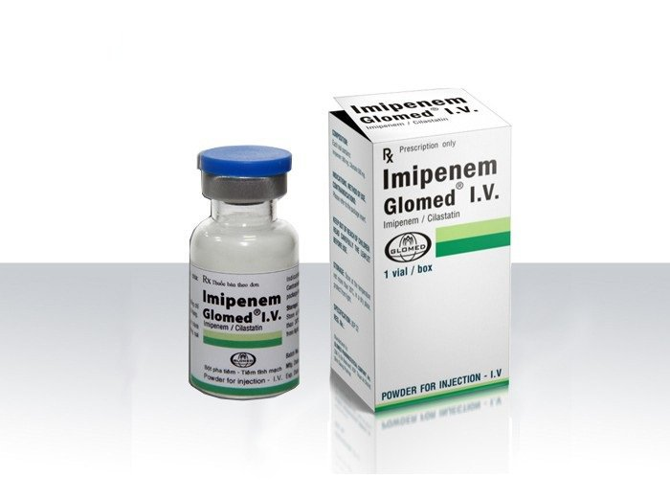
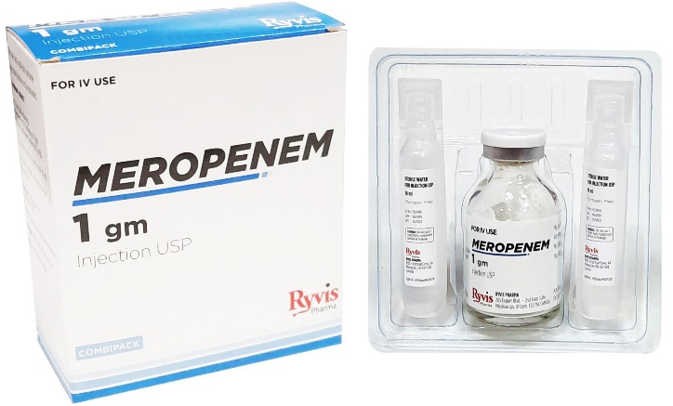
Introduction
What is carbapenem-resistance?
Carbapenems (Penicillins) –Beta-lactams , most effective broad spectrum antibiotics
Most reliable last-resort treatment for bacterial infection – fewer adverse effects compared to other last line drugs such as polymyxins
2015 CDC definition: Resistant to imipenem, meropenem, doripenem or ertapenem

Slide 3
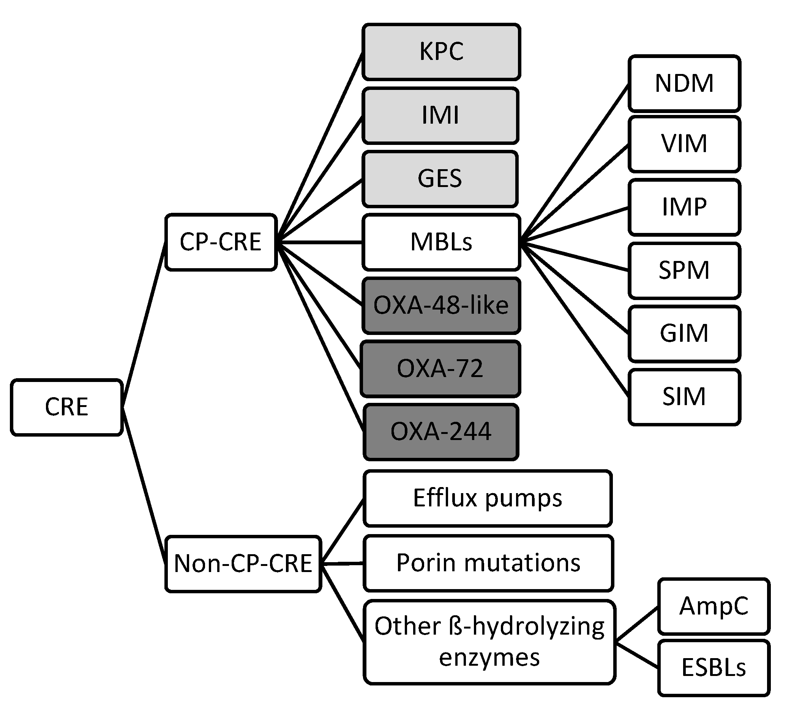
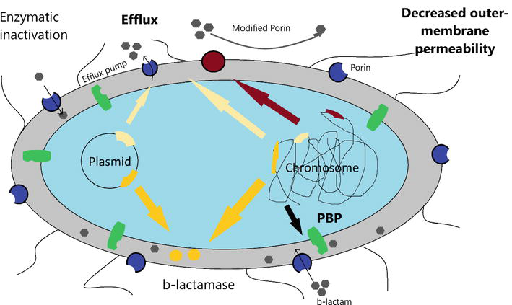
Mechanism of carbapenem resistance
KPC: Klebsiella pneumoniae carbapenemase; IMI: Imipenem-hydrolyzing ß-lactamase; GES: Guiana extended-spectrum ß-lactamase; MBLs: Metallo-ß-lactamase; OXA: oxacillinase; NDM: New Delhi metallo-ß-lactamase; VIM: Verona integron-borne metallo-ß-lactamase IMP: Imipenem resistant Pseudomonas carbapenemase; SMP: Sao Paulo metallo-ß-lactamase; GIM: German imipenemase; SIM: Seoul imipenemase; AmpC: Type C ampicillinase;
Aslam et l., 2020 doi:10.5772/intechopen.90100

Slide 4
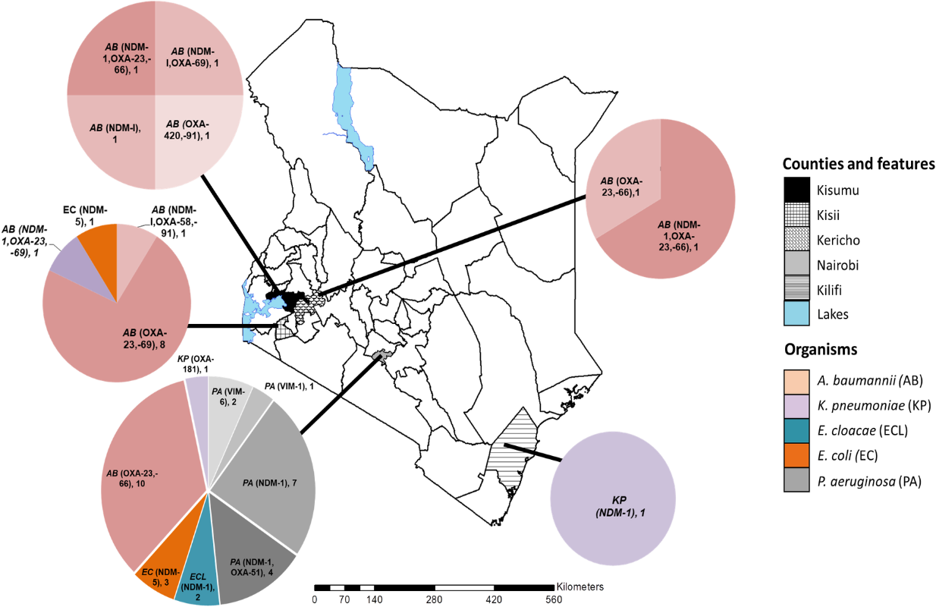
Current state of carbapenem resistance in Kenya
Musila et al., 2021

Slide 5
Objectives
Describe characteristics of cabapenem-resistant Gram negative isolates from patients in Thika Level 5 Hospital, Kenya
Describe the carbapenemase genes in Gram negative isolates from patients in Thika Level 5 Hospital, Kenya

Slide 6
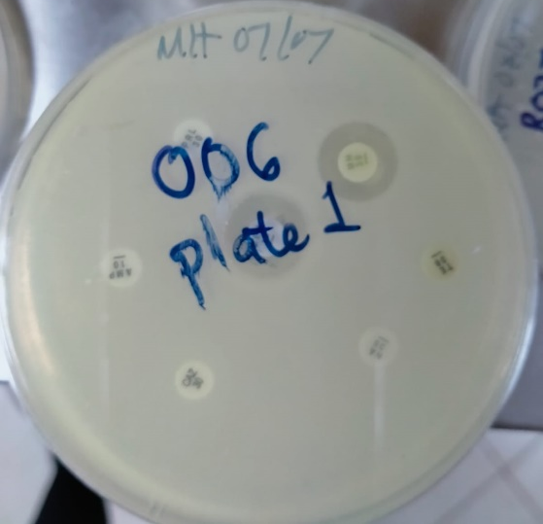
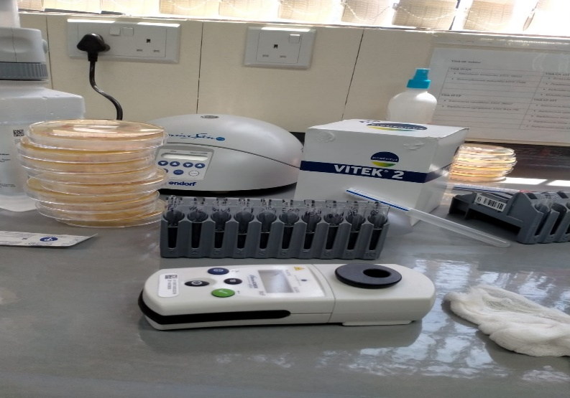
Analysis Workflow
Inoculation on MacConkey and CLED
Sample collection
Transport to the laboratory
Incubation at 38⁰C overnight
Genotypic tests
KPC, NDM, OXA,VIM,IMP
AST via disc diffusion test
Bacteria identification via
VITEK® 2 Compact system
Subculture on NA and gram stain
Data analysis

Slide 7
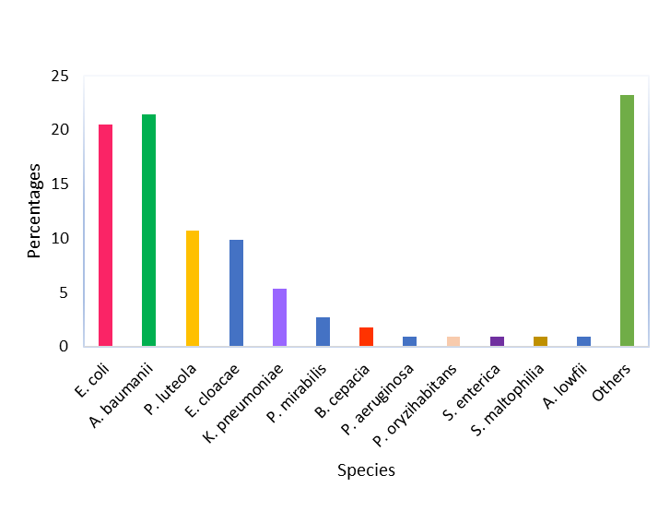
Results
305 samples were collected between March and November 2021
112 gram negative bacterial isolates were recovered A. baumannii 21.4%, E. coli 20.5%, P. luteola 10.7% and E. cloacae 9.8%

Slide 8
Carbapenem-resistant bacteria by source

Slide 9
Carbapenem-resistant Bacteria identified

Slide 10
Genomic data
blaOXA-69, blaOXA-23
blaOXA-317
blaOXA-507
blaOXA-23, blaOXA-507
blaNDM-1
Predominantly observed in A. baumanii

Slide 11
Conclusion & Recommendation
Conclusion
Considerably high level of carbapenem-resistance was observed
A significant proportion of CRE in Thika level 5 hospital produce a carbapenamase
Recommendation
CR surveillance in order to identify Carbapenamase-producing Carbapenem-resistant organisms (CP-CRO)
Improving infection control and implementation of antimicrobial stewardship to curb spread of resistance
Ensure inter-facility communication to prevent regional spread of CRO

Slide 12

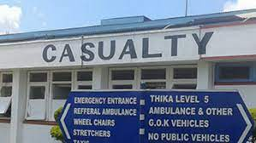

Acknowledgements
Center for Research in Infectious Disease
Dr. Jesse Gitaka
Dr. Bernard Kanoi
Mrs. Racheal Kimani
Thika Level 5 Hospital
Gabriel Gikonyo
Moses Mbogo
Thank You

