Slide 1
ASSESSMENT OF
INFECTION PREVENTION AND CONTROL (IPC)
PROGRAM IN MOMBASA COUNTY
FOR COMPLIANCE WITH
THE WORLD HEALTH ORGANIZATION (WHO) MINIMUM REQUIREMENTS
Dr. Jane W. Gitahi ,
Mtr. Florence Wachira , Caren Mibei

Slide 2
INTRODUCTION
Epidemics, Pandemics and Antimicrobial Resistance (AMR) are common challenges.
Effective IPC is the cornerstone for their control.

Slide 3
INTRODUCTION
WHO Guidelines Development Group Identified Eight core Components (CC) of IPC programs.

Slide 4
INTRODUCTION
CC 1: IPC programs
CC 2: IPC Guidelines
CC 3: IPC education and training
CC 4: Health care-associated infection (HAI) surveillance

Slide 5
CONTINUE…
CC 5: Multimodal strategies for implementing infection prevention and control activities.
CC 6: Monitoring and Evaluation and Feedback.

Slide 6
CONTINUE….
CC 7: Workload, Staffing and Bed occupancy at the facility level.
CC 8: Built Environment, Materials And Equipment For Infection Prevention And Control At The Facility Level.

Slide 7
METHODS
This Cross-sectional Study Assessed
The IPC Programs In Level 4 & 5 Facilities In Department Of Health In January 2023.

Slide 8
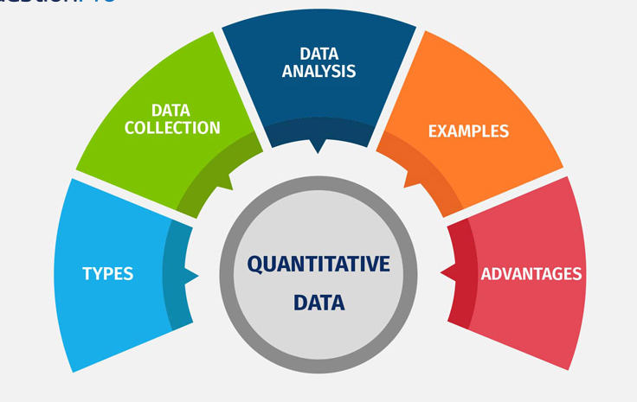
METHODS
Quantitative Data was collected using
the WHO Infection Prevention and Control Assessment Framework at the Facility Level (IPCAF).

Slide 9
Contin…
It Is A Structured, Closed-Formatted Questionnaire With An Associated Scoring System To Assign An IPC Levels.

Slide 10

Contin…
Inadequate (0–200)
Basic (201–400)
Intermediate (401–600)
Advanced (601-800).
DATA WAS ANALYZED USING EXCEL.

Slide 11

RESULTS
- ONE FACILITY SCORED 430,
- WITH THE OTHER LEVEL 4 FACILITIES BETWEEN 320 - 375.

Slide 12

RESULTS
The average scores for components were 63% Component 1, 66% Components 2 & 3 54% Components 5, 59% Components 6, 54% Components 7 and 58% Components 8. Component 4 scored 47%.

Slide 13
RESULTS

Slide 14

DISCUSSION:
The IPC Program In Mombasa County Established In June 2021 Has Gaps In All 8 Components With HAI Surveillance Scoring The Least.

Slide 15

CONCLUSION:
The IPC program is established in a stepwise manner.
The Gaps Identified will help in prioritizing areas where focus needs to be placed towards achieving full compliance.

Slide 16

All the level 4 & 5 in managers.
All the our mentors.

Slide 17


