Slide 1
Assessing Infection Prevention and Control Governance structures and Financing options in Rachuonyo North Sub County Health Facilities, Homa Bay County
Gabriel Kotewas
10TH IPNET- K CONFERENCE
Sai Rock Hotel Mombasa, 09th - 12th May 2023

Slide 2
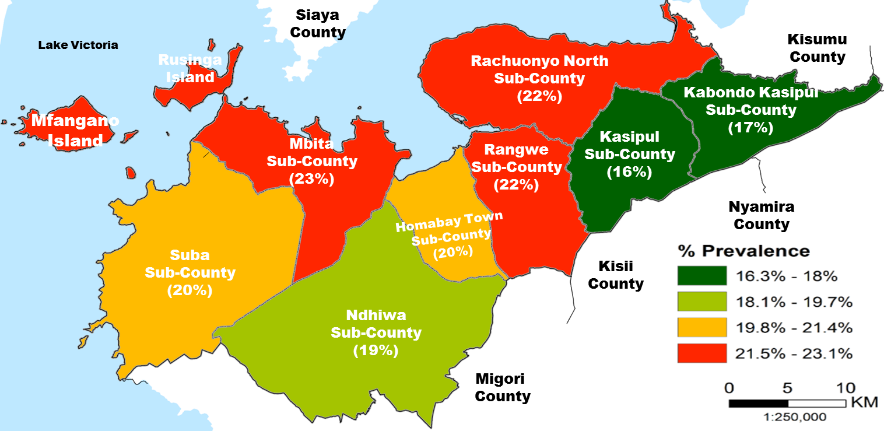
Background………..1
Rachuonyo North sub county is among the 9 sub counties of Homa Bay County Kenya.
It has a total of 50 public facilities and of which :
3 are Level four
15 Health centers
32 Dispensaries

Slide 3

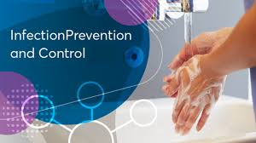
Introduction
Effective infection prevention and control (IPC) is crucial towards preventing hospital acquired infections, and is integral to safe, effective, high quality health service delivery.
The success and effectiveness of such a program requires adequate financing coupled to an effective governance system.
We assessed the health financing and governance structures for IPC implementation in health facilities within Rachuonyo North sub county, Homa Bay.

Slide 4
Methods
This cross-sectional study was implemented between December 2022 to January 2023 in both public and faith-based health facilities in Rachuonyo North Sub County.
A questionnaire was developed to collect data on demographics, IPC health financing (with focus on funding sources) and IPC governance (with focus on existence of IPC program and policy guidelines), we targeted IPC focal persons in all the 52 facilities.
We described the data using frequencies and percentages.

Slide 5
Results ….1
Of the 52 facilities targeted, 47(90%) responded
Among respondents, 26(55%) were males and 21(45%) were female.

Slide 6
Results ….2
The distribution of IPC focal persons per cadre were: laboratory officers were 12(26%), clinical officers 10(21%), nursing officers 9(19%), others 16(34%).

Slide 7
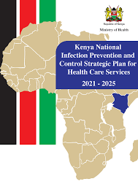
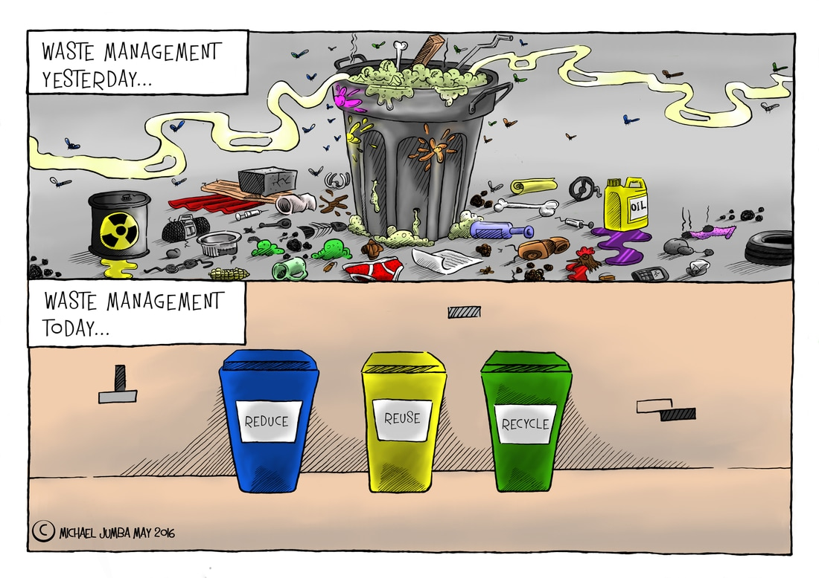
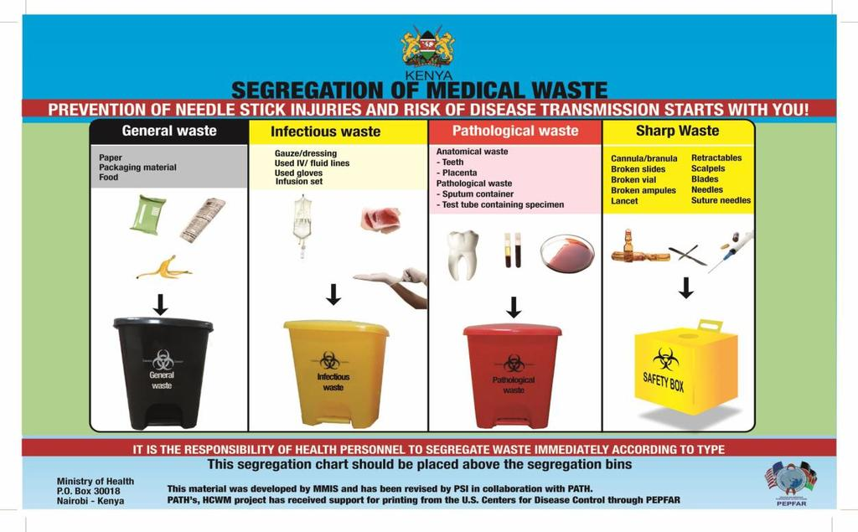
IPC programs existed in 41(87%) facilities, of which 43(91%) had IPC policy guidelines and 34(72%) had various IPC job aids

Slide 8
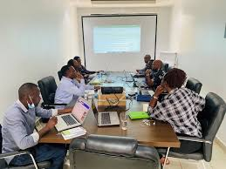

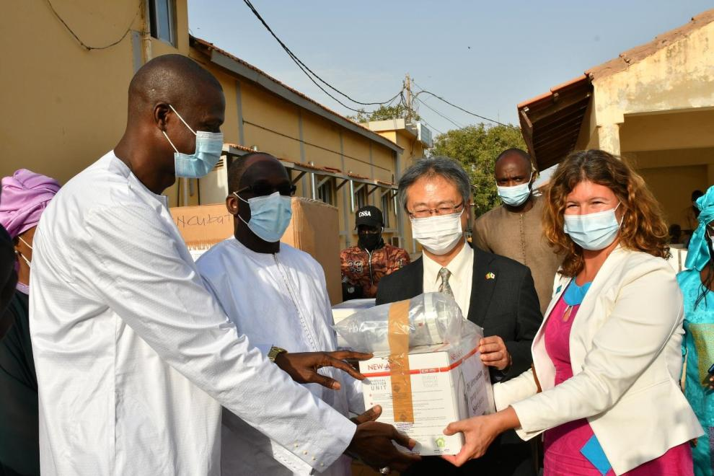
Results ….3
For financing, 25(53%) had IPC program in their annual work plan,
13(28%) had budgetary allocation for IPC,
26(55%) had donations and partner support as the main source of funding for IPC activities
5(11%) relying on facility improvement fund (FIF), and 16(34%) had mixed sources of funding.

Slide 9

Conclusion
Most facilities had an IPC program and relied on budgetary allocation and partner support for funding.
For sustainability of a robust IPC program, more facility driven finance resourcing through FIF will be of vital importance especially in this era of declining donor support.

Slide 10
Acknowledgement
Homa Bay County Department of Health
Rachuonyo North Sub County Health Facilities
IPC Focal Persons Rchuonyo North Health Facilities
LVCT Health Vukisha 95
IPNET-K Mentors

Slide 11


