Slide 1

Antimicrobial stewardship in managing superficial uninfected wounds at the Nyeri County Referral Hospital
Lydiah Wanjohi¹, Dr. Kibira Sarah¹, Dr. Nkatha Gitonga², Dr. Ndinda Kusu²
1. Nyeri County Referral Hospital
^{2.} USAID Medicines, Technologies, and Pharmaceutical Services (MTaPS) program

Slide 2
Background
Systemic use of antibiotics in wounds is alarming worldwide as up to 50% of antibiotics used in both inpatient and outpatient setting are either unnecessary or inappropriate.
This contributes to antimicrobial resistance (AMR) thus there is need to review and improve how antimicrobials are used for all types of wounds.

Slide 3
Background cont’d
The use of all antibiotics should be guided by treatment guidelines, and prescribed in situations that have clear clinical indications.

Slide 4
Overall Objective
To manage an open Weber B classification of distal fibula fracture by dressing using sodium chloride 0.9% solution and sugar.

Slide 5
Methodology
Patient was admitted
Surgical toilet was carried out
  2g Ceftriaxone was administered as antibiotic prophylaxis.
Post surgical care
  Daily dressing with 0.9% sodium chloride for 2 weeks

Slide 6
Methodology cont’d
Debridement
  Daily dressing with 0.9% sodium chloride and sugar for 2 weeks.
  Granulation was achieved and the wound was ready for grafting.
  Patient declined grafting
    Daily wound care continued for 1 week.

Slide 7



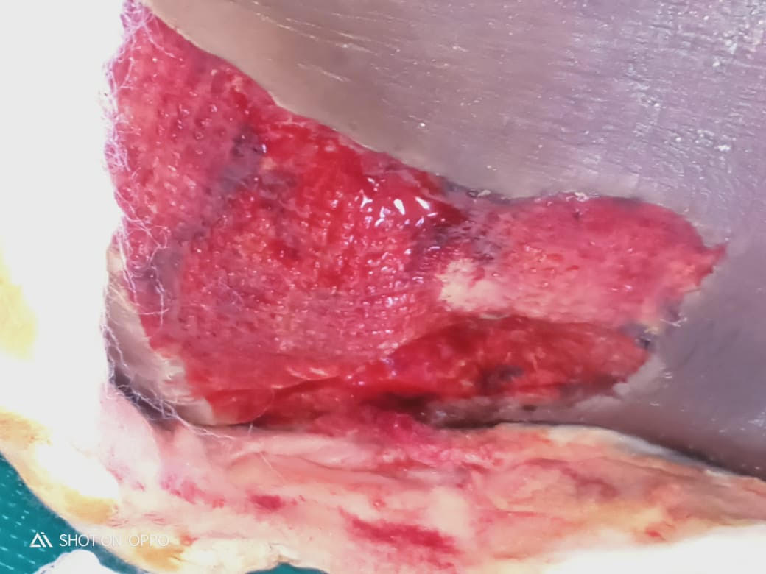
Results
Left: The Weber B classification of distal fibula fracture was a clean superficial wound after undergoing one session of surgical toileting

Slide 8

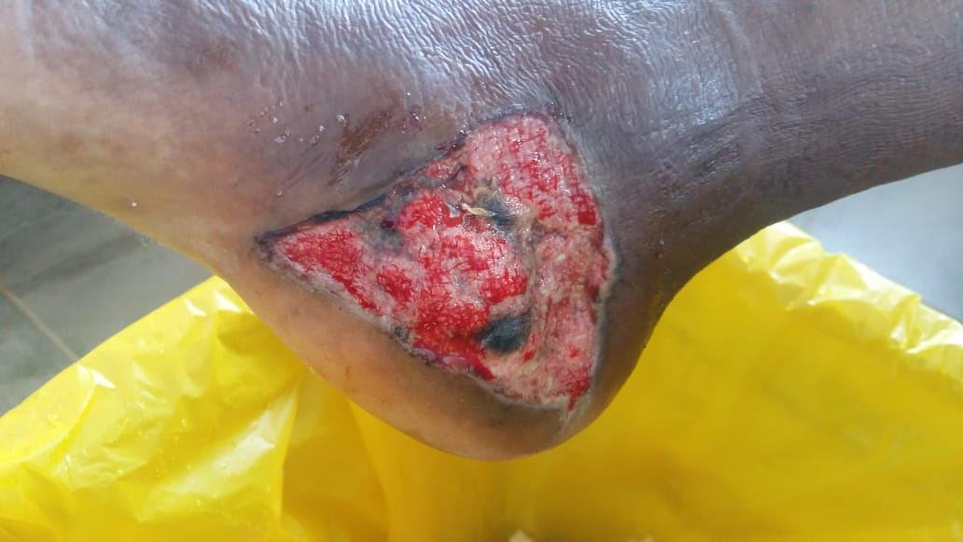
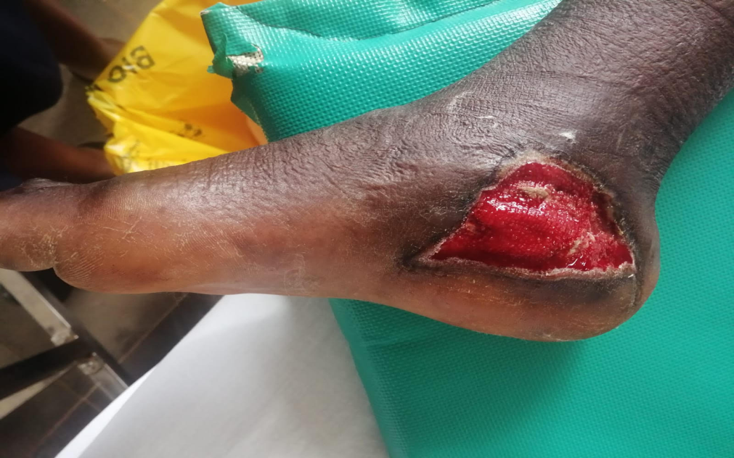
Results cont’d
Top left: Necrosis developed 2 weeks post surgical toilet.
Bottom left: wound clean after bedside debridement

Slide 9



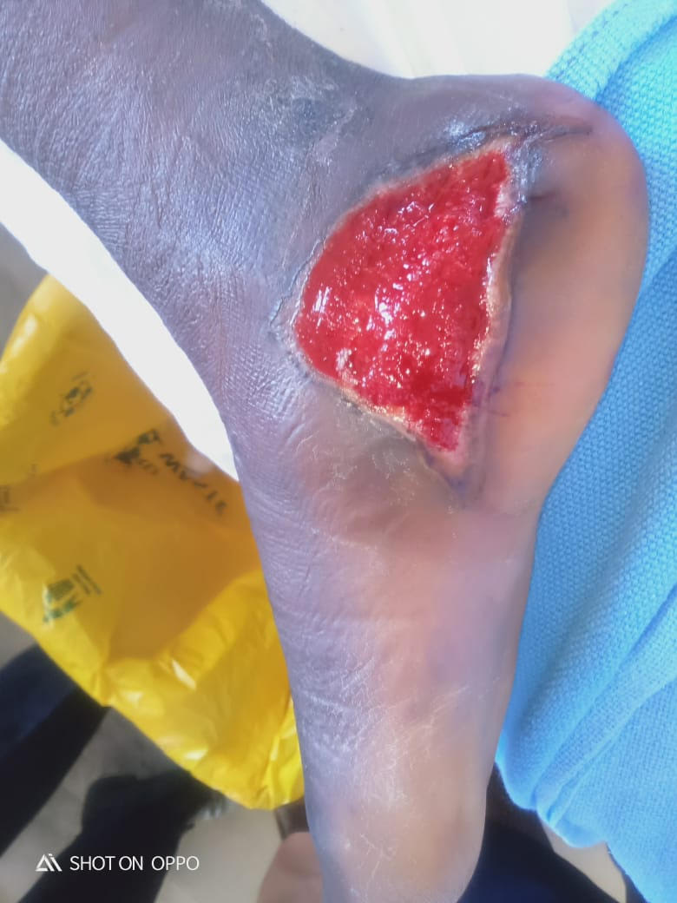
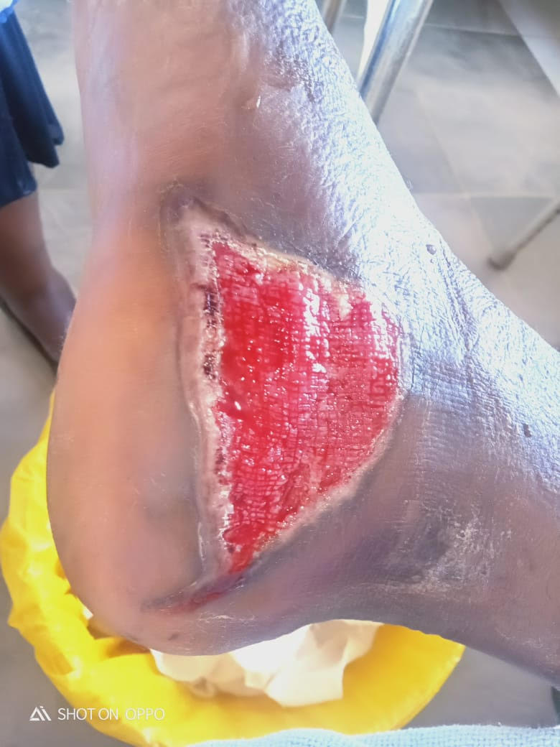
Results cont’d
  Top Left: Granulation achieved and wound ready for grafting.
Bottom Left: Wound healing after patient declined grafting.
Patient discharged through Orthopedic Outpatient Clinic after 6 weeks of admission.

Slide 10
Limitations
Un cooperative patient due to:
  prolonged drug addiction (marijuana abuse).
  Separation from the relatives (patient felt that the relatives are concerned about him).

Slide 11
Conclusion
Superficial uninfected wounds can be treated without the systemic use of antibiotics thus reducing inappropriate use of antibiotics.
This in turn contributes towards slowing down the emergence of AMR.

Slide 12
Acknowledgement
Nyeri County Referral Hospital
Nyeri Medicine Therapeutic Committee
Nyeri County Government
USAID Medicines, Technologies, and Pharmaceutical Services (MTaPS) program

Slide 13


