Slide 1

UTILIZATION OF ANTIBIOTIC PROPHYLAXIS AMONG CAESAREAN SECTION MOTHERS AT THIKA LEVEL 5 HOSPITAL.
DR. SALOME KARURI
CLINICAL PHARMACIST
THIKA LEVEL 5 HOSPITAL
IPNET CONFERENCE
SAI ROCK HOTEL , MOMBASA

Slide 2

INTRODUCTION
Appropriate Antibiotic Prophylaxis (AP) among caesarean section (CS) mothers prevents CS-associated risks of infections or poor CS outcome by about 50%¹
According to the WHO, AP must meet five criteria²:
Indication
Choice of molecule
Dose
Timing
Duration

Slide 3
Methodology
Study Site: Thika Level 5 Hospital
Study population: Enrolled Mothers for C-section SSI surveillance (KHIS system)
Period: Between 1st Oct 2022 to 28th Feb 2023.
Data obtained: Antibiotic prophylaxis:
Antibiotic regimen
Dose
Timing
Duration of therapy

Slide 4
Findings
Consideration | Consideration | Current Practice
1 | Regimen | IV Ceftriaxone 2g (3rd Generation cephalosporin) + IV Metronidazole 500mg
2 | Dosing | Standard dosing for all patients 2g ceftriaxone single dose + 500mg metronidazole single dose
3 | Time of Admin | Varying time of administration.

Slide 5
Were Pre-Op Antibiotics administered
 | Oct 22 | Nov 22 | Dec 22 | Jan 23 | Feb 23 | Total
Yes | 137 91% | 197 95% | 162 99% | 142 100% | 145 100% | 783 96.8%
No | 13 9% | 11 5% | 2 1% | 0 0% | 0 0% | 26 3.2%
Tot. | 150 | 208 | 164 | 142 | 145 | 809

Slide 6
Timing of APs

Slide 7
Antibiotic Prophylaxis and Post CS Antibiotic Use

Slide 8
Use of Antibiotics Post Caesarean Section by Month

Slide 9
Conclusion
96.8% of patients are receiving Aps although mainly 3rd Generation Cephalosporin + Metronidazole
Only 21% of patients have an incision made when the antibiotic is at tissue level (between 30-60 min of AP administration)
IV antibiotics Post Op declining , 93.5% of patients receive IV post-op antibiotics without an indication, 78% of patients are discharged on oral antibiotics
The findings indicate gaps for quality improvement focusing on AP regimen, timing and elimination of post-OP antibiotics without an indication
Notes:
“it is possible if we are willing to support the process of change” Aiken et al

Slide 10
References
1. Compliance with antibiotic prophylaxis guidelines in surgery 2021 N. Prevost et al
2. WHO Prophylactic Antibiotics for Women Undergoing Caesarean Section. Geneva, Switerland 2021
3. Changing use of surgical antibiotic prophylaxis in Thika Hospital, Kenya. AM Aiken et al

Slide 11
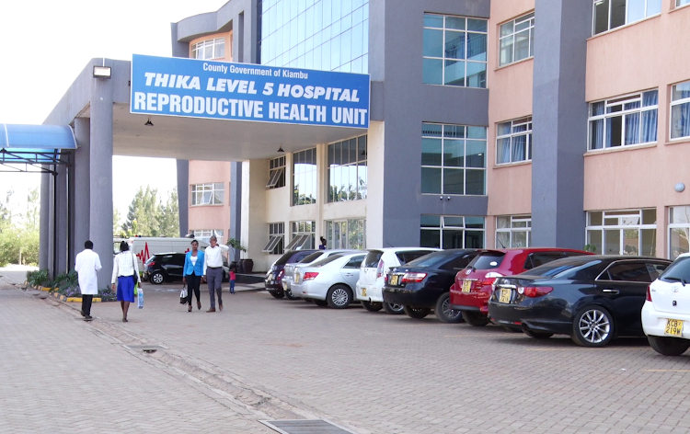
Acknowledgements
Kiambu County Government
Thika Level 5 administration
Thika Level 5 staff: IPC, AMS
I-TECH

Slide 12
Thank you!
This work is supported by US Centers for Disease Control and implemented in collaboration with the Ministry of Health and Kiambu County Health Department. The findings and conclusions in this presentation are those of the author(s) and do not necessarily represent the views of the Centers for Disease Control and Prevention/Agency

