Slide 1
ACTIVE AND PASSIVE SURVEILLANCE FOR SURGICAL SITE INFECTIONS AT KITALE COUNTY HOSPITAL
IPNET CONFERENCE
SAI ROCK HOTEL MOMBASA

Slide 2
Background for Surgical Site Infections (SSIs) and SSI surveillance
Hospital Acquired Infection (HAI) common patient safety adverse event
True HAI burden unknown;
Difficulty to gather reliable data
Estimated 100 million/ year
Globally, SSI leading reported HAI
No reliable reporting systems in LMIC
Need for surveillance

Slide 3
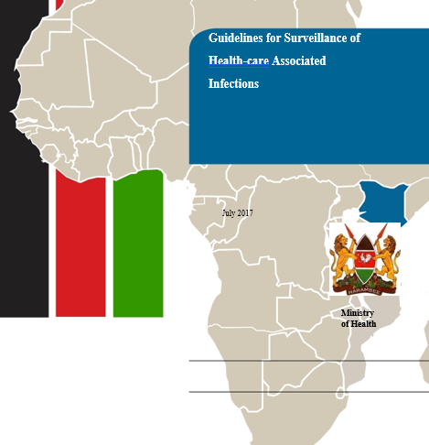
Objectives for SSI Surveillance
Strategic Priority 6 of national *HAIs guidelines
  Surveillance and Notification System; and Research
  Objective 1:To establish a Surveillance and notification system for HAIs and AMR in health care settings.
Describe the rates of SSI following CS
Strengthen and monitor implementation of IPC measures in prevention of CS SSI
DRAFT GUIDELINES

Slide 4
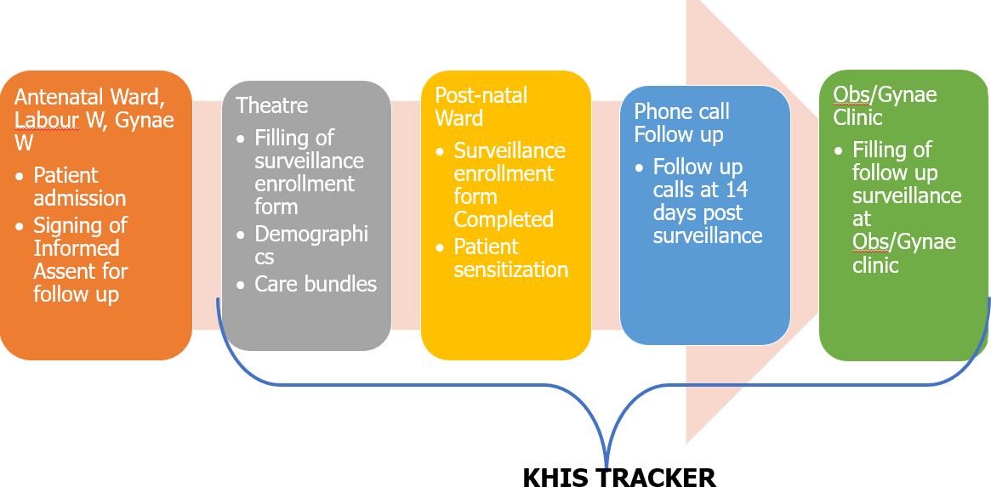
Active and Passive Surveillance Process
Active Surveillance
Passive Surveillance
Registration post c/s in MOH 384
Monthly summary to KHIS aggregate (MOH 749)

Slide 5


SSI surveillance review process
Retrospective review of records
  KHIS tracker data
  KHIS aggregate data; MOH 711 and 749
  MOH 384; SSI Peri-operative register
Variables
  Number of C/S
  Number of SSIs
Summary using proportions

Slide 6
Enrollment rates for each surveillance
Month | Number of C/S done | Enrolled for Active (%) | Enrolled for passive (%)
October | 104 | 78(75) | 121(116)
November | 78 | 76(97) | 83(106)
December | 127 | 101(80) | 130(129)

Slide 7
SSI rates per surveillance type
Month/surveillance type | Number enrolled | Number of SSI | Propotion (%)
October Active Pasive | 78 121 | 3 0 | 3.8 0.0
November Active Pasive | 76 83 | 4 3 | 5.3 3.6
December Active Pasive | 101 130 | 1 2 | 1.0 1.5

Slide 8
Conclusion
Enrollment rate varied between the two systems
SSI rates estimated by both systems
SSI rate were under-estimated in passive surveillance except December
  Clients follow up helps identify more SSIs

Slide 9
Recommendation
Regular data review meetings to identify strength and gaps
Reconcile data before uploading to KHIS aggregate
Integrate the two systems for reliable estimates
Possibly introduce a follow-up/revisit register

Slide 10




Acknowledgement

