Slide 1
IPNET-ICAN IPC PROJECT EXPERIENCE
CYNTHIA ODHIAMBO
29TH JANUARY, 2021

Slide 2
Overview
Introduction
Dashboard
Achievements
Challenges
Lesson Learnt

Slide 3
INTRODUCTION
During the COVID-19 pandemic, alot of IPC training was done but we did not know whether the HCW have implemented the IPC measures learnt.
Therefore, the IPC assessment process was to find out where there is still gaps and to assist each and every facility to handle COVID 19 and other IPC related issues
The Project covered 45 primary health facilities in 15 counties with 11 monitors
Monitors together with the County IPC coordinator or the sub county IPC co-ordinator visited the facilities after every two weeks

Slide 4
Facilities Monitored:
NAKURU COUNTY
FITC health Center – 4 visits
Mai Mahiu Health Center – 4 visits
KEY:
SIAYA COUNTY
Marenyo Health Center – 5 visits
Ligega Health Center – 5 visits
Lieta Dispensary – 5 visits
Done, available or desired outcome |  | In progress
Not done or available, or not right |  | Not applicable/Not assessed

Slide 5
F1 HEALTH CENTER DASH BOARD AS AT 9/12/2020 – ……. COUNTY
INDICATORS | 1ST VISIT | 2ND VISIT | 3RD VISIT | 4TH VISIT | 5TH VISIT
Triage Area
Triage area is outdoors | Yes | yes | yes | yes | yes
Availability of clear signage in Triage | no | no | yes | yes | yes
Well ventilated triage | yes | yes | yes | yes | yes
Recent case definition | no | no | yes | yes | yes
Trained personnel in triage | no | no | yes | yes | no
Adequate screening tools in triage | no | no | Yes | yes | yes
Hand Hygiene station available with water | no | yes | Yes | yes | yes
Hand hygiene station has soap | no | no | Yes | yes | yes
AHBR (if no water) | no | yes | No | yes | yes
Hand Hygiene compliance in triage | 0% | 40% | 50% | 50% | 80%
Functional thermometer | no | yes | Yes | yes | no
Mask use | 10% | 50% | 67% | 78% | 76%
Inside facility
Hand Hygiene station available with water | yes | yes | Yes | yes | yes
Hand hygiene station has soap | no | yes | Yes | yes | yes
AHBH (if no water) | yes | no | Yes | yes | yes
Hand hygiene performed correctly & at all times needed | no | no | No | no | no
Masks available | yes | no | Yes | yes | yes
Masks used 100% by HCWs during patient contact | yes | yes | yes | yes | yes
Wash
Disinfectant available | yes | yes | yes | yes | yes
Solutions made correctly | no | yes | yes | yes | no
Cleaning compliance
At least 2 buckets available | yes | yes | yes | yes | yes
Color coded mops available | no | no | no | no | no
Etc.—Add other indicators

Slide 6
Observation from the Dashboard:
Most of the facilities do not have trained personnel at the triage area
Supply of soap and ABHR is not consistent
Color coded clothes is still a challenge
Improvement on hand hygiene compliance in most facilities
There is consistent supply of disinfectants
Clear signage in all the triage areas

Slide 7
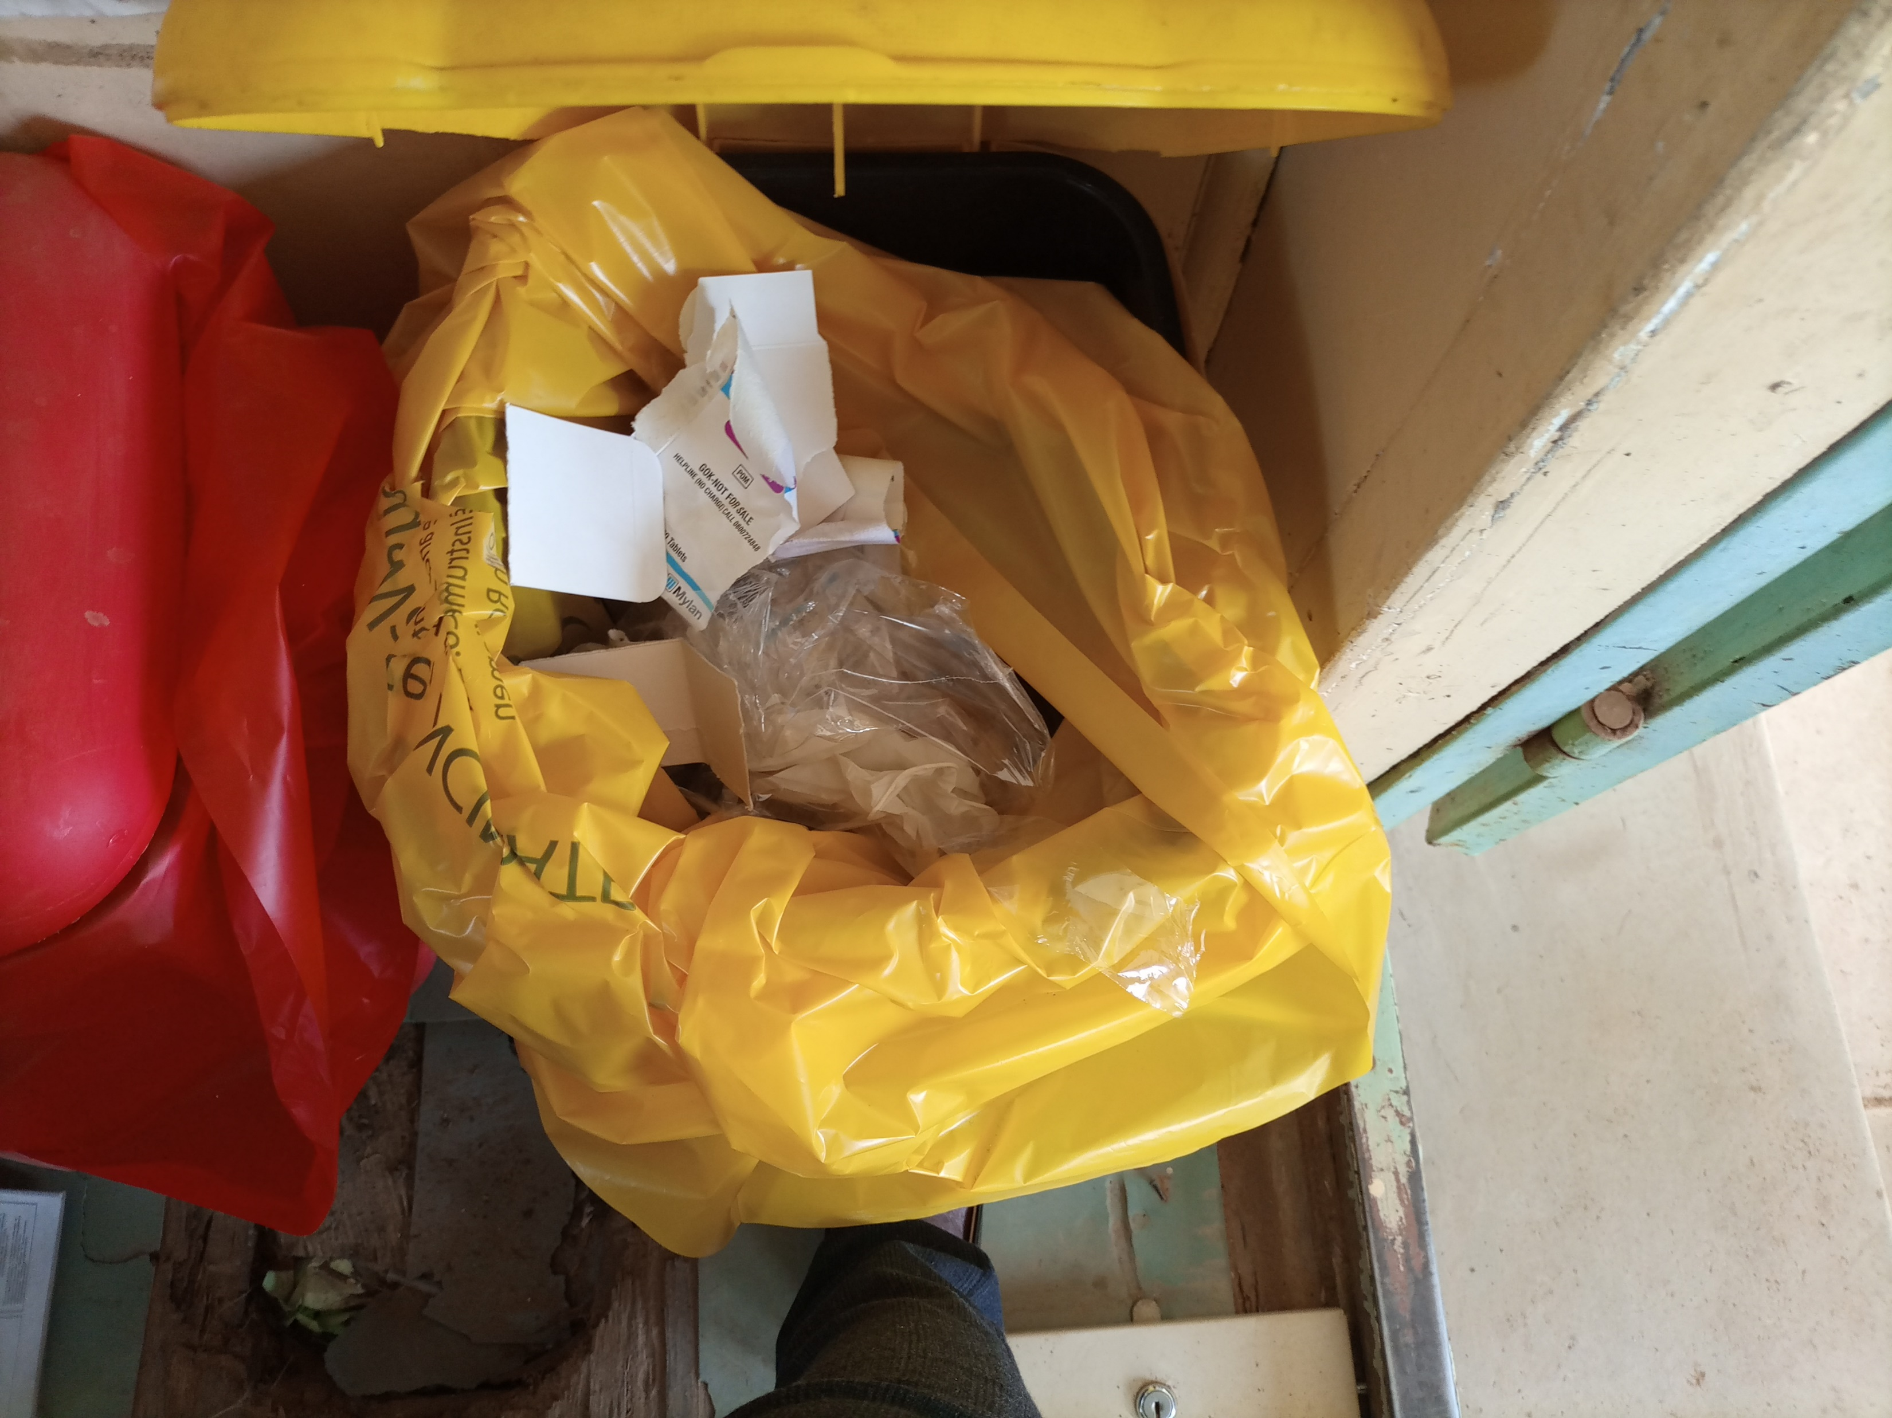
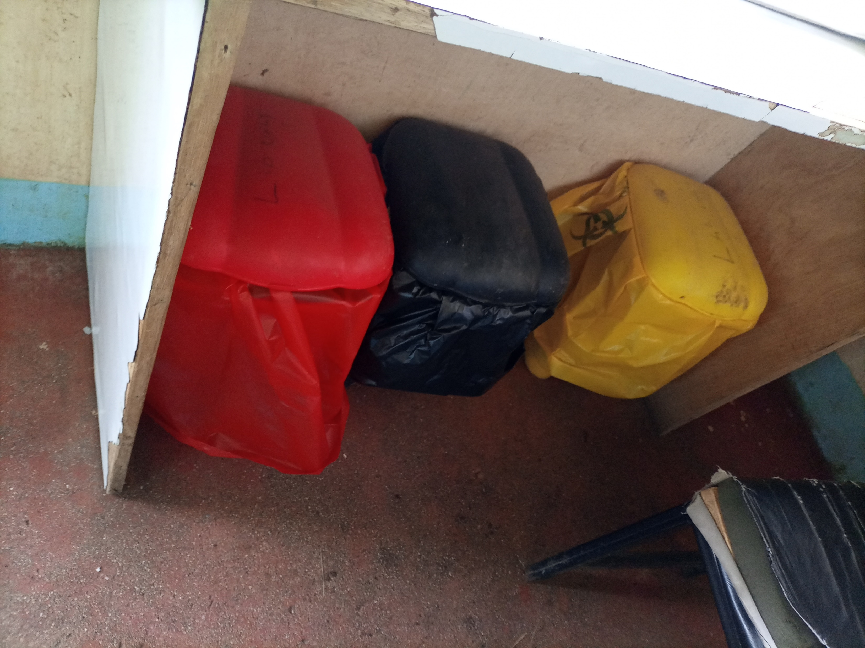
ACHIEVEMENTS
BEFORE
AFTER

Slide 8
ACHIEVEMENTS
BEFORE
No latest case definition for COVID 19 at the triage area
No COVID 19 screening at the triage area only temperature taken
Low hand hygiene compliance at the triage area and inside the facilities
No SOPs on IPC posted on the wall
AFTER
All the facilities have latest case definition for COVID 19 at the triage area
All the facilities are now screening for COVID 19, a stamp introduced to assist in the same
Hand hygiene compliance has tremendously increased in most of the facilities
SOPs and job aids are posted on the walls

Slide 9
CHALLENGES
Under supply of IPC resources
High staffs turnover
Poor road accessibility to some primary health facilities
Different attitude among some individuals
The Health workers industrial strike

Slide 10
LESSON LEARNT
Working together with the county, sub-county and facility has led to ownership of the project.
Creating a good rapport with the HCW and the support staffs proved to be the best strategy
CMEs and OJT was one of the key fundamentals for the success of the project
In cooperating the support staffs in some of the CMEs and OJT more so in IPC was key
Community involvement was very important i.e. CHVs

Slide 11


