Slide 1
National Biosafety Programs: Enhancing biosafety and biosecurity within medical laboratories to mitigate infections with SARS CoV-2
Frankline O. Mboya
DGHT –Lab and HSS Pillar
CDC-Kenya
9th infection prevention network Kenya conference
24th March 2022
Lake Naivasha Resort

Slide 2

Outline
Biosafety and biosecurity program in Kenya
Enhancing biosafety and biosecurity within medical laboratories
WHO and CDC guidance
Risk Management
Biosafety refresher trainings.
Biosafety guidance
  General guidance
  Routine diagnostic testing
  Decentralized POCT testing
  Aerosol Generating Procedures
  Virus isolation procedures
  Decontamination
  Waste Management
  Packaging and shipping of samples
References

Slide 3
Management and business programs
National legal and regulatory framework:
  A national Biosafety unit within NPHLS fully operational and coordinates biosafety implementation in Kenya
    Several Acts: The occupational safety and health Act 2007, The public health Act, Cap. 242, The environmental management and coordination Act, 1999, The work injury and benefits Act, 2007, The Biosafety Act 2009 that led to the establishment of National Biosafety Authority
      National IPC policy and guidelines
      National healthcare waste management plan and guidelines
      National TB Biosafety guidelines
c) Facility level
  Laboratory biosafety officers appointed
  IPC/Biosafety committees or focal persons
d) Trainings
  Biosafety trainings for lab personnel
  Safe Phlebotomy- addressing injection safety needs
  Health care waste Management- HCWs and Waste handlers

Slide 4
Biosafety Implementation Strategies
  1. Management and business programs
    National
      Legal framework
      Policies
      Coordination
      Facility
        In collaboration with countys.
  2. Specific safety programs
    Facility design
    Equipment management program
    Safe work practices
    Occupational health programs
    Waste management program including Chemical waste mgt efforts e.g. GTC waste
  3. Implementation
    Lab quality systems strengthening through accreditation which considers biosafety as core
    Trainings and capacity building
    Technical support at policy development, dissemination and implementation

Slide 5



Management
Administrative Controls
Effective Bio risk Management
Science
Risk Assessment,
SOPs, etc
Engineering
Facility design, HVAC,
Equipments, BSCs, etc
Notes:
Bio risk: Combines Biological agent risks and Biological security risks
Risk Management is the corresponding process of selecting appropriate containment measures to ensure that biohazards are properly controlled.

Slide 6
Enhancing biosafety and biosecurity within medical laboratories
Many global health bodies have highlighted that COVID-19 outbreak could be hazardous to health-care professionals.
Most health care workers were afraid of handling patients and respiratory specimens.
WHO and other health agencies developed interim recommendations on biosafety measures to minimize risk of COVID 19 infections.
NPHL in collaboration with other agencies sanitized Lab staff and other health care workers on COVID 19 measures and guidance.

Slide 7
WHO and CDC GUIDANCE
Interim Guidelines for Biosafety and COVID-19 | CDC
Laboratory biosafety guidance related to coronavirus disease (COVID-19) (who.int)

Slide 8
Refresher training
Biosafety refresher trainings in the Context of COVID-19
Session | Institution/Counties | Total
Special VL/EID Lab training | AMPATHPlus care laboratory-Eldoret, Coast General Hospital, KEMRI Alupe -HIV lab, KEMRI HIV Lab- Kisumu, KEMRI HIV Lab- Nairobi, KEMRI/WRP CRC Lab Kericho, National HIV Reference Laboratory, Nyumbani Diagnostic Laboratory Staffs | 100
16th April 2020
Session 1, June 11th | Siaya, Migori, Busia, Kwale | 132
Session 2, 15th June | Nairobi, Kajiado, Mombasa | 56
Session 3, 17th June | Kisumu, Kisii, Homabay, Bungoma | 268
Session 4, 18th June | Kitui, Kilifi, Bomet, Baringo, Elgeyo Marakwet | 169
Session 5, 25th June | Murang’a, Kiambu, Kirinyaga, Machakos | 354
Session 6,July 1st | Isiolo, Wajir, Makueni, Kericho, Nandi | 207
Session 7,July 7th | Embu, Turkana, Garissa | 99
Session 8,July 9th | Nyandarua, Taita Taveta, Tharaka Nithi, Nakuru, Meru | 180
Session 9, July 14th | Tranzoia, West Pokot, Laikipia | 54
Session 10, July 16th | Samburu, Kakamega, Nyeri, Vihiga | 43
Session 11, August 13th | Kakamega, Vihiga, Uasin Gishu, Samburu, Lamu, Mandera, Marsabit, Tana River | 130
Session 12, August 19th 2020 | Nairobi County (Retake to cover those missed previously) | 148
Session 13, October 21st, 2020 | Bungoma CRH, prisons facilities, FBOs facilities | 118
Overall | 47 counties and VL/EID labs | 2058
Coordinated by the National Biosafety biosecurity unit at the NPHL
Done using the pool of TOTs trained through the PEPFAR program
County and facility level support through the PEPFAR implementing partner
Adequate support for the National and County Teams leading to training success
Participation and training completion done through an individual knowledge assessment

Slide 9
Biosafety refresher training implemented virtually
All participants assessed and training documented.
Database available at the National Biosafety office and shared with the county Lab coordinators

Slide 10
GENERAL LABORATORY BIOSAFETY GUIDANCE - CDC
Perform a site-specific and activity-specific Risk Assessment to identify and mitigate risks based on:
  Procedures to be performed
  Hazard identification
  Personnel competency level
  Laboratory equipment and facility
  Available resources, such as PPE and disinfectant
Use Standard Precautions to handle all clinical specimens.
  Hand hygiene
  PPE such as laboratory coats or gowns, gloves, and eye protection
  If potential for aerosol generation, use Class II BSC or additional PPE such as mask or face shield
Follow routine laboratory practices and procedures for decontamination of work surfaces and management of laboratory waste.
https://www.cdc.gov/coronavirus/2019-nCoV/lab/lab-biosafety-guidelines.html

Slide 11
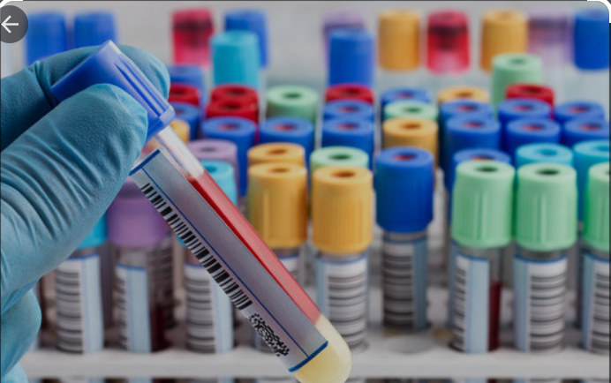
ROUTINE DIAGNOSTIC TESTING
Work in a BSL-2 laboratory, following Standard Precautions for:
  Using automated instruments and analyzers.
  Initial processing of specimens
    Considerations for Biosafety Cabinet (BSC) use is included in following slides
  Staining and microscopic analysis of fixed smears
  Pathologic examination and processing of formalin-fixed or otherwise inactivated tissues
  Packaging sealed, decontaminated primary containers with specimens for transport to diagnostic laboratories.
  Handling specimens inactivated in nucleic acid extraction buffer.
  Performing electron microscopic studies with glutaraldehyde-fixed grids
  Performing routine antibody or antigen detection tests
  https://www.cdc.gov/coronavirus/2019-nCoV/lab/lab-biosafety-guidelines.html#testing

Slide 12

DECENTRALIZED AND POINT-OF-CARE TESTING
For procedures with a high likelihood to generate aerosols or droplets, use either a certified Class II Biological Safety Cabinet (BSC) or additional precautions to provide a barrier between the specimen and personnel (CDC).
  Procedures associated with generation of infectious aerosols or droplets include centrifugation, pipetting, vortexing, mixing, shaking, removing caps, aliquoting specimens, spilling specimens, cleaning up spills.
Initial processing (before inactivation) of all specimens, including those for sequencing and NAAT, should take place in an appropriately maintained and validated BSC or primary containment device (WHO).
https://www.cdc.gov/coronavirus/2019-ncov/lab/biosafety-faqs.html
https://www.cdc.gov/coronavirus/2019-nCoV/lab/lab-biosafety-guidelines.html#decentralized
https://apps.who.int/iris/bitstream/handle/10665/331138/WHO-WPE-GIH-2020.1-eng.pdf

Slide 13
AEROSOL AND/OR DROPLET GENERATING PROCEDURED
Activities with a high likelihood of generating aerosols or droplets, use either a certified Class II Biological Safety Cabinet (BSC) or additional precautions to provide a barrier between the specimen and personnel.
Additional precautions for reducing the risk of exposure to laboratory personnel may include:
  Surgical mask, face shield, or other physical barriers such as a splash shield
  Centrifuge safety cups
  Sealed centrifuge rotors
https://www.cdc.gov/coronavirus/2019-nCoV/lab/lab-biosafety-guidelines.html
Notes:
Additional precautions to provide a barrier between the specimen and personnel

Slide 14
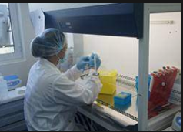
VIRUS ISOLATION
Biosafety Level 3 (BSL-3) laboratory using BSL-3 practices is necessary for virus isolation in cell culture and initial characterization of viral agents recovered in cultures of SARS-CoV-2 specimens.
Site- and activity-specific biosafety risk assessments determine if additional biosafety precautions are necessary based on situational needs.
https://www.cdc.gov/coronavirus/2019-nCoV/lab/lab-biosafety-guidelines.html#isolation
https://www.who.int/publications-detail/laboratory-biosafety-guidance-related-to-coronavirus-disease-2019-(covid-19)
Notes:
Virus isolation in cell culture and initial characterization of viral agents recovered in cultures of SARS-CoV-2 should be conducted in a BSL-3 laboratory using BSL-3 practices

Slide 15
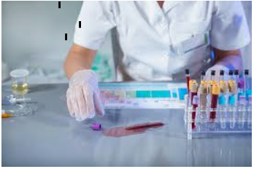
DECONTAMINATION
Decontaminate work surfaces and equipment using disinfectants known to be effective against SARS-CoV-2 (e.g., US EPA registration list).
  Follow manufacturer’s recommendations for concentration, contact time, and safe handling.
WHO guidance: Use disinfectants with proven activity against enveloped viruses such as hypochlorite (bleach), alcohol, hydrogen peroxide, quaternary ammonium compounds and phenolic compounds
https://www.epa.gov/coronavirus/about-list-n-disinfectants-coronavirus-covid-19-0
.

Slide 16
Waste Management
Handle laboratory waste from testing suspected or confirmed SARS-CoV-2 patient specimens as all other biohazardous waste in the laboratory.
Note that because Cepheid GeneXpert cartridges for SARS-CoV-2 contain guanidinium thiocyanate (GTC), high temp incineration is recommended for proper disposal.
Currently, there is no evidence suggesting additional packaging or disinfection procedures are necessary.
https://www.cdc.gov/coronavirus/2019-nCoV/lab/lab-biosafety-guidelines.html#lab-waste
https://www.who.int/publications-detail/laboratory-biosafety-guidance-related-to-coronavirus-disease-2019 (covid-19)

Slide 17
PACKING AND SHIPPING SAMPLES
Follow the International Air Transport Association (IATA) Dangerous Goods Regulations (DGR).
  Patient specimens from suspected or confirmed cases to be used for diagnostic or investigational purposes should be packaged and transported as UN3373, “Biological Substance Category B.”
  Personnel packing, and shipping patient specimens, cultures or isolates, must be trained in the regulations for Division 6.2.
Viral cultures or isolates should be transported and packed as Category A UN2814, “infectious substance, affecting humans.” (WHO)
https://www.cdc.gov/coronavirus/2019-nCoV/lab/lab-biosafety-guidelines.html#specimen https://www.iata.org/contentassets/90f8038b0eea42069554b2f4530f49ea/covid-19-dangerous-goods guidance.pdf

Slide 18
Acknowledgement
MOH, National public health laboratory biosafety and biosecurity unit.
All 47 county governments
US Center for Disease Control and prevention
Team of TOTs form MOH, county, CDC, AMREF, TB ARC
All PEPFAR implementing partners

Slide 19
Resources
WHO:
  World Health Organization. Coronavirus disease (COVID-19) technical guidance: surveillance and case definitions https://www.who.int/emergencies/diseases/novel-coronavirus-2019/technical-guidance/surveillance-and-case-definitions
  Laboratory biosafety manual, 3rd ed. Geneva: World Health Organization; 2004 https://www.who.int/csr/resources/publications/biosafety/Biosafety7.pdf?ua=1, accessed 14 February 2020
  Guidance on regulations for the transport of infectious substances 2019 – 2020 https://www.who.int/publications-detail/WHO-WHE-CPI-2019.20
US CDC
  COVID-19: https://www.cdc.gov/coronavirus/2019-ncov/index.html
  CDC COVID-19 Biosafety FAQs: https://www.cdc.gov/coronavirus/2019-ncov/lab/biosafetyfaqs.html
  ABSA International SARS-CoV-2/COVID-19 Toolbox https://absa.org/covid19toolbox/
Africa CDC
  COVID-19: https://africacdc.org/covid-19/covid-19-resources/

