Slide 1
Mapping Generation and Disposal of Guanidinium Thiocyanate( GTC) waste in GeneXpert Sites in Kenya :
A feasibility study
^{1,2} ELvis Kirui, ¹Noel Odhiambo, ¹Kenneth Ouma, ¹Dennis Wanyama, ²Kennedy Yatich, ³ Junghae Muthoni, ³Mercy Njeru, ²John Kiiru
1 Africa Medical Research Foundation (AMREF) - Kenya
2 Ministry of Health – Department of Laboratory Services (DLS) – Kenya
3 Centres for Disease Control and Prevention
Presenter: Elvis Kirui

Slide 2
Background
GeneXpert (Cepheid, CA, USA) is rapid molecular automated diagnostic near point-of-care platform
It is widely implemented for detection of:
  Tuberculosis (TB)
  Viral load (VL)
  Severe acute respiratory syndrome coronavirus 2 (SARS-CoV-2)
  Early Infant Diagnosis (EID)
The equipment gives results within two hours after starting the test, with minimal hands-on technical time

Slide 3
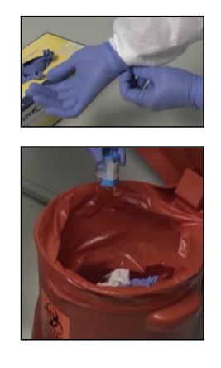
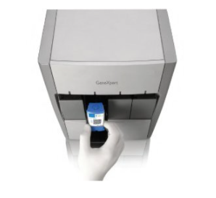
Background cont.
Currently, Kenya has about 223 GeneXpert platforms in public health, private and faith based facilities
Waste generated from GeneXpert cartridges contains a GTC, which is considered a health hazard and requires high temperature incineration for disposal

Slide 4
Problem statement
In Kenya, reagents containing GTC residues have been in use since 2008 when EID/VL testing started at KEMRI
The number of VL/EID testing laboratories has increased to 12 with additional 38 HIV point of care (POC) and about 223 GeneXpert sites that generate a significant amount of waste containing GTC
Molecular testing scale-up locally and globally waste management is becoming a growing challenge
Current MOH GX-LIMS data indicates that the GeneXpert diagnostic platform for Tuberculosis (TB)responsible for over 360, 000 TB tests annually (GX-LIMS)

Slide 5
Justification
Currently, there is no standard way of disposing of waste-containing GTC in the country
Majority of laboratories drain the liquid waste GTC down the sinks into sewer lines while others dispose of the cartridges through incineration and waste burning chambers
The study sought to evaluate the current GTC waste generated by the GeneXpert platforms and quantify average waste per test

Slide 6
Objectives
1. Map the health facilities with GeneXpert platform and generate GTC waste
2. Quantify GTC waste generated by GeneXpert platform in 2021

Slide 7
Study design , Study site and Data collection
This is a Retrospective study with chart abstraction
Data on GeneXpert testing and waste disposal platform was abstracted from the
  National testing database GXlims
  Viral load
  EID database
  National covid-19 database
Study period: January to March 2021

Slide 8
Data management
The abstracted data was cleaned and analyzed using MS Excel and STATA (Stata Corp. 2019; Stata Corp LLC., College Station, TX, USA)
Descriptive statistics
  Means and standard deviation continuous data
  Frequencies and proportions for categorical data
  Data was presented in tables and graphs

Slide 9
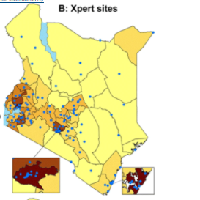
Results
Out of 223 GeneXpert platform 185(85%) reported to utilize for TB, 37(11%) SARS-CoV-2, 26(12%), EID and VL 24(11%)

Slide 10
Results
A total of 332,053 cartridges was utilized in testing in 2021
The mean (sd) waste generated per test was 1,780(1082.2) for TB, 539(1221.0) SARS-CoV-2, 178(241.7) EID and 461(644.4) VL
Test | Mean(SD)
TB | 1,780(1082.2)
SARS-CoV-2 | 539(1221.0)
EID | 178(241.7)
VL | 461(644.4)

Slide 11
Discussion
  Lack of Waste management standard operating procedures and job aids in facilities with Genexpert platform lead to improper waste disposal practices like pouring liquid chemical waste down the drain.
  Deducing from some African countries has estimates that the VL tests would translate to approximately 175,000 kg, of solid waste and 77,000 liquid chemical waste per annum as per Sleeman et al. (2018),

Slide 12
Conclusion
  Kenya currently utilizing GeneXpert platform for four different tests hence increase in the generation of wastes in terms of the number of cartridges which are hazardous

Slide 13
Recommendations
  National policy and guidelines on proper disposal and management of cartridges which contain the heath hazardous waste GTC

Slide 14
Acknowledgement
MOH-Kenya
County Health facilities
CDC- Kenya
AMREF Africa

Slide 15
Thank you

