Slide 1
Kenya’s adoption of the WHO multimodal infection prevention and control (IPC) strategies to respond to COVID-19
Daniel Kimani, MBChB, MPH, PhD
US Centers for Disease Control and Prevention (CDC)
9th IPNET Conference
Lake Naivasha Resort
Thursday, March 24th 2022

Slide 2
BACKGROUND
WHO advocates using a multimodal approach (multiple approaches in combination) to achieve:
  Behavior change of HCW
  Quality improvement of infection prevention and control (IPC) measures.
  Improved patient outcomes
  Organizational culture change
Needs to be linked with objectives of quality improvement programs and accreditation bodies.
Targeting only one area (i.e. unimodal), is highly likely to fail.
  All five areas should be considered, and necessary action taken, based on the local context and situation informed by periodic assessments.

Slide 3
1. Build it (systems change)
The system change needed to enable IPC practices including infrastructure, equipment, supplies and other resources (Enabling environment).
What infrastructures, equipment, supplies and other resources are required?
Does the physical environment influence health worker behavior?
Are certain types of health workers needed to implement the intervention?
Practical example: when implementing hand hygiene interventions, ease of access to WASH infrastructures (including water and soap) are important considerations.
  Are these available, affordable and easily accessible in the workplace? If not, action is needed.

Slide 4
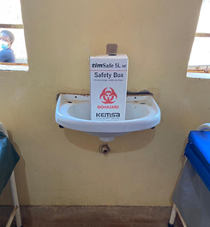
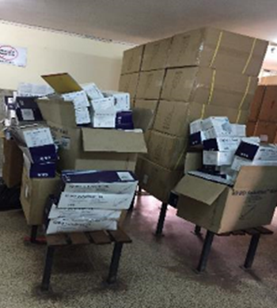
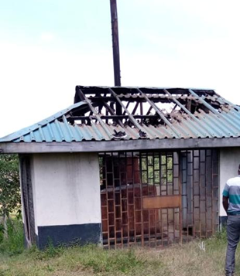
Infrastructure
Hand hygiene facilities
Storage in patient waiting bay
Blown out incinerator

Slide 5
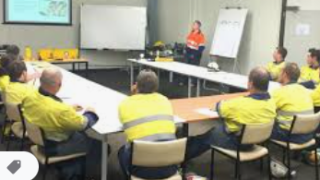
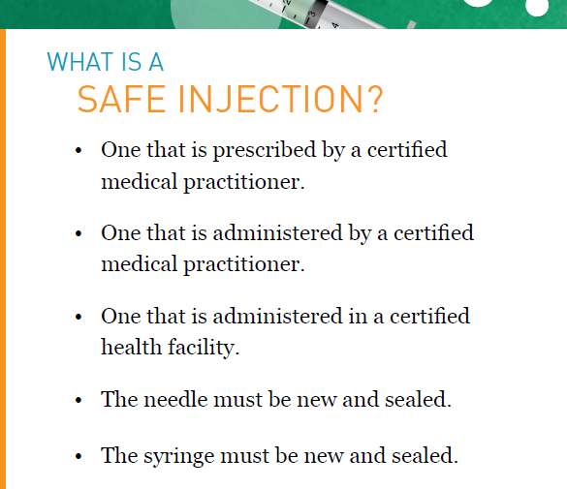
2. Teach it (training and education)
Training and education to improve health worker knowledge
Who needs to be trained?
What type of training and how frequently?
Does the facility have trainers, training aids, and the necessary equipment?
Practical example: when implementing injection safety interventions, timely training of those responsible for administering safe injections, including carers and community workers, are important considerations, as well as adequate disposal methods.

Slide 6
3. Check it (monitoring and feedback)
Monitoring and feedback to assess the problem, drive appropriate change and document practice improvement
How can you identify the gaps in IPC practice or other indicators in your setting to allow you to prioritize your intervention?
How can you be sure that the intervention is being implemented correctly and safely, including at the bedside? For example, are there methods in place to observe or track practices?
How and when will feedback be given to the target audience and managers? How can patients also be informed?
Practical example: When implementing surgical site infection interventions, the use of key tools are important considerations, such as surveillance data collection forms and the WHO checklist (adapted to local conditions).

Slide 7
Hand hygiene compliance
Hospital A
Hospital A
Hospital B

Slide 8
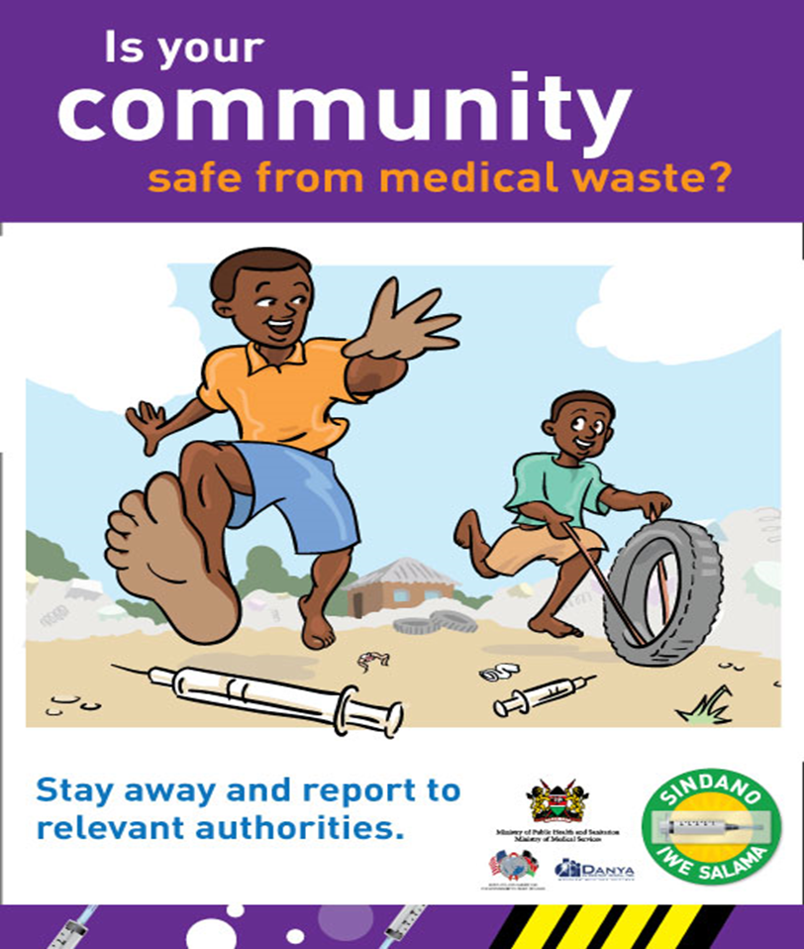
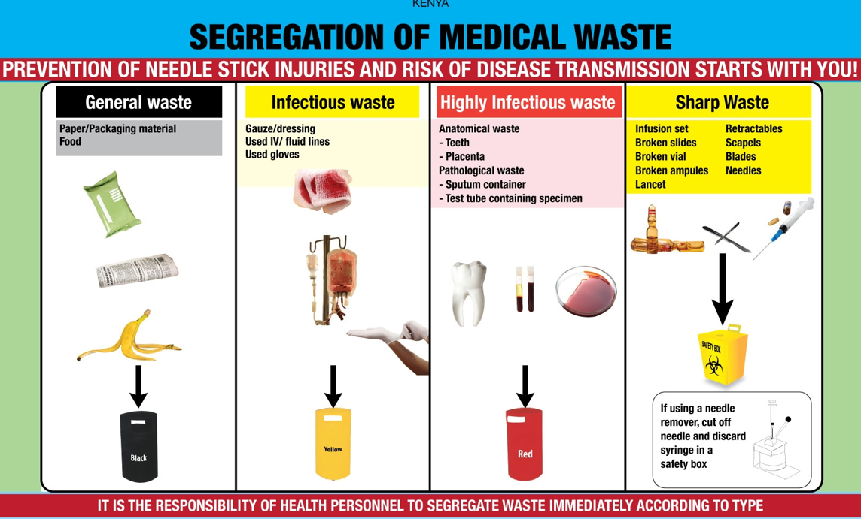
4. Sell it (Reminders and communication)
Reminders and communication to achieve the desired actions at the right time including campaigns
How are you promoting an intervention to ensure that there are cues to action at the point of care and messages are reinforced to health workers and patients?
Do you have capacity/funding to develop promotional messages and materials?
Practical example: when implementing waste management, the use of visual cues to action are important considerations

Slide 9
5. Live it (culture change)
A culture of safety to facilitate an organizational climate that values the intervention, with a focus on involvement of senior managers, champions or role models
Is there demonstrable support for the intervention at every level of the health system?
  For example, do senior managers provide funding for equipment and other resources?
  Are they willing to be champions and role models for IPC improvement?
Are teams involved in co-developing or adapting the intervention? Are they empowered and do they feel ownership and the need for accountability?
Practical example: when implementing hand hygiene interventions, the way that a health facility approaches this as part of safety and quality improvement and the value placed on hand hygiene improvement as part of the clinical workflow are important considerations.

Slide 10
INTERVENTIONS
Kenya adopted the multimodal approach by modifying an existing program to respond to COVID-19 pandemic at:
  National,
  County and
  Facility levels.
A national IPC committee was formed to coordinate COVID-19 IPC program with other arms of the response.
A training curriculum was developed, and trainings cascaded from national to facility level.
Facility risk assessments were carried out.
Data on infected healthcare workers (HCWs) were extracted from the national line list.

Slide 11
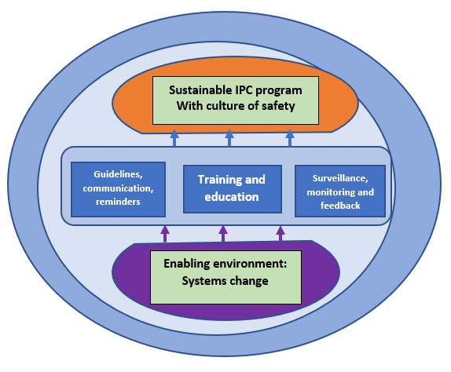

Slide 12
Outcome 1 :Enabling environment
IPC committees from national, county to facility level
The private sector and some agencies procured and fast-tracked local production of:
  IPC supplies including personal protective equipment (PPE),
  hand hygiene supplies and
  disinfectants since they were scarce globally.
    For instance, on July 16th, 2020, the Kenya COVID-19 Fund in partnership with the Equity Group Foundation confirmed training 109 local manufacturers to make PPE .
Separately, counties modified facility infrastructure to:
  improve ventilation,
  avail hand hygiene stations and
  create temporary triage and patient waiting bays to avoid overcrowding.

Slide 13
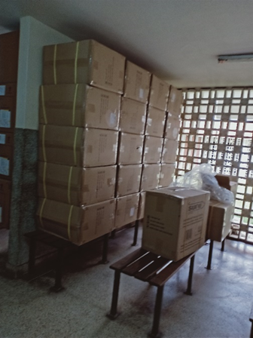

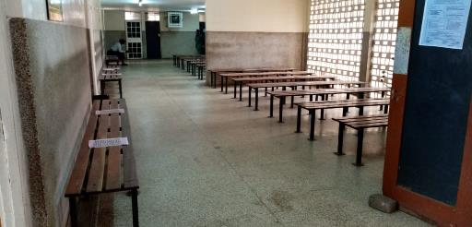
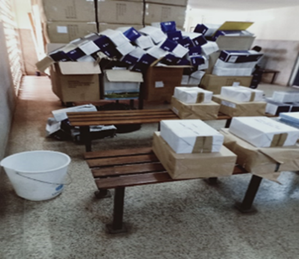
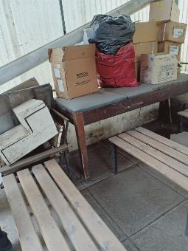
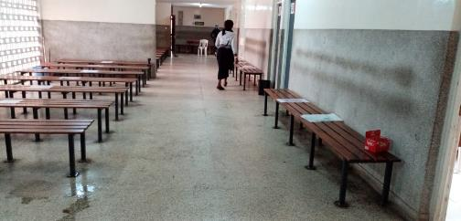
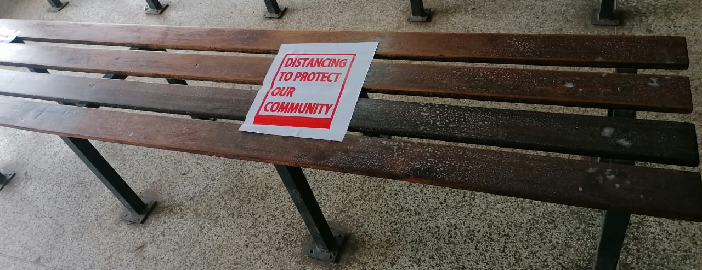
Improving airflow and ventilation
AFTER
BEFORE

Slide 14
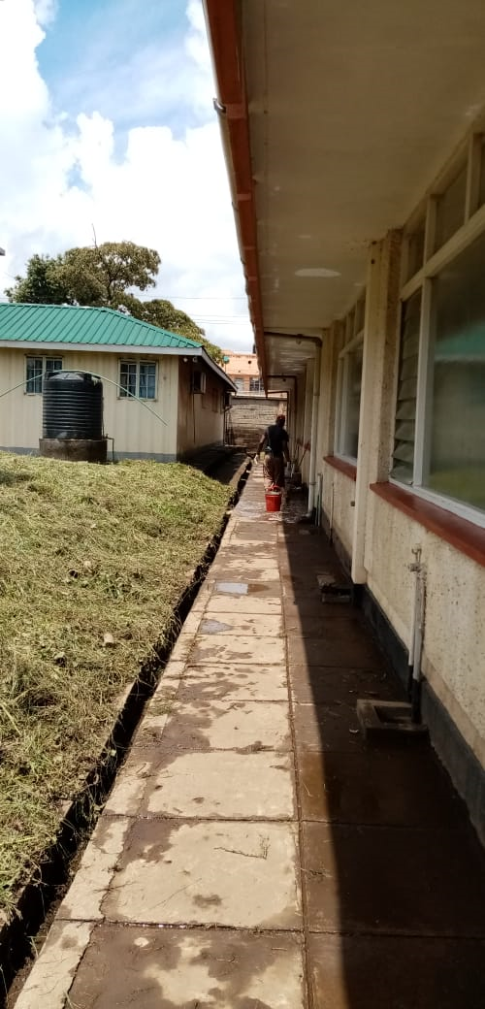
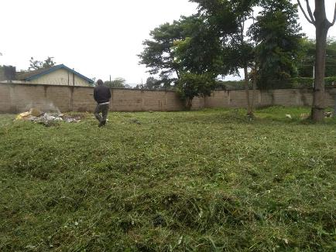
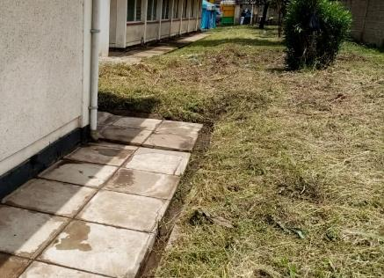

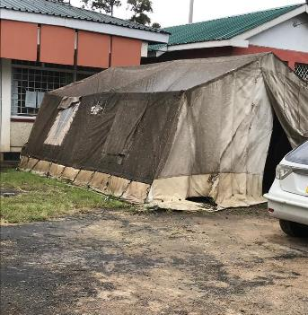
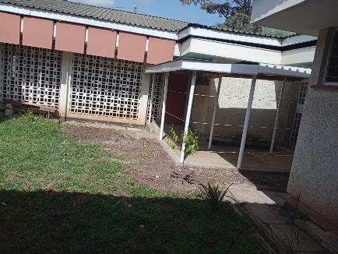
Removal or risky structures and improve workflow
AFTER
BEFORE

Slide 15
Outcome 2: Education and training
Between March and November 2020, 92,541 of 121,500 (76.2%) were trained
  Of these 28.1% received 3 days’ training, 47.4% received a day’s sensitization while 24.5% received virtual training.
COVID-19 biosafety training
  100 laboratory staff from 10 national molecular testing
  2,058 staff from county laboratories were trained.
Ten IPC webinars were held reaching an average of 200 participants per session.
Three IPC sensitization meetings were held for specific groups including:
  drivers,
  chiropractors and
  religious leaders for 50 people.
In addition, 100 HCWs working in refugee settings were trained through a two-webinar series while
550 HCWs from 9 counties were taken through a three-hour refresher IPC training.

Slide 16
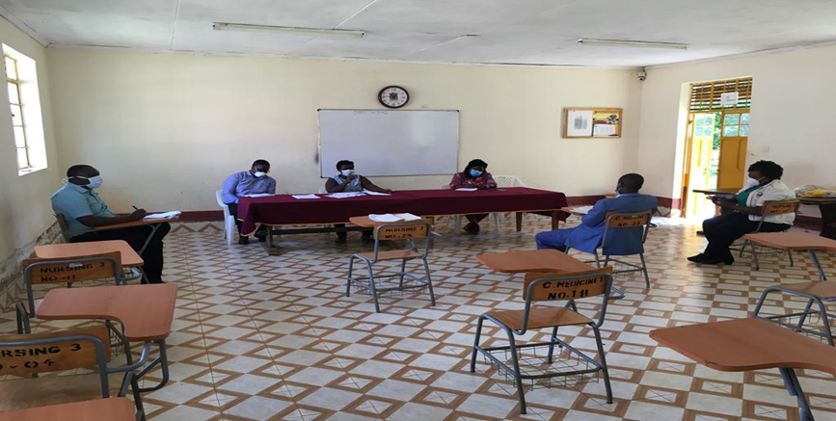
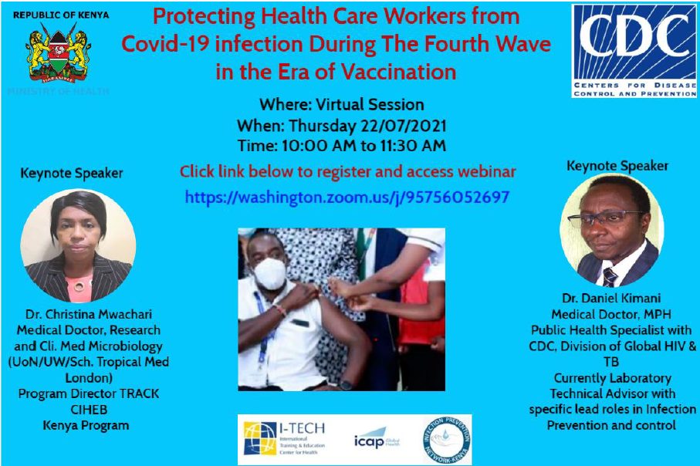
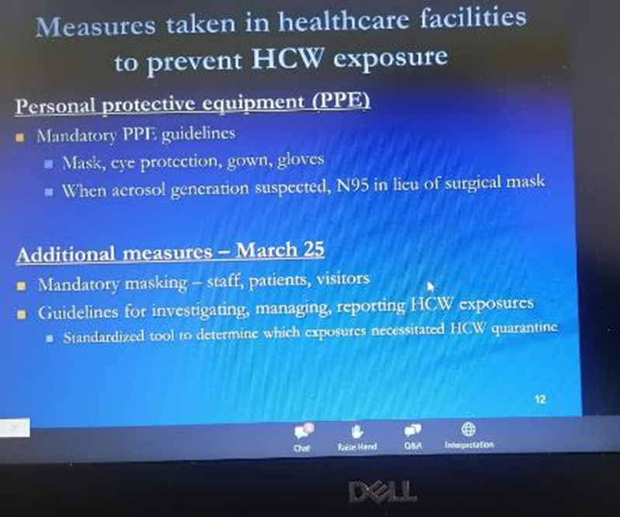

Slide 17
Outcome 3: Guidelines, reminders, and communication:
Between March and June 2020, the team developed or provided technical support to the following guidelines targeting HCWs:
  IPC considerations for healthcare settings;
  setting up quarantine and isolation centers;
  health and safety in the workplace; waste management;
  home-based care;
  safe handling of human remains;
  case management and
  rational use of PPEs.
Posters, banners and brochures with simplified information were translated to local languages targeting the public: understanding COVID-19; hand washing; cough etiquette; and home-based care.
Public health advisories on proper use of masks, use of gloves while in public places and spraying booths were developed.
All these materials were hosted in the MoH website and disseminated through training sessions and other forums.

Slide 18
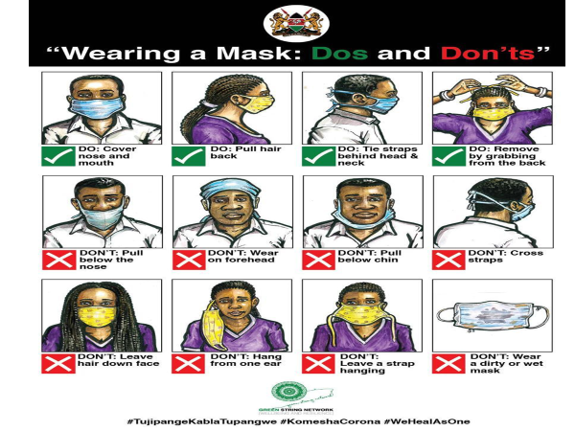

Slide 19
Outcome 4: Surveillance, monitoring and feedback: ………..a
Rapid risk assessment was done in four quarantine centers that had reported high rates of infections and two isolation centers.
Key findings included:
  Oovercrowding in quarantine centers;
  Inadequate hand hygiene facilities;
  Lack of IPC training for staff;
  Lack of IEC materials to educate the quarantined people;
  Lack of protocols to test exposed staff and for housekeeping; and
  Inadequate PPEs for HCW.
In isolation centers there was lack of HCW surveillance system, inadequate PPEs and no system for psychological support for exposed HCWs.
Based on these findings, recommendations were developed and shared with the centers for implementation.

Slide 20
Outcome 4: Surveillance, monitoring and feedback: ………b
From the health facility risk assessment, only 3 of the 16 domains met the minimum acceptable score of 80%:
  Communication and reporting, 80%;
  Hand hygiene, 81%
  Appropriate masks use, 89%)
The mean score across all domains was 61%
  lowest being handling of COVID-19 bodies (22%) and
  highest being appropriate mask use (89%).
By end-December 2020, EOC data indicated that 3,039 HCWs had been infected with SARS-CoV-2:
  This was 3.2% of 96,421 infections in the general population.
  Compared to the general population (4.8/100,000), the infection rate in the HCWs (56/100,000) was about 12 times higher

Slide 22
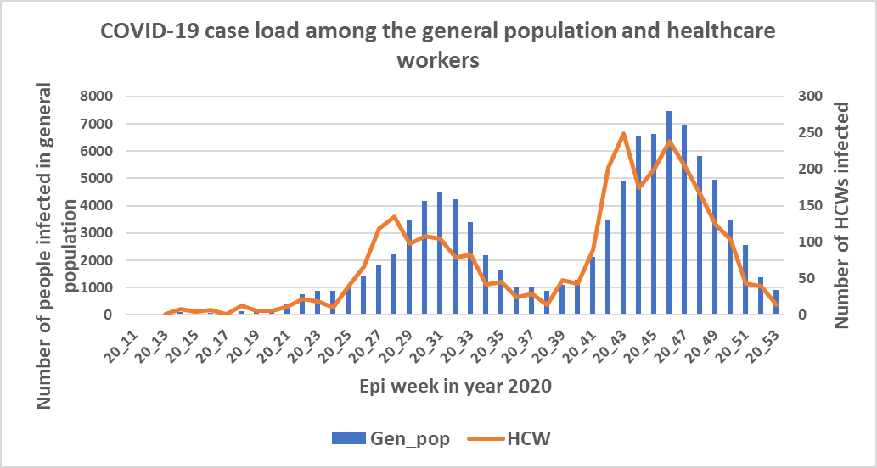
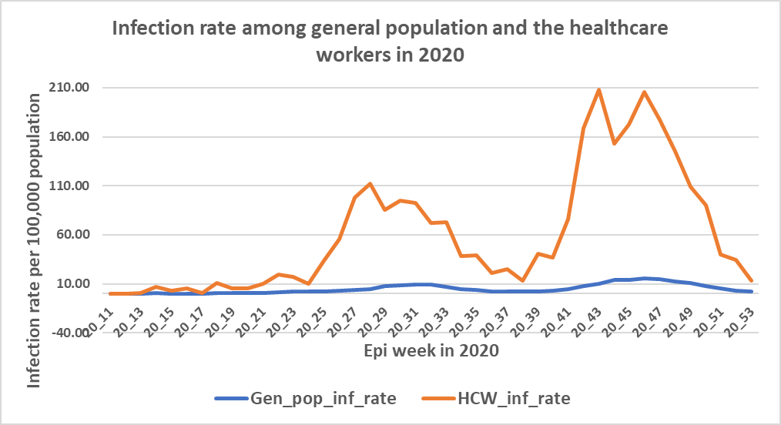

Slide 23
Outcome 5: Culture change:
To ensure consistency in COVID-19 IPC practices, senior leadership in government led by example in observing COVID-19 protocols.
Across electronic and print media, different healthcare and political leaders were seen wearing masks, keeping physical distance, and conducting hand hygiene.
Holding virtual meetings, conducting open air trainings for good ventilation and observing other IPC measures became the “new normal” and anyone not adhering was reminded of the same.
In health facilities, patients were required to wear a mask in order to get service.

Slide 24
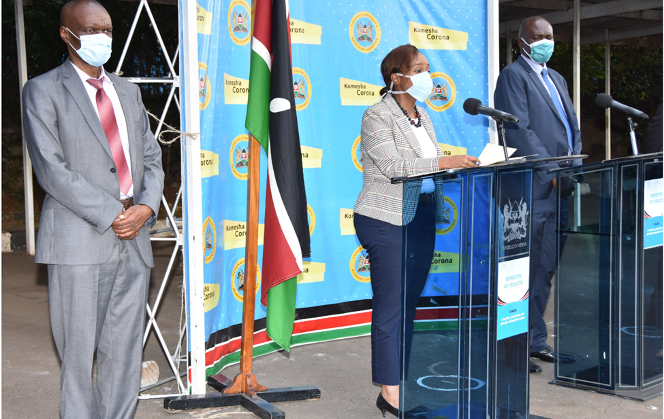

Slide 25

CONCLUSIONS
Kenya’s adoption of the WHO multimodal approach may have prevented a major surge in COVID-19 that would have overwhelmed the health system.
Facility assessment and HCW surveillance provided information on IPC gaps for use in improving the program.
The multimodal approach is recommended for implementation in various facilities.
IPC committees and QIT can use this model

Slide 26
ACKNOWLEDGEMENTS
Ministry of Health (MoH) leadership
CDC COVID-19 response team members and leadership
CDC Implementing partners:
  ITECH
  WSU
  GIS

Slide 27
Thank you and keep safe

