Slide 1
Diagnostic stewardship for antimicrobial stewardship (AMS) journey : Experiences from Nyeri County referral Hospital (NCRH)
Authors: Patrick Kamau¹, Winfred Githinji¹, Sarah Kibira¹, Francis Ragwa², Josiah Njeru³, David Mutonga³
Authors Affiliation
¹Nyeri County referral hospital
²County Department of Health, Nyeri
³Infectious Diseases Detection & Surveillance (IDDS) project of USAID.
9th Infection Prevention Network (IPNET) CONFERENCE
22nd to 25th March 2022

Slide 2
Background
Antimicrobial resistance (AMR) is a global threat to public health security with projection of 10 million annual human fatalities by the year 2050.
This will result in 2- 3.5% decrease in global gross domestic product.
Surveillance and monitoring is one of the strategic objectives in prevention and containment of AMR
The objective of this presentation is to share diagnostic stewardship journey experiences at NCRH.
Notes:
NCRH Laboratory is ISO 15189:2012 Accredited by KENAS- 2018.
Mission: To provide accurate, reliable and timely Laboratory Services.
Vision: To be the leader nationally in the Provision of high quality Laboratory Services .

Slide 3
Methods
Baseline Assessment using CDC’s LAARC tool (July 2019)
Interventions/Actions
Standardization of bacteriology SOPs
Procurement of supplies & Equipment
On-site mentorship; National & IDDS
Sensitization of clinical teams and leadership
Multidisciplinary stakeholder forums
Information systems linkage
Notes:
LAARC Tool- Laboratory assessment of antibiotic resistance testing capacity.

Slide 4
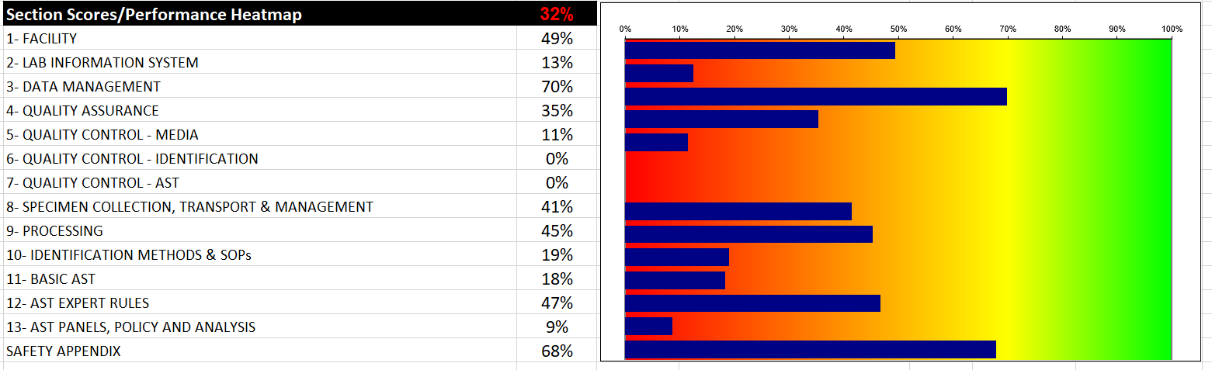
Results-Baseline assessment
Notes:
The plot is an output from the LAARC tool. Do notes to guide you on the items to focus on
Baseline score- 32 % due to :
In consistence supply of consumables.
Lack of essential equipment.
Technical capacity gap in AMR activities for staff working in the bacteriology section.

Slide 5
Results
Increased utilization of microbiology services by the clinical team
Culture workload rose from an average of 8 to 55 culture tests per month.
A total of 596 tests were performed in 2021, with slowed uptake during covid-19 pandemic outbreak peaks.

Slide 6
Results-Prevalent pathogens
Notes:
Positivity = 148/621= 23.8%

Slide 7
Results
Data generated has also highlighted antibiotic resistance trends of prevalent bacterial pathogens, a key step to be able to generate local antibiograms.
The lab is also able to report to the national AMR surveillance database through information systems linkage.

Slide 8
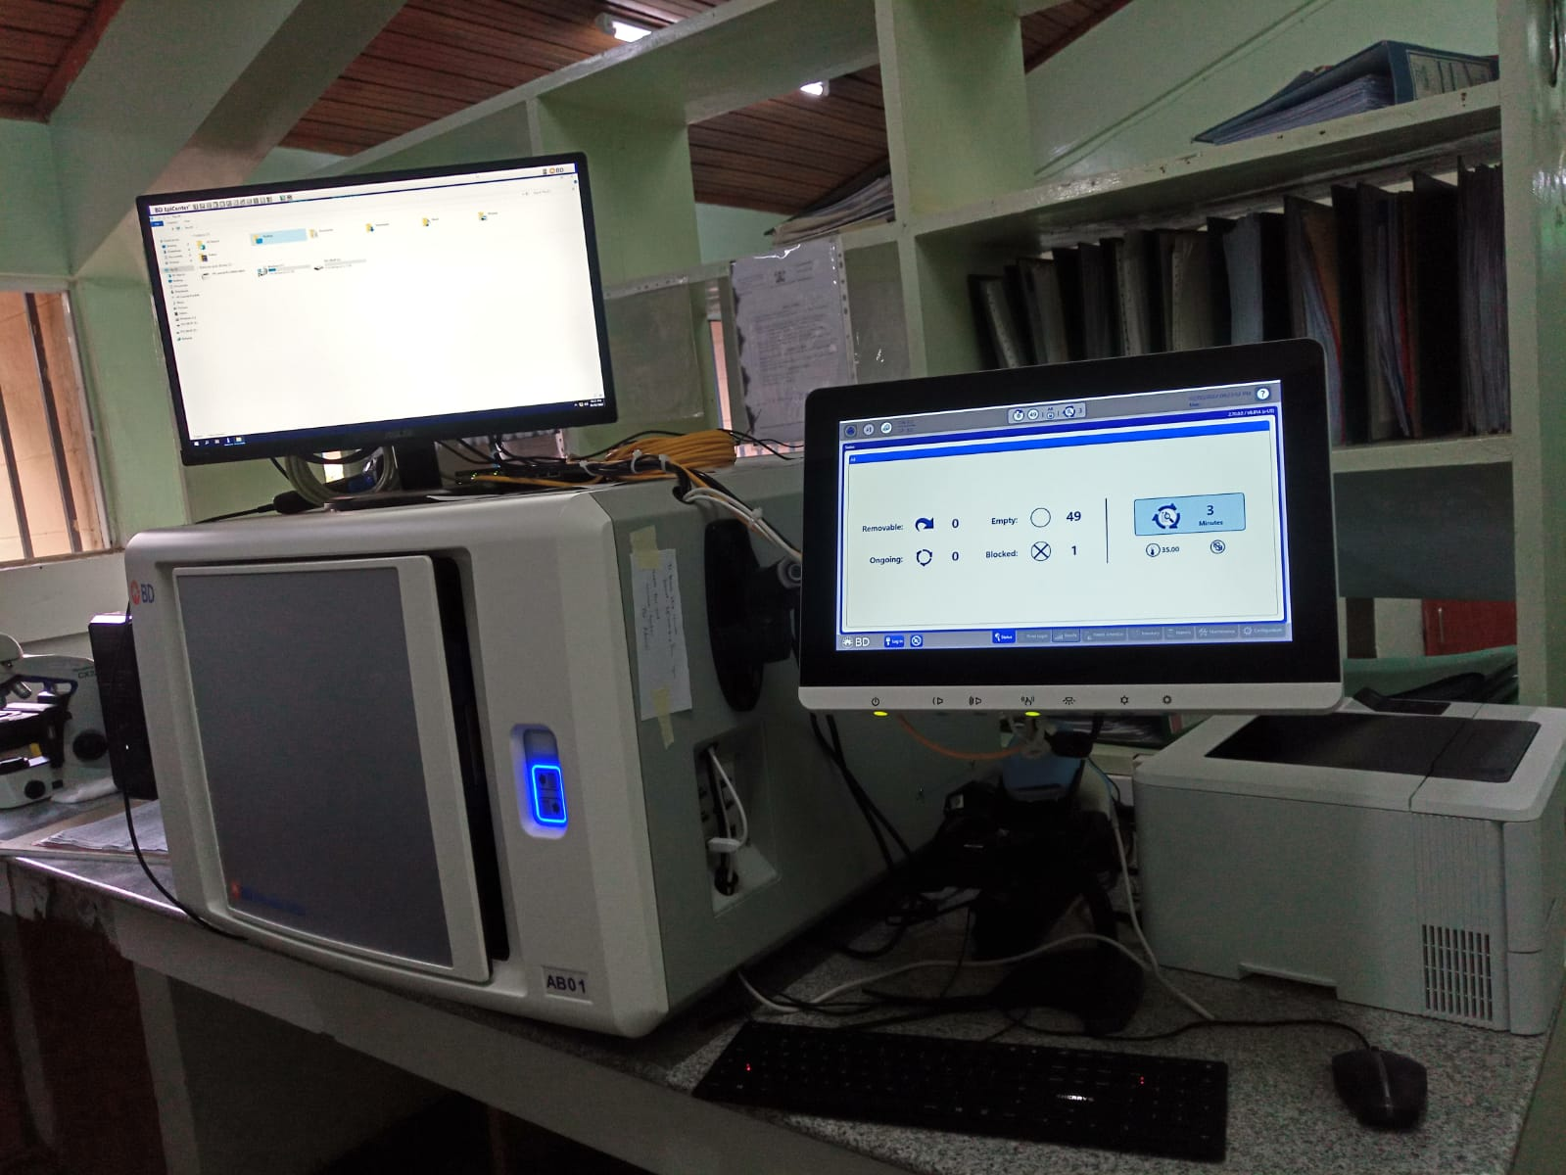
Results
Leadership Engagement
Engaging leadership at both hospital and county levels resulted in commitment of resources towards supplies and equipment which were initially a challenge.
No major service interruptions have been reported
Notes:
For blood cultures

Slide 9
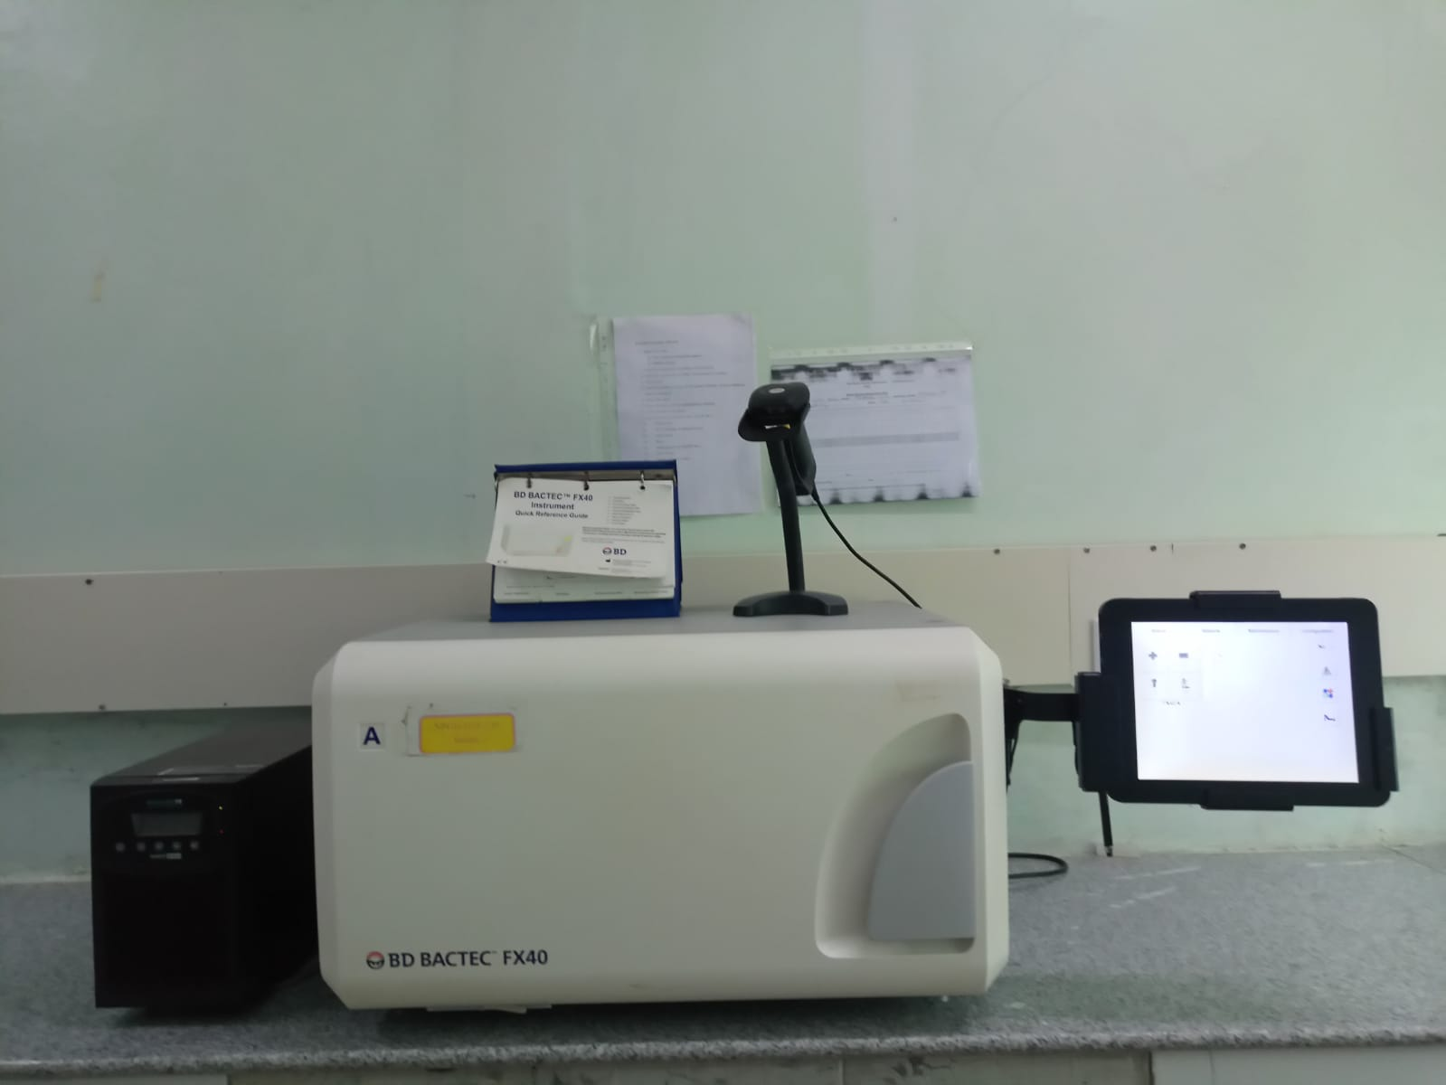
Results
Bactec Equipment- Blood culture
Notes:
For blood cultures

Slide 10
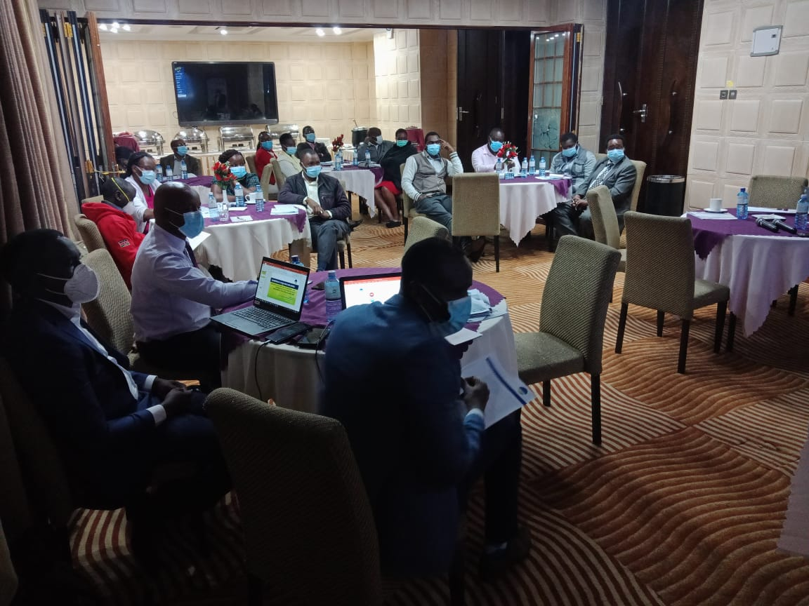
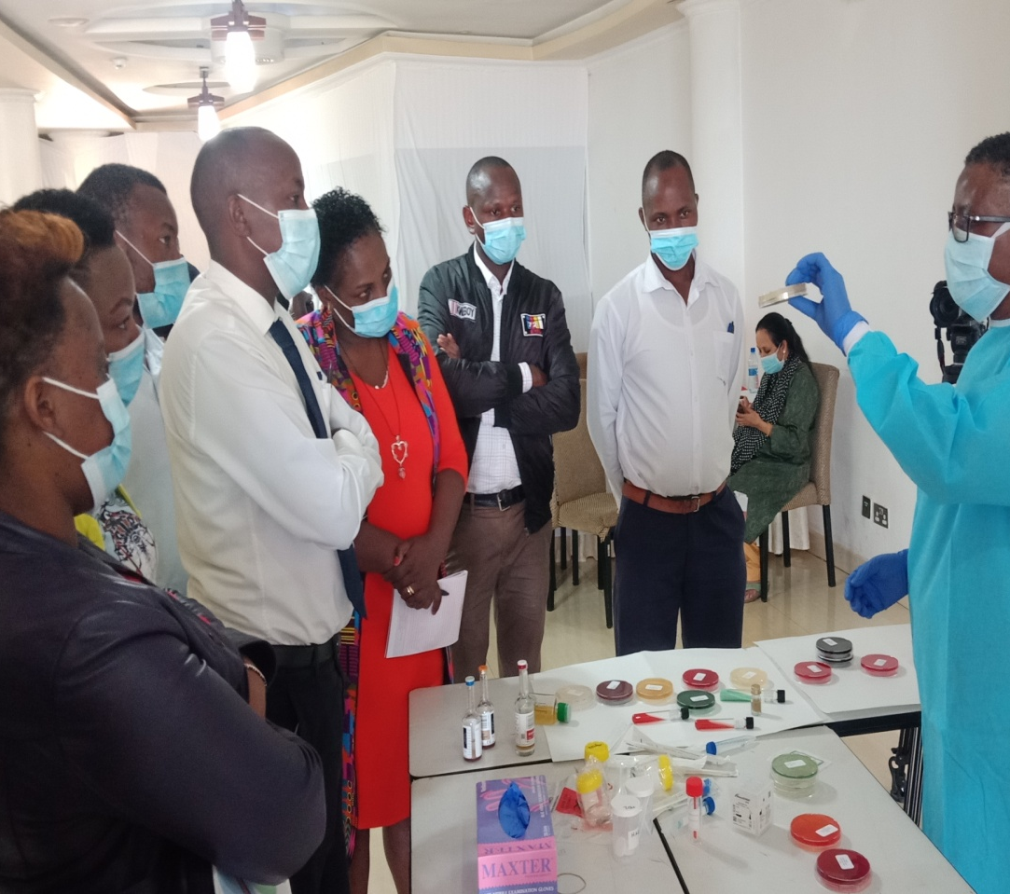

Photo taken during a training session conducted by Aga Khan, MSD and IDDS
Photo taken during a clinicians sensitization meeting by IDDS in 2021 held at White Rhino Hotel

Slide 11
Conclusion
Systematic capacity strengthening at NCRH Laboratory has resulted to:
Increased utilization of bacteriology services by clinical team.
Generation of valuable AMR data which is linked to the national database.
Improved supply of laboratory consumables.
Improved Patient care.

Slide 12



Acknowledgement
Nyeri County- Health Department.
NCRH upper management.
IDDS.
National Microbiology Reference Laboratory.
NCRH Laboratory Staffs.

Slide 13
Thank you

