Slide 1
Description of AstraZeneca vaccine defaulters among targeted populations in Nyeri County, 2021
Boniface Macharia.
Infection Prevention and Control Coordinator

Slide 2

Introduction
Kenya
  First Covid19 case was confirmed on 12th March 2020.
  As at 17th Sept 2021, confirmed cases 245,781 and 4965 deaths(CFR 3.5%).
Nyeri County
  First COVID-19 case was confirmed on 21st May 2020.
  As at 17th Sep 2021, Confirmed cases 3722 and 226 deaths (CFR 6.0%)
AstraZeneca Vaccine, mRNA
  Two dose vaccine
  Vaccination campaign in Nyeri launched March 2021

Slide 3
Problem Statement
Covid-19, global pandemic
  impacted global economies
  Socio – economic disruption
  Increased morbidity and mortality
  Preventable – through water and sanitation hygiene and vaccines (CDC, 2021)
Vaccine defaulters have reduced protection
  At risk of severe course of disease (CDC, 2021)
  Increased infectivity

Slide 4
Justification
Persons living with NCDs are at risk of severe COVID-19 infection (Baden et al 2020)
  Two out of three people in Nyeri die of an NCD (KNBS 2020)
  Critical to protect the vulnerable groups using vaccination strategy
Limited publications on vaccine data in Nyeri County
The vaccination exercise has had its challenges
  Gaps in public health promotion
  Rumors and misinformation in community
  Erratic supply

Slide 5
Objectives
Define the Sociodemographic of AstraZeneca vaccine defaulters in Nyeri County 2021.
Establish the Clinical characteristics of AstraZeneca vaccine defaulters in Nyeri County 2021.
Assess Data Quality of AstraZeneca vaccine defaulters line list in Nyeri County 2021.

Slide 6
Methods 1/2
Study area: Nyeri County, projected population of 750,000.
Study design: retrospective descriptive study and KII and phone interviews.
Data collection: social demographics & clinical variables.
Data source: Chanjo online platform.
Data analysis: descriptive statistics.

Slide 7
Social Demographic, age of vaccine defaulters in Nyeri in the year 2021.
Mean age 46±16
Variable | Frequency (n=350) | Percentage
Sex
Male | 150 | 40%
Female | 200 | 60%
Age group
≤ 19 | 21 | 10%
20-29 | 46 | 15%
30-39 | 76 | 20%
40-49 | 56 | 12%
50-59 | 76 | 20%
60-69 | 54 | 13%
≥70 | 20 | 10%

Slide 8
Distribution by residence of covid19 vaccine defaulters in Nyeri in half year 2021

Slide 9
Distribution of defaulters by professional category in Nyeri County in half year 2021

Slide 10
Distribution by dates of first dose vaccination of defaulters in Nyeri in year 2021

Slide 11
Clinical characteristics of AstraZeneca defaulters in Nyeri 2021

Slide 12
Key Informant Interviews
Nurse Manager
  Misinformation from social media in the last weeks of April 2021
  No reassurance from the authorities
  Community Focal person
  -Misinformation compounded by AEFI
  Vaccinators
  -Erratic supply of vaccines responsible for the defaulting.

Slide 13
Discussion
More females than males defaulted on the covid19 vaccine
  Could be due to anxiety related to injection or good communicators
Most cases were middle aged
  Could be due to access to misinformation
Most defaulters from Municipality or Nyeri Central
  mirrors population density or ease to transmit information.
Dates of 1st dose vaccination more in first two weeks.
  Initial acceptance of vaccine and no much official facts/info
  Majority of defaulters had no pre existing conditions

Slide 14
Conclusion
AstraZeneca defaulting points towards Infodemic
-Misinformation and Disinformation
-Female affected more than males
-More populated areas defaulting than sparsely populated
-Less intellects defaulting compared to others.
-Middle aged population defaulting more than the lest.
-Majority of defaulters had no pre existing conditions.

Slide 15
Recommendation
Health Promotion on crisis communication
-Advocacy, communication, behavior change and social mobilization.
Key messages for each target group
-Uniformed officers
-Farmers
-Business people

Slide 16
LEADERSHIP AND CAPACITY BUILDING APPROACH
CDH Committee (Training, Supervision, Roll out)
HPO (Promotion Multimodal approach)
Academia Disciplined forces Health institution SCEO Church leaders Media
Youth Police HCW Teachers Congregates Pop.
Improved uptake of Covid 19Vaccines

Slide 17
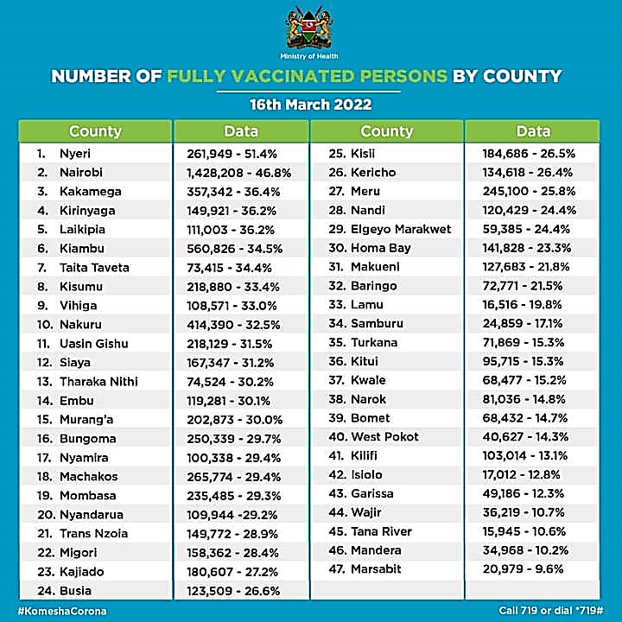
OUTCOME

Slide 18
Acknowledgements
Nyeri County Department of Health
Infection Prevention Network Kenya
Centre for Health Solutions
Medicines Therapeutic and Pharmaceuticals Technologies.

Slide 19
References
Centre for Disease Control and Prevention Covid19 Vaccine safety update, published online cdc.gov 1st March 2021
Baden et al 2020 Efficacy and safety of the Mrna-1273 SARS-CoV-2 Vaccine. New England journal of medicine DOI; 10.1056/NEJMoa2035389.
KNBS. Economic Survey 2019 and 2020
http://www.asals.go.ke/

Slide 20
Thank You

