Slide 1
Compliance with Standard Precautions and Influencing Factors among Healthcare Workers in Low and Middle income Countries (LMICs)
IPNET-K Annual Conference Scientific on 23rd -25th March 2022
Loyce Kihungi, BSC, MSC IC

Slide 2
Disclosure
No funding
Ethical approval not applicable (no human participants) but approval was applied for and provided
Academic study, thus no conflict of interest

Slide 3

Outline
Introduction
Aim
Literature review
Methodology
Findings
Conclusion

Slide 4
Introduction
Healthcare associated infections (HAIs) are threat to healthcare workers and patients
Most HAIs are preventable using standard precautions
Evolved basic infection control precautions:
  Precautions to blood stained body fluids (high risk fluids)
  I985, universal precautions applied to all patients
  1987, body substance isolation (BSI)-All body fluids non-contact
  1993 Universal precautions modified to standard precautions
Standard precautions are:
  used for all patient care
  Based on risk assessment and common sense practices

Slide 5
Research Question
What is the level of compliance with standard precautions of infection prevention and control, and the influencing factors among healthcare workers in LMIC?

Slide 6
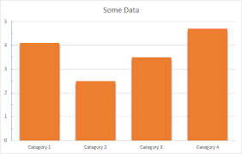
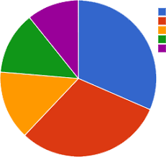
Aim
To establish compliance with the standard precautions
To determine factors influencing the practice
among healthcare workers in low and middle income countries
.

Slide 7
Literature review
1800s discovery of infection transmission concept
Focus on reduction of risk of cross-infection
Introduction of:
  Universal precautions
  standard precautions
A myriad of factors attributed to unsafe practices
Few studies focusing on all components of standard precautions
Poor adherence majorly documented
Need to develop safety climate in healthcare facilities

Slide 8
Methodology
Systematic review and synthesis of the literature
  Literature search
  Data extraction
  Content analysis
  Thematic analysis
  Interpretive synthesis
Sources of data: MEDLINE, CINAHL and Cochrane Library
Search restricted to:
  Peer reviewed articles published 2011 onwards
  English and full papers
  Healthcare facility-based research
  Studies done in low and middle income countries
Review done by two independent IPC experts

Slide 9
Search strategy
Search ID# | Search Terms
S1 | “standard precautions” OR “universal precautions”
S2 | “infection control” OR “infection prevention” OR “infection prevention and control”
S3 | “healthcare workers” OR “healthcare professionals” OR “healthcare providers” OR “healthcare personnel” OR Doctors OR Nurses
S4 | S1 AND S2 AND S3

Slide 10
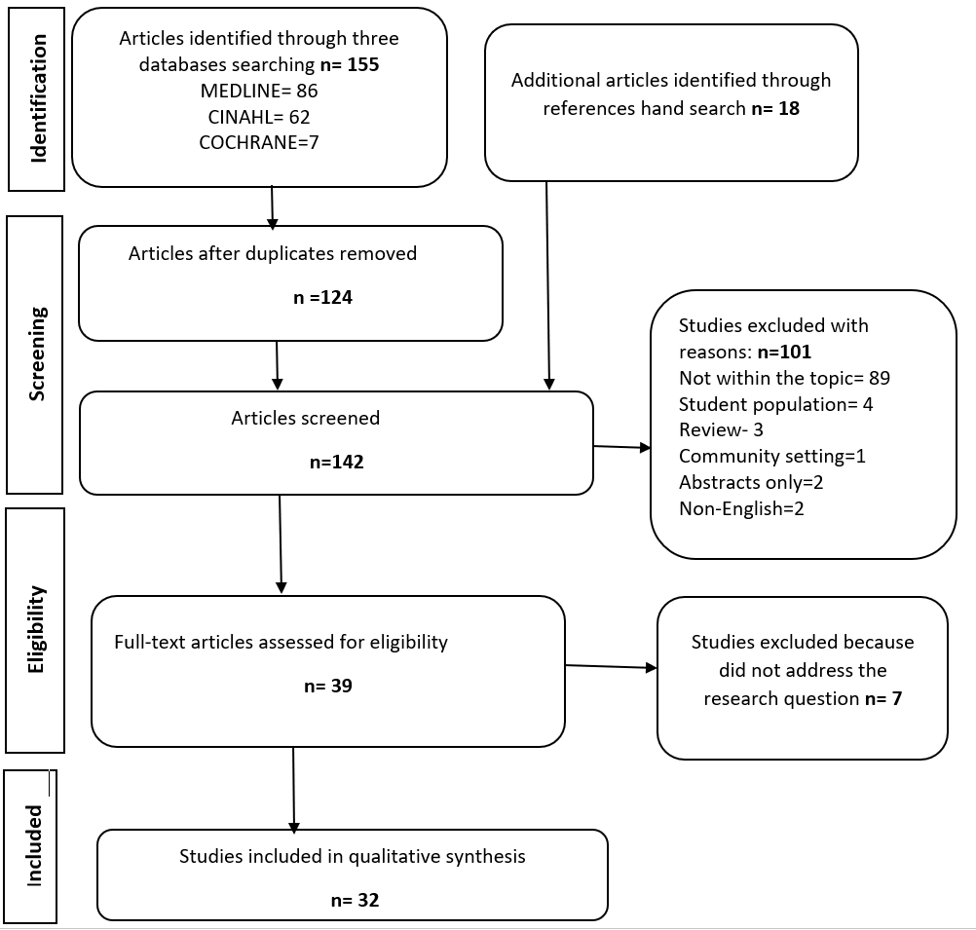
Search Process Prisma

Slide 11
Findings- Distribution of the 32 Articles
Country | No. of Articles
Nigeria | 9
Ethiopia | 4
China | 3
Turkey | 2
Brazil | 2
Ghana | 1
Philippines | 1
Pakistan | 1
Jordan | 1
Country | No. of Articles
Iran | 1
Uganda | 1
Afghanistan | 1
Egypt | 1
Myanmar | 1
India | 1
Palestine | 1
Nepal | 1

Slide 12
Findings
Cross-sectional studies
Of 32 articles reviewed, 50% (16) were from Africa, 44%(14) from Asia and 6% (2) from South America
Each study was conducted in more than one healthcare facility
Total of 180 healthcare facilities and over 14,000 participants
Participants of different cadres
Of 32 articles 41% (13) studies nurses only
Self-administered questionnaires, interviews, observation of practice, and focused group discussion
26 (81%) out of the 32 studies used self-administered questionnaire only, the rest used mixed method

Slide 13
Findings
All 32 articled passed the quality analysis
Heterogeneous studies, descriptive analysis used
Of 32 articles, 16 (53%) reported compliance as fair or low
Eleven articles with % compliance, 19% to 82.6% with six studies having scores of above 50%
Factors influencing performance included:
  training, knowledge, resources, workload, attitude, time, age, gender, support supervision, discomfort caused by protective wear, work experience, staffing, patient protection, previous exposure, policy documents, continuous monitoring, and safety climate

Slide 14
Conclusion
Poor adherence to standard precautions is a common problem, attributed to increasing rates of HAIs
Low compliance with standard precautions is a multifaceted problem
Training and education is critical for adherence to standard precautions (59% articles reported)
Adequate knowledge can lead to positive attitude

Slide 15
Recommendation
Engage actions at national, county, facility and individual levels to solve the puzzle of suboptimal compliance
Establish a culture of safety
Employ the multimodal improvement strategy
Need for an observational study with interventions to better determine compliance level and effective interventions

Slide 16


