Slide 1
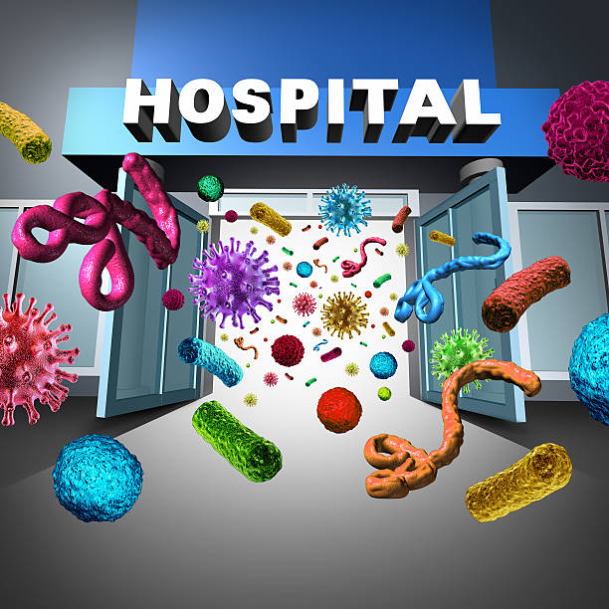
Characterization of hospital acquired infections among admitted patients at The Nairobi Hospital between January and December 2021
Authors
Beatrice Kanyoro,Linet Maobe
Infection control department
The Nairobi hospital

Slide 2
Introduction
Hospital-acquired infections(HAI), are infections that are typically not present on admission.
These infections are usually acquired after hospitalization and manifest 48 hours after admission,3 days after discharge or within 30 days of a surgical operation.
The infections are monitored closely by the National Healthcare Safety Network (NHSN) of the Center for Disease Control and Prevention (CDC).

Slide 3
NHSN HAI classification
Central line-associated bloodstream infections (CLABSI),
Catheter -associated urinary tract infections (CAUTI)
Surgical site infections (SSI)
Ventilator-associated Pneumonia (VAP)

Slide 4
HAI Burden
According to the available evidence, the impact of HAI implies
Prolonged hospital stay
Long-term disability
Increased resistance of microorganisms to antimicrobials
Massive additional financial burden for health systems
High costs for patients and their family
Unnecessary deaths.

Slide 5
Justification for HAI surveillance
Monitoring infection incidence rates
Monitoring trends, including the detection of outbreaks
Providing early warning and investigation of infection problems, and subsequent planning and intervention to control
Examining the impact of interventions
Gaining information on the overall quality of patient care.

Slide 6
Literature review
The literature review found that most developed countries including Australia,England,Scotland,France and Germany have adapted the CDC national nasocomial surveillance
The National surveillance allows for benchmaking,uses standardized definations,data collection and reporting methods.

Slide 7
Methods
Analysis of laboratory culture data captured in TNH in-patient tracking system between January and December 2021 was done
Inclusions and exclusions
Patients who had devices inserted during the admission
Infection was not present on admission
Patient had surgeries performed in the hospital

Slide 8
RESULTS
Overall, of 15,352 admissions, 176 (1.1%) had hospital-acquired
infection.
A total of 653 patients required an invasive medical device
insertion.
Median age 55 years.
56.7% (370 patients) were male,
Median duration of admission was 5 days)
19.6% (128) of the 653 patients with invasive medical devices had device related HAI.

Slide 9
HAI 2021

Slide 10
RESULTS
13 major pathogens were isolated, the most prevalent included:
Escherichia coli(20.3%),
Klebsiella species (18.0%),
Pseudomonas aeruginosa (12.5%)
Acinetobacter baumanii (10.9%).
NB: Resistance to multiple antimicrobials was common among the isolates.

Slide 11
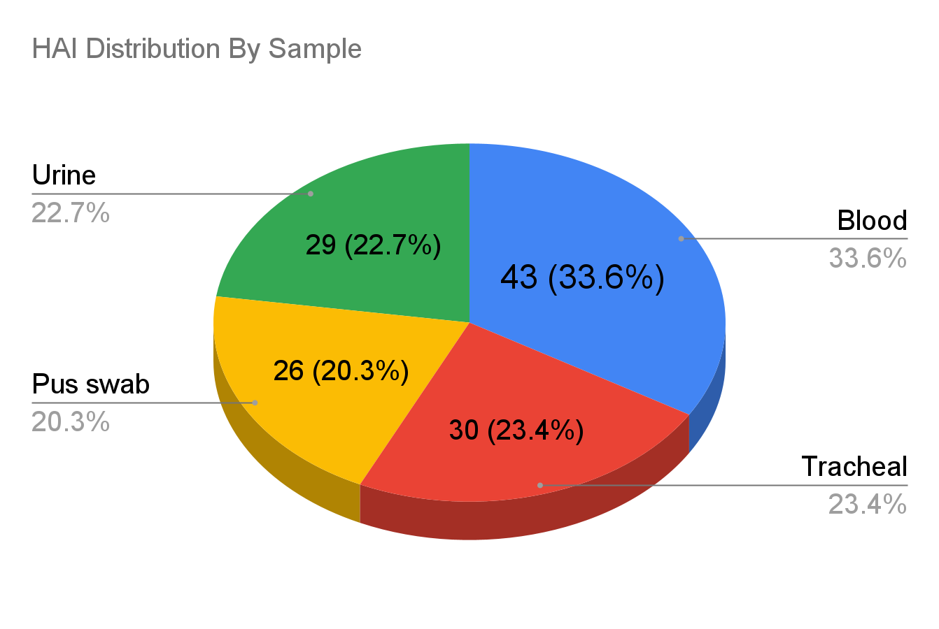
HAI Distribution Per Sample

Slide 12
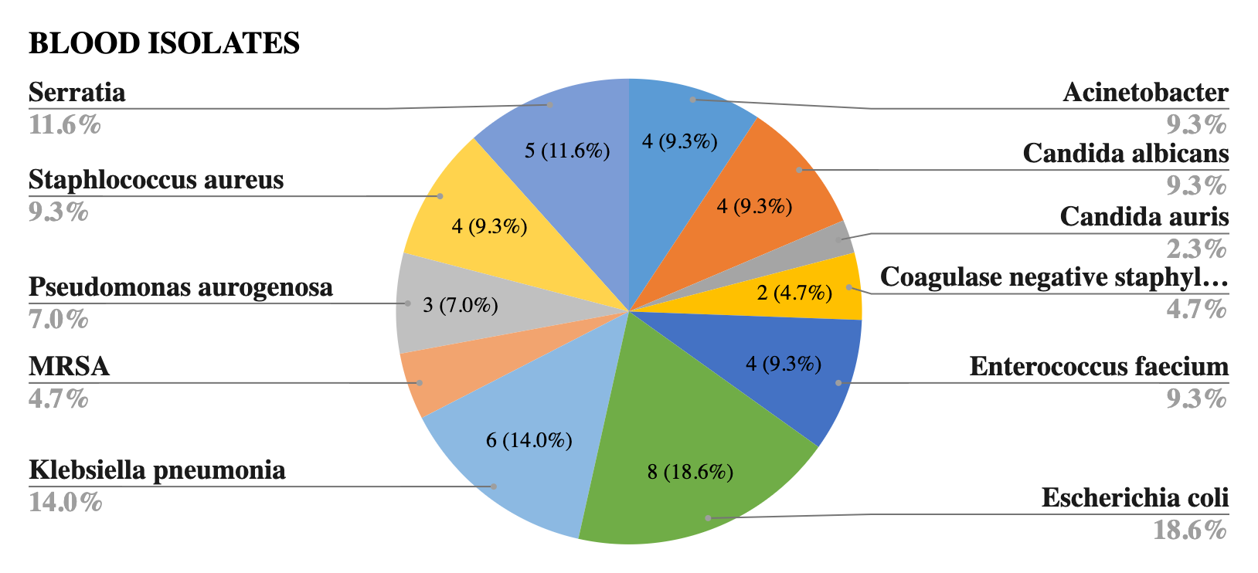
Blood Isolates

Slide 13
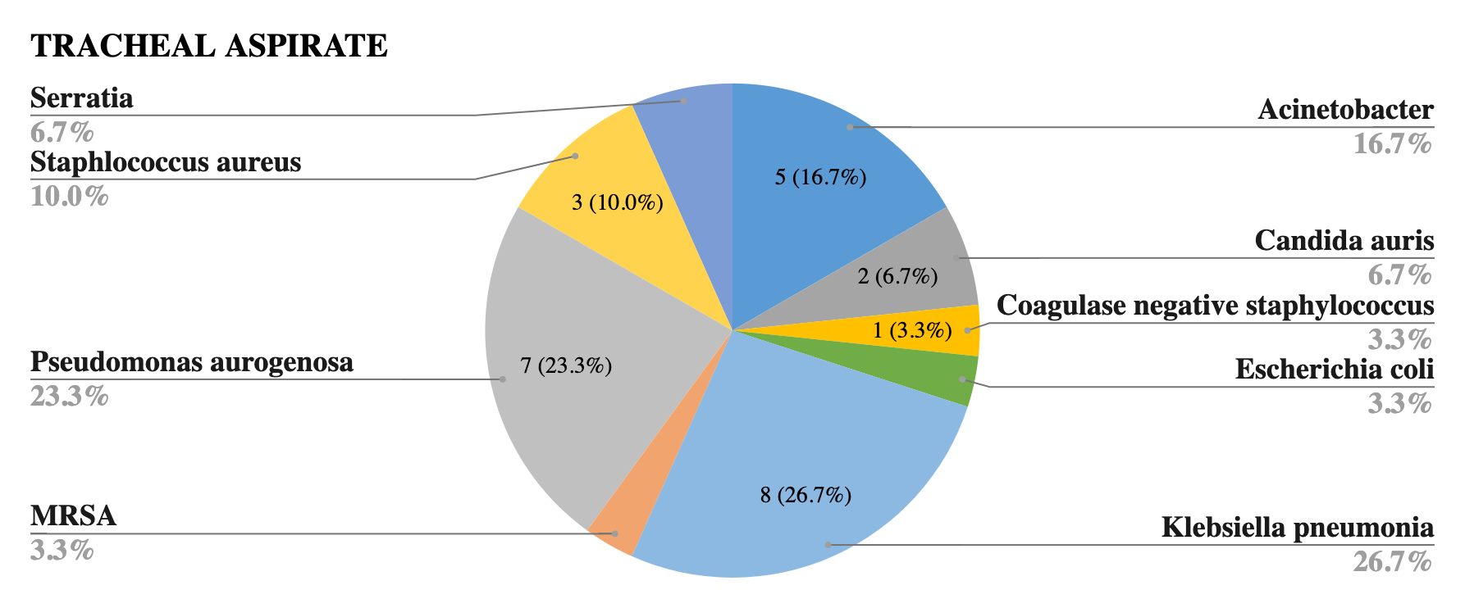
Tracheal Aspirate/ Sputum Isolates

Slide 14
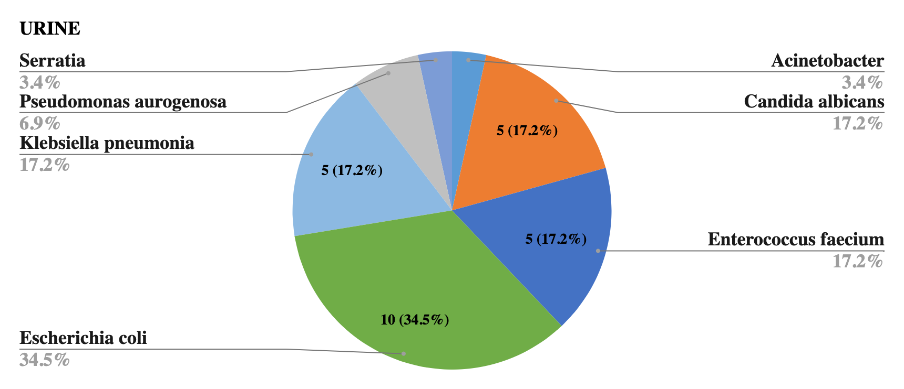
Urine Isolates

Slide 15
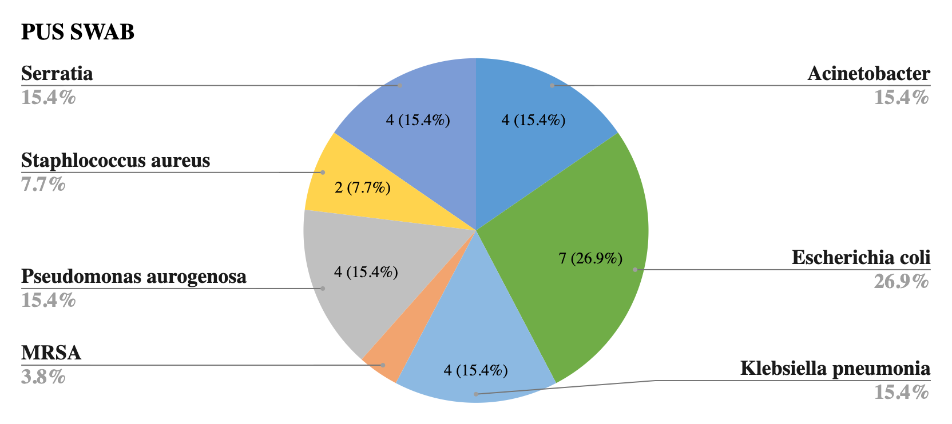
Wound/pus swab isolates

Slide 16
Conclusion
There was high prevalence of HAI among patients who underwent insertion of medical devices.
The most prevalent micoorganism isolated was E.Coli
Most isolates were MDRO
Blood had the highest number of isolates compared to other sites
Interventions strengthening IPC practices are being emphasized on and trends monitored

Slide 17
Recommendations
Training and implementation of HAI surveillance in all healthcare settings in Kenya.
More studies to be carried out locally and comparison done between identified microorganisms and antibiotic resistance.
Strengthening of AMS/AMR in healthcare settings.
Consistent and objective use of care bundles to monitor utilization of devices.

Slide 18
References
Healthcare-associated infections—the burden. Available at: http://www.cdc.gov/HAI/burden.html.
Klevens M.Edwards J.Richards C.et al.Estimating health care-associated infections and deaths in U.S. hospitals. Public Health Rep. 2007; 122: 160-167
Boev C, Kiss E. Hospital-Acquired Infections: Current Trends and Prevention. Crit Care Nurs Clin North Am. 2017 Mar;29(1):51-65.
NHSN website.

Slide 19


