Slide 1


24TH MARCH 2022
FREDRICK M. SHIGURI
BENEFITS OF UTILIZING MODERN WASTE TREATMENT METHODS-A SUCCESS STORY OF MURANG'A COUNTY

Slide 2
Background
Medical waste management presents a huge burden for hospitals
Poor practices and ineffective treatment methods increases risk of exposure to hazardous materials
40% of hepatitis B cases and 2.5% of HIV cases world wide are caused by exposure in work place.
Covid 19 pandemic created unprecedented difficulties for medical waste management
Notes:
The WHO has described antimicrobial resistance as a global problem (WHO, 2018).
They recommend action plans be developed to “combat antimicrobial resistance”.
Resistance is accelerated by misuse and overuse.
Improving antimicrobial prescribing is necessary to combat resistance.
When Penicillin was developed in the petri dishes by Alexandra Flemings, the age of the miracle drugs – antibiotics begun. The success of this discovery helped treat soldiers during the 2nd world war, to helping animals grow faster and stay healthier and finally led these miracle drugs to becoming irresistible in the prescribing world – cause if there was a chance they would work = it was worth prescribing.
The involvement of antibiotics in both the medical and agricultural world is what has led us to what many tern as the ‘post antibiotic era = the age of antibiotic resistant infections

Slide 3
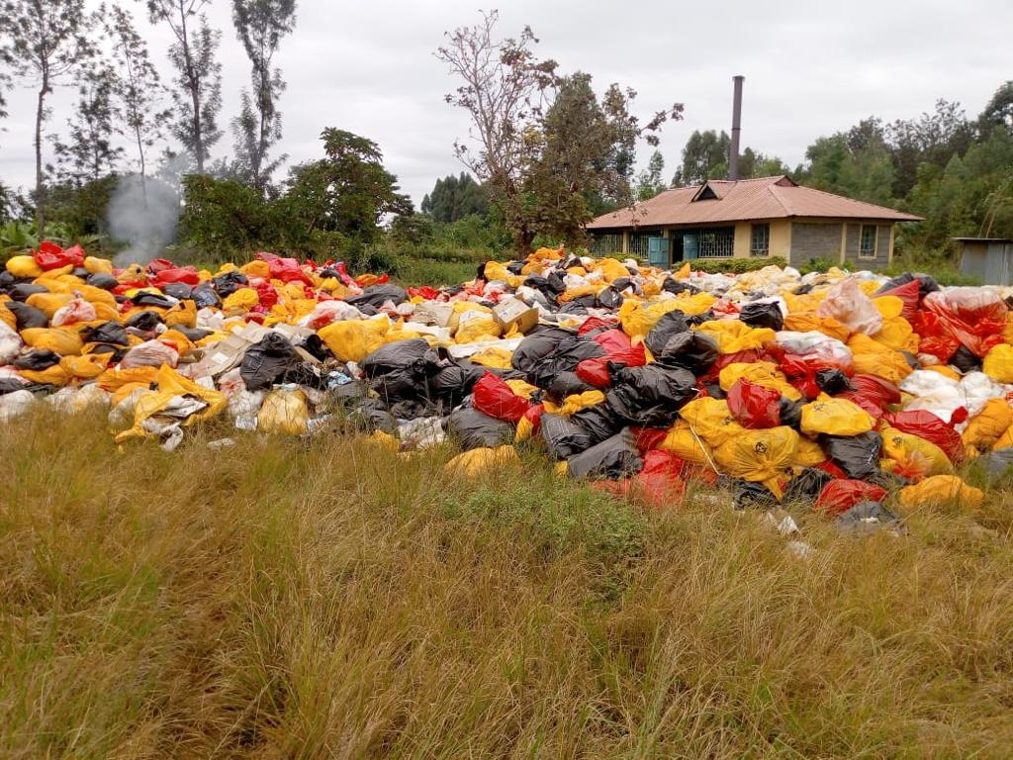
Accumulation of waste.
Notes:
At Nyeri CRH we were committed to playing our part in the fight against antimicrobial resistance, we therefore needed to know what the current state of antibiotic prescribing was and we choose to start with reviewing our outpatient department.
The objectives of this baseline audit was to;
Evaluate the current antimicrobial prescribing trends and the scale of antimicrobial prescribing
Determine our prescribers compliance with national guidelines
Evaluate the gaps in prescribing knowledge by reviewing the appropriateness of the treatments selected

Slide 4
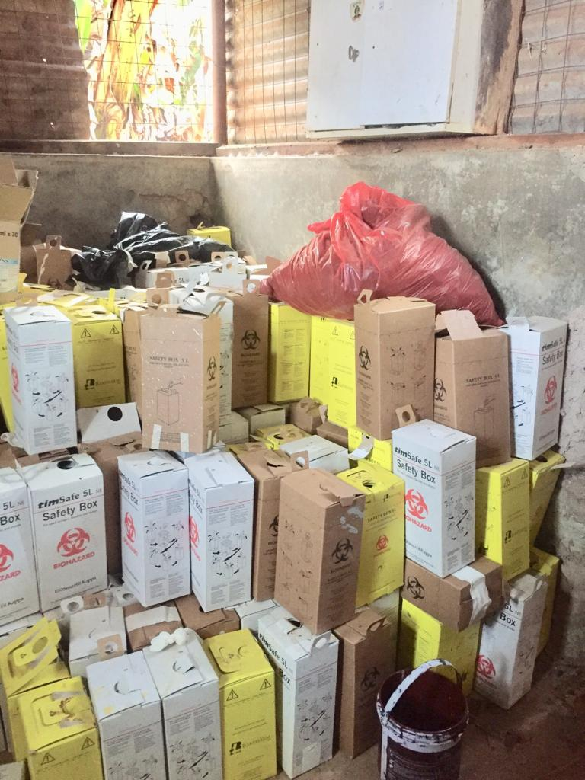
Accumulation of sharps
Notes:
At Nyeri CRH we were committed to playing our part in the fight against antimicrobial resistance, we therefore needed to know what the current state of antibiotic prescribing was and we choose to start with reviewing our outpatient department.
The objectives of this baseline audit was to;
Evaluate the current antimicrobial prescribing trends and the scale of antimicrobial prescribing
Determine our prescribers compliance with national guidelines
Evaluate the gaps in prescribing knowledge by reviewing the appropriateness of the treatments selected

Slide 5
Background cont....
  Challenges in Murang'a;
  Lack of an effective and efficient waste treatment method
  Lack of appropriate transportation vehicles
  Inadequate knowledge and awareness on HCWM and IPC
Notes:
The WHO has described antimicrobial resistance as a global problem (WHO, 2018).
They recommend action plans be developed to “combat antimicrobial resistance”.
Resistance is accelerated by misuse and overuse.
Improving antimicrobial prescribing is necessary to combat resistance.
When Penicillin was developed in the petri dishes by Alexandra Flemings, the age of the miracle drugs – antibiotics begun. The success of this discovery helped treat soldiers during the 2nd world war, to helping animals grow faster and stay healthier and finally led these miracle drugs to becoming irresistible in the prescribing world – cause if there was a chance they would work = it was worth prescribing.
The involvement of antibiotics in both the medical and agricultural world is what has led us to what many tern as the ‘post antibiotic era = the age of antibiotic resistant infections

Slide 6
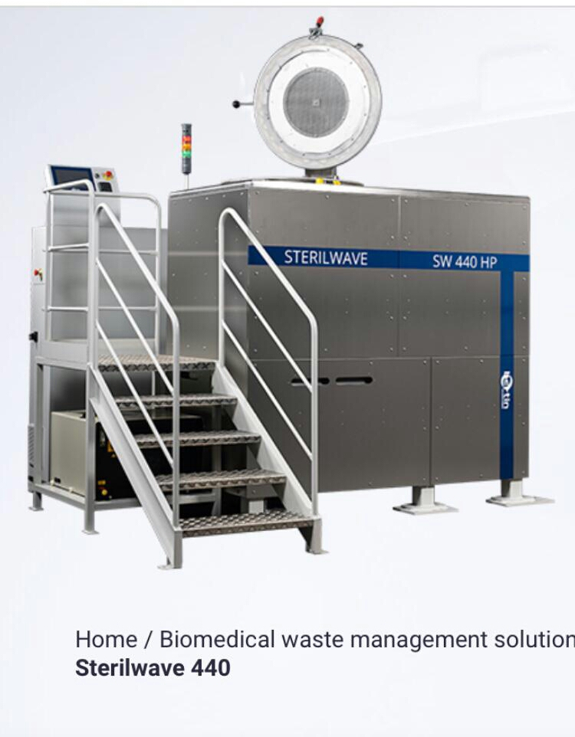
Limitations
Modern waste treatment equipment
Notes:
At Nyeri CRH we were committed to playing our part in the fight against antimicrobial resistance, we therefore needed to know what the current state of antibiotic prescribing was and we choose to start with reviewing our outpatient department.
The objectives of this baseline audit was to;
Evaluate the current antimicrobial prescribing trends and the scale of antimicrobial prescribing
Determine our prescribers compliance with national guidelines
Evaluate the gaps in prescribing knowledge by reviewing the appropriateness of the treatments selected

Slide 7
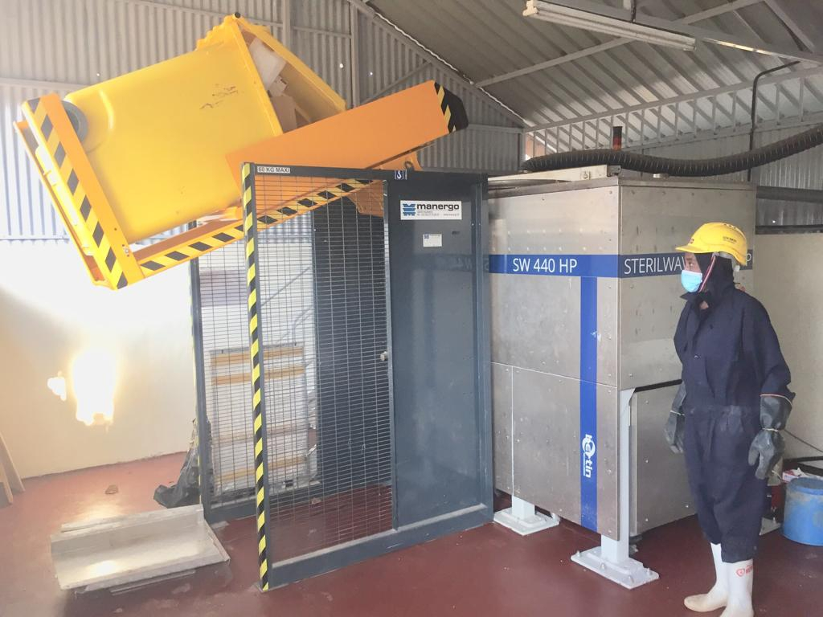
Modern waste treatment
equipment
Notes:
At Nyeri CRH we were committed to playing our part in the fight against antimicrobial resistance, we therefore needed to know what the current state of antibiotic prescribing was and we choose to start with reviewing our outpatient depart
The objectives of this baseline audit was to;
Evaluate the current antimicrobial prescribing trends and the scale of antimicrobial prescribing
Determine our prescribers compliance with national guidelines
Evaluate the gaps in prescribing knowledge by reviewing the appropriateness of the treatments selected

Slide 8
Modern waste treatment equipment
    880L /hr Up to 88 kg/hr
    440L Vessel
    30 min
Notes:
The WHO has described antimicrobial resistance as a global problem (WHO, 2018).
They recommend action plans be developed to “combat antimicrobial resistance”.
Resistance is accelerated by misuse and overuse.
Improving antimicrobial prescribing is necessary to combat resistance.
When Penicillin was developed in the petri dishes by Alexandra Flemings, the age of the miracle drugs – antibiotics begun. The success of this discovery helped treat soldiers during the 2nd world war, to helping animals grow faster and stay healthier and finally led these miracle drugs to becoming irresistible in the prescribing world – cause if there was a chance they would work = it was worth prescribing.
The involvement of antibiotics in both the medical and agricultural world is what has led us to what many tern as the ‘post antibiotic era = the age of antibiotic resistant infections

Slide 9
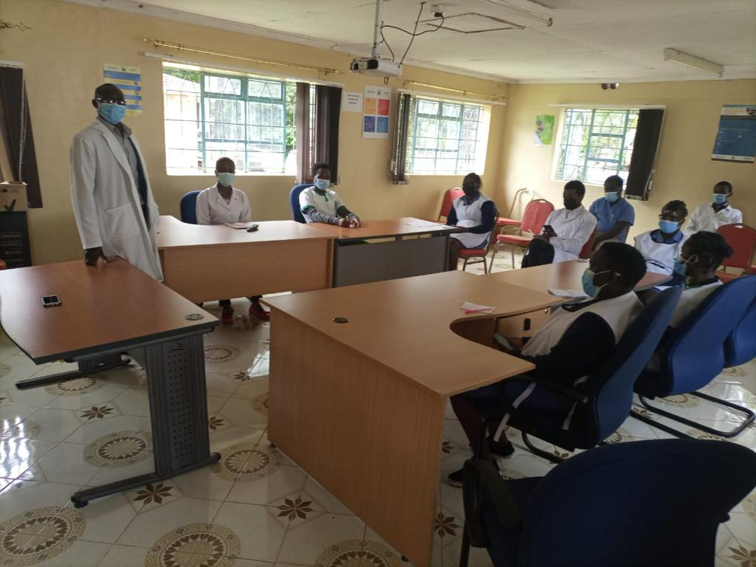
IPC CMEs
Notes:
At Nyeri CRH we were committed to playing our part in the fight against antimicrobial resistance, we therefore needed to know what the current state of antibiotic prescribing was and we choose to start with reviewing our outpatient department.
The objectives of this baseline audit was to;
Evaluate the current antimicrobial prescribing trends and the scale of antimicrobial prescribing
Determine our prescribers compliance with national guidelines
Evaluate the gaps in prescribing knowledge by reviewing the appropriateness of the treatments selected

Slide 10
Broad Objective:
To evaluate the gains made by Utilizing modern waste treatment methods within Murang'a County
Specific Objectives
To determine the health benefits of Utilizing microwave waste treatment method within Murang'a County
To determine the economic benefits of Utilizing microwave waste treatment method within Murang'a County
Notes:
At Nyeri CRH we were committed to playing our part in the fight against antimicrobial resistance, we therefore needed to know what the current state of antibiotic prescribing was and we choose to start with reviewing our outpatient department.
The objectives of this baseline audit was to;
Evaluate the current antimicrobial prescribing trends and the scale of antimicrobial prescribing
Determine our prescribers compliance with national guidelines
Evaluate the gaps in prescribing knowledge by reviewing the appropriateness of the treatments selected

Slide 11
Methodology
Key Informant Interviews - Qualitative data
Observational data was collected and collated.
Review and analysis of resources required for transportation and treatment of medical waste prior and after installation of a microwave machine - quantitative data
Notes:
At Nyeri CRH we were committed to playing our part in the fight against antimicrobial resistance, we therefore needed to know what the current state of antibiotic prescribing was and we choose to start with reviewing our outpatient department.
The objectives of this baseline audit was to;
Evaluate the current antimicrobial prescribing trends and the scale of antimicrobial prescribing
Determine our prescribers compliance with national guidelines
Evaluate the gaps in prescribing knowledge by reviewing the appropriateness of the treatments selected

Slide 12
Results
  Improved occupational health and safety
  Environmentally clean method
  Economic gain - over 2.1 million annually
  Reduction waste volume and weight
  All wastes reduced to a smooth Re-usable innert efluent
Notes:
At Nyeri CRH we were committed to playing our part in the fight against antimicrobial resistance, we therefore needed to know what the current state of antibiotic prescribing was and we choose to start with reviewing our outpatient department.
The objectives of this baseline audit was to;
Evaluate the current antimicrobial prescribing trends and the scale of antimicrobial prescribing
Determine our prescribers compliance with national guidelines
Evaluate the gaps in prescribing knowledge by reviewing the appropriateness of the treatments selected

Slide 13
Results
  Iproved recording - the entire process
  Controlled animal and human scavenging
  Freed some wasted spaces
  Improved cleanliness of working enviroment
  Conformity to legal standards of waste management
Notes:
At Nyeri CRH we were committed to playing our part in the fight against antimicrobial resistance, we therefore needed to know what the current state of antibiotic prescribing was and we choose to start with reviewing our outpatient department.
The objectives of this baseline audit was to;
Evaluate the current antimicrobial prescribing trends and the scale of antimicrobial prescribing
Determine our prescribers compliance with national guidelines
Evaluate the gaps in prescribing knowledge by reviewing the appropriateness of the treatments selected

Slide 14
Discussion
Microwave technology was prefered for its more effective, safe, wholistic and environmentally friendly method compred to incineration.
Over 44% of the economic costs are due to the nature of the machine
Microwave technology is in cost higher initially, but in the long run (about 10 years), the cost will be recovered. The overall benefit however is its capacity to protect people and environment from hazards relating to medical wastes.
Notes:
At Nyeri CRH we were committed to playing our part in the fight against antimicrobial resistance, we therefore needed to know what the current state of antibiotic prescribing was and we choose to start with reviewing our outpatient department.
The objectives of this baseline audit was to;
Evaluate the current antimicrobial prescribing trends and the scale of antimicrobial prescribing
Determine our prescribers compliance with national guidelines
Evaluate the gaps in prescribing knowledge by reviewing the appropriateness of the treatments selected

Slide 15
Limitations
The evaluation was limited to observational and key informant intervies within a local
Few participants were involved
Notes:
At Nyeri CRH we were committed to playing our part in the fight against antimicrobial resistance, we therefore needed to know what the current state of antibiotic prescribing was and we choose to start with reviewing our outpatient department.
The objectives of this baseline audit was to;
Evaluate the current antimicrobial prescribing trends and the scale of antimicrobial prescribing
Determine our prescribers compliance with national guidelines
Evaluate the gaps in prescribing knowledge by reviewing the appropriateness of the treatments selected

Slide 16
Consulsion
Modernization of medical waste treatment methods should be adopted so as to exploit the health economic, environmental as well as aesthetic benefits.
Although the cost of installation for modern equipment may be deterrent, significant cost reduction in the long term is rewarding.
Notes:
At Nyeri CRH we were committed to playing our part in the fight against antimicrobial resistance, we therefore needed to know what the current state of antibiotic prescribing was and we choose to start with reviewing our outpatient department.
The objectives of this baseline audit was to;
Evaluate the current antimicrobial prescribing trends and the scale of antimicrobial prescribing
Determine our prescribers compliance with national guidelines
Evaluate the gaps in prescribing knowledge by reviewing the appropriateness of the treatments selected

Slide 17
Acknowledgement
Muran'ga County Hospital -
Dr Floreence Kagwaini (co-author)
Infection & Prevention Committee
County Government
USAID Medicines, Technologies, and Pharmaceutical Services (MTaPS)
Notes:
At Nyeri CRH we were committed to playing our part in the fight against antimicrobial resistance, we therefore needed to know what the current state of antibiotic prescribing was and we choose to start with reviewing our outpatient department.
The objectives of this baseline audit was to;
Evaluate the current antimicrobial prescribing trends and the scale of antimicrobial prescribing
Determine our prescribers compliance with national guidelines
Evaluate the gaps in prescribing knowledge by reviewing the appropriateness of the treatments selected

Slide 18
END
Notes:
At Nyeri CRH we were committed to playing our part in the fight against antimicrobial resistance, we therefore needed to know what the current state of antibiotic prescribing was and we choose to start with reviewing our outpatient department.
The objectives of this baseline audit was to;
Evaluate the current antimicrobial prescribing trends and the scale of antimicrobial prescribing
Determine our prescribers compliance with national guidelines
Evaluate the gaps in prescribing knowledge by reviewing the appropriateness of the treatments selected

